Slide 1
HKN ECE 342 Review Session 1
Anthony Li
Alec Wasowicz

Slide 2
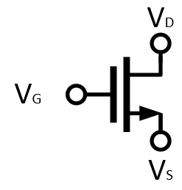
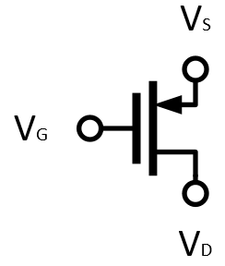
MOSFET’s
NMOS
PMOS

Slide 3
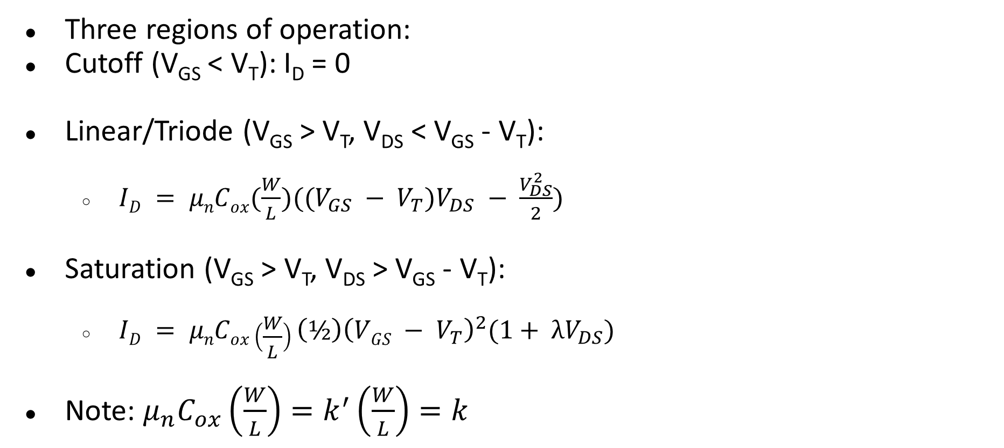
MOSFET Operating Point
Three regions of operation:
Cutoff (V_{GS} < V_{T}): I_{D} = 0
Linear/Triode (V_{GS} > V_{T}, V_{DS} < V_{GS} - V_{T}):
$ID = μnCox(\frac{W}{L})((V_{GS} − V_{T})V_{DS} − \frac{V_{DS}^{2}}{2})$
Saturation (V_{GS} > V_{T}, V_{DS} > V_{GS} - V_{T}):
$ID = μnCox\left(\frac{W}{L}\right){\left(½\right)\left(VGS − V_{T}\right)}^{2}(1+ λV_{DS})$
Note: $μ_{n}C_{ox}\left(\frac{W}{L}\right)=k^{′}\left(\frac{W}{L}\right)=k$

Slide 4
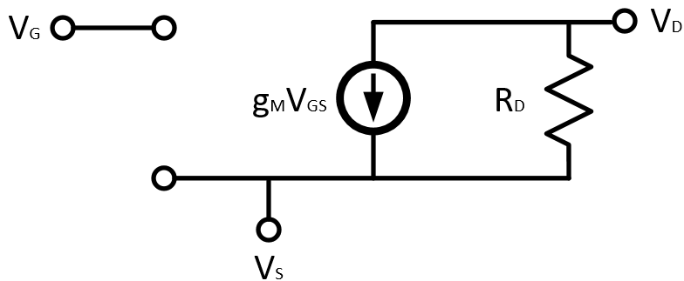

MOSFET Incremental Model
Transconductance: $g_{m}=\frac{2I_{D}}{V_{OV}}$

Slide 5
Gain Calculation
A_{v} = -G_{M}R_{out}
G_{M} = Short Circuit small signal transconductance, ratio of i_{out} to v_{in}
R_{OUT} = Equivalent incremental output resistance

Slide 6

Common Amplifier Topologies
Diode-tied Transistor
What is overdrive voltage here?
Is this always in saturation?
Common Source/Drain/Gate
Purpose of each topology?
equations
Common Source with Degeneration
Cascode
Diode Tied Transistor

Slide 7
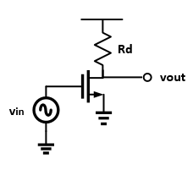
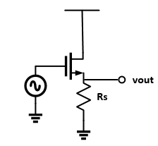
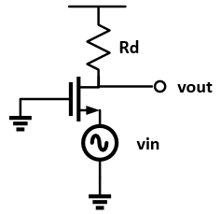
Common Source/Drain/Gate
R_{OUT} = R_{D} || r_{ds}
G_{m} = g_{m}
R_{OUT} = R_{S} || (r_{ds} || 1/g_{m})
G_{m} = - g_{m}
R_{OUT} = R_{D} || r_{ds}
G_{m} = - g_{m}
Notes:
Common Source. Your basic amplifier topology. Notice the infinite input resistance and inverted gain.
Common Drain. Also known as a level shifter. These make great buffers. Source follower?
Common Gate. good current buffer i believe.

Slide 8
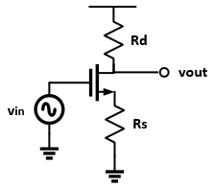
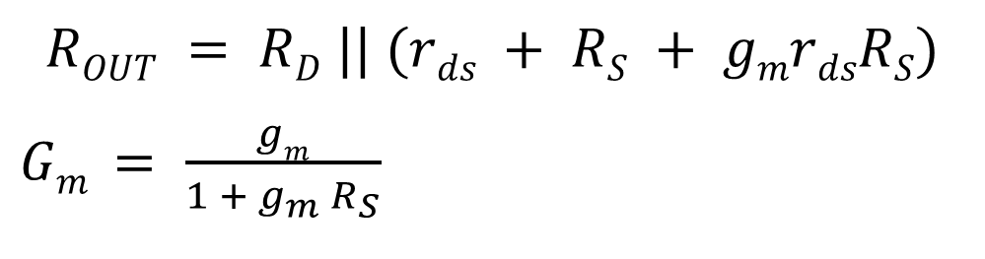
Degeneration
When a resistance is “viewed” through the drain, it appears bigger by a factor related to the transconductance.
$$ROUT = RD || (rds + RS + gmrdsRS)$$
$Gm = \frac{gm}{1 + g_{m} R_{S}}$
Notes:
Note that these formulas simplify to the common source ones if Rs is zero. Also remember that these equations rely on rds not being infinity.

Slide 9
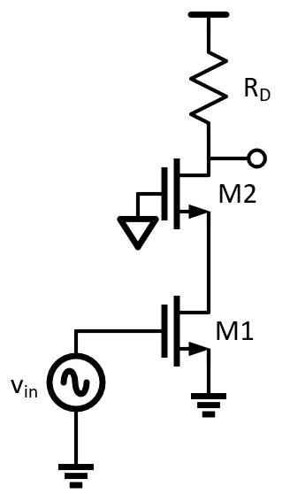
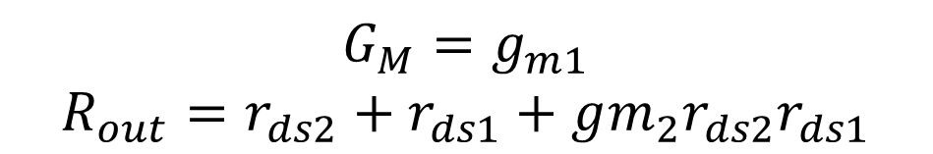
Cascode
Similar to degeneration but G_{M} is not attenuated
$$G_{M}=g_{m1}$$
$$R_{out}=r_{ds2}+r_{ds1}+gm_{2}r_{ds2}r_{ds1}$$

Slide 10
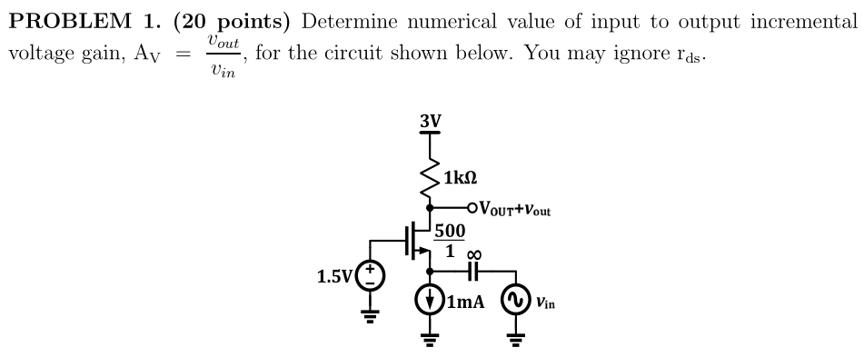
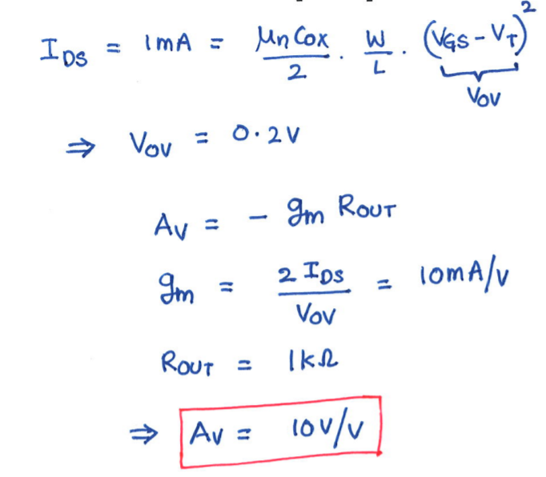
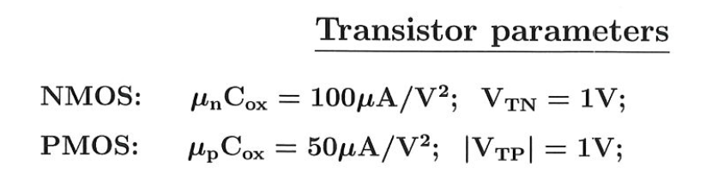
Fall 2016 Midterm 2 Problem 1

Slide 11
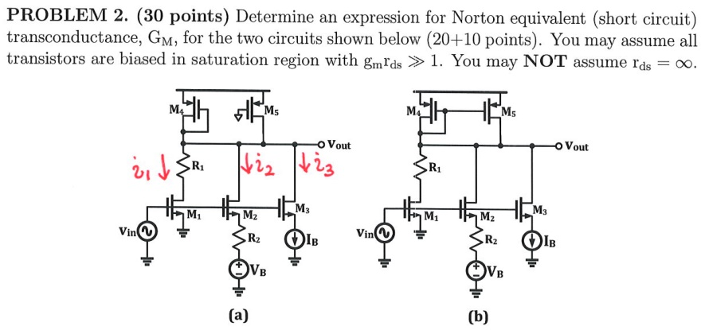
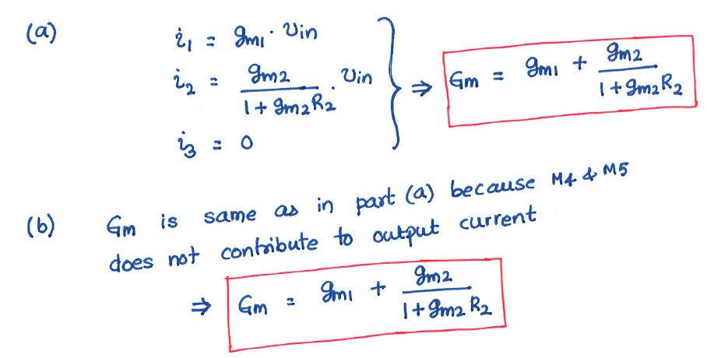
Fall 2017 Midterm 2 Problem 3

Slide 12
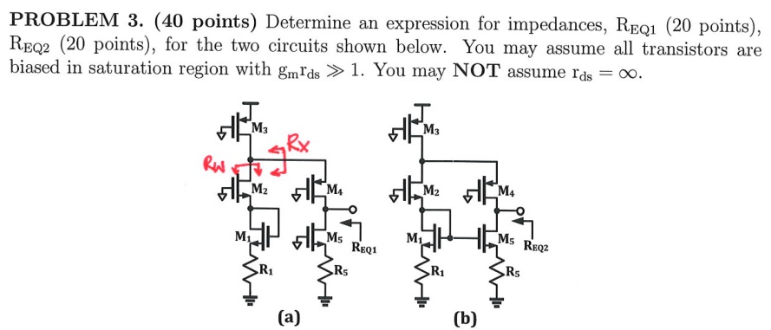
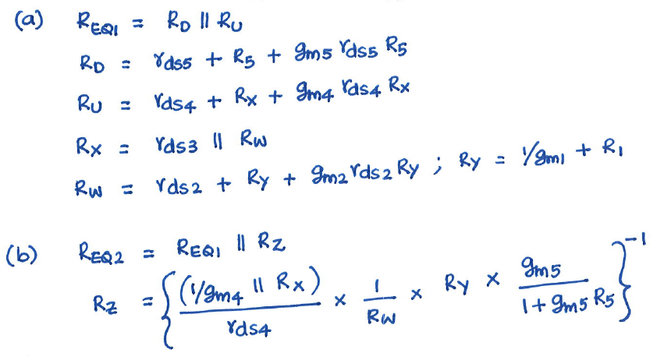
Fall 2017 Midterm 2 Problem 3

Slide 13
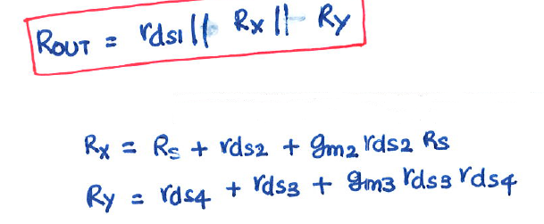
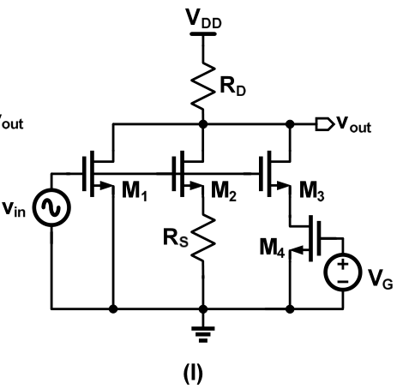

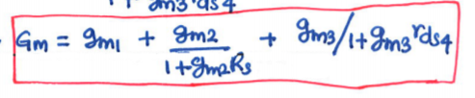
Homework 5 Problem 3 Part I
Find A_{V}

Slide 14
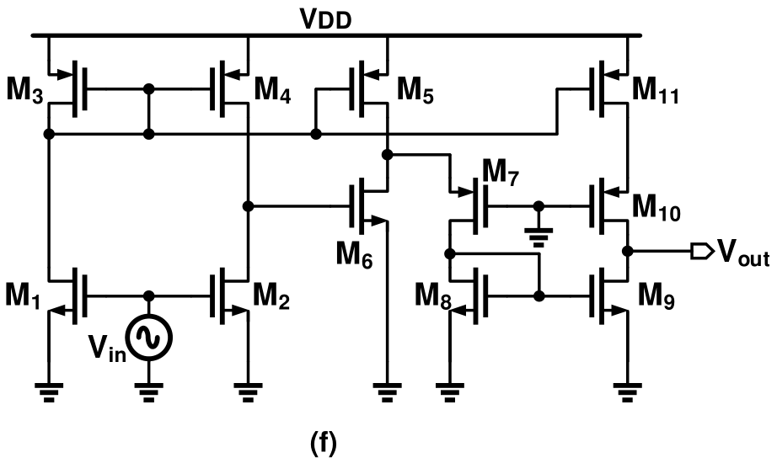
Homework 6 Problem 2 Part F

