Slide 1
Physics 214 HKN Final Exam Review Session
Steven Kolaczkowski

Slide 2

Wavefunctions and Eigenstates
Wavefunctions, $ψ(x,t)$, are how we describe the probabilistic nature of quantum particles. By themselves, wavefunctions do not have an intuitive meaning.
$P\left(Δx\right)=\int_{−\frac{Δx}{2}}^{\frac{Δx}{2}}{Ψ^{∗}\left(x\right)Ψ\left(x\right)dx}$ iff $\int_{−∞}^{+∞}{Ψ^{∗}\left(x\right)Ψ\left(x\right)dx}=1$
Momentum of a particle is described by its wavenumber, $k=\frac{p}{ℏ} \left[=\right]m^{−1}$
In later classes, $k$, will be a vector
When we say a wavefunction is an eigenstate of some quantity, we mean that quantity is definite.
Ex. $ψ\left(x\right)=Ae^{ikx}$ is a momentum eigenstate with momentum $p=ℏk$
$Ψ\left(x,t\right)=Ae^{i\left(kx−ωt\right)}$ is an eigenstate of both momentum and energy

Slide 3

Superposition, Normalization, and Orthogonality
Superposition: If we have two valid wavefunctions, linear combinations of these wavefunctions are also valid.
If a wavefunction is a superposition of a quantity (momentum, energy, polarization, etc.) it is not an eigenstate of that quantity
Normalization:
$∫{\left|Ψ\left(x,t\right)\right|}^{2}dx=∫{\left|ψ\left(x\right)\right|}^{2}dx=∫ψ^{∗}\left(x\right)ψ\left(x\right)dx=1$
Does this change with superposition?
Orthogonality Principle:
$∫{(aψ}_{n})\left(bψ_{m}\right)dx=\left\{\begin{aligned}0 if n≠m \\ ab if n=m\end{aligned}\right.$

Slide 4
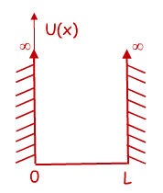

Time Independent Schrödinger Equation (TISE) and the Infinite Potential Well
$$−\frac{ℏ^{2}}{2m}\frac{d^{2}ψ\left(x\right)}{dx^{2}}+U\left(x\right)ψ(x)=Eψ(x)$$
Free Particle solution: if $U\left(x\right)=0$, then our original harmonic wave solutions works and we can say $ψ\left(x\right)=\operatorname{Acos}\left(kx\right)+Bsin(kx)$
You can verify that this will get us $\frac{k^{2}ℏ^{2}}{2m}ψ\left(x\right)=Eψ(x)$
Infinite Square Well: We need a function that is zero at x=0 and x=L
From our options above, $ψ\left(x\right)=\sqrt{\frac{2}{L}}\sin\left(k_{n}x\right)$ works if $k_{n}=\frac{nπ}{L}=\frac{2π}{λ_{n}}$
$λ_{n}=\frac{2L}{n}$ and $E_{n}=\frac{n^{2}π^{2}ℏ^{2}}{2mL^{2}}=\frac{n^{2}h^{2}}{8mL^{2}}$
$n$ is the state of the system and $n=1, 2, 3, …$

Slide 5
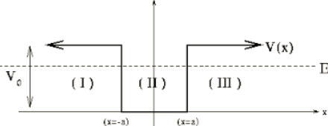

Finite Potential Wells, Boundary Conditions, and Harmonic Oscillators
With changing potentials we force two boundary conditions to be met:
$ψ\left(x^{−}\right)=ψ\left(x^{+}\right)$ and $\frac{dψ\left(x^{−}\right)}{dx}=\frac{dψ\left(x^{+}\right)}{dx}$
$\cos\left(kx\right)=\frac{e^{ikx}+e^{−ikx}}{2}$
$\sin\left(kx\right)=\frac{e^{ikx}−e^{−ikx}}{2i}$
$k=\sqrt{\frac{2m}{ℏ^{2}}\left(E−V\right)}$
Harmonic Oscillators have potentials, $V=\frac{1}{2}mω^{2}x^{2}$ and have their energy states described by $E_{n}=\left(\frac{1}{2}+n\right)ℏω$

Slide 6


Time Dependent Schrödinger Equation (TDSE): dotting your $i$’s and crossing your $h$’s
TISE: $−\frac{ℏ^{2}}{2m}\frac{d^{2}ψ\left(x\right)}{dx^{2}}+U\left(x\right)ψ\left(x\right)=Eψ\left(x\right)$
Now we are going to look at time dependent wave functions $Ψ\left(x,t\right)=ψ_{n}\left(x\right)e^{−iω_{n}t}$
TDSE: $−\frac{ℏ^{2}}{2m}\frac{d^{2}Ψ\left(x,t\right)}{dx^{2}}+U\left(x\right)Ψ\left(x,t\right)=iℏ\frac{dΨ\left(x,t\right)}{dt}$
Superposition principle: TDSE can also be solved by:
$$Ψ\left(x,t\right)=aψ_{0}\left(x\right)e^{−iω_{0}t}+bψ_{1}\left(x\right)e^{−iω_{1}t}+ …$$
Notice that this is not a solution to TISE
Superpositions oscillate with a beat frequency $ω_{beat}=ω_{i}−ω_{j}$
Does $∫{\left|Ψ\left(x,t\right)\right|}^{2}dx$ vary with time?

Slide 7
Band Structure and Intro to Condensed Matter
Pauli Exclusion Principle: For this class, all it means is you can have a max of 2 electrons per energy level.
When independent materials are brought together, their shared energy levels split into bonding and anti-bonding state.
Bandgap: The separation between energy levels in a material. There are no available states for particles to fill in the gap.
Metals have no bandgap
Insulators have large bandgaps
Semiconductors have small bandgaps
What constitutes large and small? Pft. Nothing really

Slide 8
Exam Advice
Know when and how to use your equation sheet
Don’t panic, just keep on moving
Make sure you are in the right mindset going into the exam
Spend your time showing what you know
DON’T CHEAT

Slide 9
Past Exam Questions

Slide 10
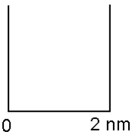

Spring 2018 Practice

Slide 11



Spring 2018 Practice

Slide 12




Spring 2018 Practice

Slide 13
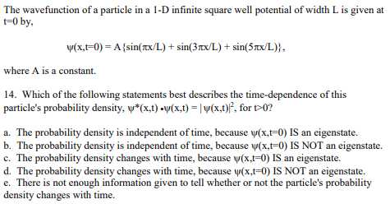
Fall 2001

Slide 14



Spring 2009

Slide 15
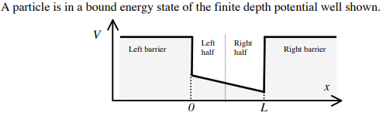


Spring 2010

Slide 16
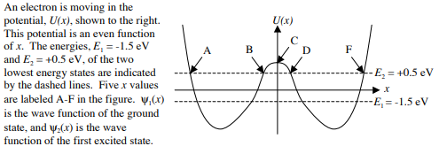


Spring 2010

