Slide 1
Physics 214 HKN Final Exam Review Session
Steven Kolaczkowski

Slide 2
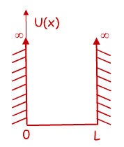

Time Independent Schrödinger Equation (TISE) and the Infinite Potential Well
$$−\frac{ℏ^{2}}{2m}\frac{d^{2}ψ\left(x\right)}{dx^{2}}+U\left(x\right)ψ(x)=Eψ(x)$$
Free Particle solution: if $U\left(x\right)=0$, then our original harmonic wave solutions works and we can say $ψ\left(x\right)=\operatorname{Acos}\left(kx\right)+Bsin(kx)$
You can verify that this will get us $\frac{k^{2}ℏ^{2}}{2m}ψ\left(x\right)=Eψ(x)$
Infinite Square Well: We need a function that is zero at x=0 and x=L
From our options above, $ψ\left(x\right)=\sqrt{\frac{2}{L}}\sin\left(k_{n}x\right)$ works if $k_{n}=\frac{nπ}{L}=\frac{2π}{λ_{n}}$
$λ_{n}=\frac{2L}{n}$ and $E_{n}=\frac{n^{2}π^{2}ℏ^{2}}{2mL^{2}}=\frac{n^{2}h^{2}}{8mL^{2}}$
$n$ is the state of the system and $n=1, 2, 3, …$

Slide 3
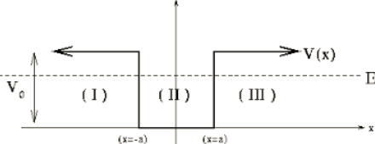

Finite Potential Wells and Boundary Conditions
Normalization: since ${\left|ψ\left(x\right)\right|}^{2}$ is a probability density, the sum of all probabilities must be one
$1=∫{\left|ψ\left(x\right)\right|}^{2} dx$
With changing potentials we force two boundary conditions to be met:
$ψ\left(x^{−}\right)=ψ\left(x^{+}\right)$ and $\frac{dψ\left(x^{−}\right)}{dx}=\frac{dψ\left(x^{+}\right)}{dx}$
$\cos\left(kx\right)=\frac{e^{ikx}+e^{−ikx}}{2}$
$\sin\left(kx\right)=\frac{e^{ikx}−e^{−ikx}}{2i}$
$k=\sqrt{\frac{2m}{ℏ^{2}}\left(E−V\right)}$

Slide 4

Reflections and Tunneling
How does k change when we pass from a classically allowed region to a classically forbidden one? What happens when we go back?
$k=\sqrt{\frac{2m}{ℏ^{2}}\left(E−V\right)}$
Transmission Probability: $T\sim Ge^{−2KL}$ where $G=16\frac{E}{U_{0}}(1−\frac{E}{U_{0}})$, $K=\sqrt{\frac{2m}{ℏ^{2}}\left(U_{0}−E\right)}$, and L is the thickness of the barrier

Slide 5


Time Dependent Schrödinger Equation (TDSE): dotting your $i$’s and crossing your $h$’s
TISE: $−\frac{ℏ^{2}}{2m}\frac{d^{2}ψ\left(x\right)}{dx^{2}}+U\left(x\right)ψ\left(x\right)=Eψ\left(x\right)$
Now we are going to look at time dependent wave functions $Ψ\left(x,t\right)=ψ_{n}\left(x\right)e^{−iω_{n}t}$
TDSE: $−\frac{ℏ^{2}}{2m}\frac{d^{2}Ψ\left(x,t\right)}{dx^{2}}+U\left(x\right)Ψ\left(x,t\right)=iℏ\frac{dΨ\left(x,t\right)}{dt}$
Superposition principle: TDSE can also be solved by:
$$Ψ\left(x,t\right)=aψ_{0}\left(x\right)e^{−iω_{0}t}+bψ_{1}\left(x\right)e^{−iω_{1}t}+ …$$
Notice that this is not a solution to TISE

Slide 6

Normalization and Orthogonality
Normalization:
$∫{\left|Ψ\left(x,t\right)\right|}^{2}dx=∫{\left|ψ\left(x\right)\right|}^{2}dx=∫ψ^{∗}\left(x\right)ψ\left(x\right)dx=1$
Does this change with superposition? Will it change over time?
Orthogonality Principle:
$∫{(aψ}_{n})\left(bψ_{m}\right)dx=\left\{\begin{aligned}0 if n≠m \\ ab if n=m\end{aligned}\right.$

Slide 7

Taking Quantum to Higher Dimensions
$−\frac{ℏ^{2}}{2m}∇^{2}Ψ\left(r,t\right)+U\left(r\right)Ψ\left(r,t\right)=iℏ\frac{dΨ\left(r,t\right)}{dt}$
Wavefunctions still need to be normalized in all space.
In this class we will only deal with rectangular potentials or spherical potentials with no $φ$ dependence $ψ\left(r,θ,φ\right)=R\left(r\right)Θ\left(θ\right)Φ\left(φ\right)=R\left(r\right)Θ(θ)$
Want to see $φ$ dependent potentials? Go to grad school!!!
Hydrogen Atom Energy: $E_{n}=−\frac{13.6eV}{n^{2}}$

Slide 8

Quantum Numbers
$n$ (Principal): $n≥1$ describes the size of the orbital
$l$(Angular or Orbital): $0≤l≤n−1$ describes the shape of the orbital
$L^{2}=l\left(l+1\right)ℏ^{2}=L_{x}^{2}+L_{y}^{2}+L_{z}^{2}$
$m$ (Magnetic): $−l≤m≤l$ describes the orientation of the orbital
$L_{z}=mℏ$
$$ψ_{n,l,m}\left(r,θ,φ\right)=R_{n,l}\left(r\right)Y_{l,m}(θ,φ)$$
$Y_{l,m}=P\left(θ\right)e^{imφ}$

Slide 9

Spin and Moments
$U=−μ ∙B=−μ_{z}B_{z}$
Stern-Gerlach: Electrons can only have two possible spin projections:
$s_{z}=\left(±\frac{1}{2}\right)ℏ=m_{s} ℏ$

Slide 10

Classes of Particles and Beyond Hydrogen (kinda)
Fermions: half integer spins
Can NEVER share all the same quantum numbers (Pauli Exclusion Principle)
Ex: electrons, quarks, protons, neutrons
Bosons: integer spins
Prefer to share all quantum numbers (This is the reason lasers work!)
Ex: photons $(γ)$, gluons, pions, $α$-particles
Want to learn more? Take Physics 470!!!
For single electrons in atoms: $E_{n}=−\frac{13.6eV}{n^{2}}Z^{2}$ where $Z$ is the number of protons

Slide 11
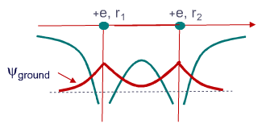
Random Condensed Matter Topics
Molecular Potentials
Band Theory and Band Structure
Conduction and Valence Bands
How does Temperature affect electron transport
Want to learn more? Take ECE 340 or PHYS 460 or I assume some Material Science class?

Slide 12
Exam Advice
Know when and how to use your equation sheet
Don’t panic, just keep on moving
Make sure you are in the right mindset going into the exam
Spend your time showing what you know
DON’T CHEAT

Slide 13
Past Exam Questions

Slide 14
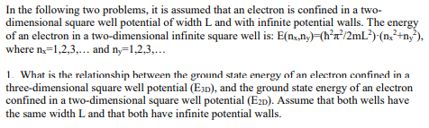



Fall 2001

Slide 15


Fall 2001

Slide 16




Fall 2001

Slide 17
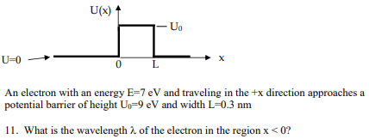



Fall 2001

Slide 18
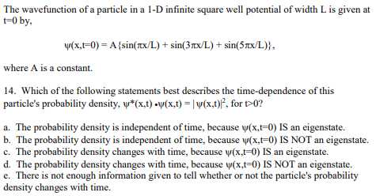


Fall 2001

Slide 19
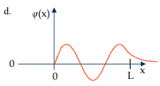
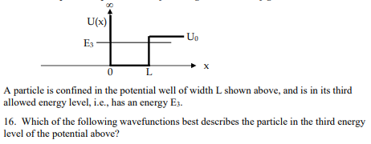
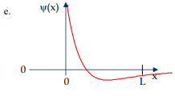
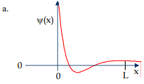
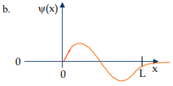
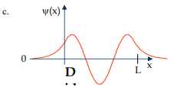
Fall 2001

Slide 20

Spring 2010

Slide 21

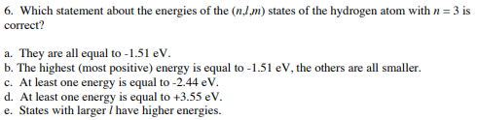
Spring 2010

Slide 22
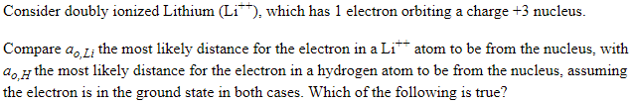

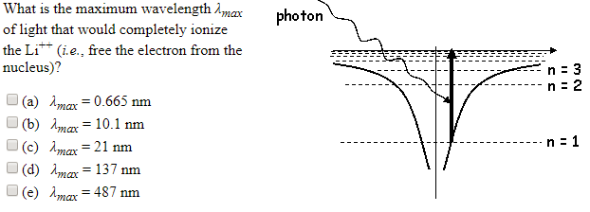
Spring 2010 26 & 27

Slide 23
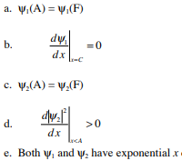
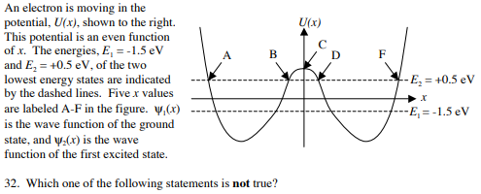


Spring 2010

Slide 24


Spring 2009

Slide 25
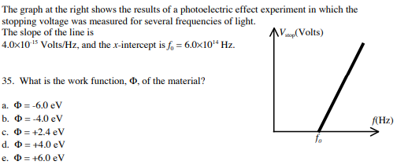

Spring 2010

Slide 26
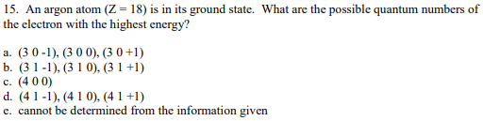
Spring 2009

