Slide 1
HKN ECE 110 Exam 3 Review Session
Steven Kolaczkowski
Joseph Ravichandran
Neil Varghese

Slide 2
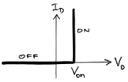


Diodes
Diodes are non-linear devices that allow current to pass in only one direction
Two possible modes:
ON: $V=V_{on}, I_{D}≥0$
OFF: $I_{D}=0, V<V_{on}$
Guess and check method, if our guess is long, we one of our rules will be violated

Slide 3
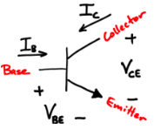

Bipolar Junction Transistor (BJT)
Three terminal device: Base, collector, emitter
$V_{BE,ON}$, $V_{CE,SAT}$, and $β$ are properties of the BJT
For more, take ECE 340
In ECE 110 we consider the Common-Emitter configuration
For more, take ECE 342
Three regions of operation:
Off: $V_{i}<V_{BE,ON}$, $I_{B}=I_{C}=0$
Active: $V_{i}>V_{BE,ON}$, $I_{C}=βI_{B}$
Saturation: $V_{i}>V_{BE,ON}, V_{CE}=V_{CE,SAT}, I_{C}≠βI_{B}$

Slide 4
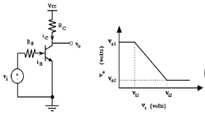

BJT Characteristics
How do we relate the input voltage, $V_{i}$, to the output voltage, $V_{CE}=V_{0}$
$V_{o1}=V_{CC}$
$V_{o2}=V_{CE,SAT}$
$V_{i1}=V_{BE,ON}$
$V_{i2} =V_{i}^{∗}=$edge of saturation
Gain = $G=−\frac{βR_{C}}{R_{B}}={(V}_{o1}−V_{o2})/(V_{i1}−V_{i2})$
Power: $P=V_{BE}I_{B}+V_{CE}I_{C}$

Slide 5
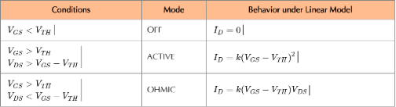

MOSFETs
Three terminal device: gate, source, drain
$V_{TH}$ is a property of the MOSFET

Slide 6
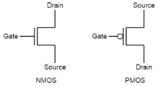

Complementary MOS Logic (cMOS)
Combinations of NMOS and PMOS transistors that are used to perform a logical operation
Ex. AND, OR, NOT, NOR
NMOS and PMOS respond differently
NMOS: $1$is a wire, $0$is an open circuit
PMOS: $0$ is a wire, 1 is an open circuit
Check Complementarity: is the circuit “Proper”
If series on top, must be parallel on bottom
If parallel on top, must be series on bottom

Slide 7
Exam Advice
Spend your time showing what you know
Make sure you are in the right mindset going into the exam
Make sure you get through the whole exam
DON’T CHEAT

Slide 8
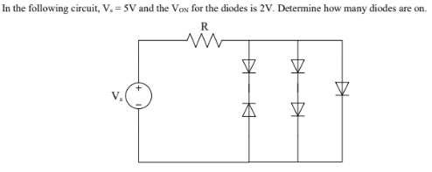

Slide 9
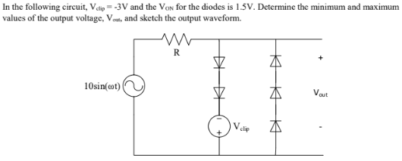

Slide 10
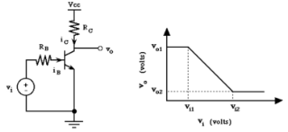

For the following circuit, $V_{CC}=5.2V$ , $V_{BE,ON}=0.7V$ , $V_{CE,SAT}=0.2V$ , $R_{B}=20kΩ$ , $R_{C}=1kΩ$ , and $β=100$
Determine the values of $V_{o1}$ , $V_{o2}$ , $V_{i1}$ , and $V_{i2}$
Find the value of $V_{CE}$ if:
$V_{i}=0.3V$
$V_{i}=1.2V$
What is the maximum value of A that keeps the BJT in the active region when:
$V_{i}=1.2+Asin(ωt)$
$V_{i}=0.9+Asin\left(ωt\right)$
$V_{i}=1.4+Asin\left(ωt\right)$
What is the gain in the active region?
Repeat part a and b with a diode with $V_{on}=1V$ inserted in series with $R_{B}$

Slide 11
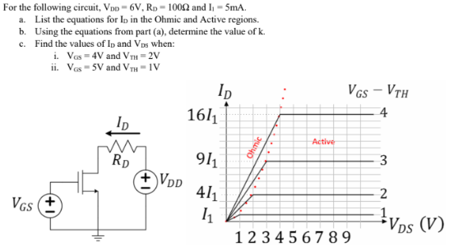

Slide 12
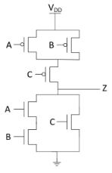
Find the truth table for the following circuit

