Slide 1
HKN ECE 342 Review Session 2
Anthony Li
Alec Wasowicz
Rex Geng

Slide 2
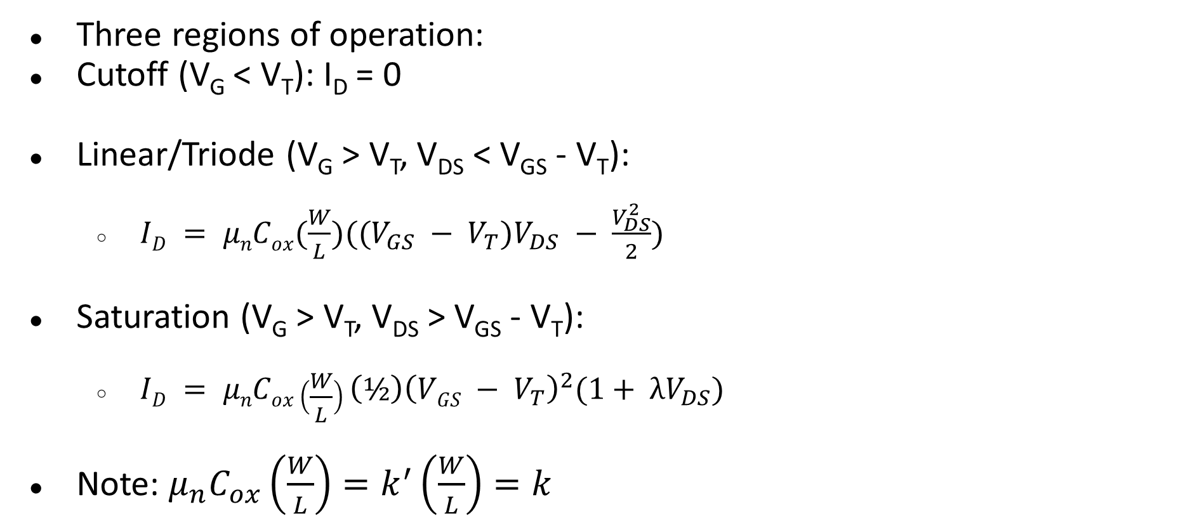
MOSFET Operating Point
Three regions of operation:
Cutoff (V_{G} < V_{T}): I_{D} = 0
Linear/Triode (V_{G} > V_{T}, V_{DS} < V_{GS} - V_{T}):
$ID = μnCox(\frac{W}{L})((V_{GS} − V_{T})V_{DS} − \frac{V_{DS}^{2}}{2})$
Saturation (V_{G} > V_{T}, V_{DS} > V_{GS} - V_{T}):
$ID = μnCox\left(\frac{W}{L}\right){\left(½\right)\left(VGS − V_{T}\right)}^{2}(1+ λV_{DS})$
Note: $μ_{n}C_{ox}\left(\frac{W}{L}\right)=k^{′}\left(\frac{W}{L}\right)=k$

Slide 3
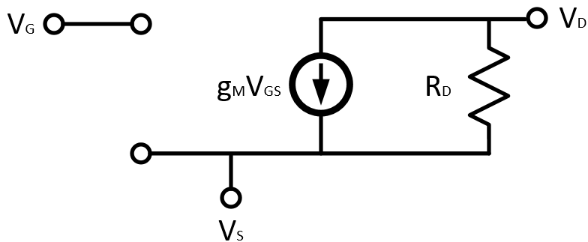

MOSFET Incremental Model
Transconductance: $g_{m}=\frac{2I_{D}}{V_{OV}}$

Slide 4
Gain Calculation
A_{v} = -G_{M}R_{out}
G_{M} = Small signal transconductance, ratio of i_{out} to v_{in}
R_{OUT} = Equivalent incremental output resistance

Slide 5
Common Amplifier Topologies
Diode-tied Transistor
Common Source/Drain/Gate
Common Source with Degeneration
Common Drain with Modulation
Cascode
Diode Tied Transistor

Slide 6
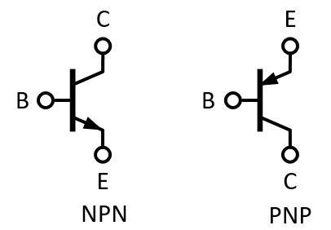
BJT

Slide 7
Regions of Operation
Three regions of operation:
Cutoff: V_{E} > V_{B} < V_{C}
Saturation: V_{E} < V_{B} > V_{C}
Forward Active: V_{E} > V_{B} > V_{C}
V_{T} = kt/q
I_{C} = ꞵI_{B}
I_{E} = I_{C} + I_{B}
Ꞵ = g_{m}R_{𝜋}

Slide 8
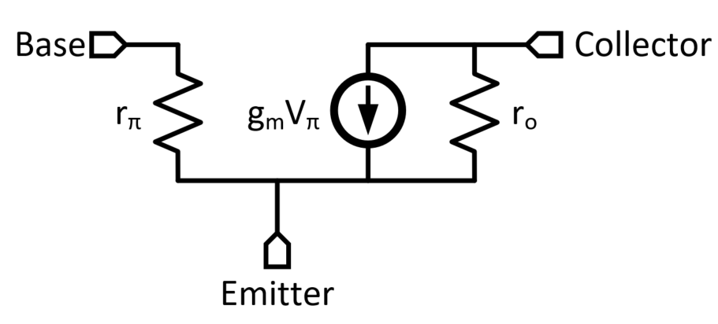
BJT Small Signal Model

Slide 9
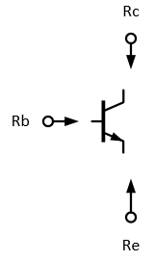


Terminal Impedance
$$RC = ro$$
$$RB = R_{π}$$
R_{E} = $\frac{R_{π}}{ꞵ+1}$
Diode-Tied = $\frac{R_{π}}{ꞵ+1}$
Diode Tied Transistor

Slide 10
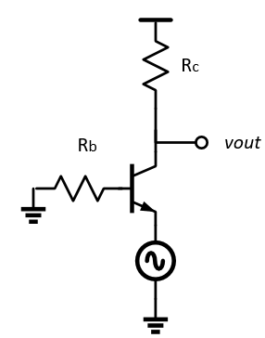
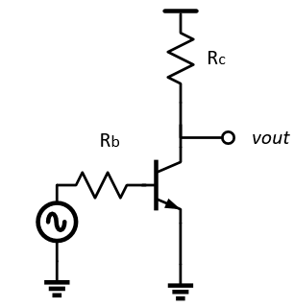
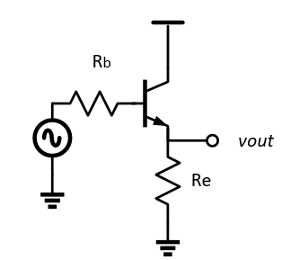
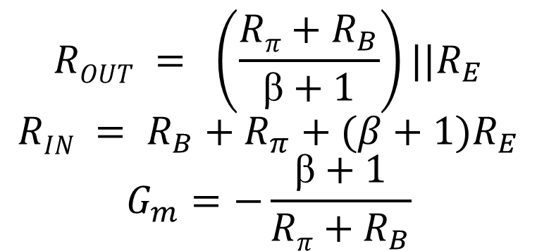
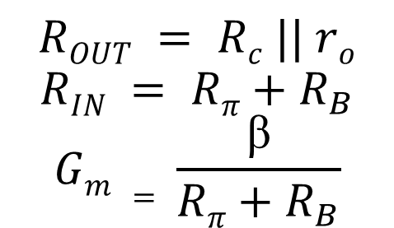
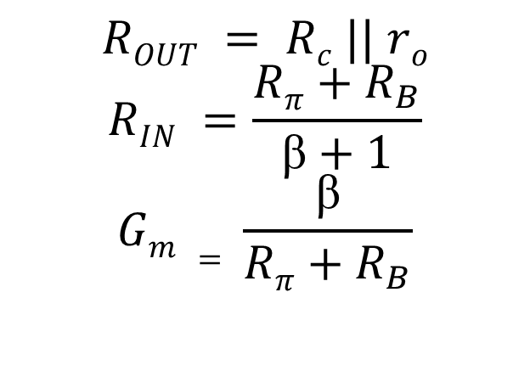
Common Emitter/Collector/Base
$$ROUT = \left(\frac{Rπ+R_{B}}{ꞵ+1}\right)||R_{E}$$
$$RIN = R_{B}+R_{π}+(β+1)R_{E}$$
$$G_{m}=−\frac{ꞵ+1}{Rπ+R_{B}}$$
$$ROUT = Rc || ro$$
$$RIN =\frac{Rπ+R_{B}}{ꞵ+1}$$
$$Gm = \frac{ꞵ}{Rπ+R_{B}}$$
$$ROUT = Rc || ro$$
$$RIN = Rπ+R_{B}$$
$$Gm = \frac{ꞵ}{Rπ+R_{B}}$$

Slide 11
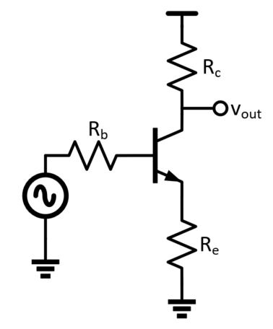
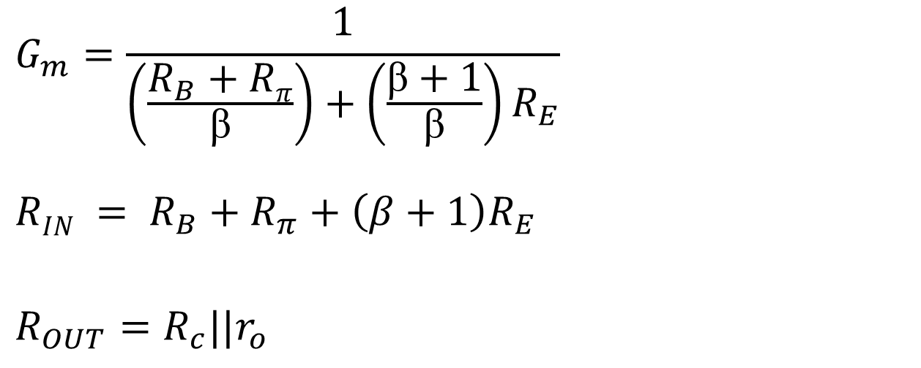
Degeneration
When a resistance is “viewed” through the collector, it appears bigger by a factor related to the transconductance.
$$G_{m}=\frac{1}{\left(\frac{R_{B}+Rπ}{ꞵ}\right)+\left(\frac{ꞵ+1}{ꞵ}\right)R_{E}}$$
$$RIN = R_{B}+R_{π}+\left(β+1\right)R_{E}$$
$$R_{OUT}=R_{c}||r_{o}$$

Slide 12
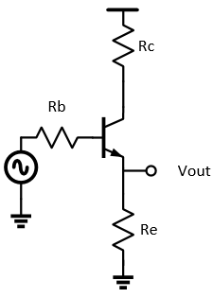
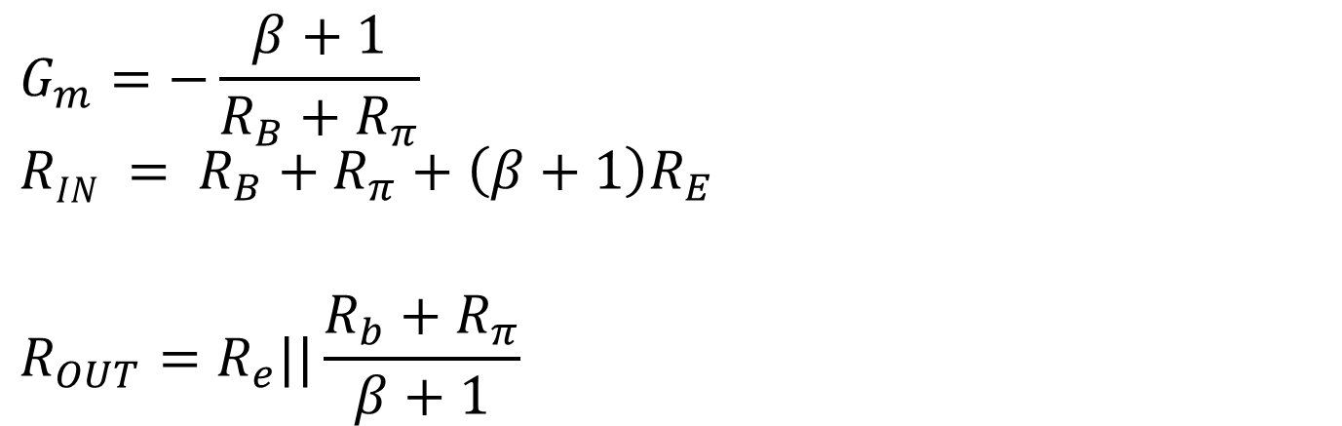
Modulation
Resistances seen through the Emitter seem smaller.
$$G_{m}=−\frac{β+1}{R_{B}+R_{π}}$$
$$RIN = R_{B}+R_{π}+\left(β+1\right)R_{E}$$
$$R_{OUT}=R_{e}||\frac{R_{b}+R_{π}}{β+1}$$

Slide 13
Bode Plots
Magnitude
Pole: Roll down by 20 db/dec, 6 db/oct
Zero: Roll up by 20 db/dec, 6 db/oct
Phase: arctan(ω/ω_{p})
Usually -90° for poles, +90° for zeros
ω_{ugf} = 20log|A_{n}| * ω_{pn} where n is the pole located before unity gain frequency

Slide 14
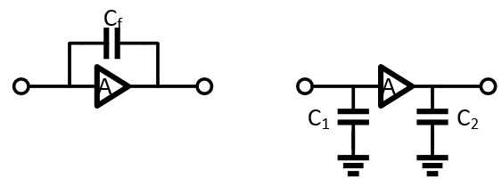

Miller Effect
$C_{1}=C_{f}\left(1+A\right)$
$C_{2}=C_{f}(1+\frac{1}{A})$

Slide 15

Open Circuit Time Constants (OCTC)
Locate all capacitors
For each capacitor, open the capacitor, find the equivalent R_{out} at the node
$ω_{3db}=\frac{1}{∑R_{n}C_{n}}$

Slide 16
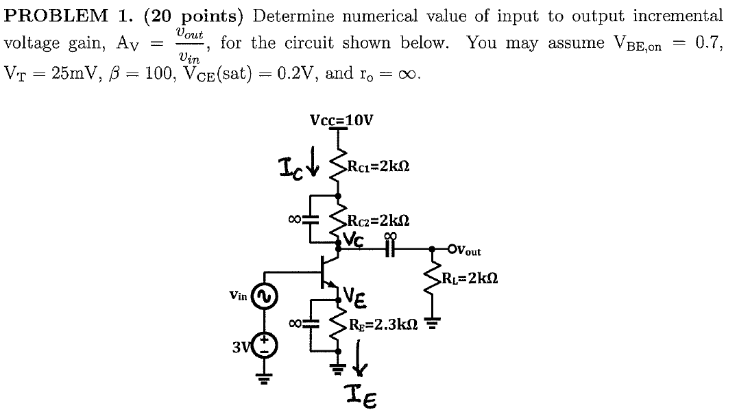
Midterm 3 Fa16 Problem 1

Slide 17
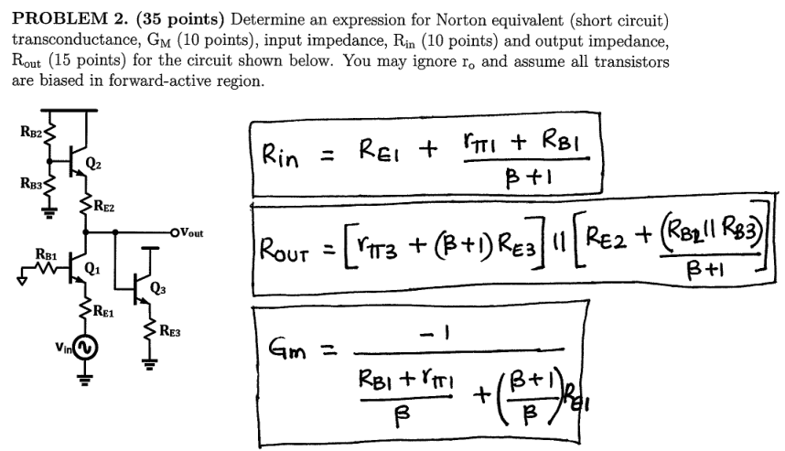
Midterm 3 Fa17 Problem 2

Slide 18
Midterm 3 Fa17 Problem 2

Slide 19
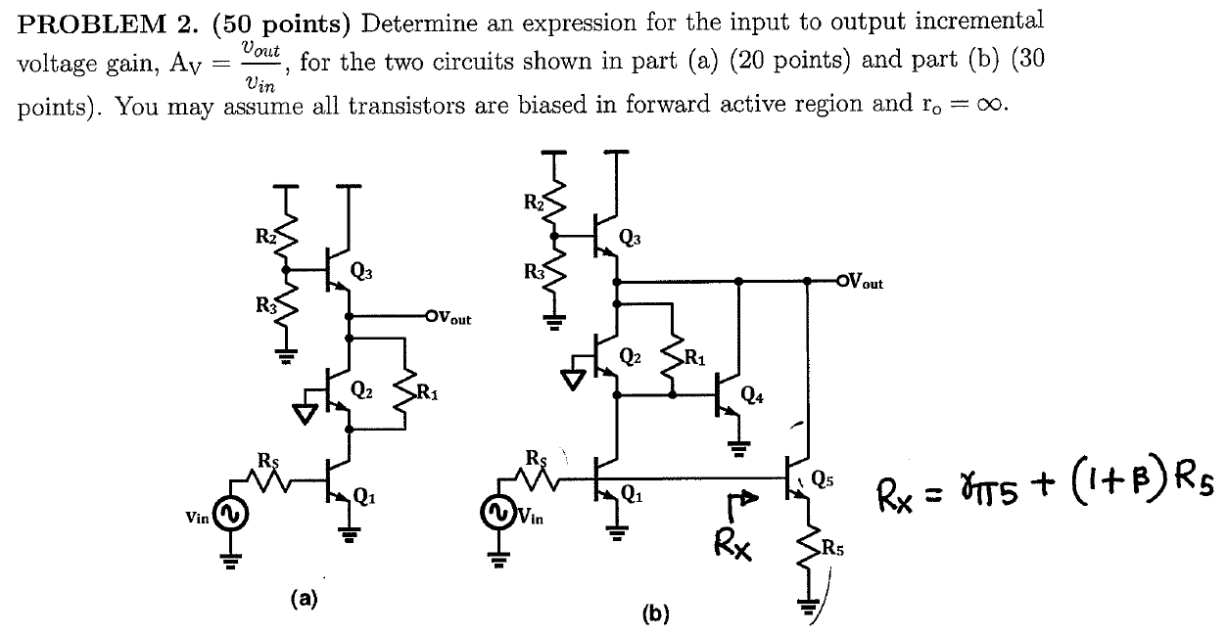
Midterm 3 Fa16 Problem 2

Slide 20
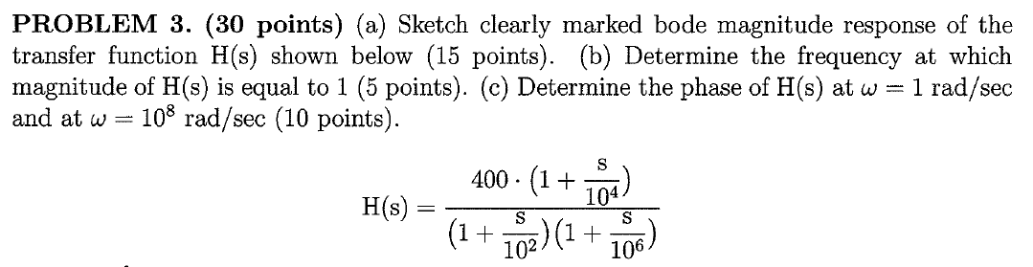
Midterm 3 Fa17 Problem 3

Slide 21
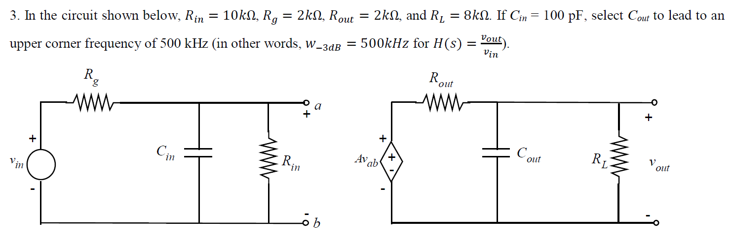
Homework 8 Problem 3

Slide 22
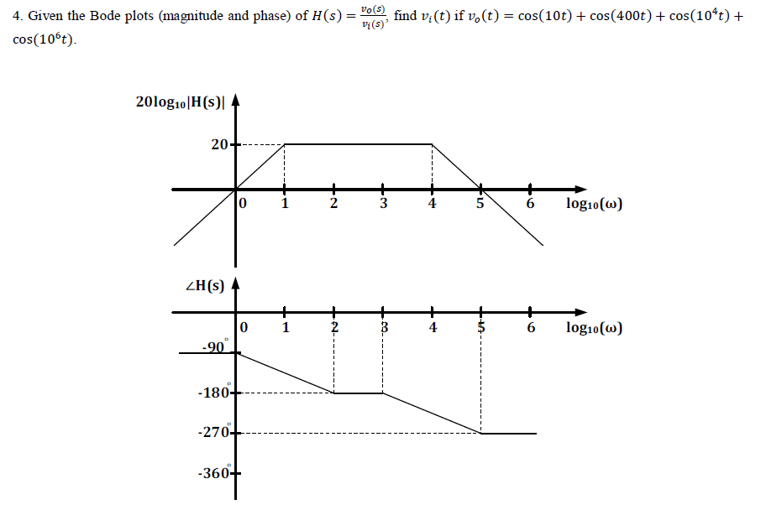
Homework 8 Problem 4

