Slide 1
Physics 214 Exam 1 HKN Review Session
Steven Kolaczkowski

Slide 2

Traveling Waves and Harmonics
The standard equation for a traveling wave is $y\left(x,t\right)=Acos⁡(kx−ωt +φ)$
$A$: the Amplitude of the wave
$k$ : the wavenumber, associated with the wave’s momentum
$k=\frac{2π}{λ} \left[=\right] m^{−1}$
$ω$ : the radial frequency, has units of $\frac{radians}{second}$, related to standard frequency ($f$) by $2πf=ω$
$φ$ : the relative phase of the wave
Ex: $\sin\left(kx−ωt+90°\right)=\cos\left(kx−ωt\right)$
This is for a wave traveling in the positive x directions $v=\frac{ω}{k}$

Slide 3

Adding Waves and Intensity
Waves can constructively or destructively interfere
$A_{total}=A_{1}+A_{2}+A_{3}+ …$
$A_{1}\left(\cos\left(kx−ωt+φ_{0}\right)+\cos\left(kx−ωt+φ_{1}\right)\right)=2A_{1}\cos\left(\frac{φ_{0}−φ_{1}}{2}\right)\cos\left(kx−ωt+\left(\frac{φ_{0}+φ_{1}}{2}\right)\right)$
Intensity ($I$): A measure of the power provided by a wave over a given area
$<I> =I_{avg}=\frac{A^{2}}{2}$
$I_{Max}={\left|A_{1}+A_{2}\right|}^{2}$, $I_{Min}={\left|A_{1}−A_{2}\right|}^{2}$
If $A_{1}=A_{2}$ then $I_{avg}={2A}_{1}^{2}\cos^{2}{(\frac{φ_{0}−φ_{1}}{2})}=4I_{1}\cos^{2}{(\frac{φ_{0}−φ_{1}}{2})}$
Keep in mind that these are $I_{avg}$, intensity varies with distance and has a maximum of $A^{2}$

Slide 4

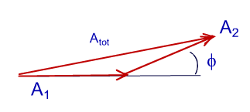

Phasors
A mathematical tool to help visualize time dependent systems
Each phasor, like a vector, has a magnitude and a direction
In this course we will only deal with phasors that share a frequency $ω_{0}=ω_{1}=ω$ (YAY!!!)
When adding phasors, we must account for their relative phase to each other
Since all frequencies are the same, adding phasors is just like adding vectors (because it is)
The total amplitude depends on the phase between the two waves.

Slide 5

Interference
Maxima Location: Located every phase change of $2π$or when interfering waves are integer wavelengths out of phase. $d\sin\left(θ_{n}\right)=nλ$ under small angel approximation:$θ_{n}=\frac{nλ}{d}$ where d is the distance between slits and $λ$ is the wavelength.
Minima Location: Located every phase change of $2π$ in between maxima
Intensity: $I=I_{0}{\left(\frac{\sin\left(φ\right)}{\sin\left(\frac{φ}{2}\right)}\right)}^{2}$ where $φ=\frac{2πdsin\left(θ\right)}{λ}≈\frac{2πdθ}{λ}$

Slide 6
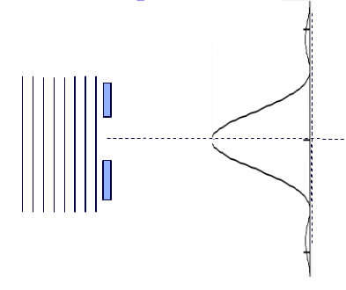

Diffraction
We can have interference between a wave going though a single slit!
This patter will have minima when the waves from the top and bottom of the slit destructively interfere (are $180°$ out of phase)
This happens at angles described by
$\sin\left(θ_{m}\right)=\frac{mλ}{a}$ or if angles are small $θ_{m}=\frac{mλ}{a}$
Intensity: $I=I_{0}{\left(\frac{\sin\left(\frac{β}{2}\right)}{\frac{β}{2}}\right)}^{2} where β≈\frac{2πaθ}{λ}$
Notice: $β$ and $φ$are essentially the same thing, only
one uses the slit spacing (d) and the other use the
slit width (a)

Slide 7

Rayleigh Criteria
Need to be able to differentiate two waves that are next to each other in a grating
Rayleigh Limit $\frac{Δλ}{λ}≥\frac{1}{Nm}$
Light from two sources can be differentiated if they are a certain angle apart where
$θ_{c}=\frac{1.22λ}{D}$ for holes and $\frac{λ}{a}$ for slits. $a$ is the slit width and $D$ is the diameter of the beam
This can be translated to a spatial size of beam limit $Δl=\frac{.122f_{lense}λ}{D_{beam}}$

Slide 8
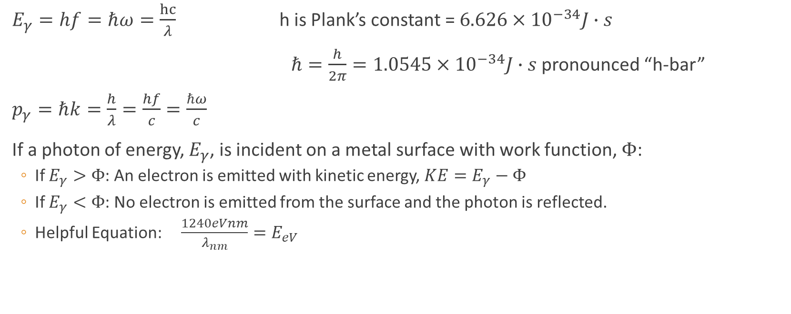

Photons ($γ$): Treating light as a particle
$E_{γ}=hf=ℏω=\frac{hc}{λ}$ h is Plank’s constant = $6.626×{10}^{−34}J∙s$
$ℏ=\frac{h}{2π}=1.0545×{10}^{−34}J∙s$ pronounced “h-bar”
$p_{γ}=ℏk=\frac{h}{λ}=\frac{hf}{c}=\frac{ℏω}{c}$
If a photon of energy, $E_{γ}$, is incident on a metal surface with work function, $Φ$:
If $E_{γ}>Φ$: An electron is emitted with kinetic energy, $KE=E_{γ}−Φ$
If $E_{γ}<Φ$: No electron is emitted from the surface and the photon is reflected.
Helpful Equation: $\frac{1240eVnm}{λ_{nm}}=E_{eV}$

Slide 9
Exam Advice
Don’t panic, just keep on moving
Make sure you are in the right mindset going into the exam
Spend your time showing what you know

Slide 10
Past Exam Questions

Slide 11
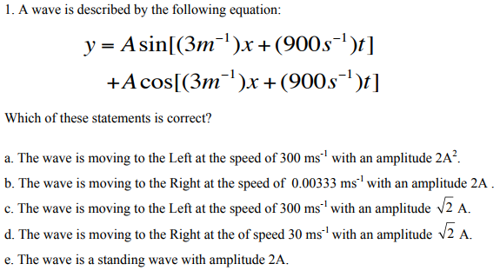
Fall 2014

Slide 12
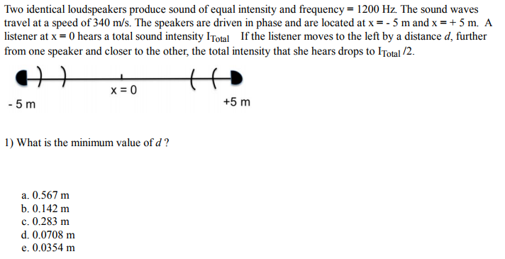
Spring 2017

Slide 13
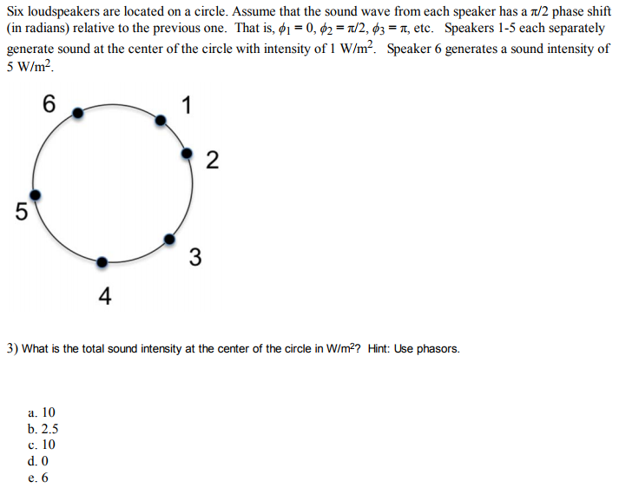
Spring 2017

Slide 14
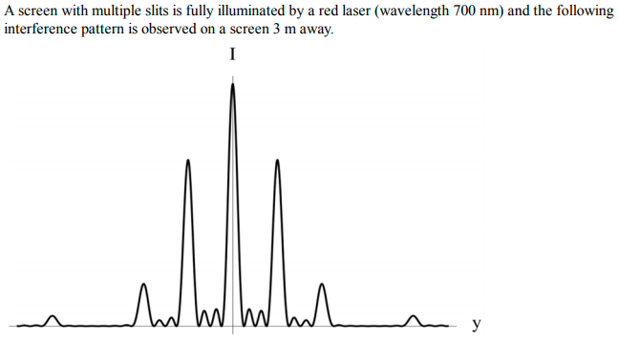

Spring 2017

Slide 15

Spring 2017

Slide 16

Spring 2017
Bonus Question: How wide are the slits?

Slide 17



Spring 2017

Slide 18
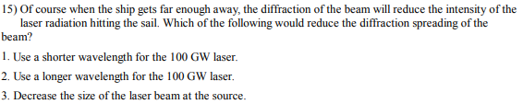

Spring 2017

Slide 19

Spring 2017

Slide 20


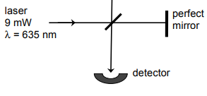


Spring 2015

Slide 21


Spring 2015

