Slide 1
ECE 220: Spring 2021 Midterm 1
HKN Review Session
Slides Credit to: Andrew Fortunat, Akhil Burle, Srijan Chakraborty, Nikhil Simha
Presented by: Michelle Zhang, Tejas Satpalkar, Shouri Addepally, Jerry Balan, Prannav Gupta
02/28/2021

Slide 2
HKN and Services
We offer 1-1 Tutoring!
Visit hkn.illinois.edu and go to “services” page to find tutors
Slides posted after review session
Generous amount of time for questions included at end, so if you have practice exam questions or general questions stick around

Slide 3
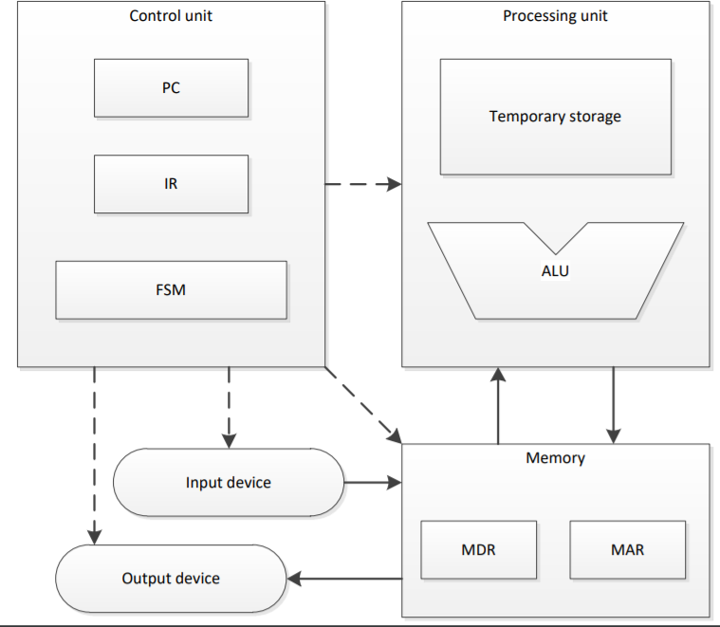
LC3: A Brief Overview
16 Bit Data
16 Bit Address (coincidence)
8 Registers (R0-R7)
Memory and Mem. Interface
MAR (Accessing addresses)
MDR (Accessing actual data)
Input (KBSR, KBDR)
Output (DSR, DDR)
PC and IR
R7 used for bookkeeping

Slide 4
Operations in LC3
Operations:
ADD, AND, NOT
Control:
BRnzp, JSR (and JSRR), JMP, RET, TRAP
(Also RTI for interrupts)
Memory Interface:
LD (LDR, LDI), ST (STR, STI), LEA

Slide 5
Pseudo-Ops and System Calls
§ .ORIG x3000
§ .END
§ .FILL
§ .BLKW#3
§ .STRINGZ
§ TRAP x25
the first instruction should be at x3000 indicate this is the end of the program #-3, #5, #0, xFFC0, xABCD, etc.
number of memory locations to reserve "Hello" (Null-terminated)
same as HALT (uses trap vector as index)

Slide 6
Examples
REMEMBER!
-16 <= immediate value <= 15
§ How to clear R0?
§ AND R0, R0, #0
§ How to do copy R1 to R0?
§ ADD R0, R1, #0
§ How to get –R0?
§ NOT R0, R0
§ ADD R0, R0, #1
§ How to left shift R0?
§ ADD R0, R0, R0

Slide 7
LC-3 Review: I/O
I/O Interactions
Polling vs Interrupts
Polling
Loop indefinitely until data is available by checking status registers (KBSR, DSR)
Interrupts
Allows program to perform other work while no data is available
Upon reception of interrupt, pause current code execution and execute special interrupt handling functions
Return to interrupted code once interrupt has been handled
Will be covered in depth in ECE 391!

Slide 8
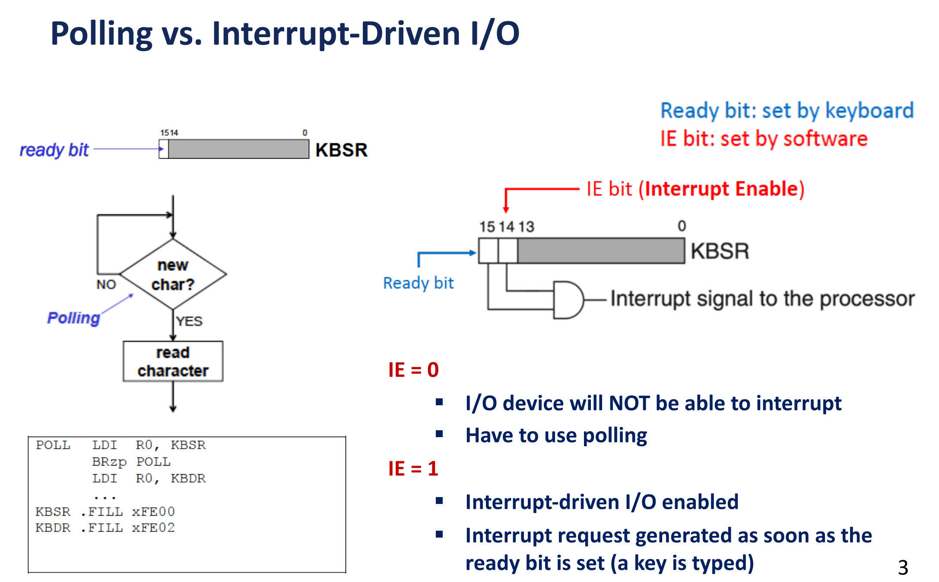

Slide 9
LC-3 Review: I/O
Memory Mapped I/O
Map I/O to specific memory addresses
Removes the need for dedicated I/O channels
Accessing the mapped memory address gives access to the input or output device
Reading from xFE02 (KBDR) returns a char of what key was pressed on the keyboard
Writing ‘a’ to xFE06 (DDR) will display ‘a’ on the display
Check the status register (KBSR, DSR) of the respective input/output before reading or writing

Slide 10
LC-3 Review: Keyboard Input
Reading from the keyboard
Poll KBSR until ready bit is set then access input data stored in lower 8 bits of KBDR
POLL | LDI BRzp LDI | R1, KBSR POLL R0, KBDR | ; Check status register ; Loop while ready bit not set ; Get keyboard input
KBSR | .FILL | xFE00 | ; KBSR address
KBDR | .FILL | xFE02 | ; KBDR address

Slide 11
LC-3 Review: Display Output
Writing to the display
Poll DSR until ready bit is set then write display data to DDR
POLL | LDI BRzp STI | R1, DSR POLL R0, DDR | ; Check status register ; Loop while ready bit not set ; Write display data
DSR | .FILL | xFE04 | ; DSR address
DDR | .FILL | xFE06 | ; DDR address

Slide 12
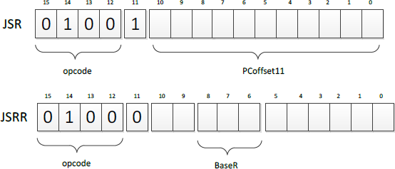
Subroutines
§ | Useful if there is a code segment that needs to be executed multiple | times
§ | Subroutines can be invoked by JSR or JSRR
§ | Return is implemented with RET instruction
TEMP <- PC
If (IR[11] == 0)
PC <- BaseR
Else
PC <- PC + SEXT(PCoffset11)
R7 <- TEMP

Slide 13
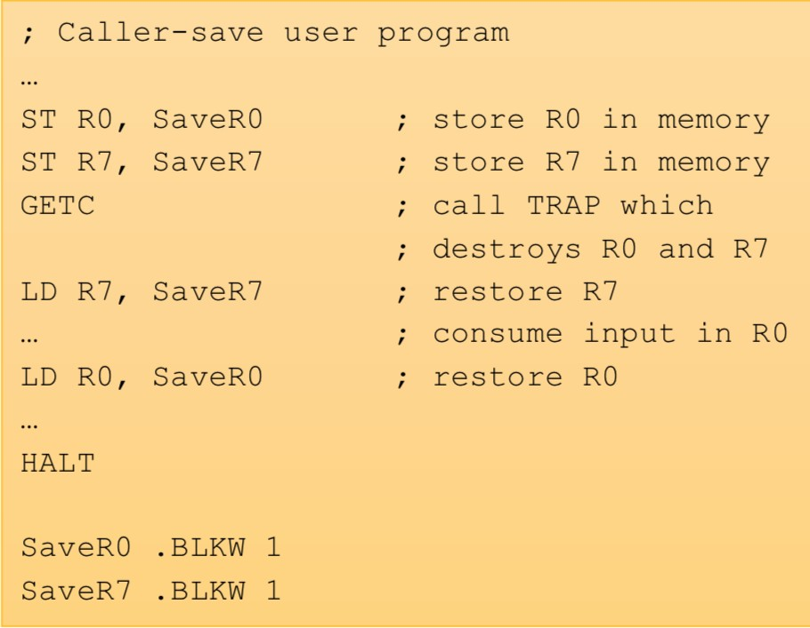
Subroutines: Callee and Caller Save
§ Subroutine will save and restore registers that it modifies except for the return values
The only visible change should be the return value (if any) upon return
§ Caller should save registers that could be modified by the subroutine if they contain important data
R7 would need to be saved since JSR and JSRR overwrite its value

Slide 14
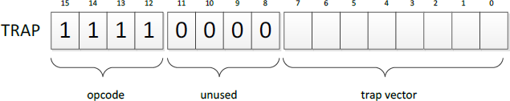
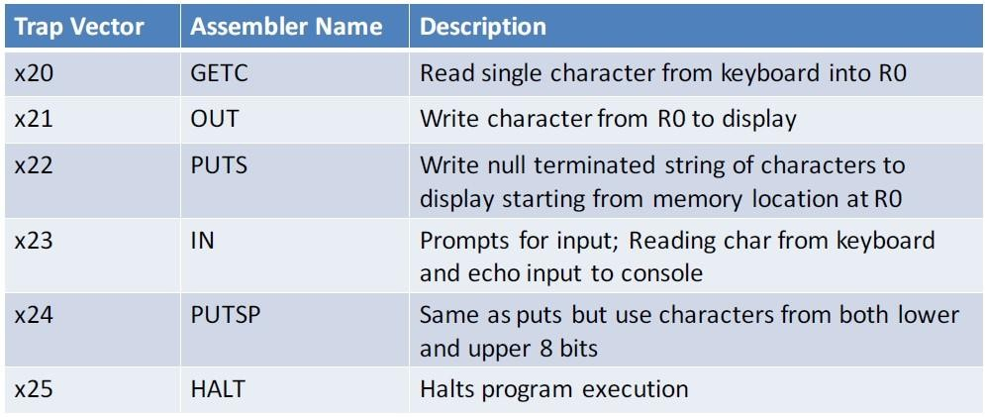
TRAPS
TRAP function
§ Passes control to operating system
§ Programmers can use complex operations without specialized knowledge

Slide 15
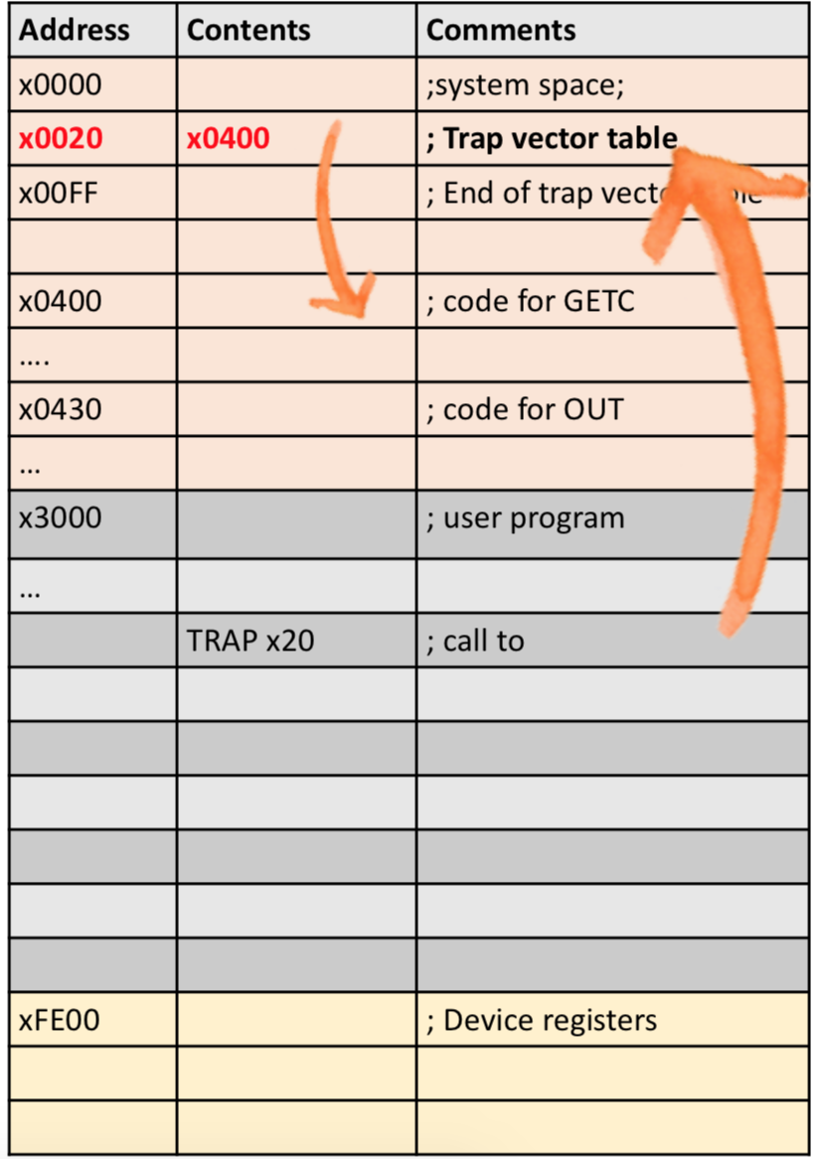
TRAPS: How they work
§ TRAP function is called by the user
§ The 8-bit trap vector is used as the index of the
service routine’s address in the trap vector table
§ The PC is loaded with the address of the service routine
§ After executing the service routine, control returns to the user program
MAR <- ZEXT(trapvector) MDR <- MEM[MAR]
R7 <- PC PC <- MDR

Slide 16
Problem with nested calls
LD R0, START LD R1, END JSR REVERSE HALT
REVERSE
ST R0, SAVER0_REVERSE
ST R1, SAVER1_REVERSE ST R2, SAVER2_REVERSE ST R3, SAVER3_REVERSE RLOOP
JSR SWAP
ADD R0, R0, #1 ADD R1, R1, #-1 NOT R2, R0 ADD R2, R2, #1 ADD R3, R2, R1 BRp RLOOP
LD R0, SAVER0_REVERSE LD R1, SAVER1_REVERSE LD R2, SAVER2_REVERSE LD R3, SAVER3_REVERSE RET
SWAP
ST R2, SAVER2_SWAP ST R3, SAVER3_SWAP
LDR R2, R0, #0 LDR R3, R1, #0 STR R2, R1, #0 STR R3, R0, #0
LD R2, SAVER2_SWAP LD R3, SAVER3_SWAP
RET

Slide 17
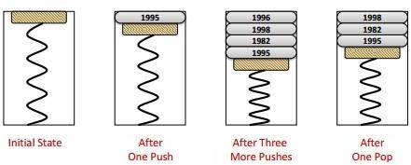
Stacks
§ Last-In-First-Out (LIFO)
§ Stack operations
Push: puts a new thing on top of the stack
Pop: removes whatever is on the top of the stack
IsEmpty: checks if the stack is empty
IsFull: checks if the stack is full
§ Example:
§ Stack pointer conventions:
End points to last fillable slot in the stack
Top points to next free slot in the stack

Slide 18
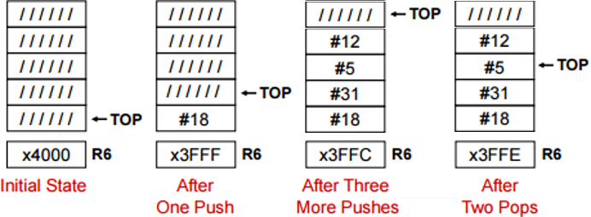
Stacks(continued)
§ Implementation
Keep elements stationary, just move the pointer
More efficient than moving everything
§ NOTICE: Different conventions for TOP: can indicate next empty slot or last pushed element in the stack (ask in OH)
END always points to the last fillable slot on the stack

Slide 19
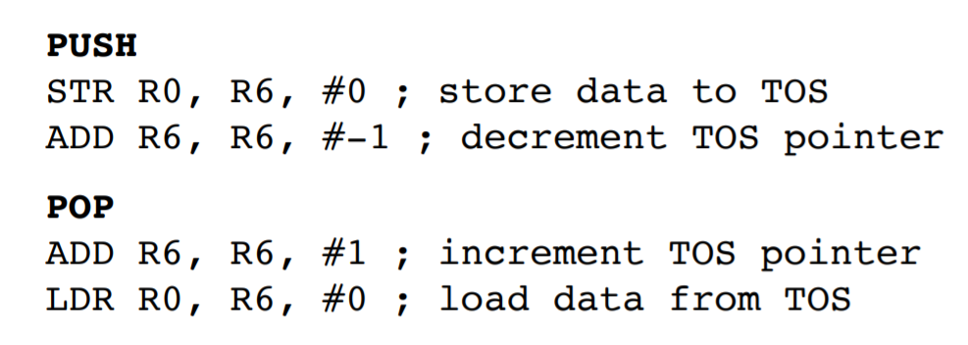
Push and Pop

Slide 20
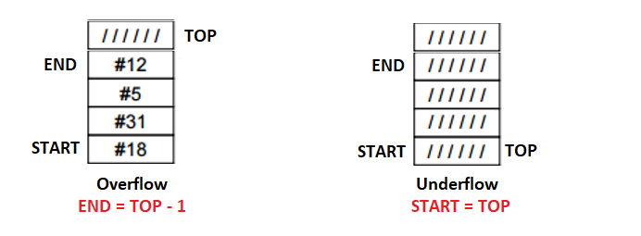
Detecting Overflow and Underflow
Overflow: attempting to push when stack is full
Underflow: attempting to pop when stack is empty

Slide 21
Push
ST R3, PUSH_SAVER3
ST R4, PUSH_SAVER4
AND R5, R5, #0 //Clear R5
//Calculating Overflow:
//TOP = END
LD R3, STACK_END
LD R4, STACK_TOP
ADD R3, R3, #-1
NOT R3 //2’s complement of R3
ADD R3, R3, #1
ADD R3, R4, R3
BRz OVERFLOW
STR R0, R4, #0 //Push value in R0 to stack
ADD R4, R4, #-1 //Update stack top
ST R4, STACK_TOP
BRnzp DONE_PUSH
OVERFLOW
ADD R5, R5, #1
//Return 1 in R5 if overflow
DONE_PUSH
LD R3, PUSH_SAVER3
LD R4, PUSH_SAVER4
RET
//Restore R3 and R4
//Make sure not to modify R7

Slide 22
Pop
ST R3, POP_SAVER3
ST R4, POP_SAVER4
AND R5, R5, #0 //Clear R5
//Calculating Underflow:
//TOP = START
LD R3, STACK_START
LD R4, STACK_TOP
ADD R3, R3, #-1
NOT R3 //2’s complement of R3
ADD R3, R3, #1
ADD R3, R4, R3
BRz UNDERFLOW
LDR R0, R4, #0 // Load value pushed in R0
ADD R4, R4, #1 //Update top of stack
ST R4, STACK_TOP
BRnzp DONE_POP
UNDERFLOW
ADD R5, R5, #1
//Return 1 in R5 if underflow
DONE_POP
LD R3, POP_SAVER3
LD R4, POP_SAVER4
RET
//Restore R3 and R4
//Make sure not to modify R7

Slide 23
Practice Questions
Assuming 3 items have been pushed onto the stack. After a POP operation, will the last item pushed onto the stack be erased from memory? Explain.

Slide 24
Is polling I/O more efficient than interrupt- driven I/O? Explain.

Slide 25
Explain what a stack underflow is.

Slide 26
The input stream of a stack is a list of all the elements we pushed onto the stack, in the order that we pushed them. If the input stream is ZYXWVUTSR, create a sequence of pushes and pops such that the output stream is YXVUWZSRT.

Slide 27
How many instructions, in terms of SOME_NUMBER, are run in this program?
LD R0, OP1 LD R2, OP2
ADD R1, R0, #0
TOP
ADD R2, R2, R0 ADD R1, R1, #-1 BRp TOP
HALT
OP1
.FILL #SOME_NUMBER
OP2
.FILL #10

Slide 28
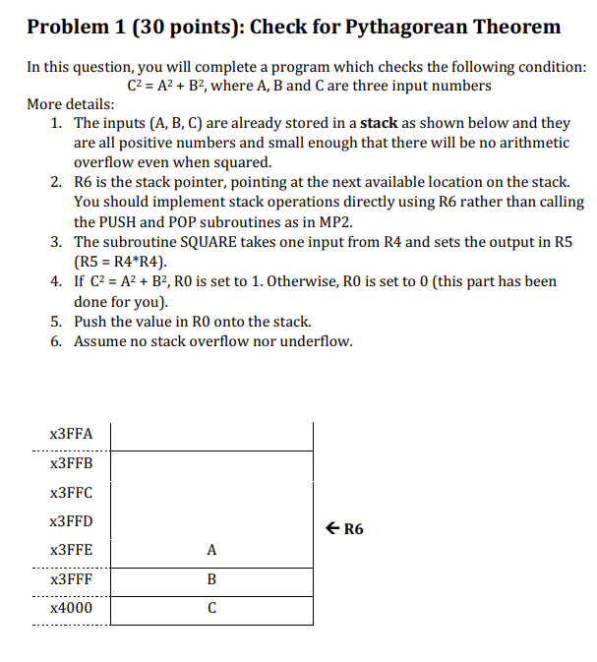
Past Exam Programming Question

Slide 29
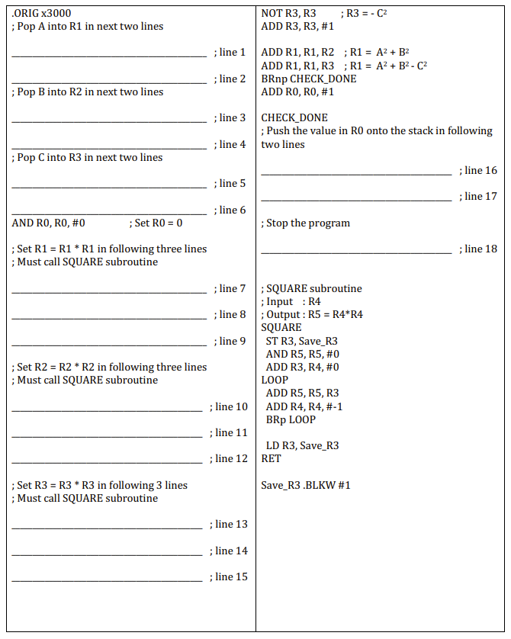

Slide 30
ADD R6, R6, #1
LDR R1, R6, #0
ADD R6, R6, #1
LDR R2, R6, #0
ADD R6, R6, #1
STR R0, R6, #0
LDR R3, R6, #0
ADD R6, R6, #-1
TRAP x25
ADD R4, R1, #0
JSR SQUARE
ADD R1, R5, #0
ADD R4, R2, #0
JSR SQUARE
ADD R2, R5, #0
ADD R4, R3, #0
JSR SQUARE
ADD R3, R5, #0

Slide 31
Tips
Use LABELS
Use semicolon to comment
BR = BRnzp
Draw a flow chart if necessary
Try to remember what kind of numbers are in the registers that you are using. Write them down when calculation gets complicated.
Assign different registers to specific functionality when the task is
complex (R1 for row count, R2 for column count, etc)
Make register table. It’s extremely useful.
R7 should not be changed. Ever!!!
Don’t get frustrated, breathe and start over.

Slide 32
GOOD LUCK!
HKN offers peer-to-peer tutoring if you need any help, just go to this website and email/contact any of us: https://hkn.illinois.edu/service/
All slides posted on HKN website You can do it!

