Slide 1
HKN ECE 329 Exam 1 Review Session
Jason Pan
Sanat Pandey

Slide 2
Topics
Vector Calculus Review
Coulomb’s Law and Lorentz Force
Maxwell’s Equations
Boundary Conditions
Conductors
Dielectrics
Capacitance

Slide 3
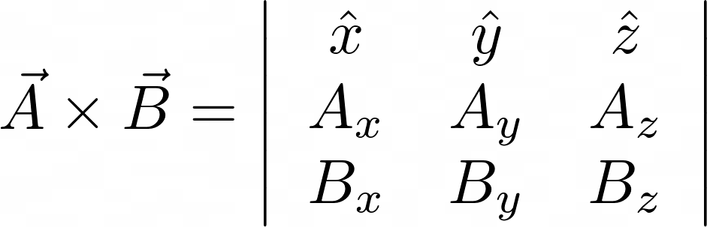
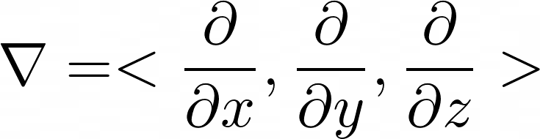
Vector Review
Dot Product: Scalar result
Cross Product: Vector result
Del Operator
Notes:
Jason

Slide 4
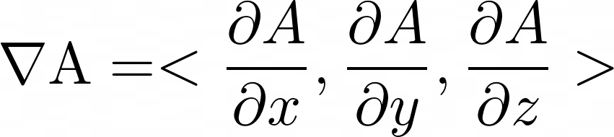
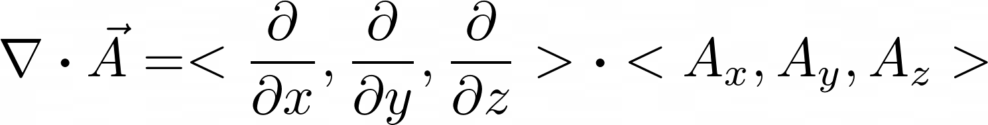
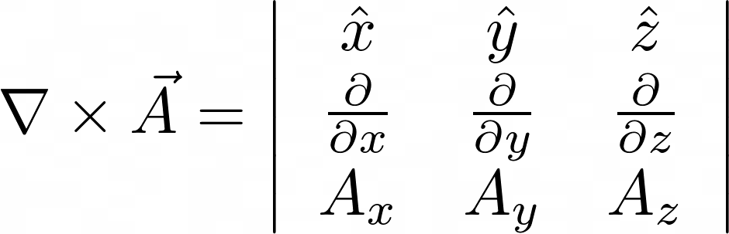
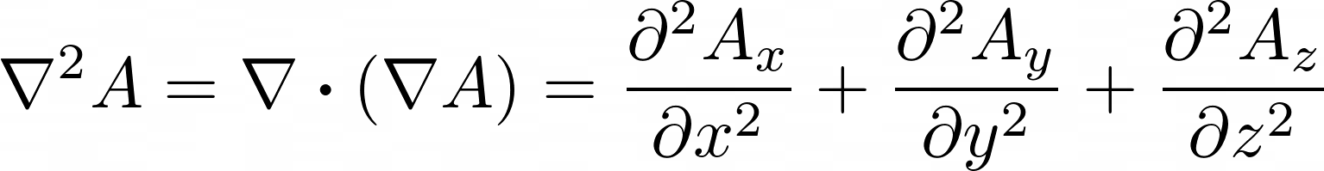
Vector Calculus Review
Gradient
Divergence
Curl
Laplacian
Notes:
\nabla \mathrm{A}=<\frac{\partial A}{\partial x}, \frac{\partial A}{\partial y}, \frac{\partial A}{\partial z}>
\nabla \boldsymbol{\cdot} \vec{A}=<\frac{\partial}{\partial x}, \frac{\partial}{\partial y}, \frac{\partial}{\partial z}>\boldsymbol{\cdot}<A_{x}, A_{y}, A_{z}>
\nabla \times \vec{A} = \left | \begin{array}{ccc}\hat x & \hat y & \hat z \\ \frac{\partial}{\partial x} & \frac{\partial}{\partial y} & \frac{\partial}{\partial z} \\ A_x & A_y & A_z \end{array} \right |

Slide 5
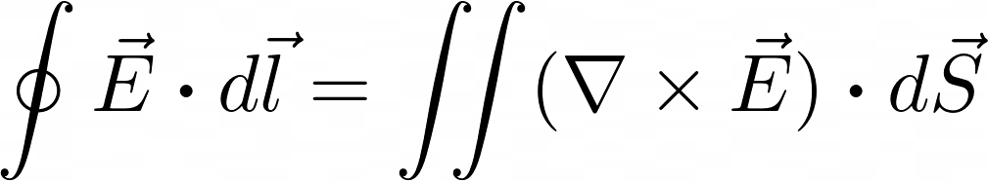
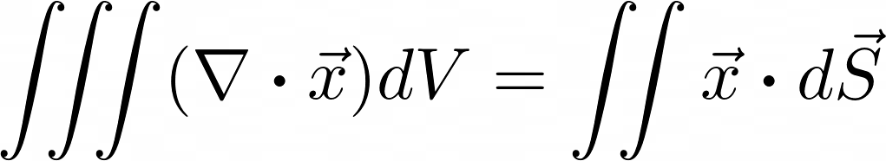

Vector Calculus Theorems
Stokes Theorem
Divergence Theorem
Helmholtz Theorem
Notes:
\oint \vec{E} \boldsymbol\cdot d \vec{l}=\iint(\nabla \times \vec{E}) \boldsymbol\cdot d \vec{S}
\iiint(\nabla \boldsymbol\cdot \vec{x}) d V=\iint \vec{x} \boldsymbol\cdot d \vec{S}
\vec B = -\nabla \Phi + \nabla \times \vec A

Slide 6

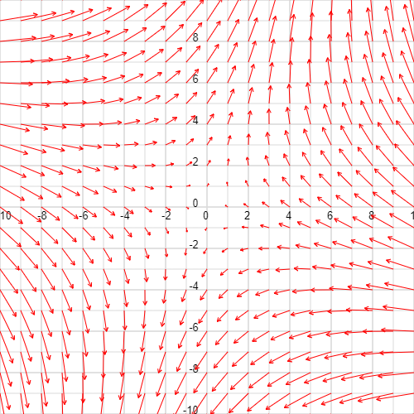

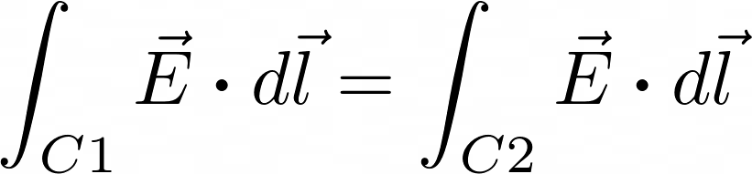
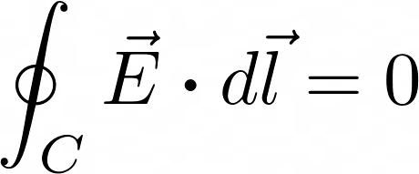
Conservative Fields
Have a defined scalar potential
Are curl free
Line integrals are path-independent
Closed loop integrals are zero
C
C1
C2

Slide 7
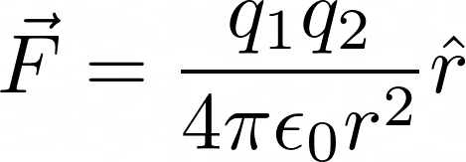
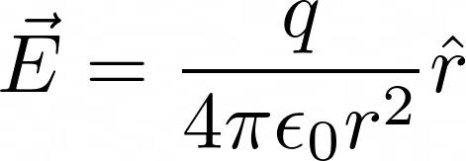
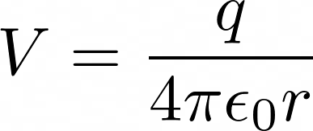

Coulomb’s Law and Lorentz Force
Coulomb’s Law: For point charges
Lorentz Force
Notes:
\vec F = \frac{q_1q_2}{4\pi\epsilon_0r^2}\hat r
\vec E = \frac{q}{4\pi\epsilon_0r^2}\hat r
V = \frac{q}{4\pi\epsilon_0r}
\vec{F}=q \vec{E}+q \vec{v} \times \vec{B}

Slide 8
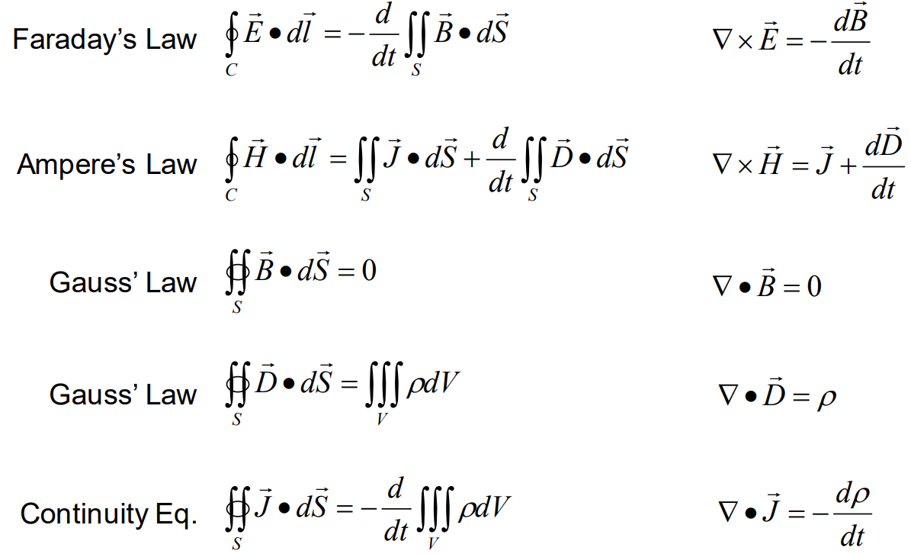
Maxwell’s Equations (and Continuity Equation)
Notes:
Sanat

Slide 9


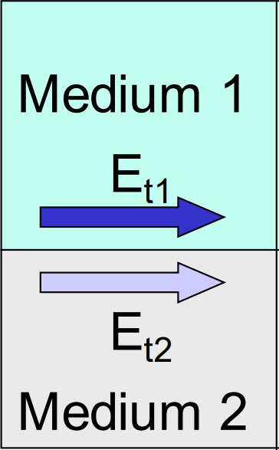
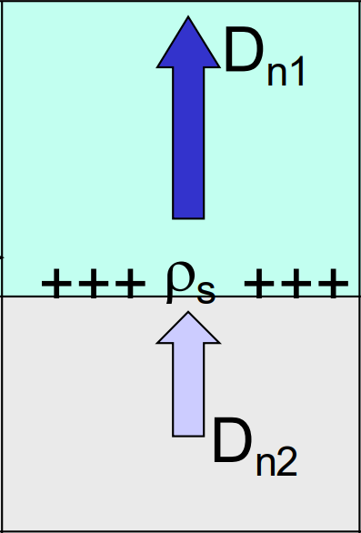
Boundary Conditions
Helpful at edges between materials
Notes:
E_{1 t}=E_{2 t}
D_{1 n}-D_{2 n}=\rho

Slide 10


Conductors
Dielectrics
For perfect conductor: E-field is zero inside
Charges will accumulate on surfaces
Dipoles orient according to external electric field
Notes:
\vec{J}=\sigma \vec{E}
\vec{D}=\epsilon\vec E = \vec{P}+\epsilon_{0} \vec{E}_{\text {total }}=\vec{E}_{\text {total }} \epsilon_{0}\left(1+\chi_{e}\right)

Slide 11
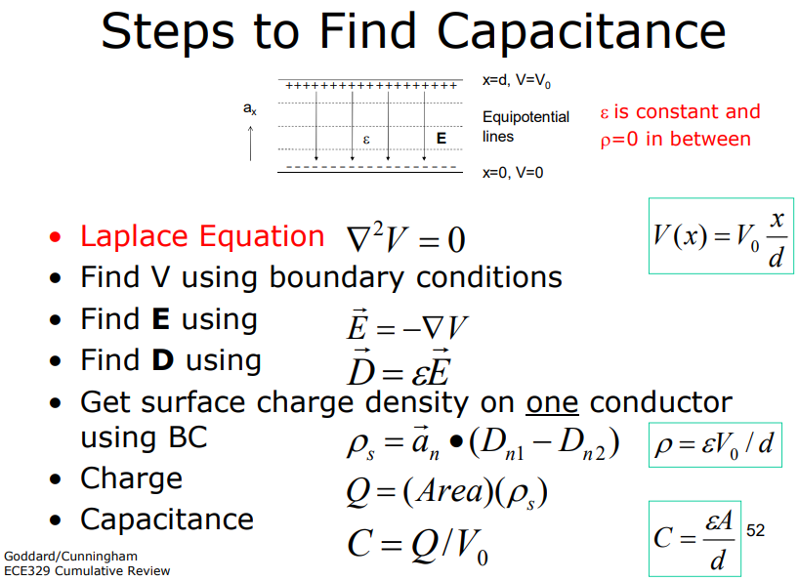
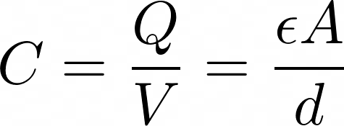
Capacitance
Notes:
Jason

Slide 12
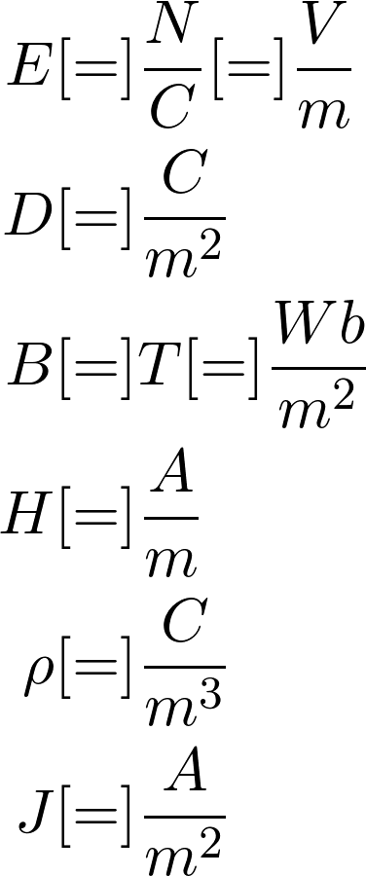
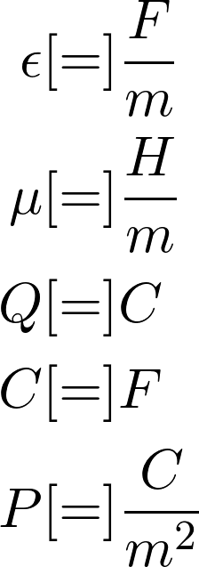
Units
Notes:
\begin{align*}
E&[=]\frac{N}{C}[=]\frac{V}{m} \\
D&[=]\frac{C}{m^2} \\
B&[=]T[=]\frac{Wb}{m^2} \\
H&[=]\frac{A}{m} \\
\rho&[=]\frac{C}{m^3} \\
J&[=]\frac{A}{m^2}
\end{align*}
\begin{align*}
\epsilon&[=]\frac{F}{m} \\
\mu&[=]\frac{H}{m} \\
Q&[=]C \\
C&[=]F \\
P&[=]\frac{C}{m^2}
\end{align*}

Slide 13
Exam Advice
Fill up your notecard (yourself!)
Be careful of multiple choice questions
Use Maxwell’s Equations
Notes:
Sanat

Slide 14
Review Problems

Slide 15
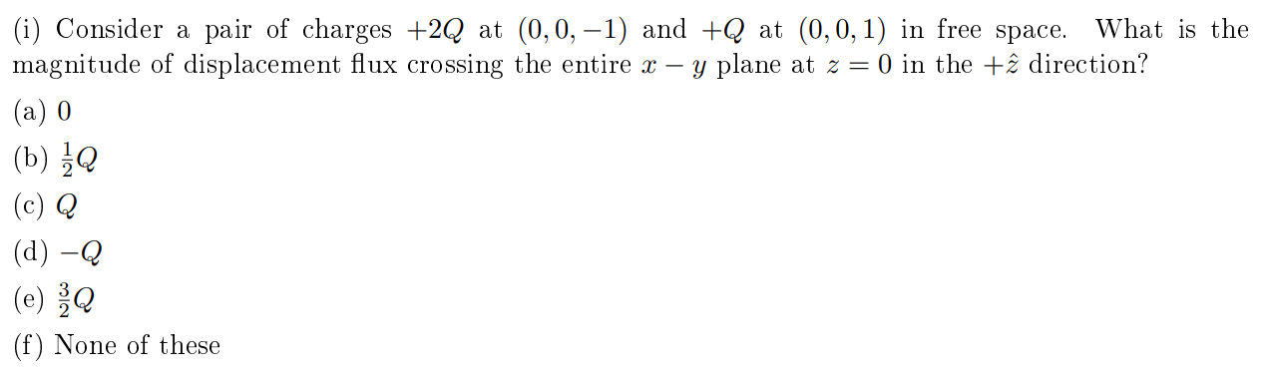
Fall 2015, 1.i
Notes:
Sanat

Slide 16
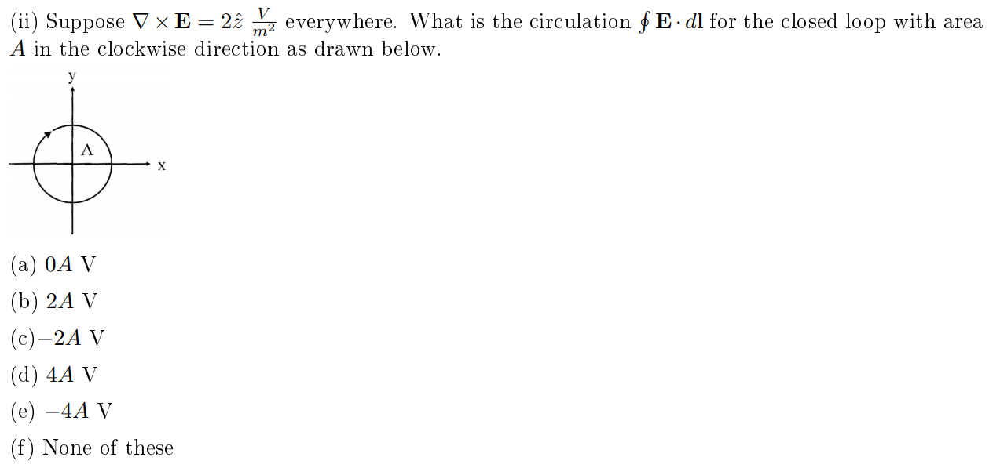
Fall 2015, 1.ii
Notes:
Sanat

Slide 17
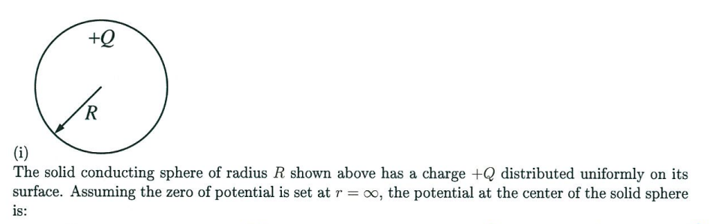
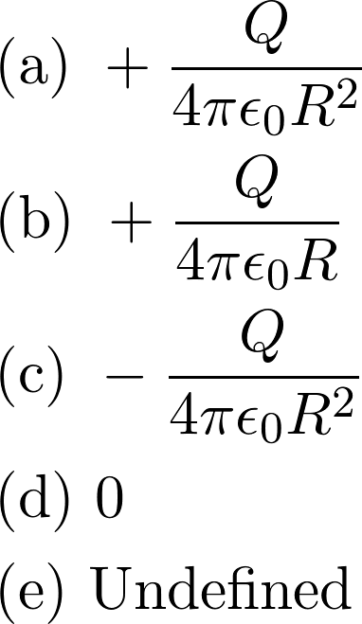
Spring 2019, 1.i

Slide 18
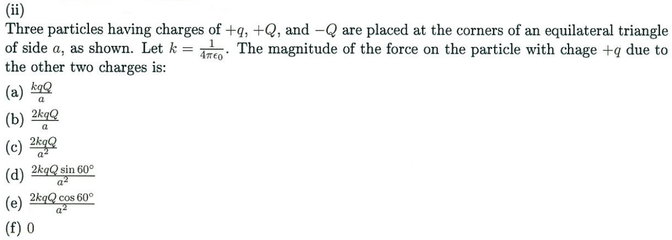
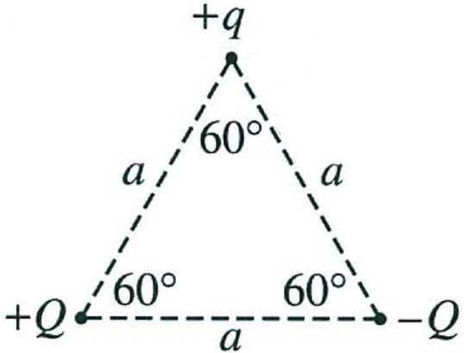
Spring 2019, 1.ii
Notes:
Sanat

Slide 19
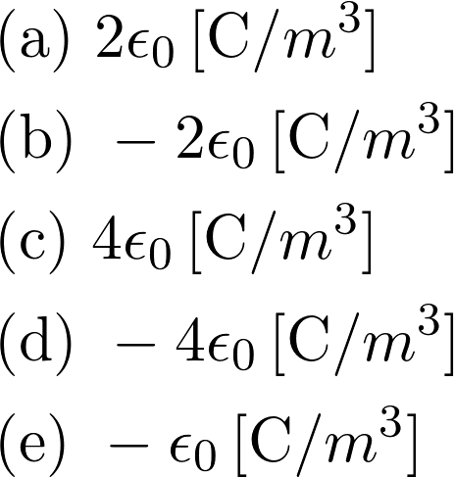
Spring 2019, 1.iii
Notes:
Sanat

Slide 20
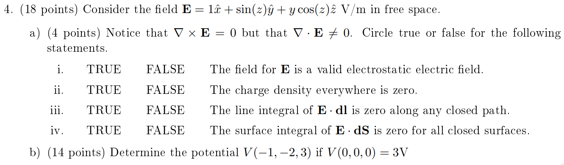
Fall 2015, 4
Notes:
Sanat

Slide 21
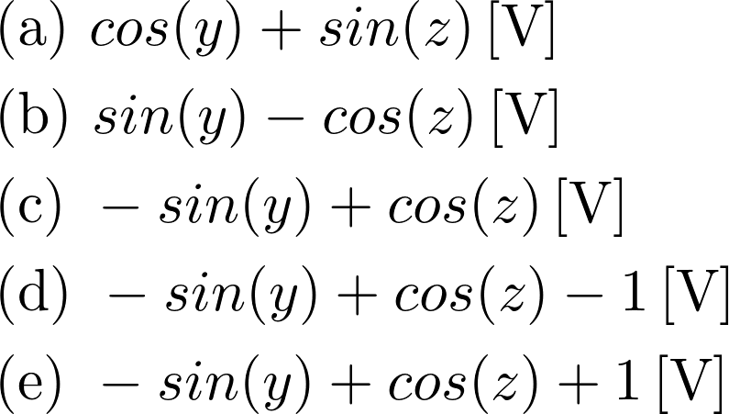
Spring 2019, 1.iv
Notes:
Jason

Slide 22
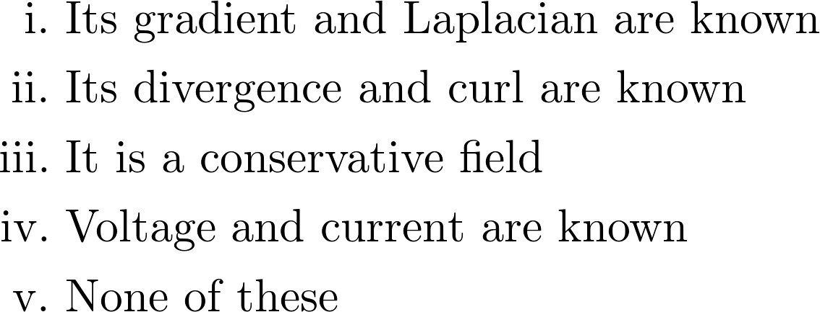
Fall 2018, 1.b
Notes:
Jason

Slide 23
Spring 2018, 3
Notes:
Jason

Slide 24
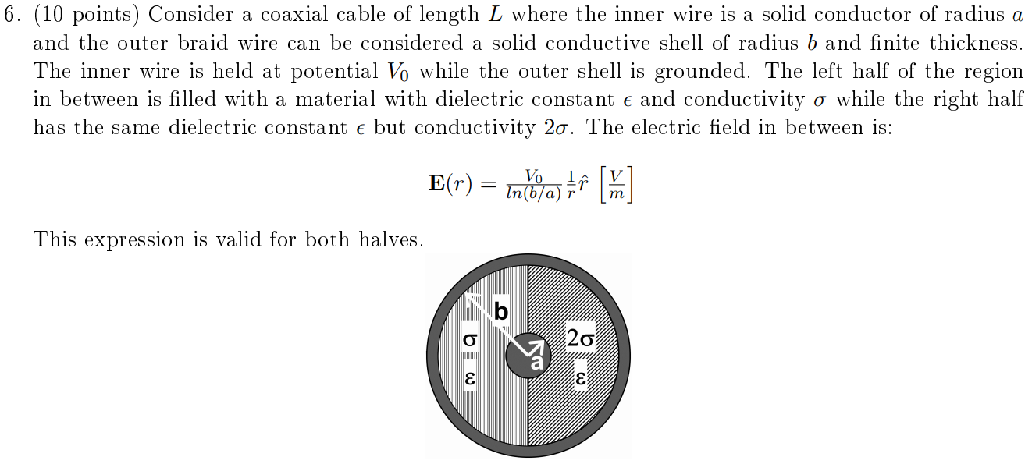
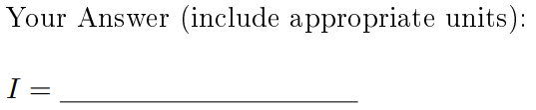
Fall 2015, 6
Notes:
Jason

Slide 25
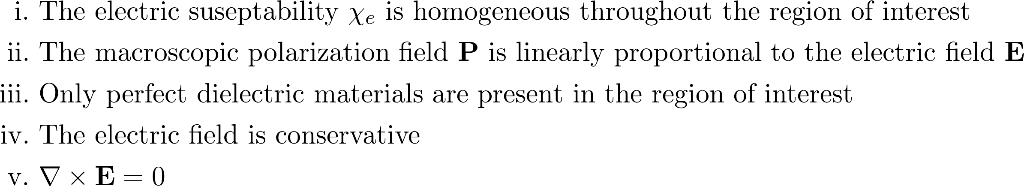
Fall 2018, 1.e
Notes:
Jason

Slide 26
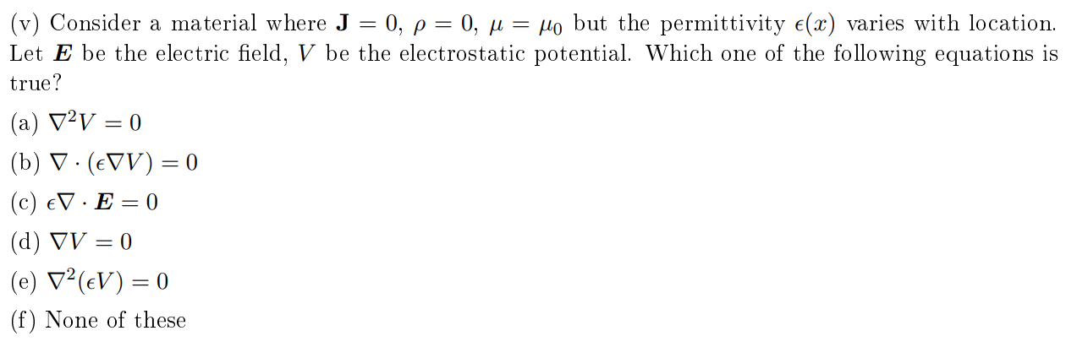
Spring 2017, 1.v
Notes:
Jason

Slide 27
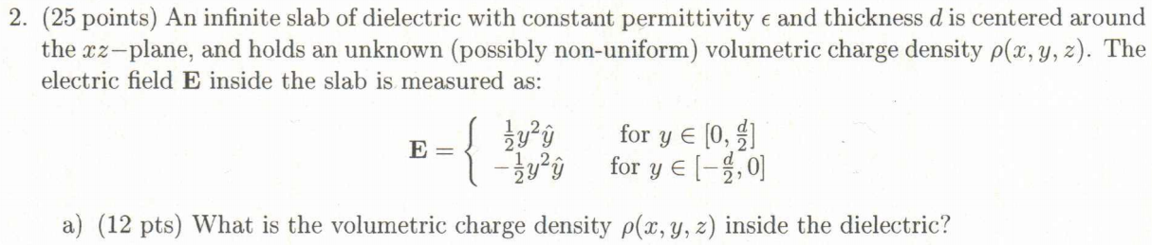
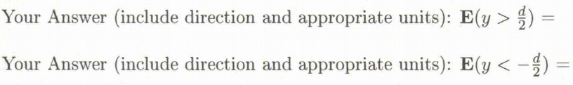
Spring 2019, 2(a,b)
Notes:
Sanat

Slide 28
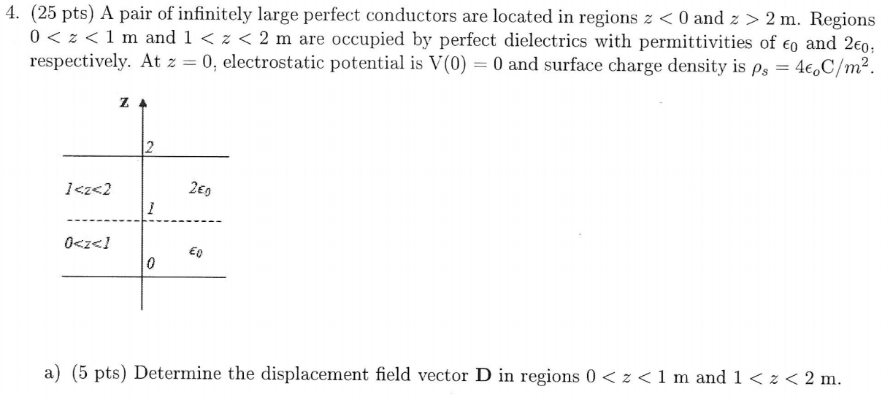
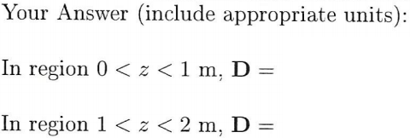
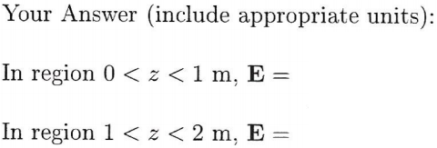
Fall 2017, 4(a,b)
Notes:
Jason

Slide 29
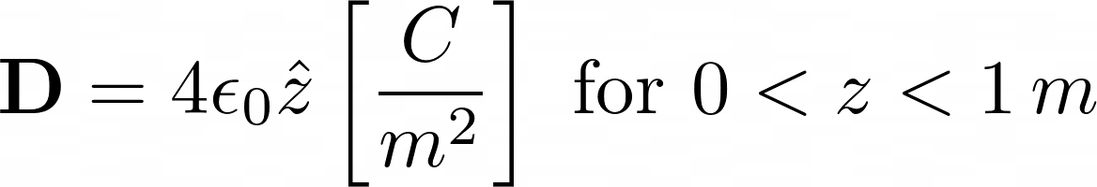
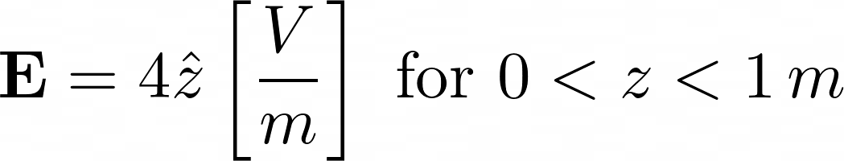
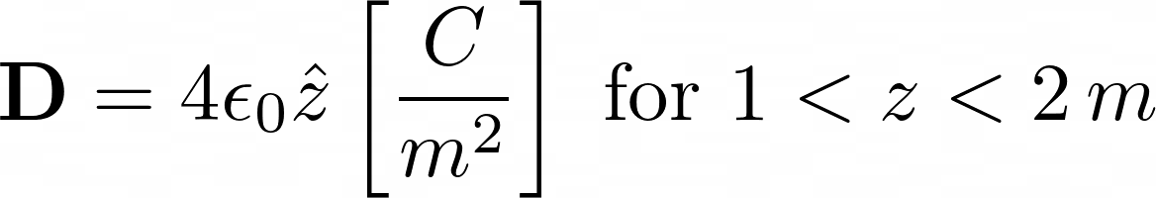
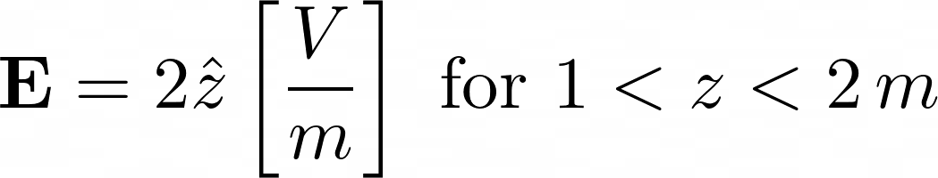
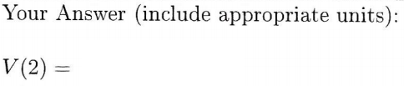

Fall 2017, 4(c,d)
Notes:
Jason

Slide 30
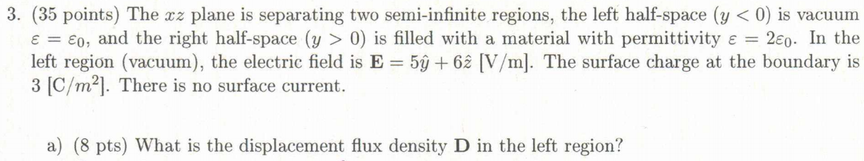
Spring 2019, 3(a,b)

Slide 31
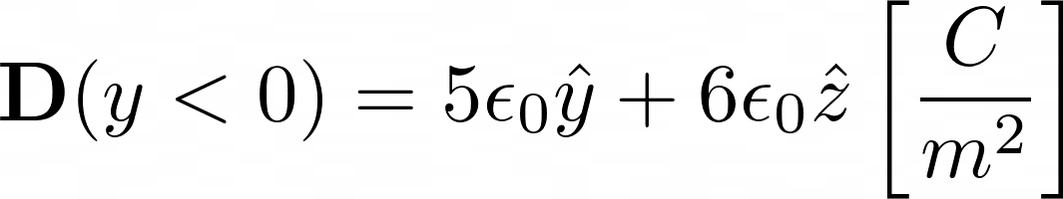
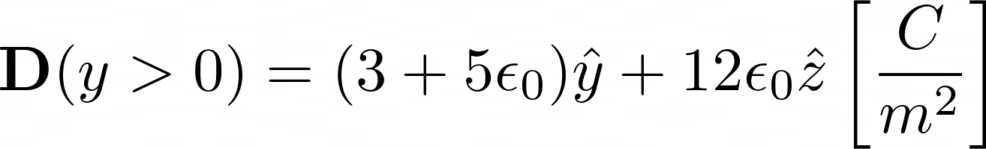
Spring 2019, 3(c,d,e)
Notes:
M
\textbf{D}(y<0)=5\epsilon_0\hat y + 6\epsilon_0 \hat z \left[\frac{C}{m^2}\right]
\textbf{D}(y>0)=(3+5\epsilon_0)\hat y + 12\epsilon_0 \hat z \left[\frac{C}{m^2}\right]

Slide 32
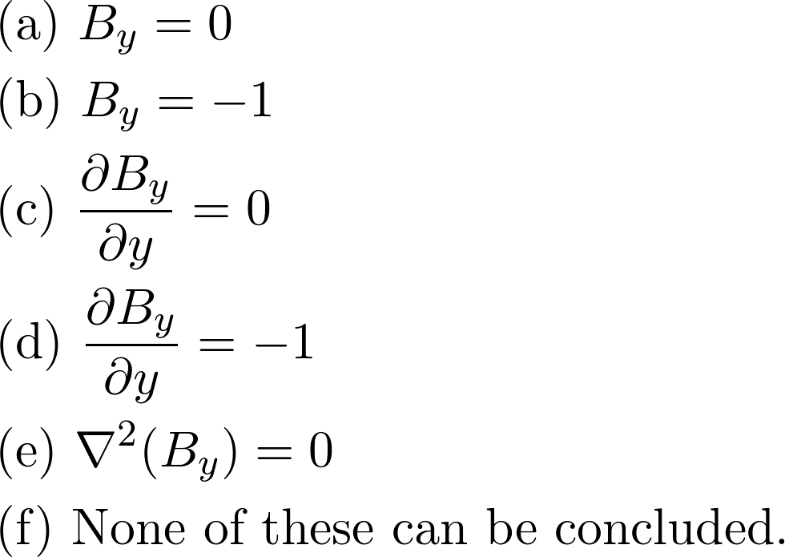
Spring 2018, 1.vii
Notes:
A
\text{(vii) Suppose you measure the components of magnetic flux density everywhere and observe that} \\
\text{$B_x = x$ and $B_z = 0$. What can you conclude about $B_y$?}
\begin{align*}
&\text{(a) } B_y=0 \\
&\text{(b) } B_y=-1 \\
&\text{(c) } \frac{\partial B_y}{\partial y} = 0 \\
&\text{(d) } \frac{\partial B_y}{\partial y} = -1 \\
&\text{(e) } \nabla^2(B_y)=0 \\
&\text{(f) } \text{None of these can be concluded.}
\end{align*}

