Slide 1
ECE 329 Problems HKN
Spring 2017 Exam 1

Slide 2
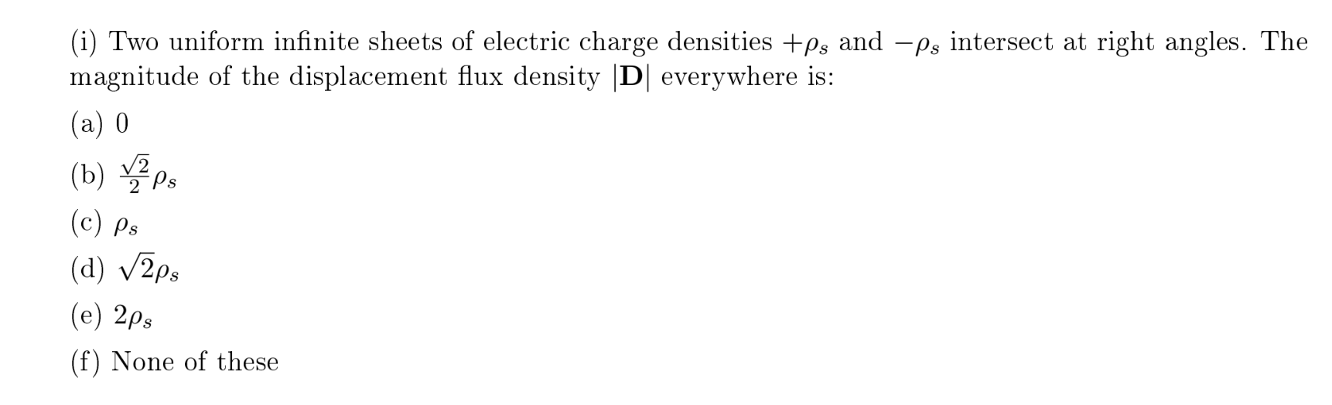

Slide 3
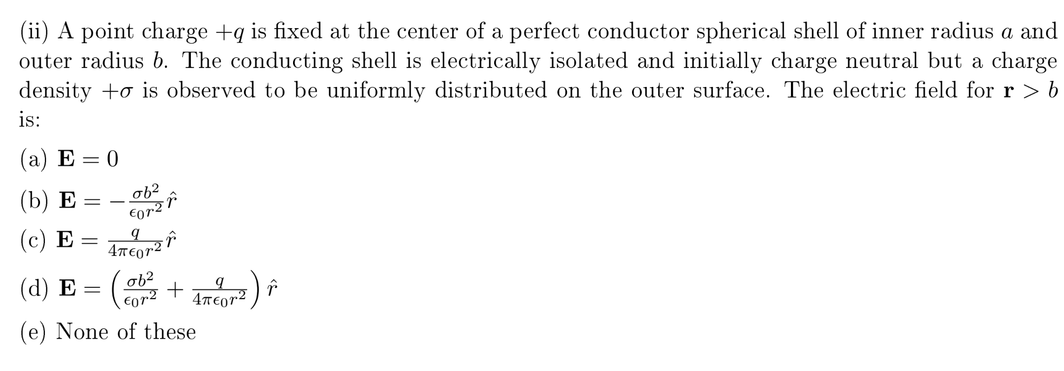

Slide 4
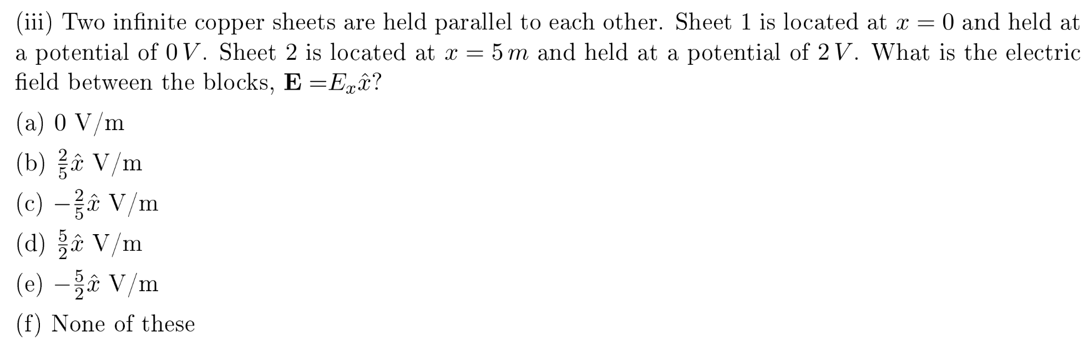

Slide 5
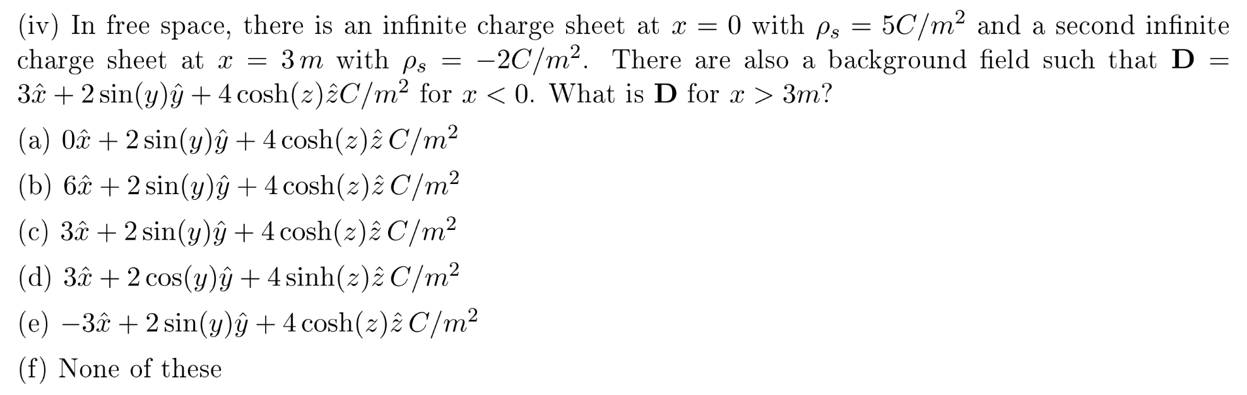

Slide 6
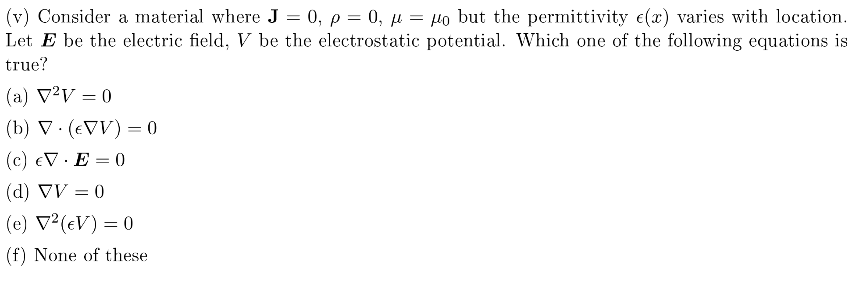

Slide 7
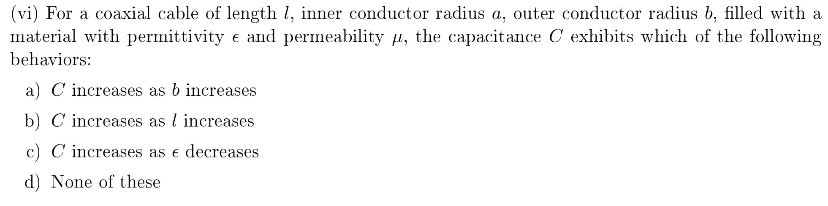

Slide 8
SP14 (4 pts) Assuming that the scalar potential V can be defined, which of the following statements is true?
i. TRUE or FALSE: The potential difference between two points is identical, independent of path
ii. TRUE or FALSE: The electric field is conservative
iii. TRUE or FALSE: The electric field lines will always be perpendicular to equipotential surfaces
iv. TRUE or FALSE: The electric field lines will follow the shortest path between two equipotential surfaces

Slide 9
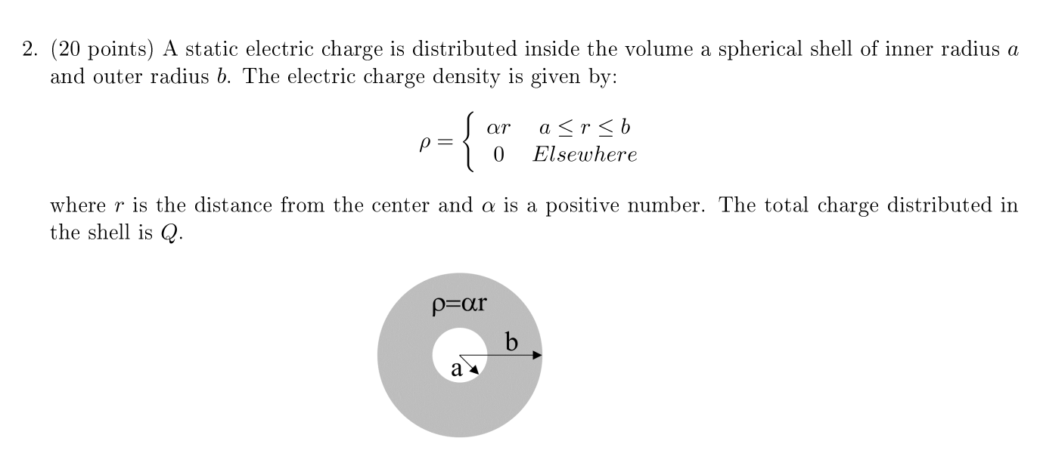
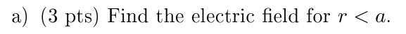

Slide 10
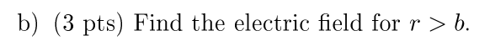

Slide 13
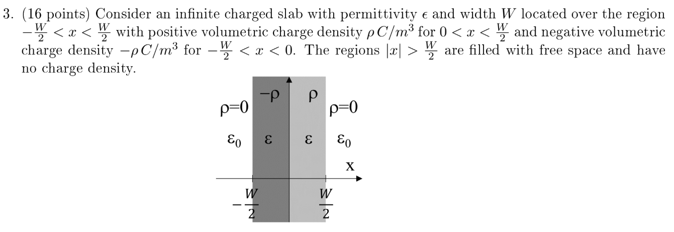
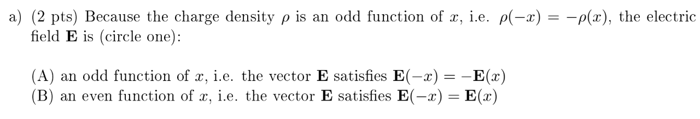

Slide 14
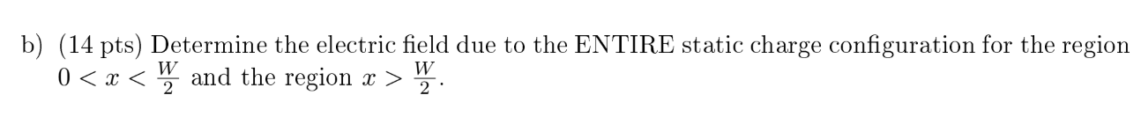

Slide 15
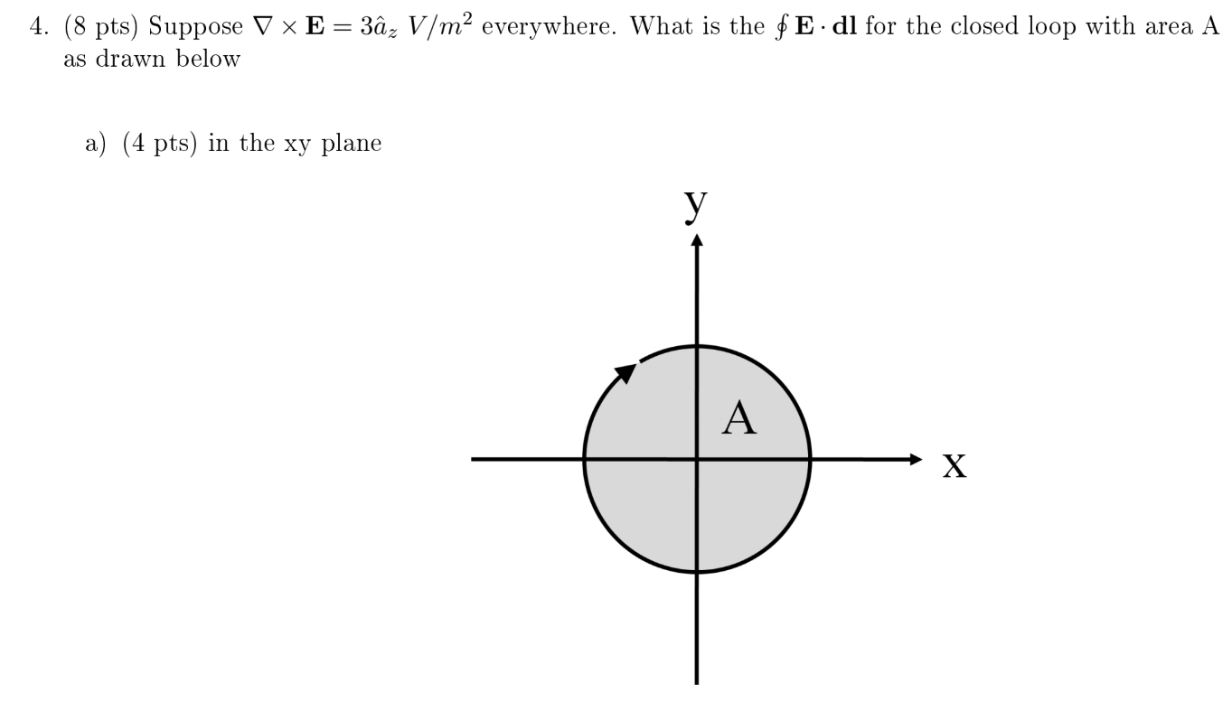

Slide 16
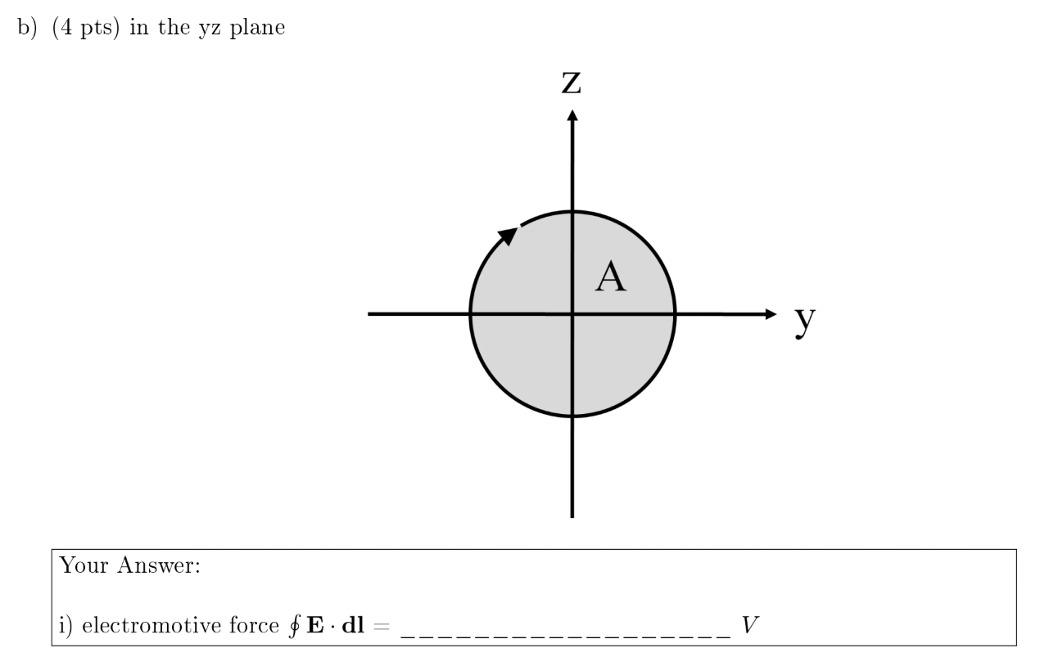

Slide 17
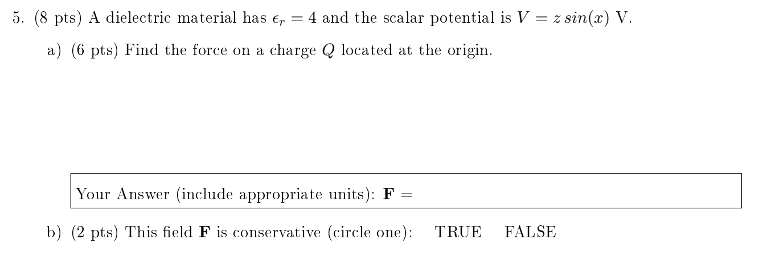

Slide 18
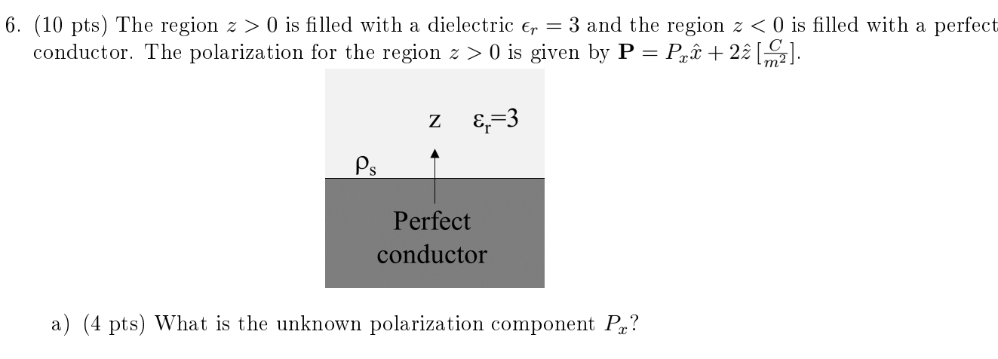

Slide 19
