Slide 1
Application of Deep Learning
Methods for Stock Market Prediction
Author:
Vlad Savchenko

Slide 2
Background and motivation
There were multiple breakthroughs in applications of deep learning methods to various fields: image classification, game competitions etc.
We apply such methods to stock market prediction
We expect performance improvement over existing models

Slide 3
Data Collection
Weekly closing prices of SPY ETF are collected from TradeStation™ trading platform
TradeStation™ provides clean, filtered data, corrected for errors, missing values and outliers
Next, data is loaded into Pandas data frame for further analysis and modeling

Slide 4
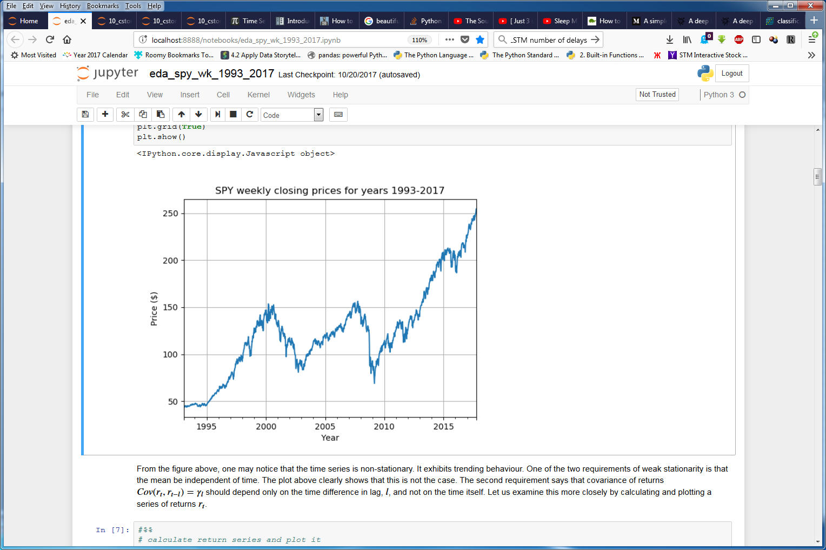
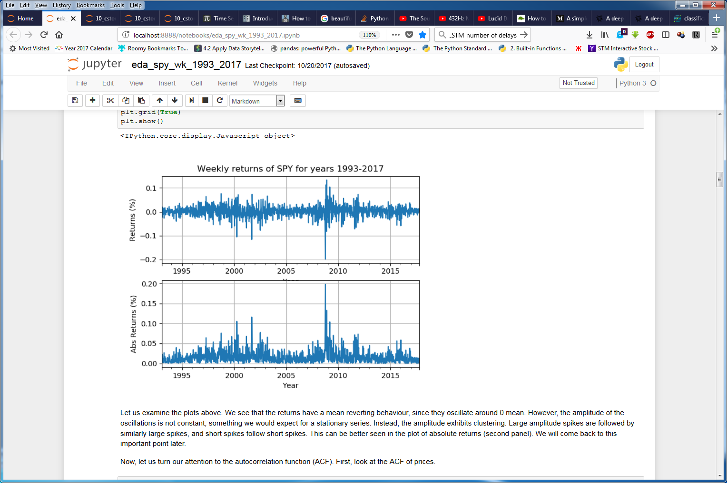
Data Exploration
Trending, non-stationary data
Mean reverting behavior with volatility clustering

Slide 5
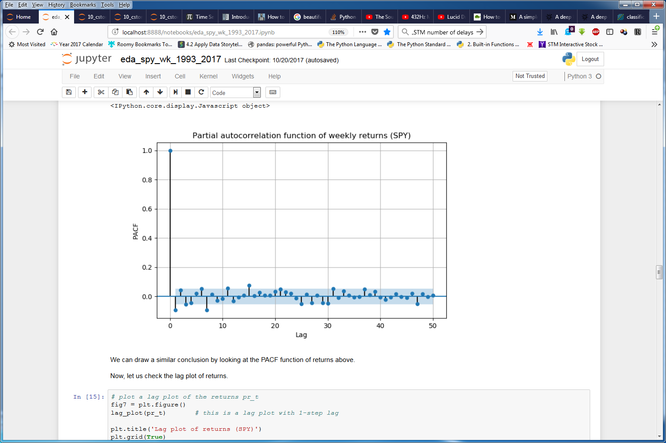
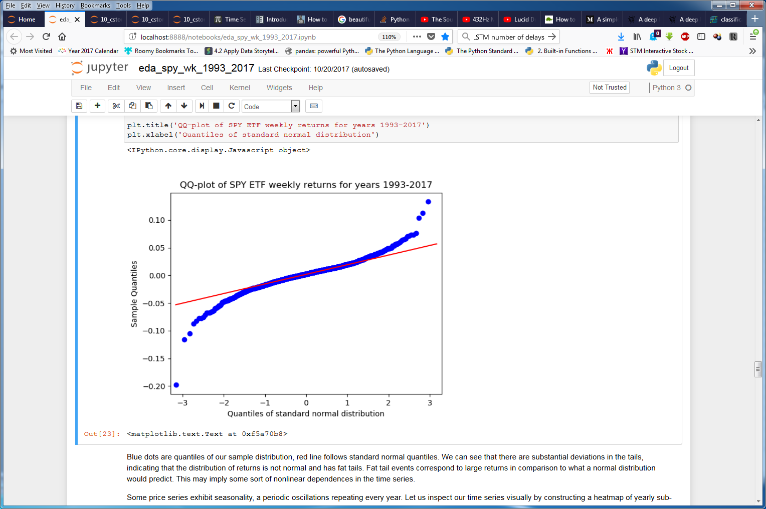
Exploratory Data Analysis
All PACF coefficients are close to zero
Distribution of returns has substantial departures from Normal pdf

Slide 6
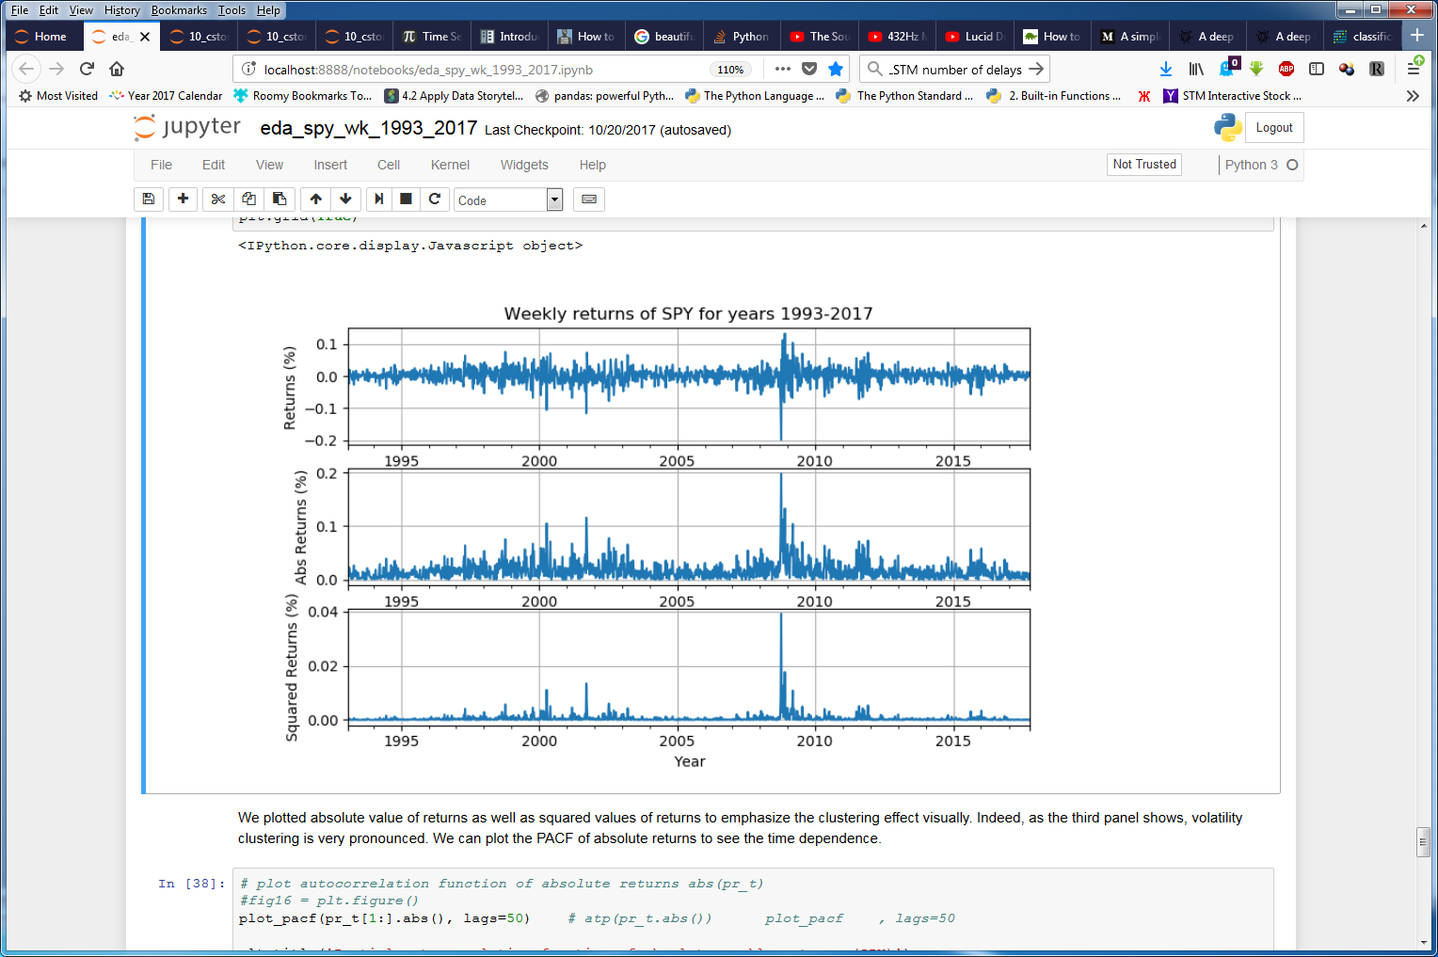
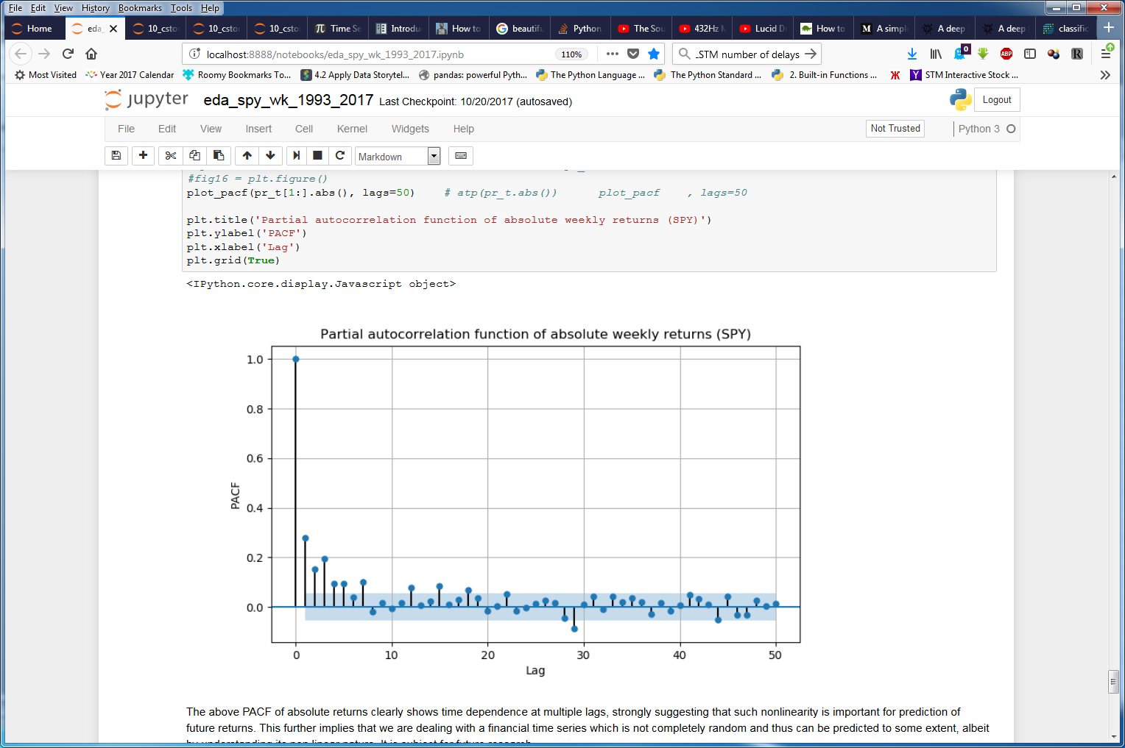
Exploratory Data Analysis
Volatility clustering
Non-zero PACF coefficients

Slide 7
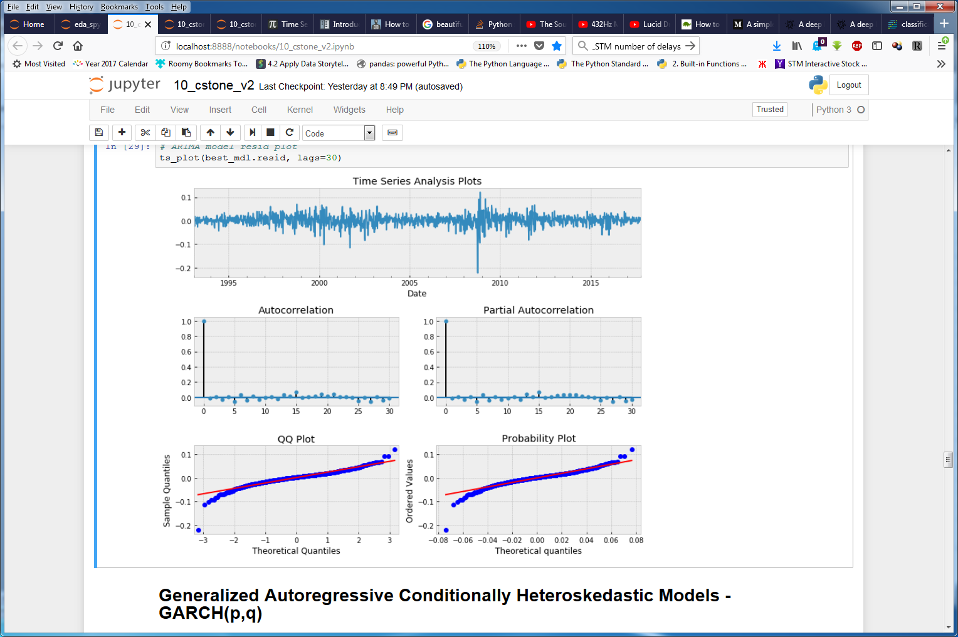
ARIMA modeling of SPY returns

Slide 8
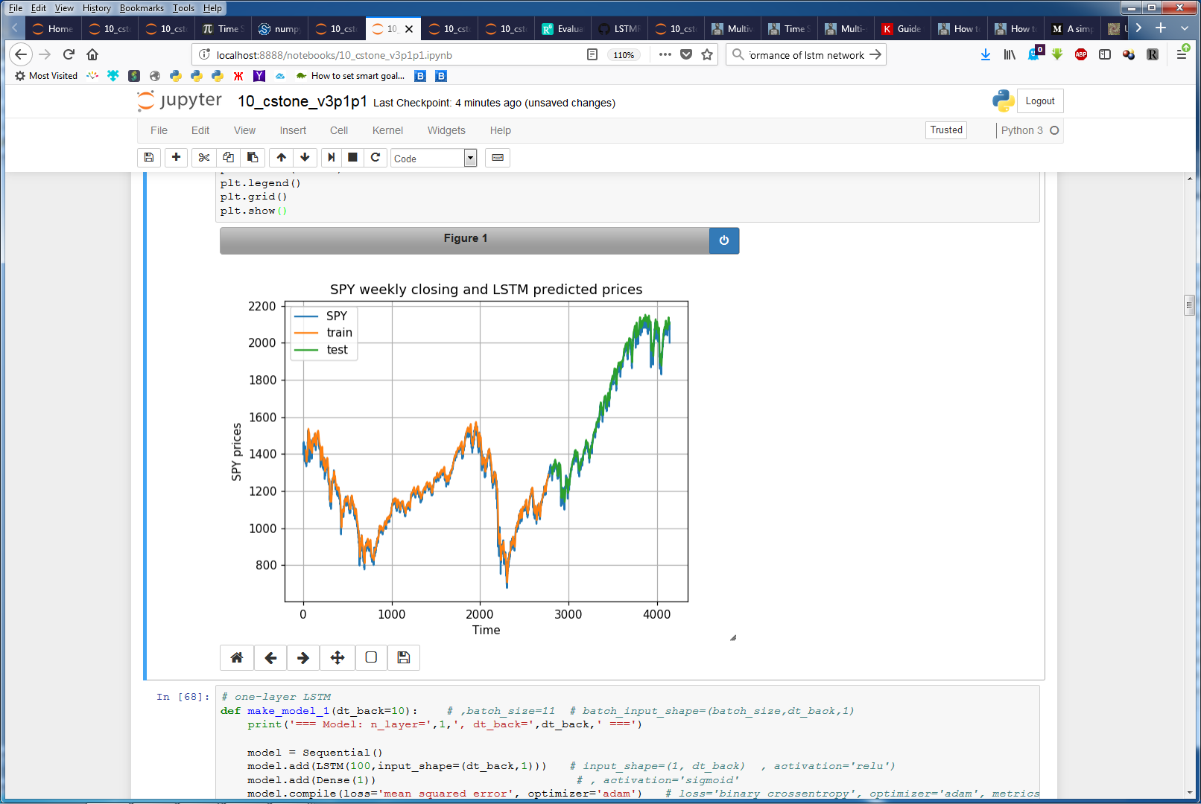
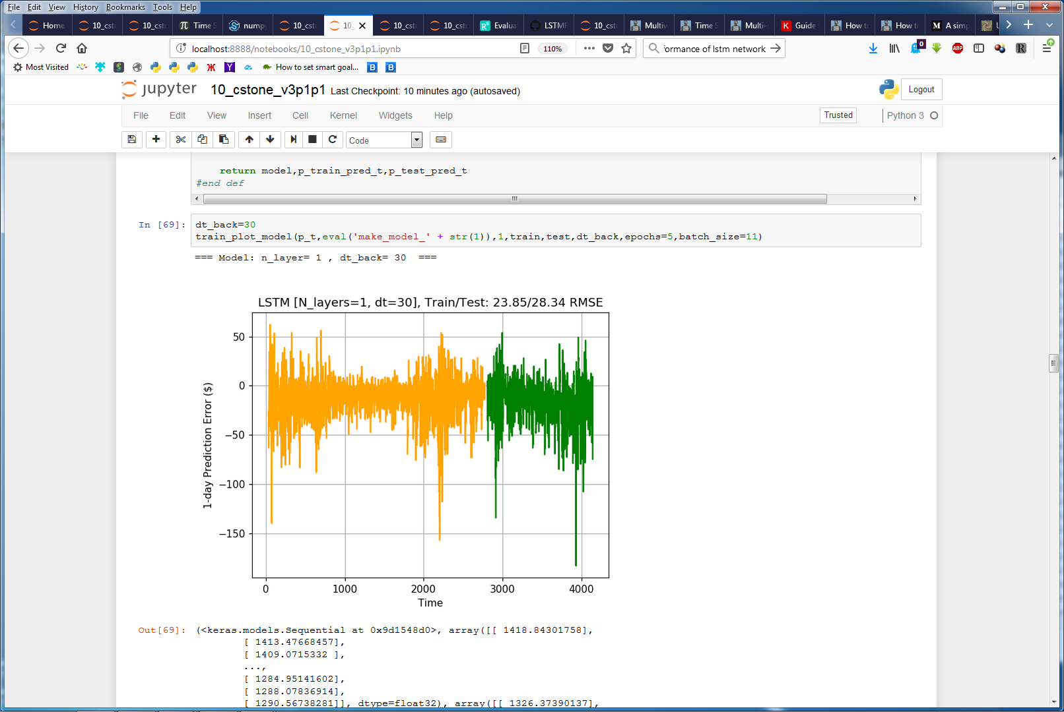
Training LSTM network on SPY data
LSTM network architecture: 1-layer, 100 neurons, one dense output layer, look-back 30 time steps
Network learned trends
Achieved Train/Test scores of 23.85/28.34 RMSE better than ARIMA score of 35.49 RMSE

Slide 9
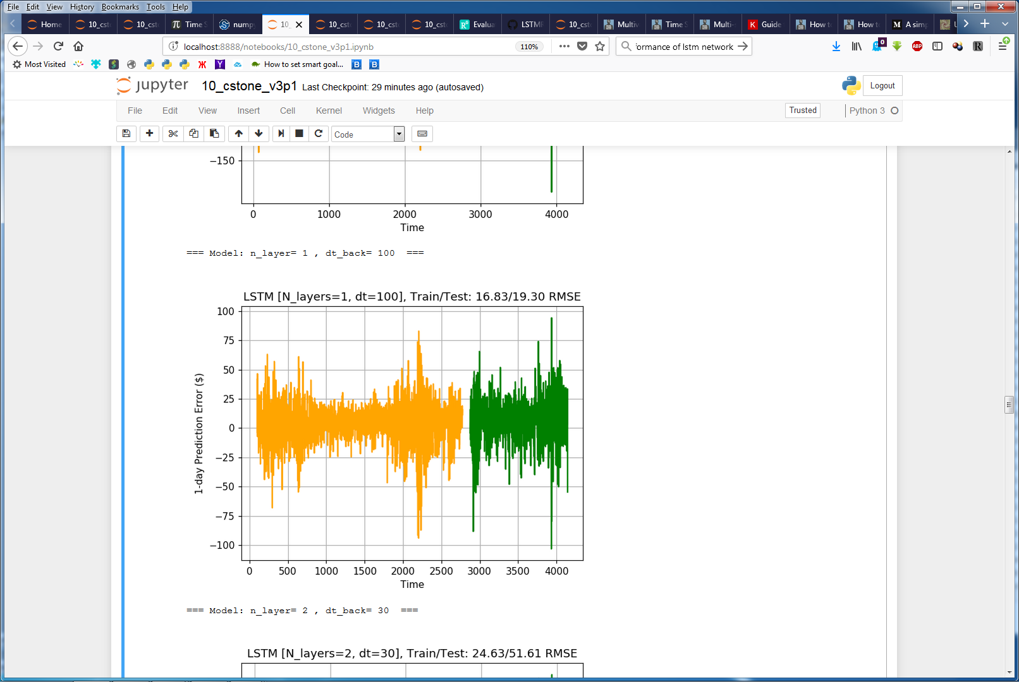
Training Results (1-layer stateless LSTM)
Longer look-back times improve performance

Slide 10
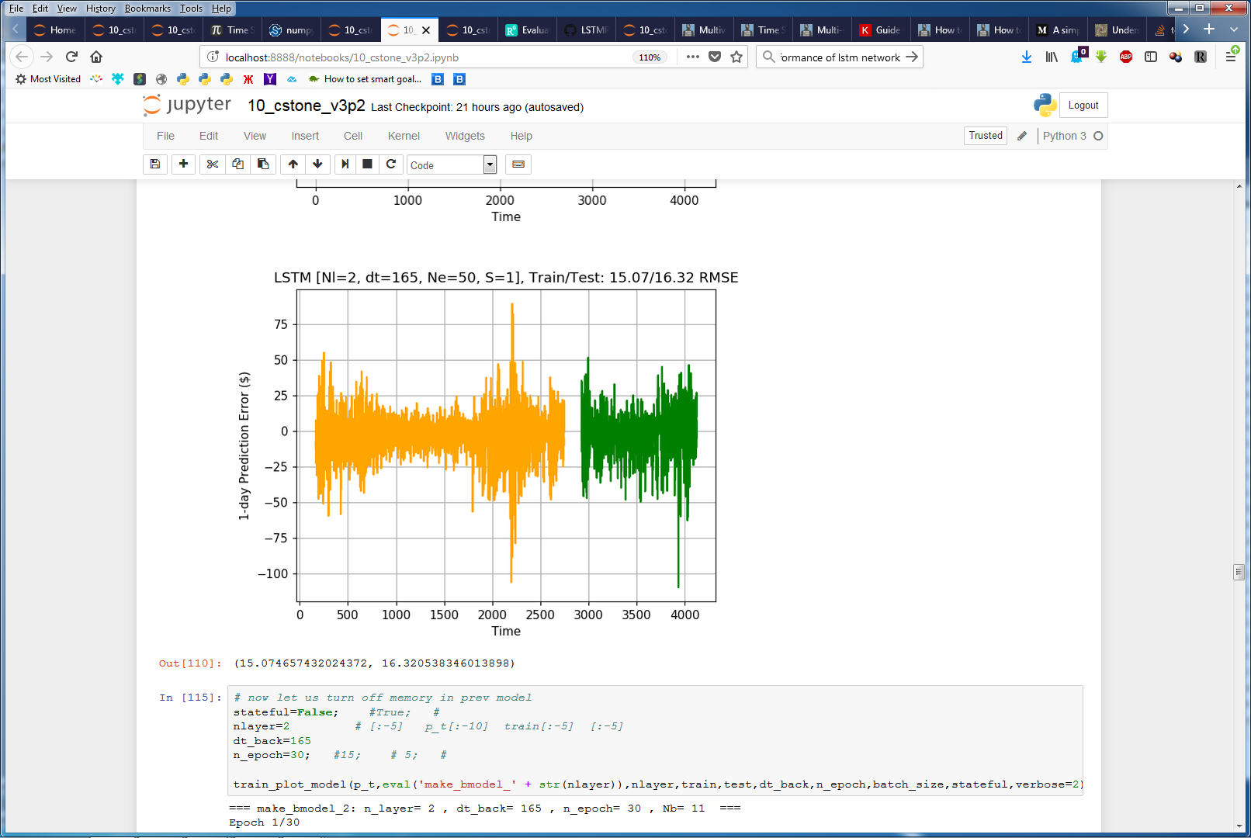
Training Results (2-layer statefull LSTM)
Keeping track of internal state, stacking 2 layers improves performance

Slide 11
Conclusions
LSTM network learned to follow major trends, as well as to react to trend changes
It outperforms ARIMA modeling predictions
Longer look back periods, deeper network, keeping track of internal state improved predictions

