Slide 1
The Political and Economic Drivers of the Diffusion of Renewable Energy in the United States
Harrison Karp, Advised By Professor Jennifer Raynor

Slide 2
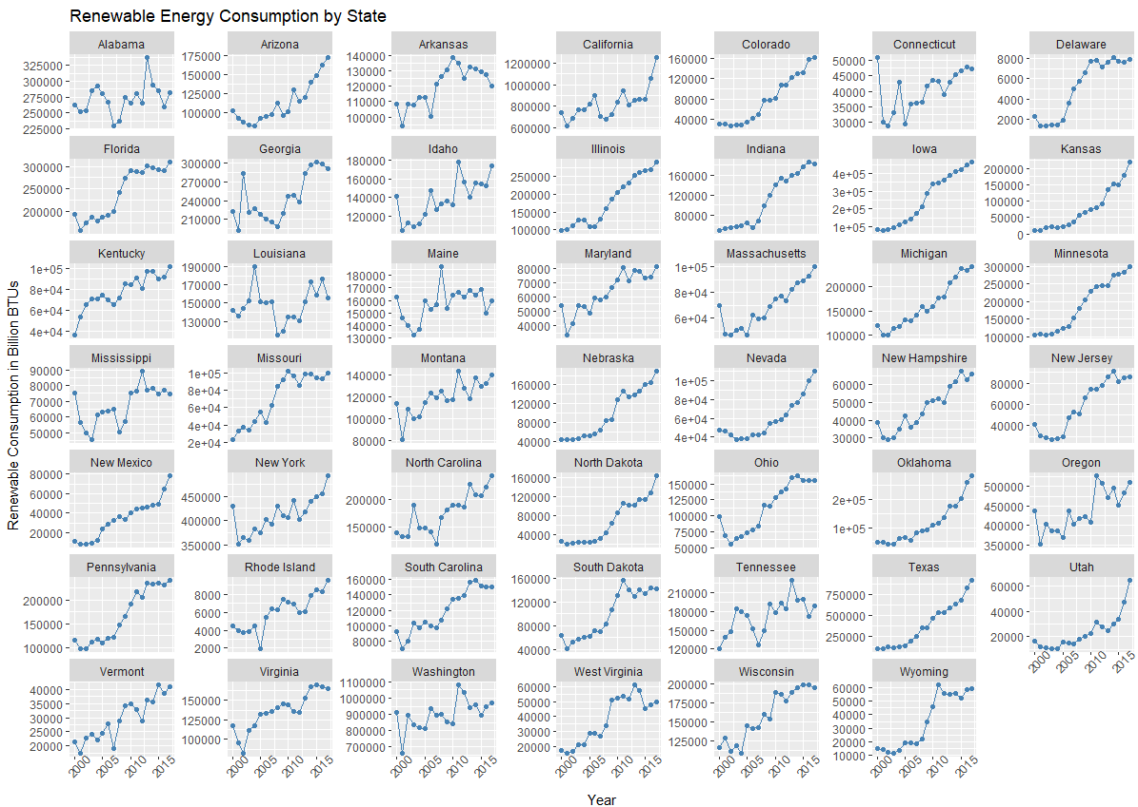

Slide 3
Introduction

Slide 4
State of Clean Energy
72% of Americans believe climate change is occurring (YPCCC)
60% of Americans believe Congress should do more to address climate change (YPCCC)
Since 2009, 1,125 bills concerning climate change have been introduced to Congress, but only 27 (2.4 %) have been signed into law (Govtrack)
By 2090, the United States will save $224 billion in economic damages every year if global warming is limited to 2.8°C (5°F), compared to the current path of 4.5°C (8°F) (EPA)
38% of US greenhouse emissions are released by the electricity production industry (EIA)
Notes:
A majority of Americans believe and want to deal with climate change, but our politicians have done very little, even withdrawing from the Paris Climate Accords in 2017.
One possible avenue of reform is the electricity production sector

Slide 5
Research Question
What political and economic factors drive the consumption of clean energy in US states?
Which of these factors provide possible avenues toward addressing climate change?
Notes:
Individual states have already taken dramatic action to address climate change, like California did by installing cap and trade in 2013
In the 4 years after the installation, greenhouse gas emissions decreased by 5.3%
Can states that haven’t pushed renewables learn what has pushed states like California in order to speed up their transitions?

Slide 6
Existing Literature
Dasgupta and Cian (2018) reviews 60 applied econometric studies concerning environmental performance and policy adoption
Commonly Significant Factors
Political variables like perception of corruption, lobbying, and government partisanship
Economic variables like Gini coefficient, income per capita, and unemployment rate
Gaps Identified
Influence of institutional quality on environmental outcomes
Synthesis of economic, political, and institutional factors
Notes:
Most of the papers reviewed either use time series, cross sectional, or simple MLR regression models
Few used panel regression or FE/RE
My paper contributes to both gaps in the literature and attempts to be more econometrically robust

Slide 7
Methodology

Slide 8
Data Sources
Political Factors
Government partisanship (NCSL)
Politician and public ideology (Prof. Richard Fording)
Oil and coal reserves (EIA)
Economic Factors
U3 unemployment percentage (Census Bureau)
Gini coefficient (Prof. Mark Frank)
Powerplant fuel prices (EIA)
Consumption of renewable energy (EIA)
Notes:
Prof Richard: Politician and citizen ideology - 0-100 with 100 being fully liberal, assumes that congressional ideology is representative and extrapolates
Abandoned : Google Trends data on MSNBC, CNN, and Fox News, watchdog group Open Secrets data on political donations and politician’s investments, league of conservation voters NRA-like scorecards, Yale climate change polling, UVA congressional

Slide 9

Model
Log(Renew_{it}) = $β$₁(log(Price Elec_{it})) + $β$₂(log(Neighbor_{it})) + $β$₃(log(Political_{it})) + $β$₄(log(Economic_{it}))+ state_{i} + year_{t} + e_{it}
Includes state and year fixed effects
Instrumenting for price of electricity
Notes:
HYPOTHESES
Price of electricity: the price and quantity demanded of a good are theoretically endogenous, that’s why I am instrumenting, will give more details
Neighbor: the average clean % of a state’s neighborhood. Theoretically important because state’s share electricity over the grid and because of technology and policy diffusion
Political: as conservative political parties or fossil fuel companies become more powerful, clean energy consumption will fall.

Slide 10
Instrumental Variable
Existing literature on electricity prices
Utilizing the price that powerplants pay for coal fuel
Also tested natural gas and nuclear fuel prices
F statistics range from 25-180 depending on the specifications of regression
Notes:
Most papers that utilized electricity price were attempting the explain the passage of environmental legislation
I didn’t find papers using demand for electricity as the dependent variable, so nothing in my literature review dealt with the instrumenting issue.
Could be that high prices encourage reform or high prices make investing in high cost renewable harder.
Interestingly, even natural gas produces about 15% more of the US’s electricity than coal, the coal fuel price performs much better as an instrumental variable. Neither the coal fuel price nor the natural gas price was particularly strongly correlated with electricity price by the coal fuel price was more strongly correlated, which may be the source of its improved performance.
About .35 to -.23

Slide 11
Results

Slide 12
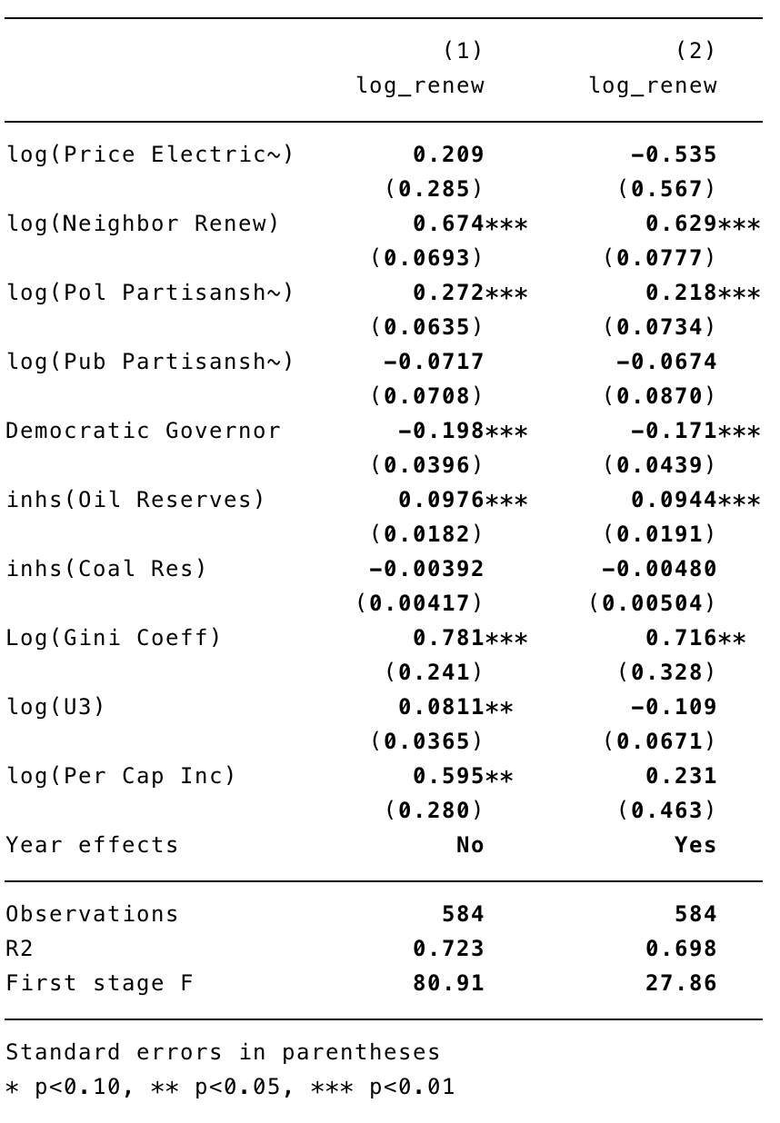
Regression Results
Regression 1 robust SE, state FE
Regression 2: robust SE, state FE + year FE
Notes:
M1: base model, the first three use this same base of variables and state fixed effects
M2: adding the U3 unemployment variable
M3: adding the public partisanship variable that is derived from the politician’s partisan ship variable
M4: adding state clustering of error
M5: adding year fixed effects

Slide 13
Discussion

Slide 14
Issues
Limited variability in variables of interest
Instrumental variable identification
Notes:
Year fixed effects may just add too many parameters to calculate for only 750 observations. The data is not really available at the county level or for more years, so this data availability is a hard limit. This data is also not entirely analogous to the international context, so that is not really an option either
Some variables were excluded because of lack of variability. For example, only 22 states have the party in control of the state legislature change over the 18-year period of the dataset.
One variable that has been shown to be reliably a reliably significant factor in both the passage of environmental legislation and in environmental outcomes is the perception of corruption. I have been unable to find any data approximating this factor. It is a foundational element of many “quality of institution” variables, so it is greatly of interest.

Slide 15
Next Steps
Expand my literature review
Collect data on renewable energy mandates
Continue to search for variables of interest or proxies
Attempt to increase the number of years the dataset spans
Notes:
In my literature review, I will continue to look for more papers to suggest alternatives to coal fuel price as an instrumental variable for electricity price. Also continue to look for both new possible explanatory variables or econometric ways to deal with limited data.
Another quality of institution variable is education rates, usually measured by the graduation rate. This data was spotty and not available for enough years, but a potential proxy variable could be literacy rates.
Look for alternate sources of key variables that stretch farther back than existing sources. If I can get more data, hopefully I will be able to prove that my variables are significant and all I lack are the degrees of freedom and predictive power I need

