Slide 1
CMSC 628: Introduction to Mobile Computing
Nilanjan Banerjee
University of Maryland
Baltimore County
nilanb@umbc.edu
http://www.csee.umbc.edu/~nilanb/teaching/628/
Introduction to Mobile Computing

Slide 2

Why do I need to learn smart phone programming?
“The number of smartphone users in 2016 is projected to be close to 2.6 billion”
--- Marketing charts
“Smartphone penetration is now 73.4% of Internet users with 190.5 million total smartphones now active in the US”
--- ComScore
What will drive our research in mobile computing over the next decade? One force is the emergence of mobile devices as rich sensors. The other force is the convergence of mobile computing and cloud computing.
--- Mahadev Satyanarayanan

Slide 3
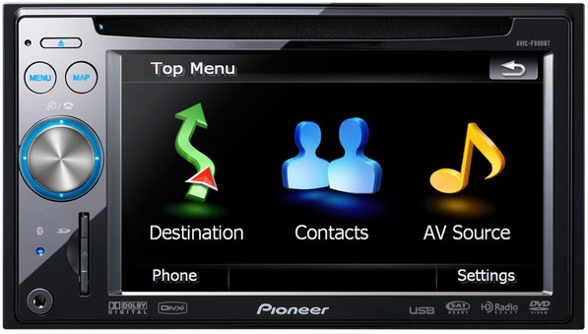
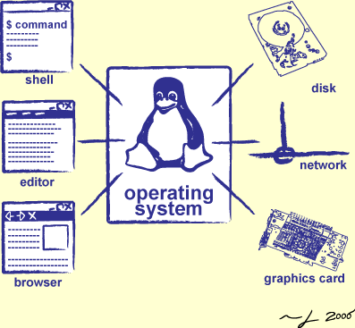

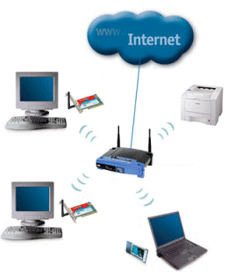

What does mobile phone programming encapsulate?
Operating system
design
User-interface design
programming
languages
networking
cloud
computing

Slide 4
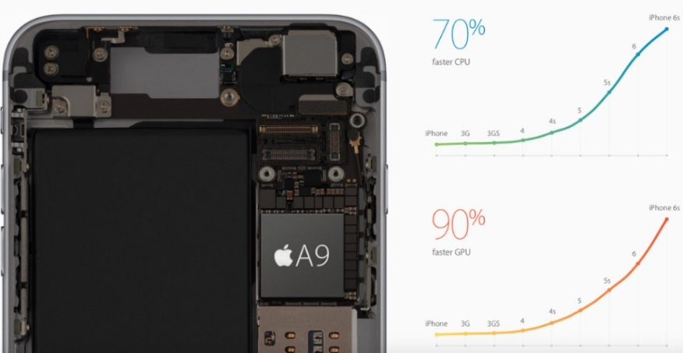
Why is it difficult to develop good mobile apps.
Is it computational power?
1.8 GHz processors
Is it memory
2 GB of RAM in most cases
Battery constraint (biggest constraint)
iPhone 7 has a battery capacity of 2,900 mAH
Limited battery is always a constraint
Cannot build apps which kill your battery
Too many options
Accelerometer, GPS, compass, WiFi, Bluetooth, 3G….

Slide 5
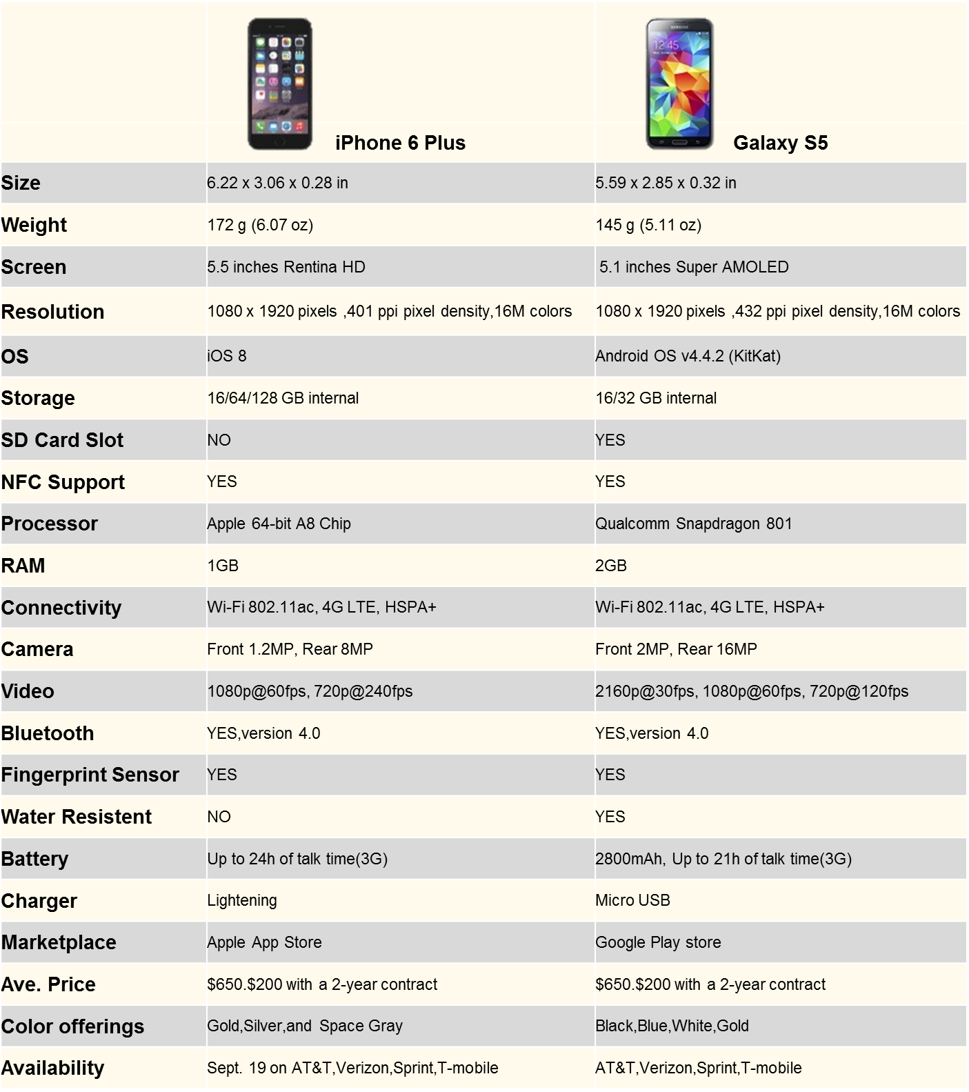
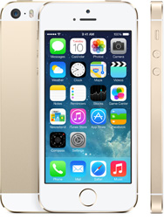
To give you an idea of the specification of a phone!

Slide 6
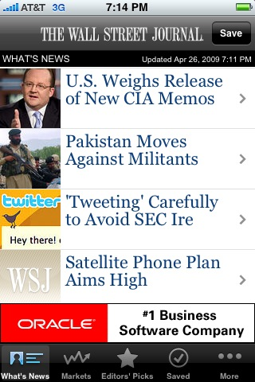
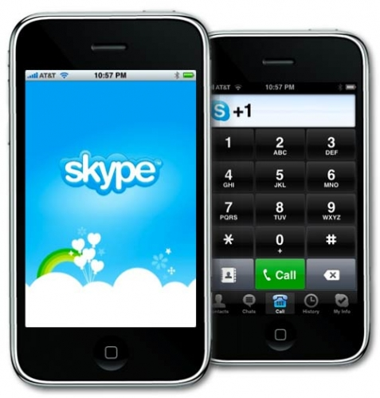
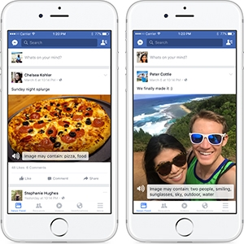

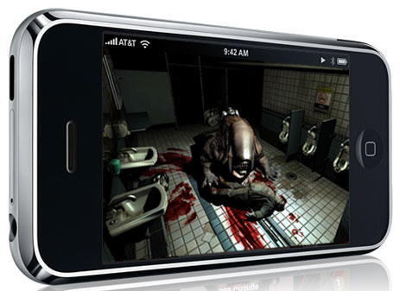
What are the potential applications… endless…

Slide 7
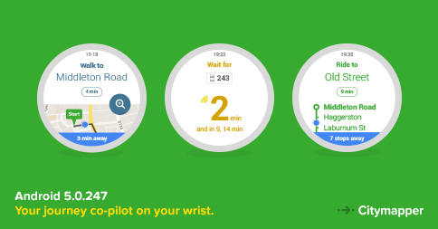
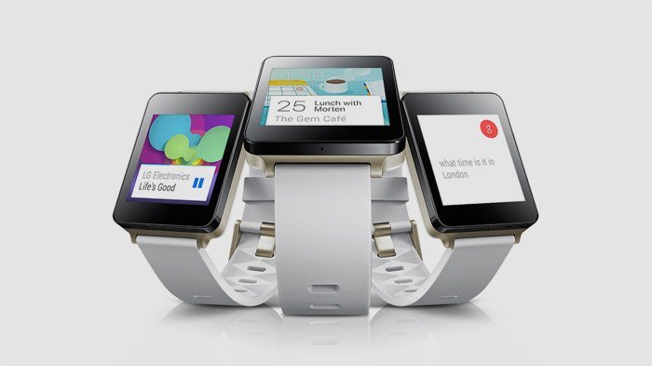
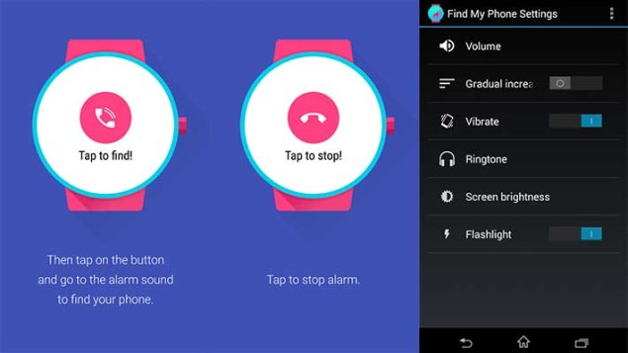
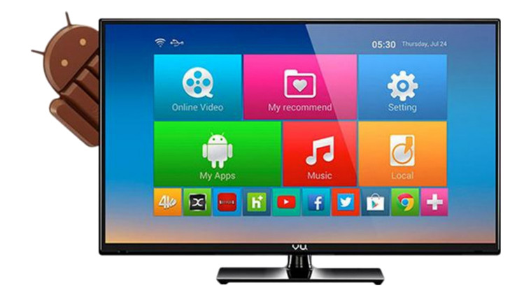

Things become more complicated with other mobile devices
Smart watches
Android Glass
Smart Android TV

Slide 8
Ok! Tell me what the course contents are
Primer to the Android platform
User interfaces
design UI elements using xml (Android)
event driven programming (listeners and delegates)
Programming sensors
accelerometers, compass, GPS
Networking
radios, sockets, and http data transfer
Localization
map services
Storage
local storage and sqllite
Cloud services
Google web services
Android wear APIs for smart watches

Slide 9
Is this course for me?
Should have knowledge of object-oriented programming.
Knowledge of Java or some other OOP language is a must!
Should have working knowledge of networking and operating system concepts
This is not a book-oriented course. There are lots of online resources that you can leverage

Slide 10
How will I be graded?
Individual Assignments (3 total) (35 points)
Different semantics for evaluation
In-class midterm (20 points)
Testing design skills and mobile programming skills
Final project groups that would be determined later (35 points)
We will have a poster/demo session
Attendance (10 points)
Recorded through in class exercises

Slide 11
Assignments
Three assignments on design problems
Involve coding for the Android
Groups of one solving the assignments
Grading
Source code (7 points)
Video --- every group will make a video of their assignment and upload it on youtube. (3 points)
Further instructions for submission as we float the assignments.

Slide 12
Midterm
In-class midterm
Design and coding problems
Grading
20 points towards final grade

Slide 13
Group Project will be in combination with students in Fine arts
We will have a joint session to form groups of 4 CS/CE students and 2 Fine Arts students
Discuss the projects that you can build
Idea is to have CS/CE students implement the application and the design students design the UI
Every group will be given a Tablet and a Sony Smartwatch
There would be an intermediate lecture from the Center of Entrepreneurship on campus to discuss how you can choose projects that have societal impact.
Working demo by the end of the semester
Poster/demo session at the end of class
Showcase your apps to people in the university

Slide 14
Lecturing style
Demo-oriented Lecturing
bring your laptops and mobile phones
In-class assigments
Once we have learnt the concepts we will read a couple of application oriented papers from conferences like MobiSys

Slide 15
Resources you will need
Android Studio
I will go through the installation process today.
Mobile Phones
Android phones or tablets (for the individual assignments)
Android wear devices (I will provide one Sony Smartwatch per group)
Google developer’s account to access the google webservices

Slide 16
Administrivia…
Course webpage and reading list
www.csee.umbc.edu/~nilanb/teaching/628/
My email id: nilanb@umbc.edu
Discussion Group
Piazza (I will send out the invites before next lecture)
Class hours: 1:00pm – 2:15 pm (Tuesday, Thursday)
Office hours: TBD
TA : Siraj Menon
Office hours: TBD.

Slide 17
Let me show you what to install to get started.
Primer on installation of the Android toolkit.
Start on developing a simple Android app.

Slide 18
CMSC 628: Introduction to Mobile Computing
Nilanjan Banerjee
University of Maryland
Baltimore County
nilanb@umbc.edu
http://www.csee.umbc.edu/~nilanb/teaching/628/
Introduction to Mobile Computing

