Slide 1
CMSC 628: Introduction to Mobile Computing
Nilanjan Banerjee
University of Maryland
Baltimore County
nilanb@umbc.edu
http://csee.umbc.edu/~nilanb/teaching/628/
Introduction to Mobile Computing

Slide 2
Announcement
Everyone must have received a piazza invitation.

Slide 3
Today and Next (possibly) lecture
Try to understand what is an Activity, Intent.
Build a simple mobile app from scratch
Start a new activity
Build simple UI elements such as EditText, Button
Add EventListeners to UI elements
Learn about the lifecycle of the app
Compile and run the app.
Build a little more complex app
Has two activities
Use Intent to start a new activity
Pass data between two activities

Slide 4
Cookbook to developing an app
How many screens does the app have?
What does each screen look like?
What is the intent/need for each screen?
What resources do you need to implement each screen?
Manage the transition between the screens

Slide 5
Activities
Typically corresponds to one UI screen
But they can be
Faceless
A floating window
Return a value
Typically a complex application will have multiple activites
E.g., email application
Activity 1: log in page
Activity 2: displaying a set of email
Transfer data between activities
Usually form a bundle and pass it around (we will talk about in detail)

Slide 6
Intents
A description of what you want done… something like a verb
E.g. Intent of a music player is to PLAY
Intents are of two types – Implicit and Explicit
Explicit
Application states what it needs
Implicit
System decides for you which application/component can best respond to the Intent.
You just specify what the Intent is.

Slide 7




Intents
Home
Picasa
Photo Gallery
Contacts
“Pick photo”
GMail
Client component makes a request for a specific action
System picks best component for that action
Chat
New components can use existing functionality
Blogger
Blogger

Slide 8
Resources
Utilities that an application uses and “reuses”
Strings, colors, dimensions, style/theme
.

Slide 9
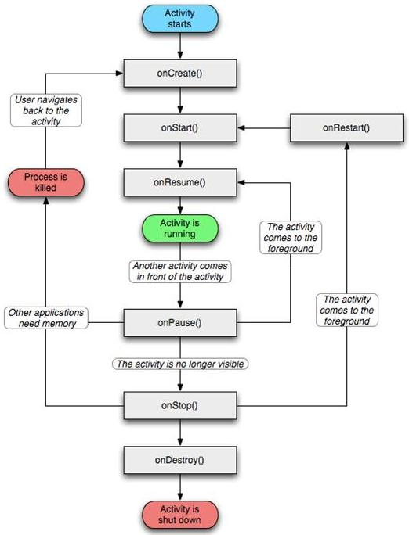
Application lifecycle

Slide 10
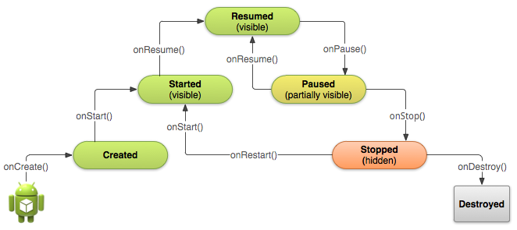
Starting an activity
Activity starts
onCreate(), onStart(), onResume() are called in succession
onStart()
Activity is partially visible
Ack: Android Development website

Slide 11
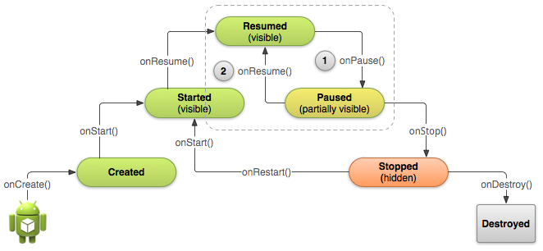
Pausing and Resuming an Activity
How is pausing defined?
If an activity is partially visible in the background
Dialog boxes open up
Method called is onPause()
What should you do before an activity pauses
save state of the application?
release resources

Slide 12
Stopping and Starting an Activity
How is stopping an activity defined?
If the activity is not visible
Press back or home button
Start a new activity or receive a phone call
What should you do before an activity stops
save state of the application?
release resources
System destroys
the activity

