Slide 1
CMSC 628: Introduction to Mobile Computing
Nilanjan Banerjee
University of Maryland
Baltimore County
nilanb@umbc.edu
http://csee.umbc.edu/~nilanb/teaching/628/
Introduction to Mobile Computing

Slide 2
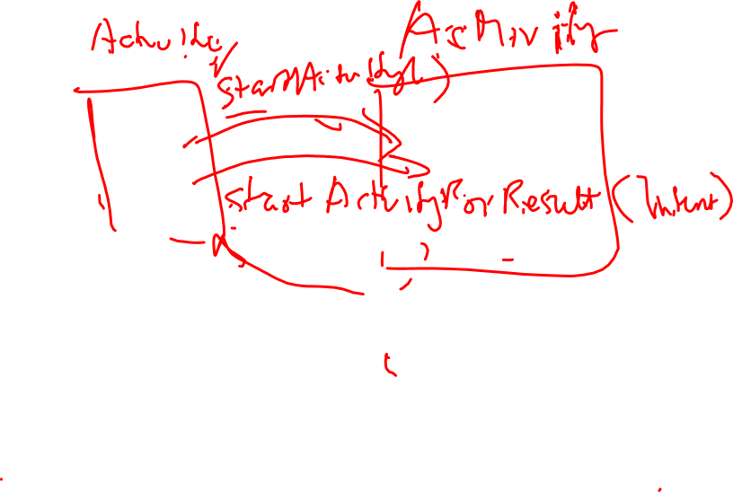

Slide 3
Today’s lecture
Android Lifecycle
Activity starts up
Activity suspends and resumes
Activity is stopped and restarted.

Slide 4
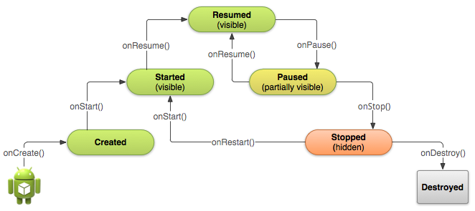
Starting an activity
Activity starts
onCreate(), onStart(), onResume() are called in succession
onStart()
Activity is partially visible
Ack: Android Development website

Slide 5
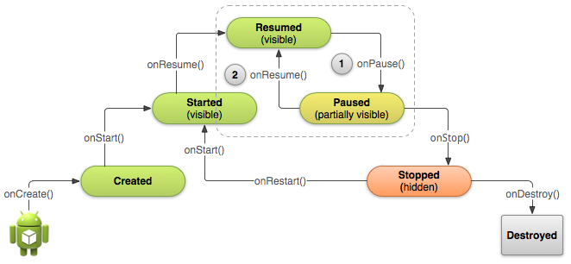
Pausing and Resuming an Activity
How is pausing defined?
If an activity is partially visible in the background
Dialog boxes open up
Method called is onPause()
What should you do before an activity pauses
save state of the application?
release resources

Slide 6
Stopping and Starting an Activity
How is stopping an activity defined?
If the activity is not visible
Press back or home button
Start a new activity or receive a phone call
What should you do before an activity stops
save state of the application?
release resources
System destroys
the activity

Slide 7
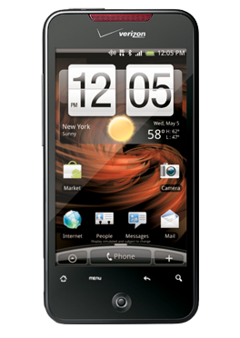
Android Sensors
Android Sensors:
MIC
Camera
Temperature
Location (GPS or Network)
Orientation
IMU
Proximity
Pressure
Light

Slide 8
Two types of sensors on the android platform
Hardware sensors
Physical sensors present on the phone
Accelerometers, temperature, gyroscope
Software sensors
Virtual sensors that are built on top of hardware sensors.
Orientation sensors
accelerometer + gyroscope

Slide 9
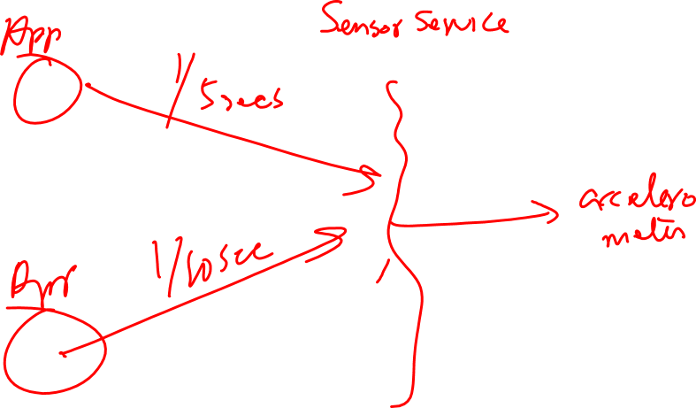

Slide 10
Async Callbacks
Android’s sensors are controlled by external services and only send events when they choose to
An app must register a callback to be notified of a sensor event
Each sensor has a related XXXListener interface that your callback must implement
E.g. SensorListener LocationListener
Your App
SensorManager
Register Callback
Sensor Event
Sensor Event
Sensor Event

Slide 11
Getting the Relevant System Service
The non-media (e.g. not camera) sensors are managed by a variety of XXXXManager classes:
LocationManager (GPS)
SensorManager (accelerometer, gyro, proximity, light, temp)
The first step in registering is to obtain a reference to the relevant manager
Every Activity has a getSystemService() method that can be used to obtain a reference to the needed manager
public class MyActivity … {
private SensorManager sensorManager_;
public void onCreate(){
…
sensorManager_ = (SensorManager) getSystemService(SENSOR_SERVICE);
}
}

Slide 12
Registering for Sensor Updates
The SensorManager handles registrations for
Accelerometer, Temp, Light, Gyro
In order for an object to receive updates from a sensor, it must implement the SensorEventListener interface
Once the SensorManager is obtained, you must obtain a reference to the specific sensor you are interested in updates from
The arguments passed into the registerListener method determine the sensor that you are connected to and the rate at which it will send you updates
public class MyActivity … implements SensorListener{
private Sensor accelerometer_;
private SensorManager sensorManager_;
public void connectToAccelerometer() {
sensorManager_ = (SensorManager)getSystemService(SENSOR_MANAGER);
accelerometer_ = sensorManager_
.getDefaultSensor(Sensor.TYPE_ACCELEROMETER);
sensorManager_.registerListener(this, accelerometer_,
SensorManager.SENSOR_DELAY_NORMAL);
}

Slide 13
The SensorEventListener Interface
Because there is one interface for multiple types of sensors, listening to multiple sensors requires switching on the type of event (or creating separate listener objects)
Also forces registration at the same rate per listener
Simple approach:
public class MyActivity … implements SensorListener{
// Called when a registered sensor changes value
@Override
public void onSensorChanged(SensorEvent sensorEvent) {
if (sensorEvent.sensor.getType() == Sensor.TYPE_ACCELEROMETER) {
float xaccel = sensorEvent.values[0];
float yaccel = sensorEvent.values[1];
float zaccel = sensorEvent.values[2];
}
}
// Called when a registered sensor's accuracy changes
@Override
public void onAccuracyChanged(Sensor arg0, int arg1) {
// TODO Auto-generated method stub
}
}

Slide 14
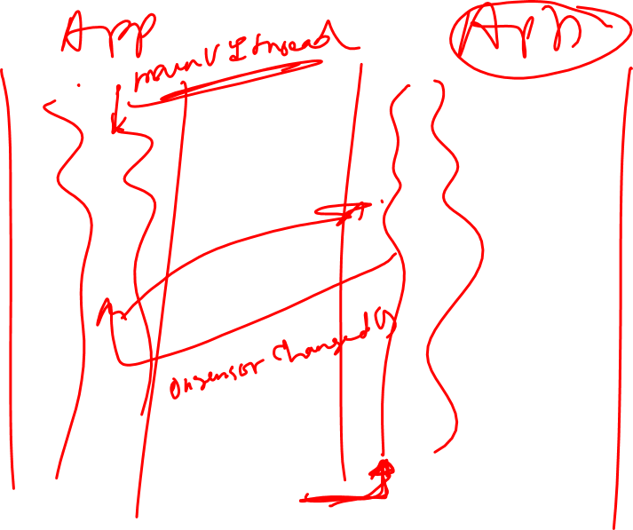

Slide 15
The SensorEventListener Interface
Another approach for multiple sensors (probably better):
public class MyActivity … {
private class AccelListener implements SensorListener {
public void onSensorChanged(SensorEvent sensorEvent) {
…
}
public void onAccuracyChanged(Sensor arg0, int arg1) {}
}
private class LightListener implements SensorListener {
public void onSensorChanged(SensorEvent sensorEvent) {
…
}
public void onAccuracyChanged(Sensor arg0, int arg1) {}
}
private SensorListener accelListener_ = new AccelListener();
private SensorListener lightListener_ = new LightListener();
…
public void onResume(){
…
sensorManager_.registerListener(accelListener, accelerometer,
SensorManager.SENSOR_DELAY_GAME);
sensorManager_.registerListener(lightListener, lightsensor,
SensorManager.SENSOR_DELAY_NORMAL);
}
public void onPause(){
sensorManager_.unregisterListener(accelListener_);
sensorManager_.unregisterListener(lightListener_);
}

Slide 16
Android System Services
Each App runs in its own process
Each Android system service, such as the SensorManager, also runs in its own thread
This has important implications:
Communication with the system services is through IPC
The thread that delivers an event will be a special thread that is dedicated to processing incoming IPC calls
If you directly update the GUI from any thread other than the display thread, bad things happen

Slide 17
How to Update the GUI with Sensor Data
Android has a built in mechanism for queuing work that needs to be run on the display thread
The Handler class allows you to create a queue inside of your Activity that can store work for the display thread
You create a handler once and then post work to it
public class MyActivity … implements SensorListener{
private class AccelWork implements Runnable {
private Location data_;
public AccelWork(Location d){data_ = d;}
public void run(){
//do something with the data to the GUI
}
}
private Handler myHandler_ = new Handler();
// Called when a registered sensor changes value
@Override
public void onSensorChanged(SensorEvent sensorEvent) {
AccelWork work = new AccelWork(sensorEvent);
myHandler_.post(work);
}
}

Slide 18
How to Update the GUI with Sensor Data
The lazy approach
public class MyActivity … implements SensorListener{
private Handler myHandler_ = new Handler();
// Called when a registered sensor changes value
@Override
public void onSensorChanged(final SensorEvent sensorEvent) {
myHandler_.post(
new Runnable(){
public void run(){
//do something with the sensorEvent data
//to the gui
}
}
);
}
}

Slide 19
Android System Services (some topics we will cover later)
How do I run the SensorManager in a separate thread
How do I update the UI thread from a separate thread

Slide 20
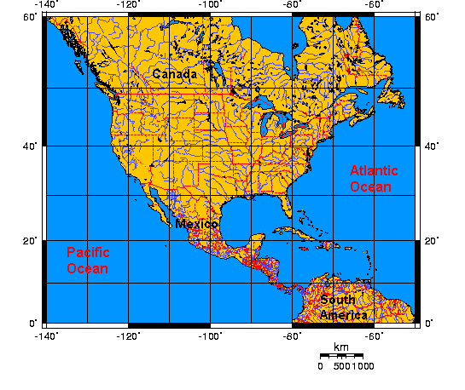


What is localization, aka location?
absolute location
(lat, long)
relative location
context location

Slide 21



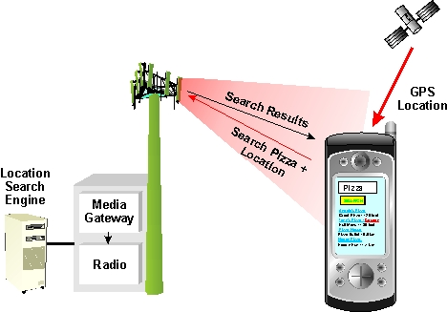

Why should I care about localization?
social application
advertisements
podcasting

Slide 22
Registering for Location Updates
The LocationManager handles registrations for GPS and network location updates
In order for an object to receive updates from GPS, it must implement the LocationListener interface
Once the LocationManager is obtained, an object registers for updates by calling requestLocationUpdates (there are multiple versions you can use)
The arguments passed into the requestLocationUpdates method determine the granularity of location changes that will generate an event
send updates that are at least X meters apart
send updates at least this far apart in time
send updates that have this minimum accuracy
public class MyActivity … implements LocationListener{
private LocationManager locationManager_;
public void onCreate(){
…
locationManager_ = (LocationManager) getSystemService(LOCATION_SERVICE);
locationManager_.requestLocationUpdates(LocationManager.GPS_PROVIDER, 10,
Criteria.ACCURACY_FINE, this);
}
}

Slide 23
Location Providers
The phone’s location can be determined from multiple providers
GPS
Network
GPS location updates consume significantly more power than network location updates but are more accurate
GPS: 25 seconds * 140mA = 1mAh
Network: 2 seconds * 180mA = 0.1mAh
The provider argument determines which method will be used to get a location for you
You can also register for the PASSIVE_PROVIDER which only updates you if another app is actively using GPS / Network location
public class MyActivity … implements LocationListener{
private LocationManager locationManager_;
public void onCreate(){
…
locationManager_ = (LocationManager) getSystemService(LOCATION_SERVICE);
locationManager_.requestLocationUpdates(LocationManager.PASSIVE_PROVIDER, 10,
Criteria.ACCURACY_FINE, this);
}
}

