Slide 1
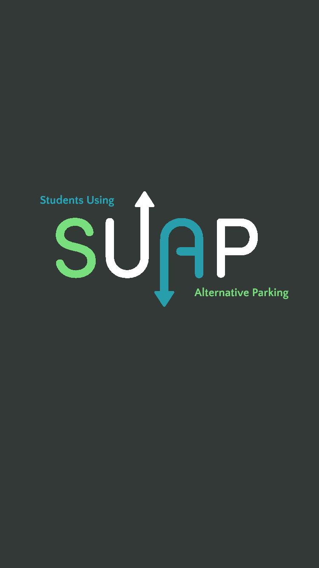
CMSC 628
INTRODUCTION TO MOBILE COMPUTING
-TEAM # 10

Slide 2
Motivation:
Do you commute to campus?
Have you ever had a problem finding a parking spot?
How long have you searched for a parking spot?
Have you ever been late to or missed classes because you couldn’t find a parking spot?
Problem Statement:
Driving from lot to lot, circling like vultures and even stalking other students in a desperate attempt
to find parking should sound familiar if you commute to campus.
Although there are many parking apps out there, we found it specific and personal to have one for
UMBC students since we know how difficult it could get to find a spot during peak hours.

Slide 3
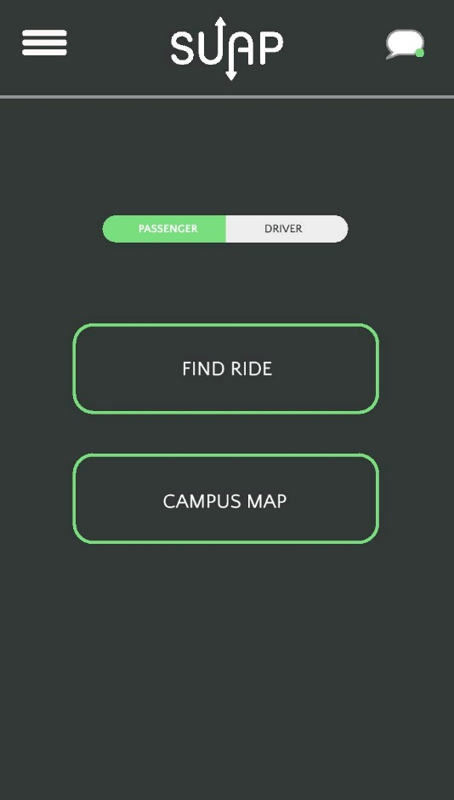
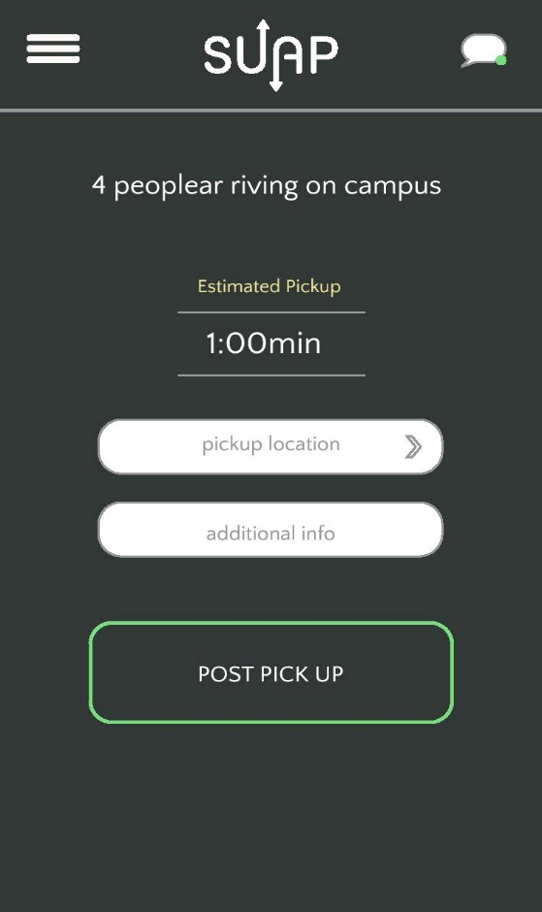
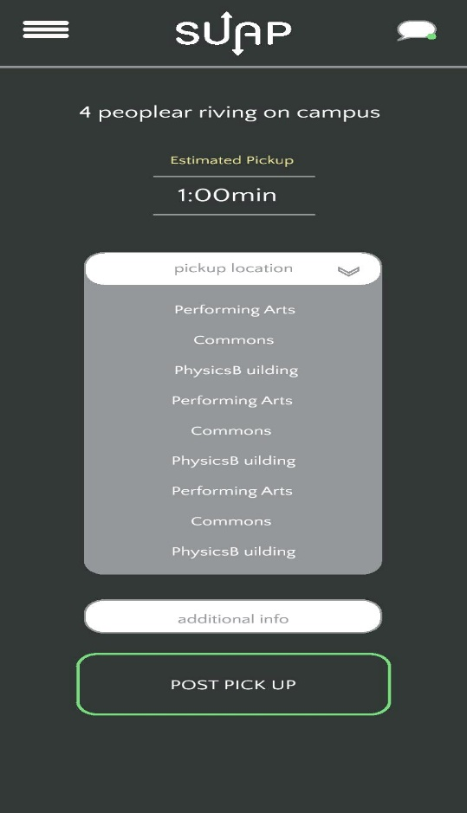
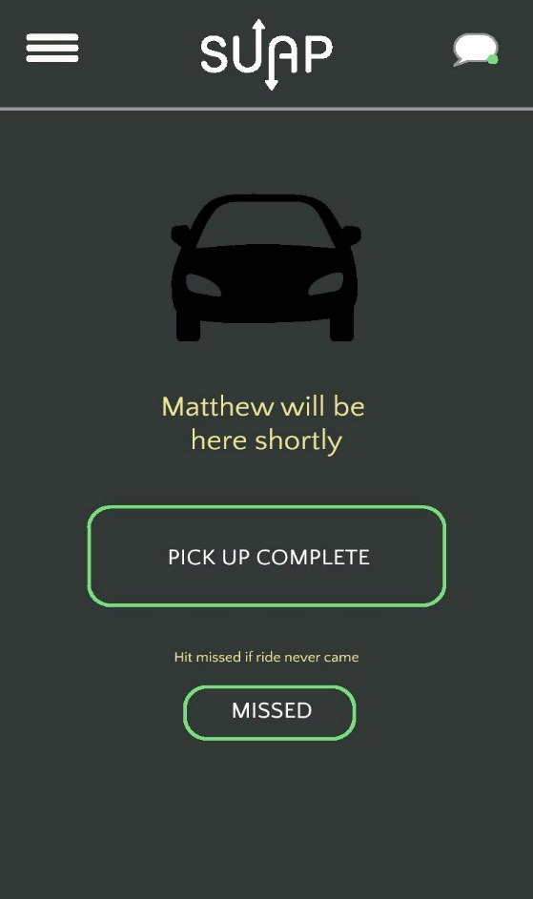
PASSENGER MODULE
A cool app for hitching a ride and getting parking during peak hours
UMBC specific
Two categories of users:
Looking for parking - Drivers
Need a ride to their car - Passengers

Slide 4
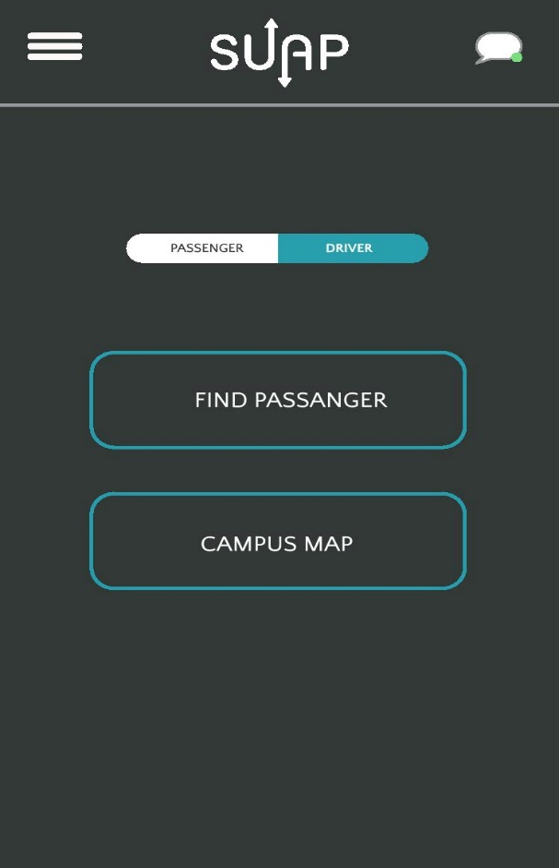
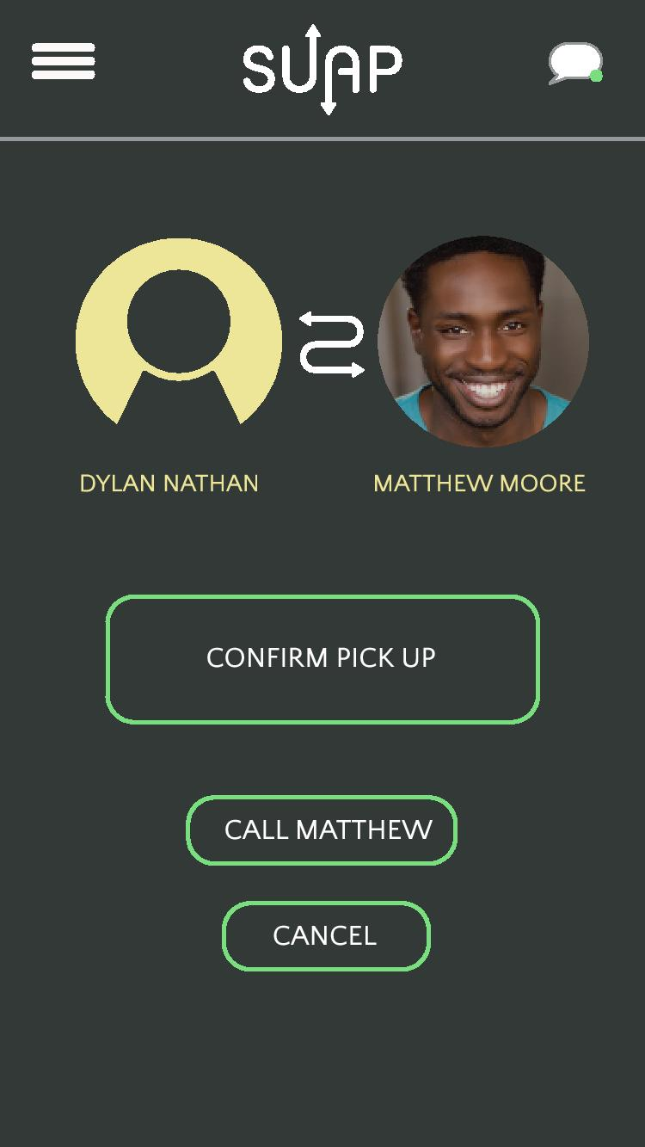
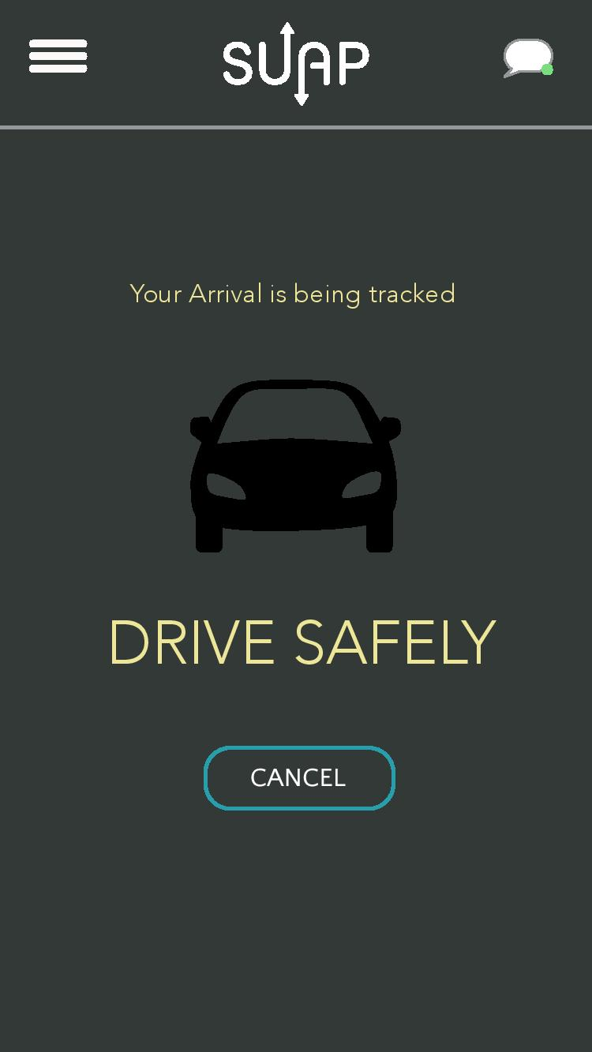
DRIVER MODULE
Auto – Match Suapers based on parking permits
Once connected - display map with ETA and pick up location

