Slide 1
Graphical Abstract
Generated by AI

Slide 2
Research Summary
This paper summarized RAG models, including evolution, paradigms, technical paradigms, and discussion and future prospects. Through summarizing, this paper could help readers and professionals have a comprehensive understanding of RAG models and their applications in NLP.

Slide 3
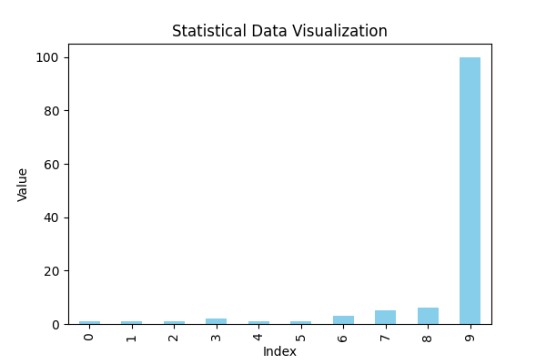
Graphical Data

