Slide 1




Famtality
Healthier, Longer, Better Lives for Families

Slide 2

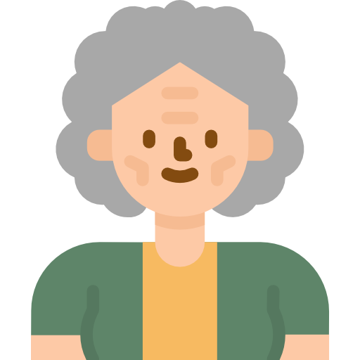


Chung’s Family Story
Strong health and insurance awareness
Brought the 1st medical insurance product 12 years ago
Exercises regularly
Weak health and insurance awareness
Never buy any insurance product
Got stroke 2 years ago
Relying on public healthcare for Rehab
Mr. Chung
Chung’s mother

Slide 3
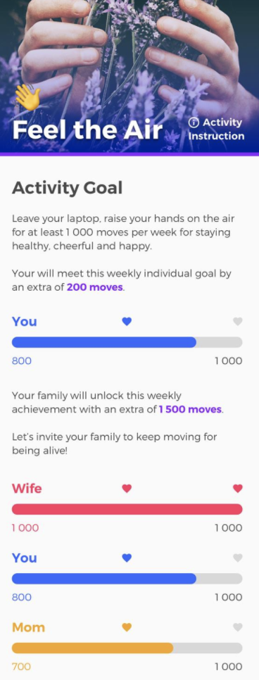

Problem and Solution
Low Awareness of
Family Health and Insurance Protection
We would like to use Gamification
to extend Health and Insurance Awareness
From Personal to Family Level

Slide 4
Validation
By analyzing 6,747 users data from AIA Vitality Dataset
The average age is 37.4 (majority young people)
Average exercise hours are 2.88 hrs/week (Recommended: 3.75 hrs/week)
40% of users have an intention to loss weight
Family-based Physical Challenges
to target the whole FAMILY
Get Healthier
is an attractive theme
Notes:
3.75 hours / week – for

Slide 5

Benefits for Stakeholders
Company
Family protection product line
More business - family member referral
Broader DataSet (non client) for better business decision
Royalty Stickiness
Customer and Family
Promote Family communication, bonding
Know Your Health – Monitor, Body check, Precaution
Incentive – discount, movie tickets, coupons….
Discounted insurance plan
Intermediaries
More business
Reconnect with client – review policy
Referral opportunities

Slide 6
RoadMap
Phase 1 – Existing individual clients
Warm referral business
Get family members onboard
Phase 2 - Corporate clients
Phase 3 - Launch to General Public
Self sustainable eco-system ( open for venders provide services, Startup offer IoT/innovative ideas to track user data)
Innovative digital customer engagement channel
Notes:
3.75 hours / week – for

