Slide 1
Famtality
Healthier, Longer, Better Lifes

Slide 2
Finding
Total data | 6,747
Male | 57.8%
Female | 43.0%
Avg age | 37.4 |  | +
Intention
Lose Weight | 40% |  | +
Exe | 2.88hr/wk |  | +
Avg Age 37.4 (Mid aged)
youngster/ silver age <- Opportunity
Most of people (40%) intended to loss weight
2.88 hr / wk exercise which is lower then recommended.

Slide 3
Our Products and Services
運用不同裝置特色，規劃個人化保單的能力：保險科技驅動下的保險市場，個人化、客製化的保險產品將會大行其道，因此，保險公司必須要有跨界產品規劃的能力，運用物聯網及不同智慧連網裝置的特色，結合客戶的需求，提供差異化、客製化的高附加價值的保險產品及服務組合。
將來自不同裝置資訊，即時蒐集及整合與跨域數據分析的能力：通過不同的數據分析可以獲得客戶洞見，提供正確決策與差異化服務的參考
Market entry strategies
Product and brand launch
Competitive intelligence data
Market analysis,
review and monitoring

Slide 4
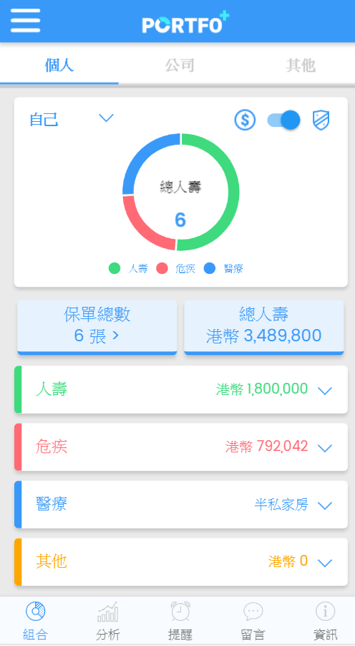


Family Member
Family Member
Exciting Vitality Customer
Family Member
Family Member

Slide 5
UI - Demo

Slide 6
for AIA business:
  Increase business prospect - family member
  Promote family health – less claim
  Analysis collected data for better business decision
  Family protection product line
for Family:
  Game: communication / family bonding
  Reduced premium
  Incentive – movie ticket/insurance plan discount
  Know your health – Precaution
  Free Body check: Montior health
For Agent:
  Reconnect with client – review policy
  Referral opportunities

Slide 7
Worth mention:
「AIA Vitality」過去12個月增加超過60%。
UBI(Usage Based Insurance) –
Big Data Analysis – Accurate prediction
Underwrite base on data
Personalize 個人化
Customization

Slide 8
Our Strengths
Durable goods
Electronics
Healthcare
Foods
Consumer Goods and Services
Global Data
Research Network
Benchmarking
Brand intelligence
Trends
Industry and Technology Markets
Finance
B2B Services
Machinery
Media
Trade

