Slide 1


Famtality
Healthier, Longer, Better Lives for Families

Slide 2

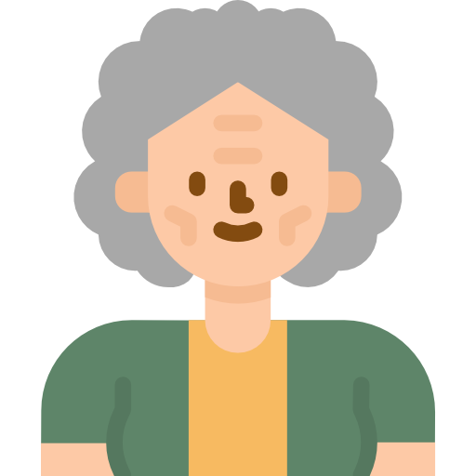


Chung’s Family Story
Strong health and insurance awareness
Had his first medical insurance product 12 years ago
Exercises regularly
Weak health and insurance awareness
Never buy any insurance product
Got stroke 2 years ago
Relying on public healthcare for Rehab
Mr. Chung
Chung’s mother

Slide 3
Problem and Solution
Low Awareness of
Family Health and Insurance Protection
We would like to use Gamification
to extend Health and Insurance Awareness
From Personal to Family Level
One Screenshot to Demo

Slide 4
Validation
By analyzing 6,747 users data from AIA Vitality Dataset
The average age is 37.4 (i.e. majority young people)
Average exercise hours are 2.88 hrs/week (Recommended: 3.75 hrs/week)
40% of users have an intention to loss weight
We would like to demonstrate
How to use Family-based Physical Challenges
to make the whole family Get Healthier
Notes:
3.75 hours / week – for

Slide 5
Reward Mechanism
Games
Rewards
Existing Customers
New Customers

Slide 6

Benefits for Stakeholders
Insurance Service Provider
Customer and Family
Insurance Agent

