Slide 1
AngularJS Lab

Slide 2
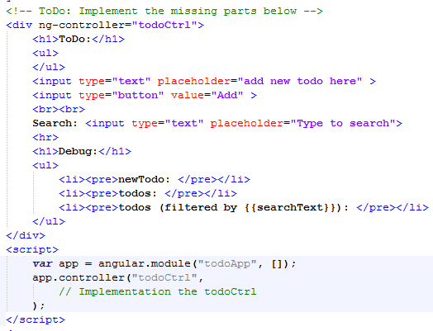
Tasks
todoApp_skeleton.html
Complete the missing features to make an interactive Angular Todo App
The TA will demo the solution in a web browser

Slide 3
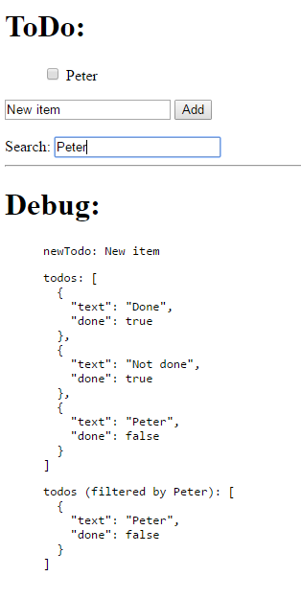
Key references and expected output
Key references
Scope: https://docs.angularjs.org/guide/scope
Filter: https://docs.angularjs.org/guide/filter
Controller: https://docs.angularjs.org/guide/controller
Expected output

