Slide 1

Multi-Receiver Real-time Physical Intrusion Detection “Burglar Alarm” with GNU Radio and USRP N310
PRESENTED BY -
HIMANSHU KUMAR - 24SP06015
SHUBHAM GUPTA - 24SP06001

Slide 2
SYSTEM OVERVIEW: BURGLAR ALARM USING USRP B210
The burglar alarm works by:
Transmitting a known signal pattern.
Receiving the reflected signal (due to movement/obstacle change).
Detecting anomalies (using peak detector & thresholding).
Triggering an alarm (via audio tone or digital trigger).

Slide 3
LOGIC BEHIND BURGLAR DETECTION
No Movement → Signal reflects back identically → No large peaks.
Intrusion/Movement → Signal gets disrupted → Peak detector triggers.
Thresholding + Binary Slicing → Clean 0/1 logic → Sends 1 to multiplier.
Tone × 1 → Audible alarm only when intrusion is detected.

Slide 4
TRANSMITTER SIDE (Signal Emission)
Block | What It Does | Why It's Needed | How It Helps in Burglar Alarm | Input Parameters
Signal Source | Generates a baseband tone (1 kHz cosine) | Acts as the known signature signal | Repeated waveform is easy to detect when reflected | Sample Rate: 1.92M — Frequency: 1kHz — Amplitude: 100
Constellation Modulator (QPSK) | Modulates signal | For realistic wireless transmission | Adds noise-resilience and better spectrum usage | Constellation: QPSK — Diff Encoding: No — Samples/Symbol: 10 — Excess BW: 350
Interpolating FIR Filter | Upsamples signal | Needed for SDR transmission (higher rate) | Aligns symbol rate with USRP hardware | Interpolation: 8 — Taps: 32
QT GUI Time Sink | Visual monitor of TX waveform | For debugging and visualization | Confirms signal generation is correct | Points: 1024 — Sample Rate: 1.92M
UHD: USRP Sink | Sends signal via B210 over the air | Interface to RF hardware | Transmits QPSK signal to environment | Device: USRP B210 — Center Freq: 2.4 GHz — Sample Rate: 1.92M

Slide 5
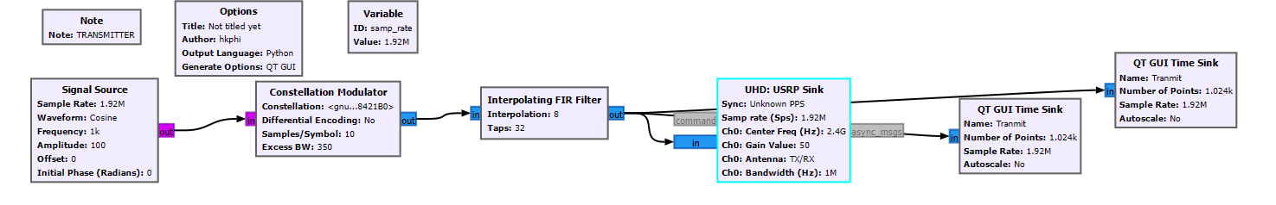

Slide 6
RECEIVER SIDE (Detection )
Block | What It Does | Why It's Needed | How It Helps in Burglar Alarm | Input Parameters
UHD: USRP Source | Captures environment signal | Interface to B210 | Receives back reflected signal | Center Freq: 2.4 GHz — Sample Rate: 1.92M — Gain: 50
AGC | Automatic Gain Control | Handles variable amplitude | Adapts to distance/movement intensity | Rate: 100u — Max Gain: 65536 — Ref: 1 — Gain: 10
QT GUI Time Sink | See received signal | For debugging | Checks if environment is reflecting signal | Points: 1024 — Sample Rate: 1.92M
File Sink | Store received signal to K.dat | For offline analysis (optional) | Helps with post-event analysis | Path: K.dat — Unbuffered: False
Multiply | Mixes received with internal LO | Frequency translation | Helps downconvert for baseband processing | Inputs: RX × Local Oscillator
Decimating FIR Filter | Downsamples | Match processing rate | Reduces processing load | Decimation: 16 — Taps: 64
Root Raised Cosine Filter | Matched filtering | Reduce ISI | Clean up modulated signal | Gain: 1 — Symbol Rate: 1 — Alpha: 0.35 — Taps: 21.12M
Symbol Sync | Extract symbols | Symbol timing recovery | Converts stream into meaningful bits | TED: Mueller & Muller — Sps: 10 — Damping: 1 — Output Sps: 1
Costas Loop | Carrier synchronization | QPSK demodulation | Removes phase offset | Loop BW: 0.05 — Order: 2
Constellation Decoder | Symbol-to-bit conversion | Final demapping | Gives bitstream to analyze activity | Constellation: QPSK

Slide 7
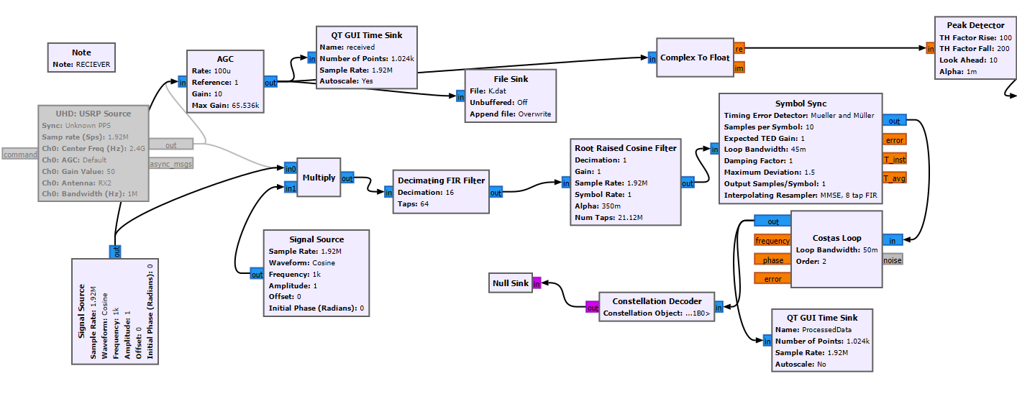

Slide 8
RECIEVER SIDE (ALARM)
Block | What It Does | Why It's Needed | How It Helps in Burglar Alarm | Input Parameters
Null Sink | Discards bitstream | No further bit decoding | Just confirming reception | Data Type: char
Complex to Float | Splits I/Q for peak detection | Required for further analysis | Analyze amplitude envelope | Input: AGC output
Peak Detector | Finds energy spikes | Detect motion/intrusion | Triggers when reflection pattern changes | TH Rise: 100 — TH Fall: 200 — Alpha: 1m — Look Ahead: 10
Threshold | Binarizes peak output | Intrusion logic | Movement = peak above threshold | Low: -200 — High: 200 — Initial: 0
Binary Slicer | Converts analog to binary | For clean detection | Eliminates small noise | Input: Thresholded float
UChar to Float | Converts bits to float | For audio or further logic | Needed for scaling | Input: Binary bitstream
Signal Source (Cosine) | Tone generator for alert | Alarm sound tone | Acts as alarm bell | Sample Rate: 1.92M — Frequency: 1kHz — Amplitude: 100
Multiply | Mix tone with motion bit | Audio trigger logic | Plays tone only on intrusion | Input: Tone × Binary
Audio Sink | Plays sound | Final output | Audible alarm to user | Sample Rate: 1.92M
QT GUI Time Sink (Processed) | Final view of Costas output | Debugging | Helps analyze locked carrier | Points: 1024 — Sample Rate: 1.92M

Slide 9
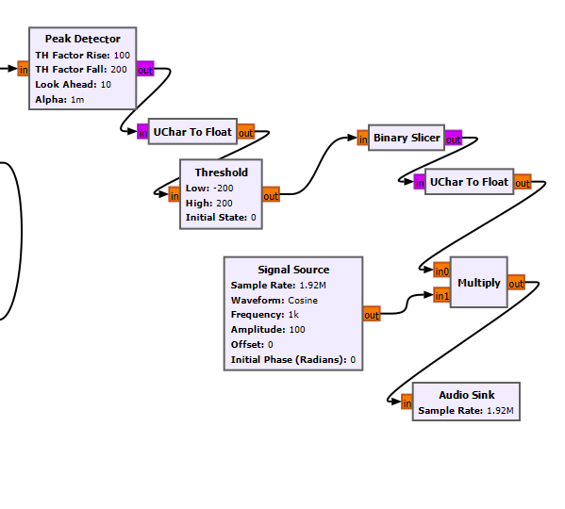

Slide 10
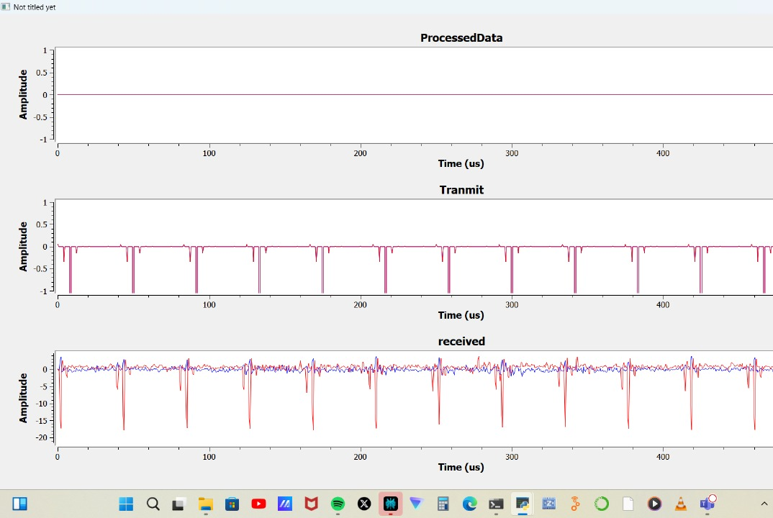
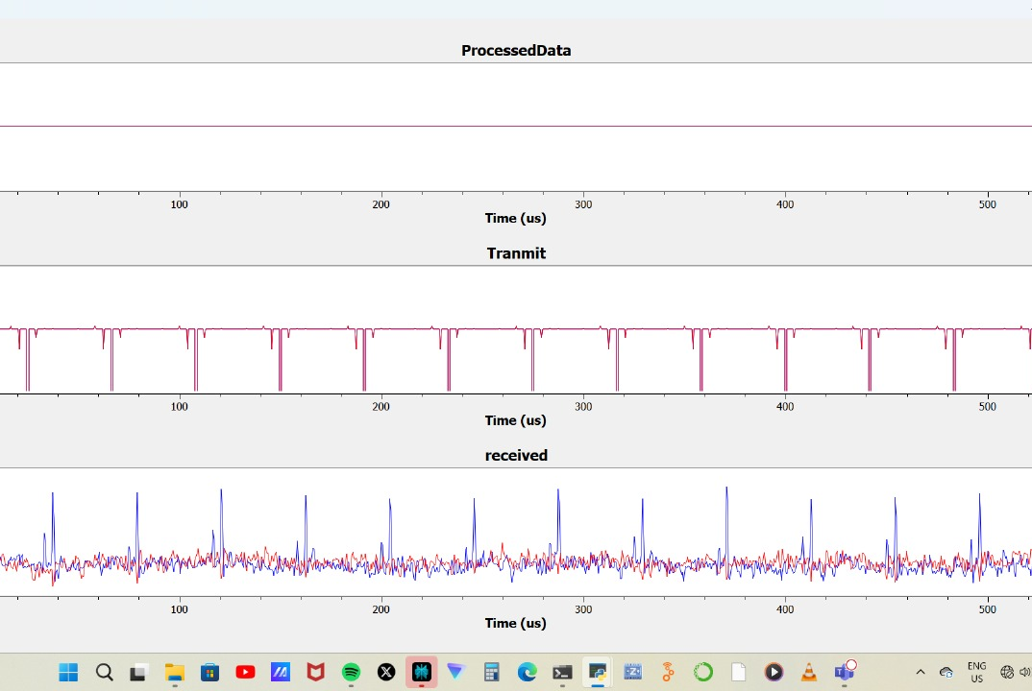
RESULTS

Slide 11
WHY USRP B210?
Dual-channel SDR (can support MIMO or separate TX/RX antennas).
Wide RF range: 70 MHz to 6 GHz → Good for ISM band (2.4 GHz in this case).
Compatible with GNU Radio → Perfect for prototyping real-time systems.
USB 3.0 interface → High-speed streaming for real-time processing.

Slide 12
Extension Ideas !
Use machine learning on the K.dat recordings for intelligent classification.
Add SMS/email alert when intrusion is detected.
Integrate directional antennas to focus surveillance region.

Slide 13

THANK YOU !

