Slide 1
SHIZUNE MATCHA
Product Naming
Consultation
Brand overview, grade naming structure, and label text discussion
March 2026

Slide 2
01
BRAND OVERVIEW
Brand Philosophy
Market & Positioning
Stillness / Serenity / Elegance
SHIZUNE (静音) is a premium Japanese matcha brand built on the concept of quiet elegance. Not a commodity tea product, but a contemporary Japanese premium brand.
Primary Market: United States (now on sale) Canada&Singapore (soon)
Target Audience: Health-conscious, design-savvy consumers who value authenticity over price
Price Range: $24 – $44 (40g)
Channels: Amazon US, Shopify DTC
https://www.amazon.com/gp/product/B0FR4MFY3B
https://shizunematcha.com/

Slide 3
02
PRODUCT LINEUP
Select Grade
Reserve Grade
Prestige Grade
Shizuoka
Kagoshima
Uji, Kyoto
$24 / 40g
$34 / 40g
$44 / 40g
Premium daily matcha.
Carefully selected quality
for everyday enjoyment.
Special reserve matcha.
Deeper flavor and aroma.
Considering Organic.
The pinnacle of matcha.
Uji tradition and prestige.
Small-batch excellence.
40g can / 80g bag
40g can / 80g bag (TBD)
40g can only

Slide 4
03
GRADE NAMING RATIONALE
Select
"Carefully chosen." Communicates quality commitment while naturally implying that higher tiers exist above it.
Changed from "Essential" after Amazon reviews showed customers misread it as "basic = low quality."
Reserve
Widely understood in the wine & spirits industry. American consumers intuitively recognize it as "a cut above standard."
Familiar to US consumers from wine labels (e.g., Reserve Cabernet).
Prestige
Clearly signals the highest tier. Matches the historical prestige of Uji matcha and its centuries-old reputation.
Uji is the birthplace of Japanese tea culture.
Discussion: Do these grade names feel natural and intuitive to a US consumer? Any concerns?

Slide 5
04
NAMING ALTERNATIVES CONSIDERED
Candidate | Considered For | Status | Reason
Essential | Entry tier (Shizuoka) | Replaced | Misread as "basic = low quality" by customers
Harvest | Entry tier (Shizuoka) | Rejected | Too agricultural, lacks premium feel
Superior | Mid tier | Rejected | Implies "best" — contradicts having a tier above
Signature | Mid tier | Rejected | Decent, but Select communicates quality more directly
Select | Entry tier (Shizuoka) | Adopted | "Carefully chosen" — quality-focused, no ceiling conflict
Reserve | Mid tier (Kagoshima) | Adopted | Wine/spirits convention, intuitive for US market
Prestige | Top tier (Uji, Kyoto) | Adopted | Unmistakably top-tier, matches Uji heritage
Discussion: Are there other grade names we should consider? What impressions do these names give?

Slide 6
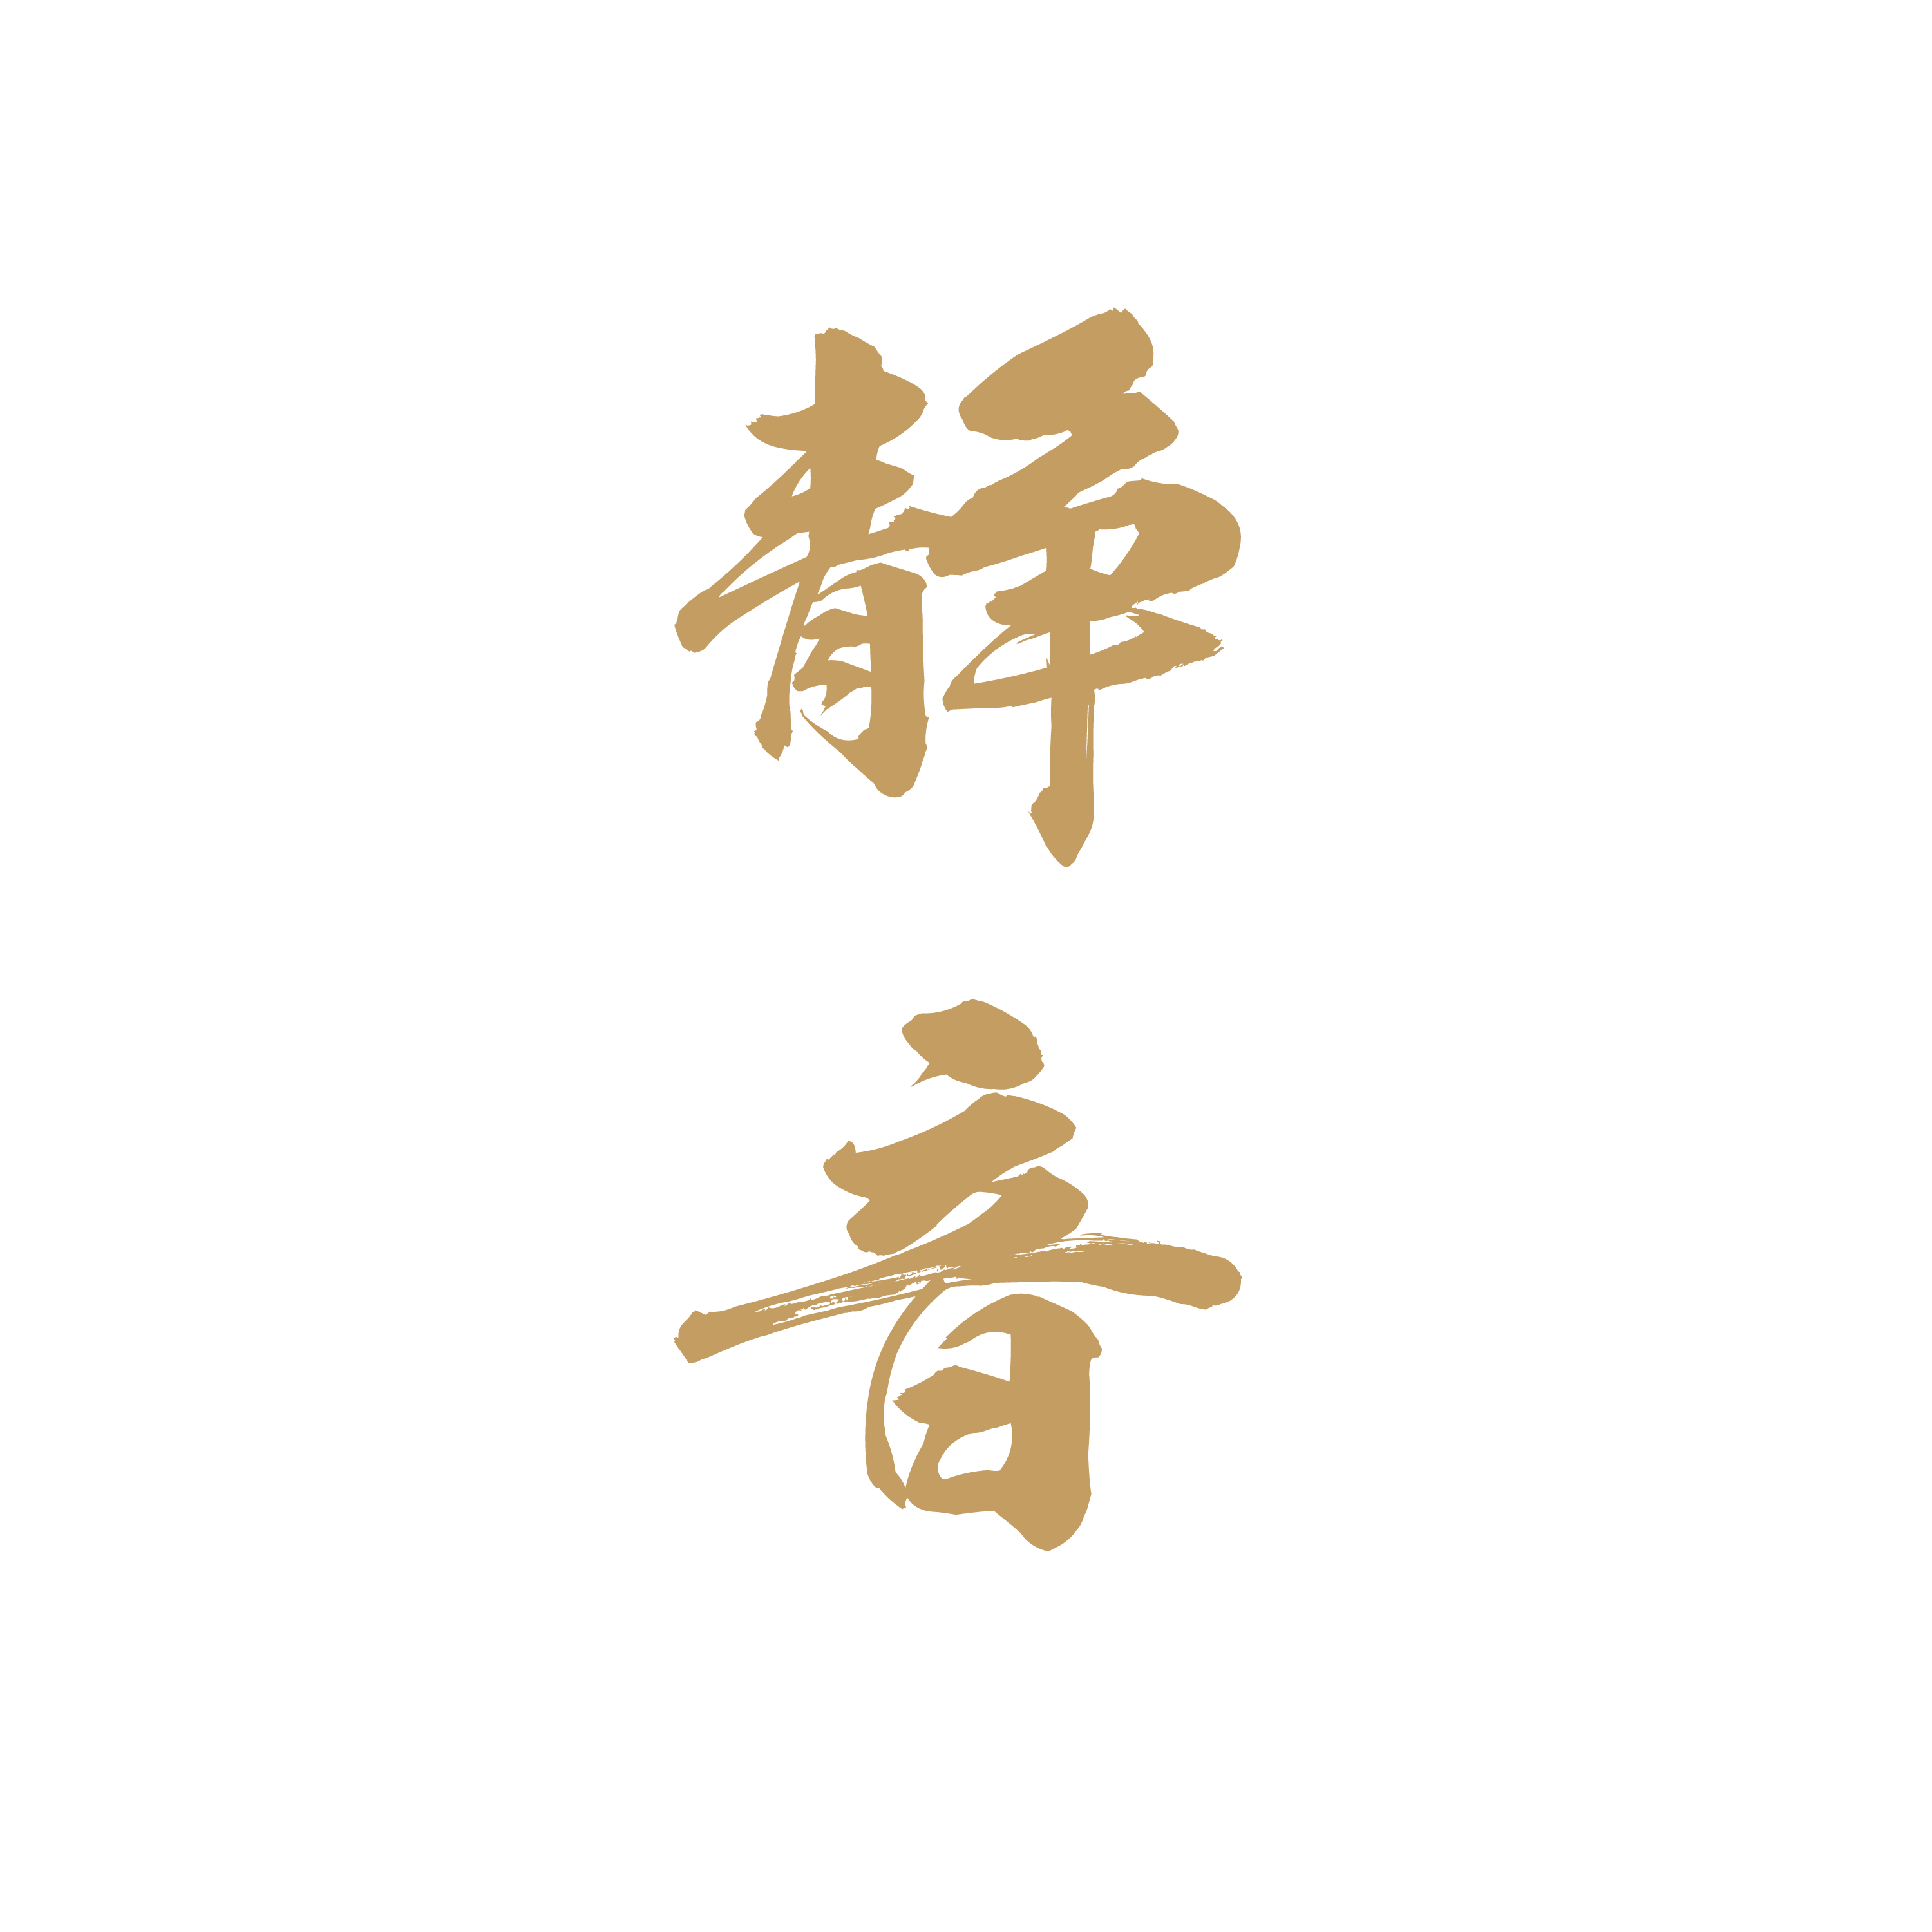


05
FRONT LABEL TEXT STRUCTURE
Brand Identity
SHIZUNE + 静音 calligraphy
Origin
"Shizuoka" communicates
"Japanese" without the word
Grade + Product
"Select Grade Matcha" — grade
name + product in one line
Shizuoka, Japan
FDA Required
"Green Tea Powder" — Statement
of Identity (bold, mandatory)
Prestige Grade Matcha
Green Tea Powder
FDA Required
"Net Wt." — bottom 30% of label,
minimum size enforced
Net Wt. 1.4 oz (40g)

Slide 7
06
AMAZON PRODUCT TITLES
Select
Shizune Matcha - Shizuoka Select Grade - Green Tea Powder
Reserve
Shizune Matcha - Kagoshima Reserve Grade - Green Tea Powder
Prestige
Shizune Matcha - Uji Kyoto Prestige Grade - Green Tea Powder
Note: If Reserve Grade goes organic, title becomes: Shizune Matcha - Organic Kagoshima Reserve Grade - Green Tea Powder
Discussion: How do these product names read? Any awkward phrasing or suggestions?

Slide 8
DISCUSSION POINTS
01
Grade Names
Do "Select," "Reserve," and "Prestige" clearly communicate a quality hierarchy to US consumers?
02
Product Titles
Does "Shizune Matcha - [Origin] [Grade] - Green Tea Powder" read naturally as an Amazon product name?
03
"Fine Japanese Matcha"
As a tagline under the brand name — does it enhance or clutter the label? Or is "Shizuoka, Japan" sufficient?
04
Label Copy
"Born in the shaded tea fields of Shizuoka, where time is measured in seasons." — Does this feel authentic or overwrought?
05
Overall Impression
Looking at the naming and label text as a whole, what is your first impression of this brand?

Slide 9
New Design Options
OptionA
OptionB
Fine Japanese Matcha
Uji, Kyoto, Japan
Shizuoka, Japan
Prestige Grade Matcha
Prestige Grade Matcha
Green Tea Powder
Green Tea Powder
Net Wt. 1.4 oz (40g)
Net Wt. 1.4 oz (40g)

Slide 10
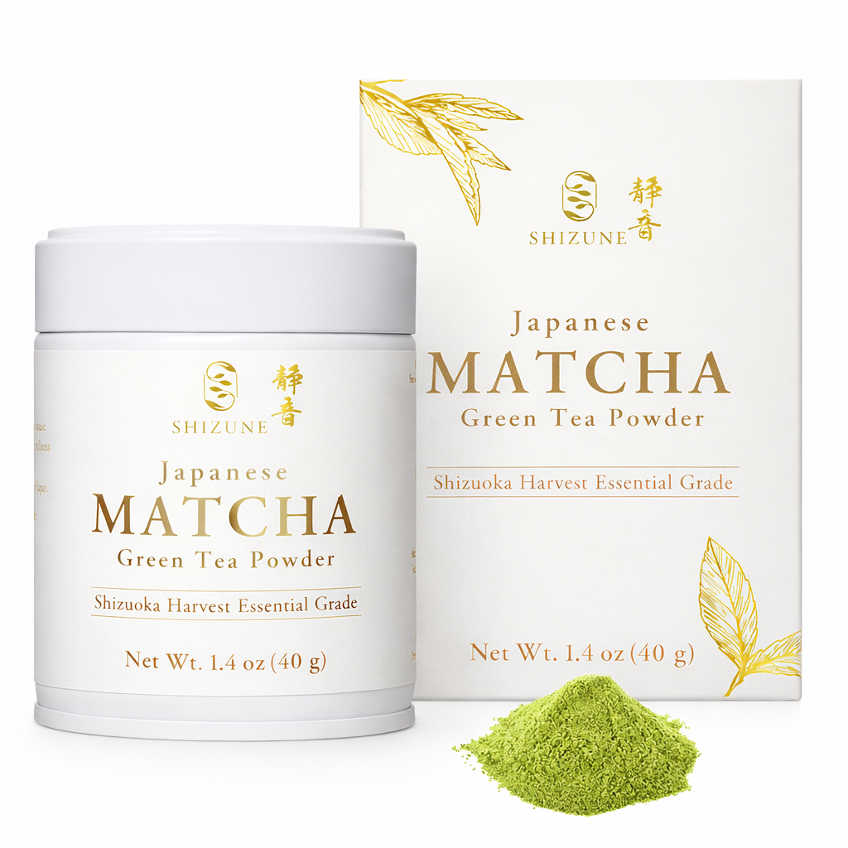
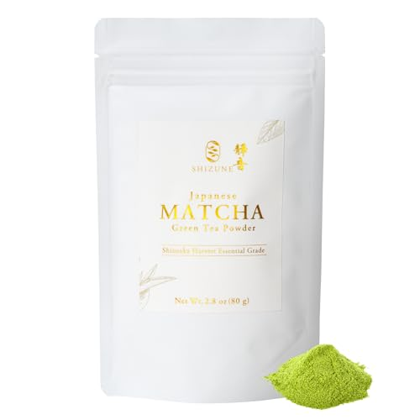
Current Design

Slide 11
Current Design

Slide 12
Current Design

