Slide 1
Cmpe 48A Term Project
Mustafa Atak, Hasan Kerem Şeker

Slide 2
Initial Architecture
Voting Interface
Redis
Client
The Load Balancer
Worker
Result Displayer
Database

Slide 3
Why We Changed The Initial Architecture
Could not measure response time directly
Redis quickly queues the initial request, but the requested change is reflected later in the system.
When the response is received, the votes might not be inserted in the database.
Could implement a polling mechanism to check for database updates, but this would affect performance and could not match each request and database change.

Slide 4
The Final Architecture
Cloud Function 1 (See All Votes)
Voting Interface and
Result Displayer (Backend)
Client
The Load Balancer
(Only on Kubernetes)
Database
Cloud Function 2 (See Each City Vote)

Slide 5
Comparison Between The Two Architecture
In the initial architecture, the client could send the request quickly, so it did not need to wait for the completion of the database write operation. The request is queued by Redis.
On the other hand, the final architecture allows us to measure each request’s effects on the system and the response time.
In our project, we deployed the system on VMs and Kubernetes. Then we compared the results.

Slide 6
VM Based Architecture Results

Slide 7
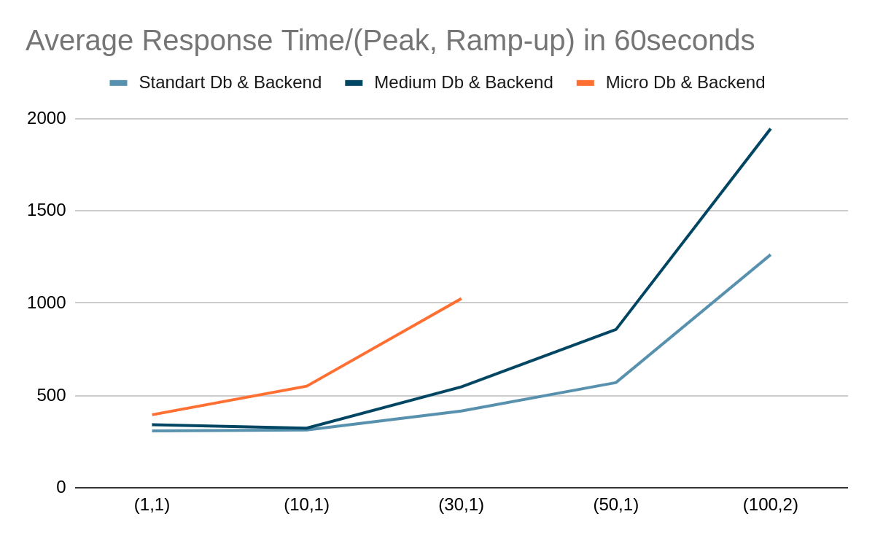
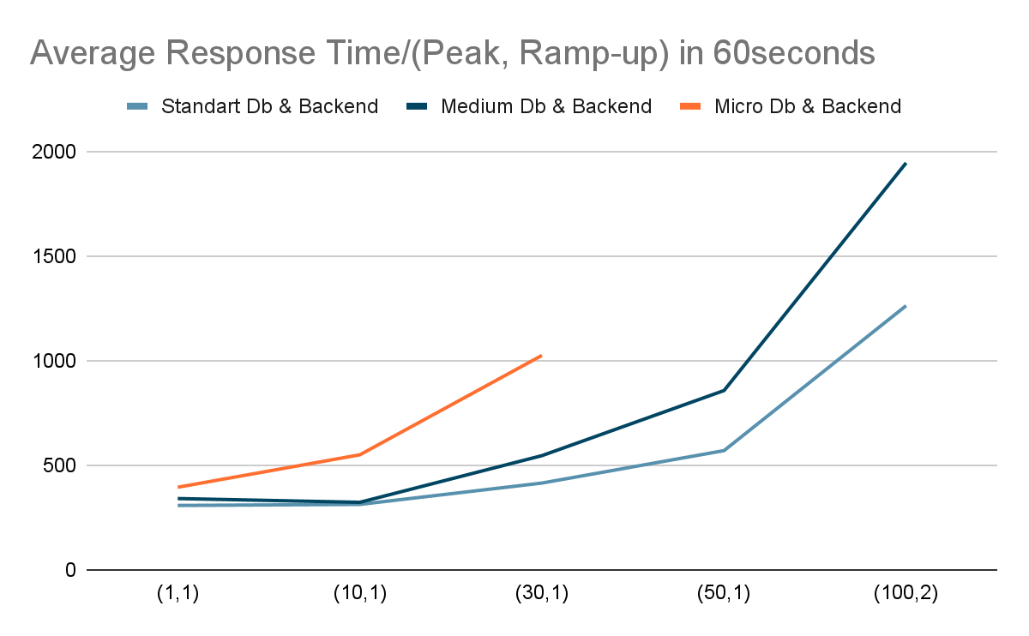
Load Response Time Relation

Slide 8
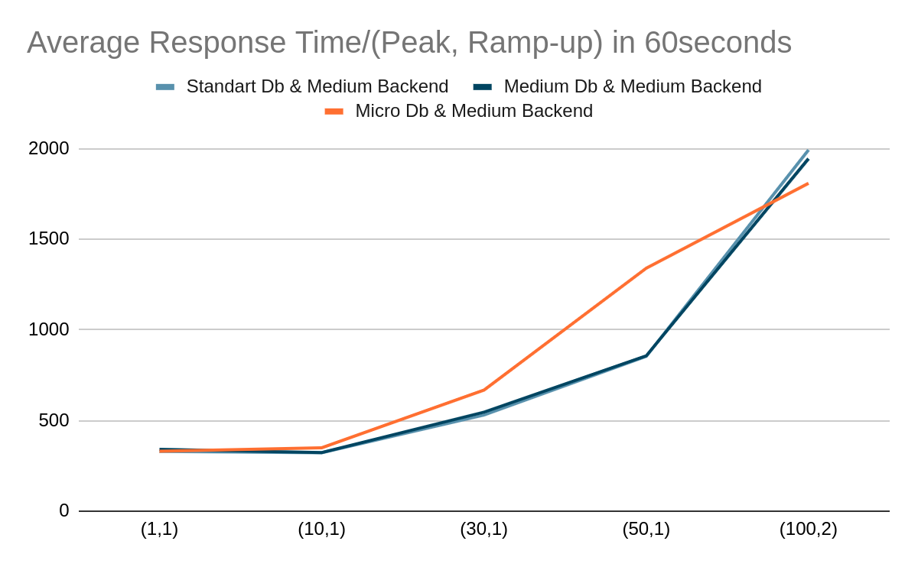
Database Spec Response Time Relation

Slide 9
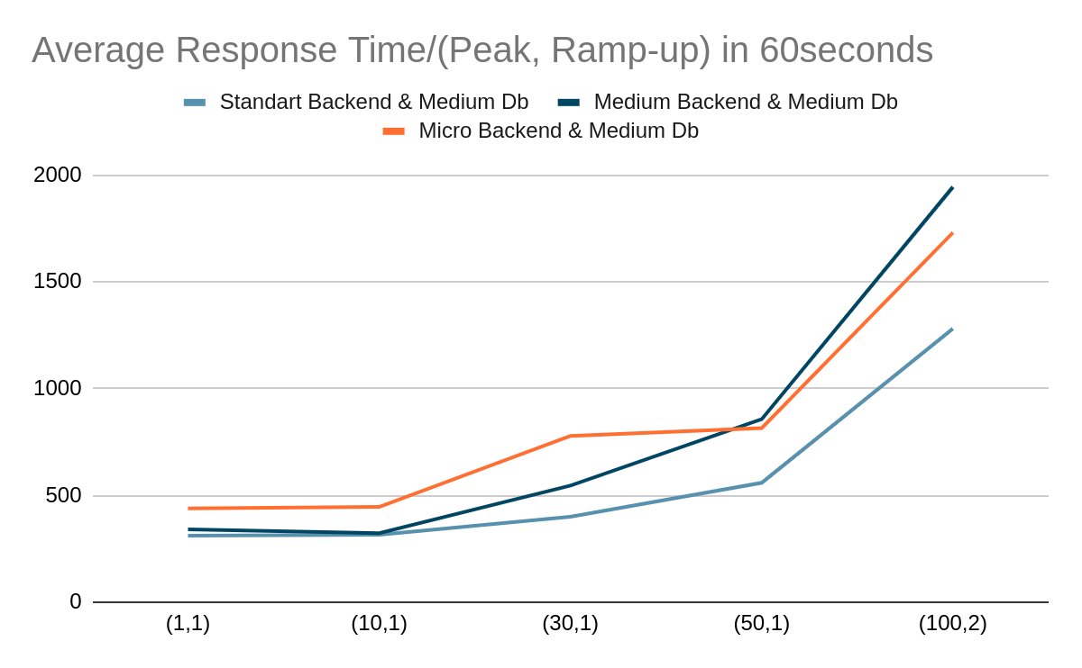
Backend Spec Response Time Relation

Slide 10
Kubernetes Based Architecture Results

Slide 11
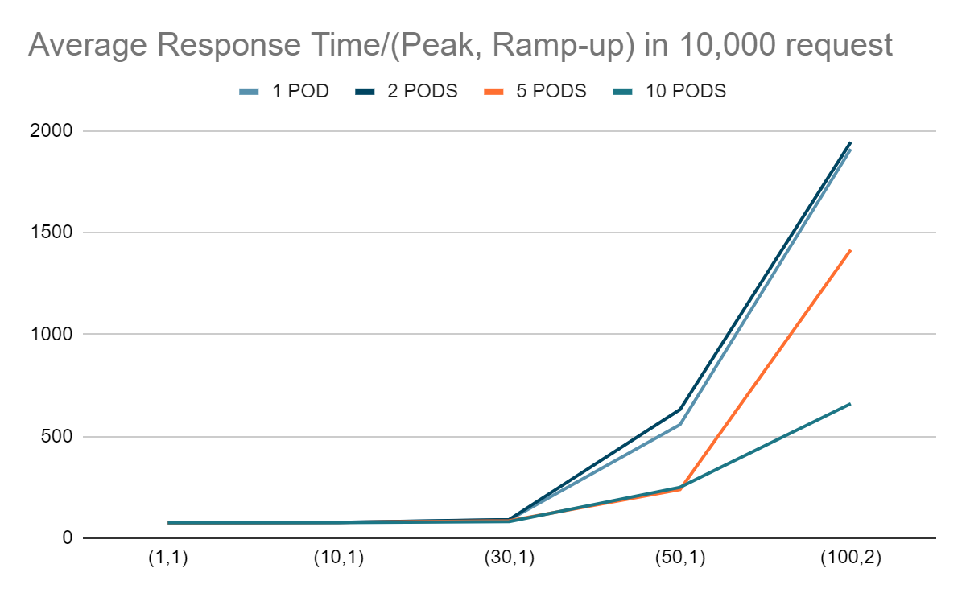
Load Response Time Relation / Postgres

Slide 12
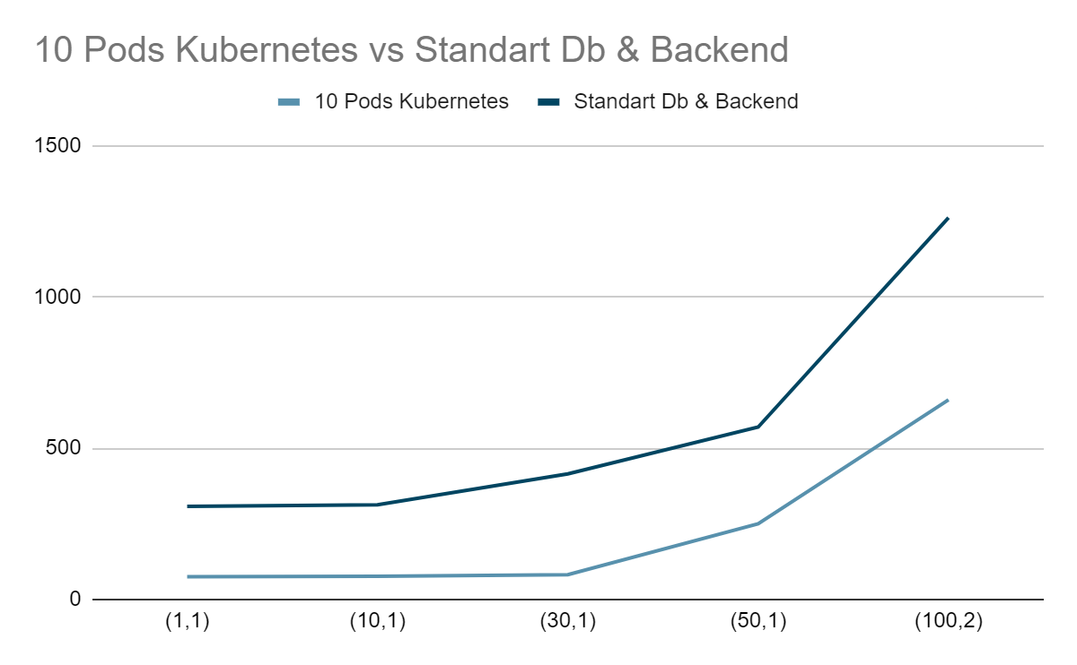
Comparing the Best Options

Slide 13
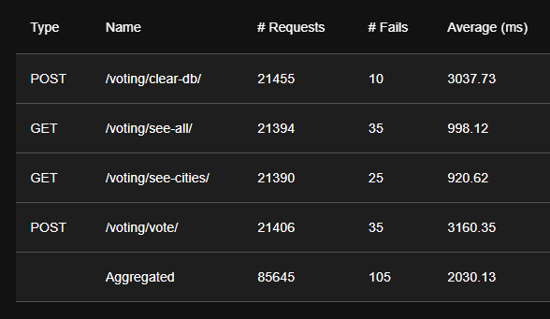
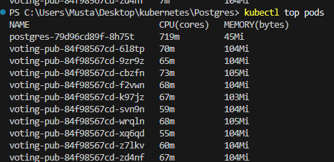
What is the problem?

Slide 14
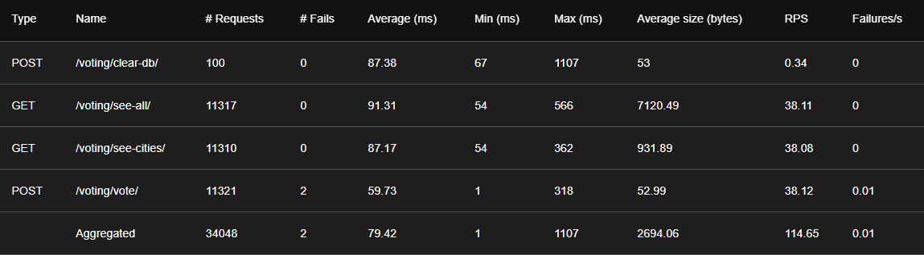
Solution?
2 Pod Redis Results for 100 User

Slide 15
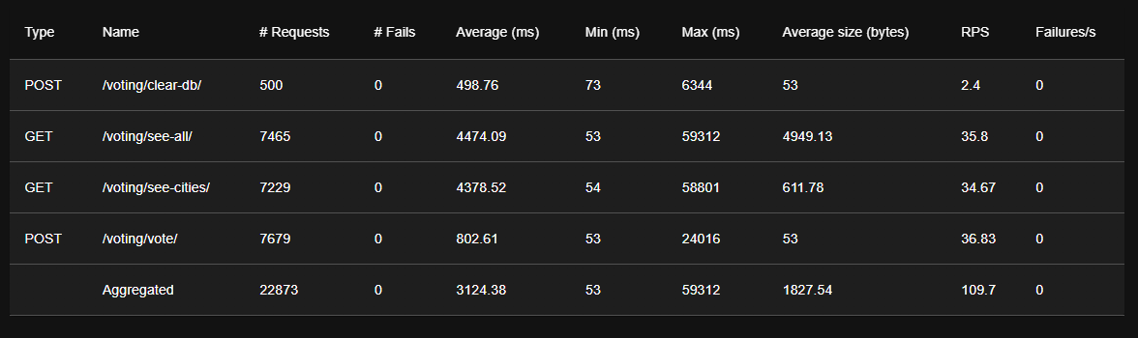
Solution?
2 Pod Redis Results for 500 User

Slide 16
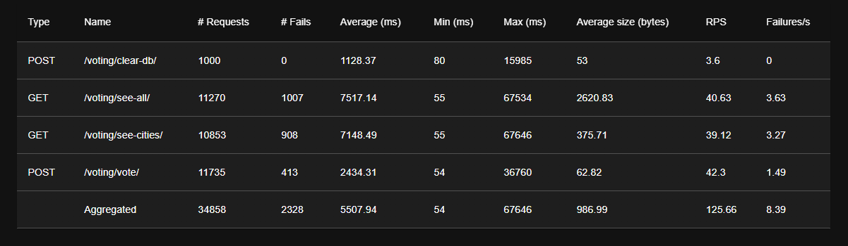
Solution?
2 Pod Redis Results for 1000 User

Slide 17
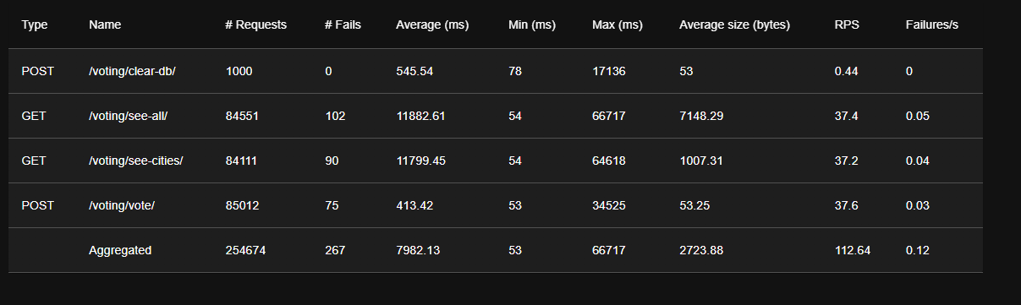
Solution?
10 Pod Redis Results for 1000 User

Slide 18
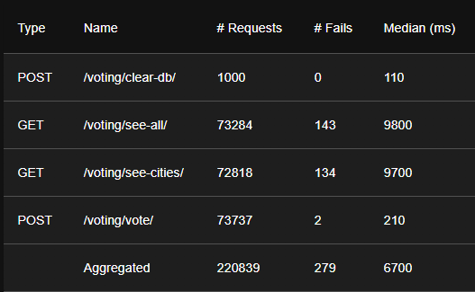
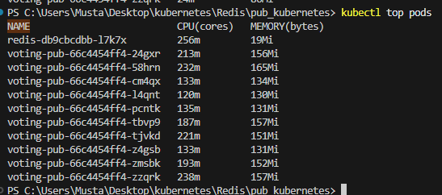
Improvement (Maybe)
10 Pod Redis Results for 1000 User + Cached Minutely

Slide 19
Final Words

