Slide 1

Earnings
Presentation
FY2026 Q2
Second Quarter of Fiscal Year
Ending December 31, 2026
ibis inc. (TSE Growth: 9343)
August 10, 2026

Slide 2
Q2 Subscription Billing Sales Up 66.4% YoY to a Record High,
Recurring Revenue Driving Growth as We Enter the Harvest Phase
FY2026 Q2 Consolidated Results Highlights
 | FY2025 Q2 Consolidated Results | FY2026 Q1 Consolidated Results | FY2026 Q2 Consolidated Results | YoY (QoQ)
Subscription Billing Sales | 270million yen | 410million yen | 450million yen | +66.4% （+10.3%）
Number of ibisPaint Subscriptions | 303.7thousand | 448.0thousand | 484.5thousand | +59.5% （+8.2%）
Net Sales | 1.21billion yen | 1.46billion yen | 1.54billion yen | +27.2% （+6.1%）
Operating Profit | 260million yen | 370million yen | 260million yen | -1.5% （-29.6%）
Operating Profit Margin | 21.9% | 25.6% | 17.0% | -4.9pt （-8.6pt）
The net increase in ibisPaint subscriptions (new subscriptions, net of cancellations) reached 36,527, a Q2 record. Although the net increase declined 27.5% QoQ due to seasonality and a higher cancellation rate following strong subscription additions in Q1, new subscriptions increased 4.5% QoQ, continuing to serve as a key growth driver
Net sales also reached a record high, as both subscription billing in the mobile segment and contract development in the solutions segment exceeded the company’s plan, driving 27.2% YoY and 6.1% QoQ growth in net sales
Operating profit would have been 390 million yen (YoY +48.9%), but an additional advertising investment of 134 million yen was made above the company’s plan to expand recurring revenue from Q3 onward
* YoY stands for “Year over Year”
* Consolidated financial statements have been applied since FY2025. The profit and loss of Techno-Speech, Inc. has been consolidated from April 1, 2025, and the profit and loss of Zeroichi Start Inc. has been consolidated from January 1, 2026
* Pages 3-5 present cumulative results, while pages 2 and 6-8 show results for the accounting period
* Regarding the purchase price allocation (PPA) for the acquisition of Techno-Speech, Inc., figures as of FY2025 Q2 were disclosed based on provisional accounting treatment; following the finalization of the PPA, the figures have been retroactively restated to reflect the finalized accounting treatment

Slide 3
All Metrics Progressing Ahead of the Full-Year Plan, Targeting
Full-Year Operating Profit Above the Plan Despite Upfront Investments
FY2026 Q2 Cumulative Consolidated Results and Full-Year Progress
 | FY2025 Q2 Consolidated Cumulative Results | FY2026 Q2 Consolidated Cumulative Results | FY2026 Consolidated Cumulative Plan | YoY (% of Plan)
Subscription Billing Sales | 520million yen | 870million yen | 1,730million yen | +67.8% （50.5%）
Number of ibisPaint Subscriptions | 303.7thousand | 484.5thousand | 547.4thousand | +59.5% （Net Additions: 58.0% of full-year plan）
Net Sales | 2.37billion yen | 3.00billion yen | 5.45billion yen | +26.5% （55.2%）
Operating Profit | 570million yen | 630million yen | 1,350million yen | +11.1% （47.0%）
Net Profit Attributable to Owners of the Parent | 380million yen | 450million yen | 940million yen | +19.6% （48.5%）
First-half progress toward the full-year plan reached 50.5% for subscription billing sales (+9.1% vs. plan) and 58.0% for the net increase in ibisPaint subscriptions (+18.7% vs. plan), both showing steady progress ahead of the plan
As acquisition efficiency exceeded the plan, we reallocated an additional 150 million yen to advertising in the first half to build up recurring revenue. We will optimize the pace of investment in the second half, while still targeting full-year operating profit above the plan
Progress is tracking ahead of the plan, but from a conservative standpoint, we maintain our initial full-year guidance, including our net sales forecast
* Consolidated cumulative results (FY2025 Q2 and FY2026 Q2) represent year-to-date “interim net profit attributable to owners of the parent”
* The FY2026 full-year consolidated forecast represents “net profit attributable to owners of the parent” for the full fiscal year
* Regarding the purchase price allocation (PPA) for the acquisition of Techno-Speech, Inc., figures as of FY2025 Q2 were disclosed based on provisional accounting treatment; following the finalization of the PPA, the figures have been retroactively restated to reflect the finalized accounting treatment

Slide 4
Growth in Net Sales and Profit Despite Goodwill Amortization;
Strengthening the Earnings Base
FY2026 Q2 Consolidated Financial Results Overview
（millions of yen）
Net Sales Trends
（millions of yen）
Various Profit Trends
Net Sales
YoY
+26.5%
Operating Profit
YoY
+11.1%
Net Profit
YoY
+19.6%
* The mobile segment includes the mobile business, BCS (Business Cloud Service), and other businesses
* Consolidated financial statements have been applied since FY2025. The profit and loss of Techno-Speech, Inc. has been consolidated
from April 1, 2025, and the profit and loss of Zeroichi Start Inc. has been consolidated from January 1, 2026
* Regarding the purchase price allocation (PPA) for the acquisition of Techno-Speech, Inc., figures as of FY2025 Q2 were disclosed based on provisional accounting treatment; following the finalization of the PPA, the figures have been retroactively restated to reflect the finalized accounting treatment

Slide 5
Over 20% Sales Growth Maintained in Both Mobile and Solutions Segments
FY2026 Q2 Consolidated Financial Results by Segment
（millions of yen）
Net Sales Trends
（millions of yen）
Segment Profit Trends
Mobile Segment
YoY
+21.9%
Solutions Segment
YoY
+29.9%
Mobile Segment
YoY
+13.1%
Solutions Segment
YoY
+20.3%
* Consolidated financial statements have been applied since FY2025. The profit and loss of Techno-Speech, Inc. has been consolidated
from April 1, 2025, and the profit and loss of Zeroichi Start Inc. has been consolidated from January 1, 2026
* For convenience, VoiSona sales include sales for CeVIO in the same B2C area, as well as from the production of voice libraries for VoiSona and CeVIO
* Regarding the purchase price allocation (PPA) for the acquisition of Techno-Speech, Inc., figures as of FY2025 Q2 were disclosed based on provisional accounting treatment; following the finalization of the PPA, the figures have been retroactively restated to reflect the finalized accounting treatment

Slide 6
Subscription Billing Drove Quarterly Sales to a Record High
Mobile Segment FY2026 Q2 Consolidated Financial Results
Sales by Category and Overseas Sales Ratio Trends
Segment Profit and Gross Profit Margin Trends
（millions of yen）
Subscription Billing Sales
YoY
+66.4%
In-App Advertising Sales
YoY
-11.6%
（millions of yen）
Mobile Segment
YoY
-0.2%
FY23
FY24
FY25
FY26
FY23
FY24
FY25
FY26
✓ Mobile segment sales totaled 850 million yen (YoY +23.2%), expanding strongly
✓ Although in-app advertising sales decreased quarter on quarter, the weaker yen supported results, which came in above expectations. A solid trend is expected to continue from Q3 onward
✓ Subscription billing sales have surpassed in-app advertising sales since Q3 of the previous fiscal year and have become a stable sales pillar
✓ Additional advertising investment of 134 million yen above the company’s plan was made to expand recurring revenue from Q3 onward, resulting in segment profit declining 21.2% QoQ
✓ The new advertising investment model introduced in late December 2025 successfully drove growth in ibisPaint subscription billing users
✓ Gross profit margin improved by 1.2pts YoY to 85.9%, maintaining a high level
* Consolidated financial statements have been applied since FY2025. The profit and loss of Techno-Speech, Inc. has been consolidated
from April 1, 2025, and the profit and loss of Zeroichi Start Inc. has been consolidated from January 1, 2026
* Subscriptions on the left chart represent the total subscription billing sales of ibisPaint and BCS

Slide 7
Sales Reached a Record High for 4 Consecutive Quarters;
Gross Profit Margin Remained at a High Level
Solutions Segment FY2026 Q2 Consolidated Financial Results
（millions of yen）
Trends in Sales by Segment
（millions of yen）
Trends in Segment Profit and Gross Profit Margin
Contract Development
YoY
+156.7%
IT Engineers
Dispatch
YoY
-5.4%
Solutions Segment
YoY
+15.3%
FY23
FY24
FY25
FY26
FY23
FY24
FY25
FY26
✓ Sales totaled 660 million yen (YoY +33.3%), marking a record high for four consecutive quarters
✓ Contract development sales grew significantly. Although the timing of orders resulted in some revenue being concentrated in Q2, progress toward the full-year plan remains on track
✓ The consolidation effect of the absorption-type merger with Zeroichi Start Inc. (effective April 1, 2026) supported growth
✓ Segment profit continued to grow YoY, driven by growth in contract development
✓ Gross profit margin remained at the same level as the record high in Q1, staying above 30%
✓ The establishment of an AI-driven development structure is advancing development efficiency, aiming to transition to a next-generation SIer business model
* Consolidated financial statements have been applied since FY2025. The profit and loss of Techno-Speech, Inc. has been consolidated
from April 1, 2025, and the profit and loss of Zeroichi Start Inc. has been consolidated from January 1, 2026

Slide 8
Promoting Ad Optimization to Drive Subscription Growth and Investment in Engineers to Strengthen the Growth Foundation
FY2026 Q2 Non-Consolidated Major Expense Items
Advertising Investment Trends
Trends in Investment in Engineers
（millions of yen）
（millions of yen）
FY23
FY24
FY25
FY26
FY23
FY24
FY25
FY26
✓ Advertising expenses increased 159.0% YoY as the first-half profit upside was allocated to advertising investment
✓ Although new ibisPaint downloads totaled 16,467 thousand (−7.2%), investment efficiency improved due to a higher subscription conversion rate
✓ From the second half onward, we plan to invest around 120 million yen per quarter while optimizing the pace of investment
✓ Investment in engineers in the mobile segment totaled 100 million yen (YoY +4.3%), reflecting organizational expansion aimed at strengthening the product
✓ Investment in engineers in the solutions segment totaled 440 million yen (+16.3%) , of which 10 million yen was attributable to the consolidation effect of the merger with Zeroichi Start Inc., reflecting substantial strengthening of the talent base supporting order growth
* Investment in engineers refers to the total labor and hiring costs of engineers in each segment
Notes:
テキストを入れる

Slide 9
Net New Subscription Contracts Continued to Expand at 1.4x the Growth Rate
The Number of IT Engineers Reached a Record High, Strengthening Organizational Capability
FY2026 Q2 Non-Consolidated Business KPIs
Mobile Segment
Solutions Segment
DAU (Daily Active Users)
Number of ibisPaint Subscriptions
Number of IT Engineers
（millions）
（thousands of subscription）
（person）
Growth Rate
1.4
times
+180,746
+132,685
Jun 2026, Q2
YoY
+0.5%
Jun 2026, Q2
YoY
+59.5%
Jun 2026, Q2
YoY
+11.9%
✓ DAU remained at a high level of over 6.44 million, serving as a stable foundation for in-app advertising sales
✓ The number of ibisPaint subscriptions reached 484 thousand, with Q2 net new subscriptions of 36,527, a Q2 record. Although net new subscriptions declined 27.5% QoQ due to temporary factors, the underlying growth trend remains unchanged, and subscription conversion continues to expand steadily
✓ Progress toward the full-year target for net subscription additions reached 58.0%, significantly ahead of plan
✓ The number of IT engineers increased by 29 YoY to 273 (including 9 from the merger with Zeroichi Start Inc.). Following the redefinition of skill sets in Q1 to support the transition to a next-generation SIer model, voluntary departures among employees below the required standard increased and hiring standards were tightened, shifting the organization to prioritize profit margins and AI development capabilities over headcount
* DAU represents the number of free active users per day, and MAU represents the number of monthly active users across all series, including paid app users but excluding the Edu series
* The figures shown above the DAU bar chart represent DAU at the end of each quarter

Slide 10

Harvest
the Momentum
From Japan to the world -
ibis turns global creativity into growth.
Investor Digest
ibis inc. (TSE Growth: 9343)
May 12, 2026

Slide 11



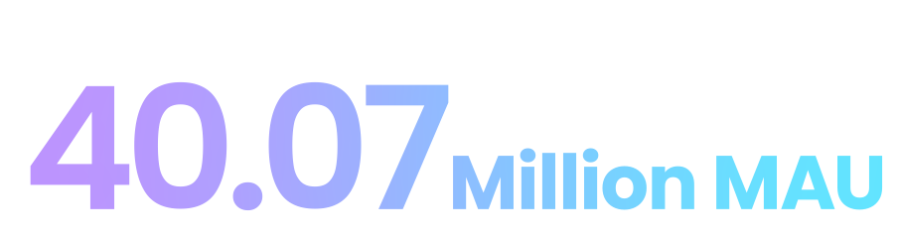
The world is drawn on ibisPaint
The go-to drawing app ranked No.1 for 7 consecutive years^{※1}
In-house ads accelerate subscriptions
Japanese IP leads the market
*1 App Store “Graphics & Design” category (from 2019 through January-November 2025), global basis, Monthly Active Users (MAU). Source: data.ai by Sensor Tower
*2 January–December 2025, global basis, Monthly Active Users (MAU). Source: Company research
*3 Source: “Intellectual Property Strategic Program 2025,” Cabinet Office of Japan. Available at: https://www.cas.go.jp/jp/seisakukaigi/titeki2/chitekizaisan2025/pdf/suishinkeikaku.pdf (accessed April 6, 2026)
⚫︎ Overseas MAU Ratio: Over 90%^{※2}
⚫︎ Cumulative Downloads: 520 million
⚫︎ Subscribers: 397K (Paid Conversion Rate: 1.0%)
⚫︎ Subscription ARPU: 17.1x In-app Advertising ARPU
⚫︎ Global IP Market：
Expected to Reach JPY 20 Trillion by 2033 ^{※3}

Slide 12



A Japan-Based Tech Company Developing the World’s No. 1 Mobile Painting App
About ibis
Net Sales Breakdown
MAU and Subscribers Trend
Company Profile
by Business Segment
■ MAU（millions, left axis） Subscribers (thousands, right axis)
■ Mobile Segment (ibisPaint Development and Operations)
■ Solutions Segment
■ AI Singing Voice Synthesis Segment
2000
2.4%
Established:
Subscribers 397K
（millions）
（thousands）
Number of
Employees:
357
MAU 40.07M
Net Sales
￥5.00B
Including 302 IT engineers
Locations:
FY2025
Subscription
CAGR^{※2}
2.2
X
Osaka
41.1%
56.5%
(123.3%)
Aug 2018–Dec 2025
Mobile Segment Revenue Breakdown
Overseas
Japan
Tokyo
75.9%
24.1%
Nagoya
2018/5
2025/12
*1 App Store “Graphics & Design” category (from 2019 through January-November 2025), global basis, Monthly Active Users (MAU). Source: data.ai by Sensor Tower
*2 CAGR is calculated from August 2018, when the subscription service was launched

Slide 13
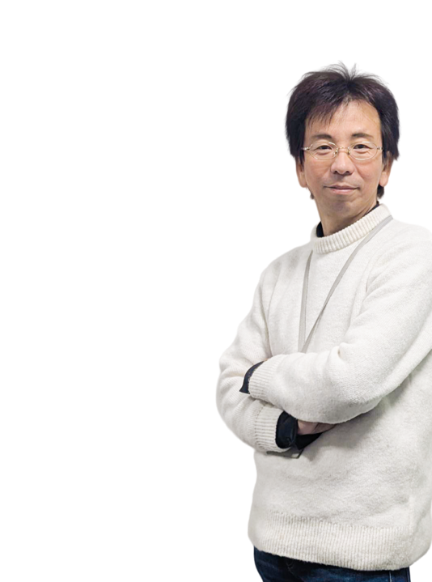



Bringing surprise and joy to young creators worldwide with technology born in Japan
Founder Profile
WHO I AM
WORK STYLE
MY PASSION
A pioneer
in technology
Dual-track management:
Engineering × Marketing
Delivering technology born in Japan to every corner of the world
Began programming in elementary school and became immersed in building high-speed, high-performance technology—creating innovations born in Japan that can compete globally.
Combining engineering expertise with marketing insight, he led the company’s global expansion and guided ibis to its 2023 public listing.
Delivering “WOW!” experiences and the joy of creation to Gen Alpha and Gen Z worldwide, accelerating creativity and unlocking new possibilities in the AI era.
President & CEO
Eiji Kamiya
Born in 1973,
Nagoya, Aichi, Japan
* Generation Alpha and Generation Z: An age group mainly corresponding to
elementary school through high school students (as defined by the Company)
13

Slide 14
A steadfast passion continues to drive ibis forward
Corporate Philosophy
MISSION
Delivering “WOW!” Experience on Mobile
VISION
Boost Japanese Tech to the World
ibis aims to elevate the global presence of ‘Made in Japan’
VALUE
Group of Experts in Advanced Technologies
Rapid Decision-Making and Execution
Continuous Challenge
We are a group of experts who continuously acquire cutting-edge technologies, fully aware of our role as specialists in advanced technology, committed to solving societal challenges.
Not only do we develop fast and efficient software, but we also make swift decisions and execute them promptly, ensuring agility in our operations.
By relentlessly pursuing challenges without slowing down, we create new value and drive innovation.

Slide 15



Continuing to expand into global markets, bringing the mobile segment onto a growth trajectory
Our Journey So Far
Net Sales Trend
Global Market Expansion Strategy
(millions of yen)
Mobile Segment
CAGR
^{Current Fiscal Year Outlook}
Focus on Internet advertising to invest in high-performing markets
■ Solutions Segment
■ Mobile Segment
■︎ AI Singing Voice Synthesis Segment
1
31.4%
FY20-FY26
Establish a proven “success formula” to maximize investment efficiency
^{Change in}
^{Fiscal Year-End}
2
Foster growth cycles through disciplined self-funded investment
3
Global Market Expansion Phase
May. 2000
Jun. 2011
Mar. 2023
Apr. 2025
Key
Milestones
Founded
ibisPaint Released
Listed on TSE Growth Market
AI Singing Voice Synthesis Segment Launched
* CAGR=Compound Annual Growth Rate
Notes:
改行変更

Slide 16




ibisPaint has become the world’s No. 1 global app*¹
ibisPaint Achievements
Global Active User Ranking
Cumulative Downloads
Graphics & Design Category
As of December 2025
No.1
520M
*
¹
Seven consecutive years as No. 1
Overseas ratio 93.9%
MAU (Monthly Active Users)
Users Under the Age of 25
As of December 2025
As of December 2025
40.07M
91.7%
*
³
Overseas ratio 90.5%^{*2}
A leading painting app
for Gen Alpha and Gen Z creators
*1 App Store “Graphics & Design” category (from 2019 through January–November 2025), global basis, Monthly Active Users (MAU). Source: data.ai by Sensor Tower *2 MAU overseas ratio (January-December 2025), worldwide, MAU, in-house research *3 Share of active users under the age of 25 on iPhone and Android (January–November 2025) in Japan and the United States. Source: data.ai by Sensor Tower. The comparison includes five leading apps considered by the Company to be its direct global competitors

Slide 17





A market-leading strategy centered on Gen Alpha and Gen Z through mobile specialization
Market Opportunity
Expanding Creative Demand
Among Gen Alpha and Gen Z
Market Potential
High-Growth Market
ibisPaint User Ratio Under 25
Global Art App Market Size (2035)
CAGR(2025–2035)
44.1%
USD2.36B
12.4%
*1
*2
*3
+
+
*1 ibisPaint user ratio under age 25 (January–November 2025). Data cover two countries, Japan and the United States, based on data.ai by Sensor Tower
*2,3 Figures related to the global art app market (2035 market size: USD 2.36 billion; 2025–2035 CAGR: 12.4%) are based on independent research and estimates by Future Market Insights
Notes:
改行変更

Slide 18

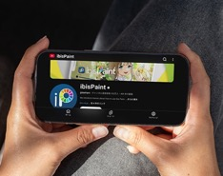
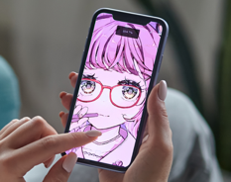

Designing a seamless user experience to be the first illustration app of choice for Gen Alpha and Gen Z
Strengths of ibisPaint (1)
z
z
Easy to Start
Content that Drives Growth and Continued Use
Basic Functions Are Free
ibisPaint YouTube Subscribers
Freemium
model
3.05M
Onboarding
Continued use
z
z
Superior Usability
Rapid Updates and Strong Customer Loyalty
PC-Class Advanced Features
Full-Scale Creation with a Single Finger
Top-Tier App Store Ratings
4.7
5
Highly optimized mobile-first design
App Store
/
4.6
Google Play
5
/
Click the image to view the demo video
* ibisPaint YouTube subscriber count and App Store ratings are as of January 19, 2026

Slide 19


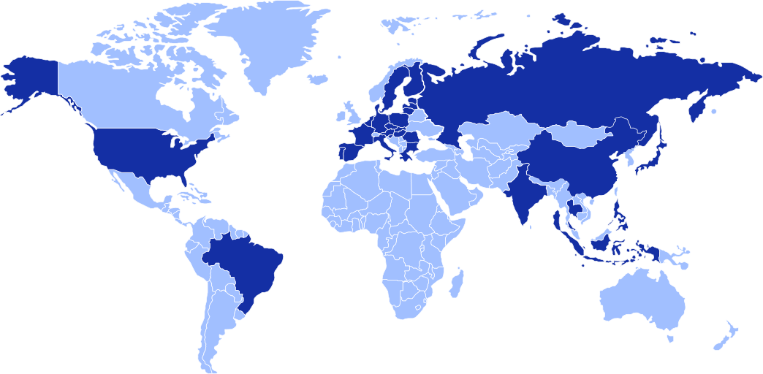










Driven by global marketing and passionate users, we have built one of the world’s largest user bases
Strengths of ibisPaint (2)
Cumulative Downloads by Major Countries and Regions^{*1}
Cumulative Global Downloads
(as of December 2025)
Countries and regions where ibisPaint is used
(millions of downloads)
Over Time
OVER
200
Exceeded
500M
■ Overseas
■ ︎Japan
Exceeded
300M
Exceeded
100M
39.05M
3
rd.
43.46M
MAU Composition:
Global User Share
2
47.46M
24.00M
31.84M
(Japan and Overseas)
nd.
21.69M
22.41M
90.5 %
88.7 %
Supported in
36.68M
^{*2}
^{*3}
19
24.77M
as of
December 2025
as of
December 2025
Languages
1
48.48M
st.
■ ibisPaint
■ Total of Direct Competitor Painting Apps
■ Overseas
■ Japan
*1 As data by country for Huawei downloads is unavailable, they are attributed to China for convenience. Source: Company research *2 January–December 2025, global basis, Monthly Active Users (MAU). Source: Company research *3 Share of active users across all age groups (January–November 2025), global basis, Monthly Active Users (MAU). Source: data.ai by Sensor Tower. The comparison covers five leading applications considered by the Company to be its direct global competitors

Slide 20
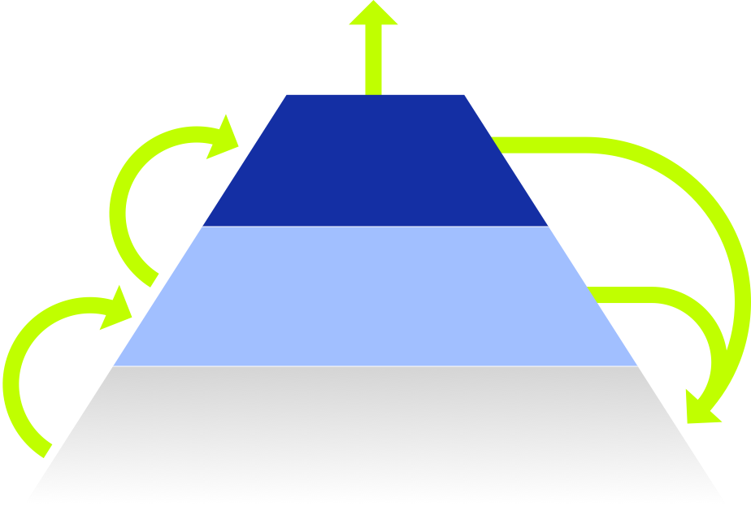

Through advanced technology and a lean, elite team, we maximize efficiency and generate a high-margin model
Strengths of ibisPaint (3)
An ecosystem that efficiently monetizes our user base
A stable, diversified sales structure
Sales Breakdown of the Mobile Segment
Diversified monetization and continued use
ARPU
17.1X
¥321.4
Paid users
*1
¥ 2.83B
Promoting conversion through our own advertising for free
(Subscriptions Billing +
One-Time Purchase Apps)
¥18.7
FY2025
In-App
Advertising
Subscription
Billing
Organic growth through word of mouth
Conversion to paid plans
■ Subscription Billing (42.5%)
■ One-Time Purchase App (9.6%)
■ In-App Advertising (47.7%)
Free app active users
Industry-leading productivity
Low-cost user acquisition
Free Access
Sales Per Employee
Potential users
as of December 2024
2.0X
that of Company C
¥70.56M
*2
(Mobile Segment Employees Basis)
*1 The sales figures shown at the center of the "Sales Breakdown of the Mobile Segment" pie chart include “Miscellaneous." The figures in parentheses represent the percentage of the sales mentioned earlier *2 "Sales Per Employee" is calculated by dividing Mobile Segment sales by the number of employees, excluding temporary employees. Comparisons with Company C are based on the same calculation method applied to Company C’s comparable businesses

Slide 21




Delivering ibis’s technological value to the world through mobile innovation
Two Segments Driving the Expansion of the Mobile Segment
Solutions Segment
AI Singing Voice Synthesis Segment
Stable Growth Business
New Growth Business
Provides mobile-app development for domestic companies, supporting implementation across all devices. Strong expertise in cloud server construction and migration.
Leveraging the voice-synthesis technology of our subsidiary Techno-Speech, Inc., we provide an AI Singing Voice Synthesis App “VoiSona” and aim for global expansion.
¥2.05B
¥0.11B
FY2025
FY2025
Client Portfolio
Client Portfolio
■ Contract Development (26.1%)
■ IT Engineer Dispatch (73.9%)
■ VoiSona (78.1%)
■ Contract Development (21.9%)
* For convenience, the sales breakdown chart for Voisona includes sales from CeVIO, which operates in
the same B2C area, as well as sales from the production of voice libraries for both VoiSona and CeVIO
Notes:
メインメッセージ改行

Slide 22


Entering a prime phase for monetizing one of the world’s largest user bases
Overview of Growth Strategy
(100 million yen)
Medium- to Long-Term Sales Growth Image
Growth Targets for FY2035
Consolidated Net Sales
■ M&A Activities
■ AI Singing Voice Synthesis Segment
■ Mobile Segment (Subscription Billing)
■ Mobile Segment (Non-Subscription Billing)
■ Solutions Segment
￥15.0B
CAGR
15.0%
FY20-FY35
(excluding M&A)
Total Subscription Contracts
2M
1.73 billion yen
Subscription Sales
EXCEED
Non-subscription
Sales
1.35 billion yen
Subscription Rates
FY2026/12
5.0%
FY2024/12
Seeding Phase (-2015)
Growth Phase (2016-2023)
NOW
Harvest Phase (2024 onward)
* The illustrative figures and target values on this page are based on the Consolidated Medium-Term Management Plan for 2026

Slide 23


Driving subscription conversion via free in-app house ads to 40 million active users
Growth Strategy (1)
Growth Impact of Subscriber Expansion
Three Growth Drivers
Subscription
Billing
Sales
(Illustrative)
1
Free in-app house ads
2
New function enhancements exclusive to subscriptions
¥24.0B
3
Optimized onboarding
to increase conversion
¥6.0B
Progress in Number of Subscriptions
(thousands of
subscriptions)
¥1.20B
FY2025 Results
CAGR
853.9
56.8%
700.6
Subscription
Users
Potential
Subscribers^{*1}
Number of
Heavy Users^{*2}
Monthly
Active Users
FY21-FY28
547.4
2.00M
7.94 M
40.07 M
397.6
0.397M
1.0 %
5.0%
19.8 %
Conversion rate
^{Strategic target}
*1 The number of potential subscribers is defined as monthly active users whose conversion rate is 5% (industry average of 3-10%) *2 The number of heavy users is defined as monthly active users whose average monthly usage time is greater than that of current subscription subscribers * Figures are based on actual results for the end of FY2025. The planned figures for FY26-28 for "Progress in Number of Subscriptions" are based on the 2026 Medium-Term Management Plan
Notes:
改行

Slide 24



Accelerating subscription growth through pro use features and multi-device expansion
Growth Strategy (2)
Enhancing Professional Features
Based on User Feedback
Sales Trends of ibisPaint for Windows/Mac
■ One-Time Purchase App ■ Subscription Billing
(thousands of yen)
Subscription Service Launched
One-Time Purchase App Second Price Increase
Subscription
Price Increase
Mac Version
Released
One-Time Purchase App First Price Increase
Establishing ibisPaint
as a Lifelong Creative Partner
Windows Version
Released
FY2022
FY2023
FY2024
FY2025
Notes:
改行変更

Slide 25


Building a creative foundation that connects creative power worldwide
Growth Strategy (3)
Concept: Next-Generation Creative Platform
A New Music Creation Experience
The Ever-Expanding Creative Activities of ibisPaint
Empowering Creative Expression of Next-Generation
Voice Library Extensions (Enhanced Paid Models)
New AI Features
Ongoing Release including 3D Animation
“Smart Credit”
New Monetization via
a Usage-Based Model
Innovative Creation Tools Leveraging AI
New Products for
Next-Generation Creators
AI Singing Voice Synthesis App
Painting App
Synergies Driven by User Traffic
from ibisPaint (40 million MAU)
Strategic M&A
Enhancing and Expanding Product Value
UI Customization × Design
Evolution Toward Professional-Grade
Music Video Creation Tools
Integrating Video and Music
Unleashing Creative Expression and Generating New Culture from Japan
Notes:
改行変更

Slide 26


Accelerating corporate growth through stable sales and AI-driven market expansion
Growth Strategy for the Solutions / AI Singing Voice Synthesis Segment
Solutions Segment
AI Singing Voice Synthesis Segment
Evolving into a high-margin, scalable SIer business model
Applying the ibisPaint model to lead AI singing voice synthesis
Specialized Talent × AI
M&A-Driven Sler Base
Target for Corporate Value Enhancement
Before M&A
After M&A
Corporate Value
Corporate Value
￥510M
￥2.5B
Business scalability is improved by high-quality Sler enabled by no-code and AI-driven development efficiency.
On April 1, 2026, Zeroichi Start Inc. will be merged into the Company, strengthening our SI talent and technical capabilities.
Driving a fivefold increase in corporate value by scaling our mobile development and global growth model through M&A.

Slide 27

Accelerating growth with 1.4x subscription billing sales, driving further profit expansion
FY2026 Performance Plan
Company-wide:
By Segment: Net Sales and Operating Profit
Subscriptions: Sales
Net Sales and Operating Profit
■ Mobile Sales
■ Mobile Segment Profit
■ Sales ● Subscription Contracts (thousands）
■ Net Sales ■ Operating Profit
■ Solutions Sales
■ Solutions Segment Profit
■ AI Singing Voice Synthesis Sales
■︎ AI Voice Singing Synthesis Segment Profit
(millions of yen)
(millions of yen)
Sales
Growth Rate
(millions of yen)
Subscription
Growth Rate
成長率
+37.7%
+9.0%
Sales
Growth Rate
1,731
+9.0%
5,454
3,084
+6.8%
5,005
Subscription
Billing Sales
Growth Rate
2,196
1,202
+44.1%
1,618
Sales
Growth Rate
+46.3%
1,201
（24.0%）
+12.8%
1,355
（24.9%）
289
174
FY2025
Results
FY2026
Plan
FY2026
Plan
-55
FY2025
Results
FY2026
Plan

Slide 28
Disclosure of New Key Consolidated Financial Targets for the Next 3 Years
Targeting Subscription Billing Sales of JPY 2.79 Billion, 2.3x FY2025 Levels
Operating Profit Growth Target: 20% or Higher from FY2027 Onward
Key Consolidated Management Indicators (FY2026–FY2028)
 | Results |  | Plan
（Unit: million yen） | FY2024 | FY2025 | FY2026 | FY2027 | FY2028 | CAGR
Net Sales | 4,625 | 5,005 | 5,454 | 6,327 | 7,427 | 14.1%
YoY(%) | - | 8.2% | 9.0% | 16.0% | 17.4% | -
Mobile Segment Sales | 2,611 | 2,830 | 3,084 | 3,591 | 4,110 | 13.2%
Subscription Billing Sales | 687 | 1,202 | 1,731 | 2,255 | 2,791 | 32.4%
Solutions Segment Sales | 2,014 | 2,055 | 2,196 | 2,525 | 3,030 | 13.8%
AI Singing Voice Synthesis Segment Sales | - | 118 | 174 | 210 | 286 | 34.0%
Operating Profit | 1,155 | 1,201 | 1,355 | 1,634 | 1,988 | 18.3%
YoY(%) | - | 4.0% | 12.8% | 20.6% | 21.6% | -
Operating Margin | 25.0% | 24.0% | 24.9% | 25.8% | 26.8% | -
Net Profit Attributable to Owners of the Parent | 839 | 848 | 940 | 1,093 | 1,339 | 16.4%
YoY(%) | - | 1.2% | 10.8% | 16.3% | 22.5% | -
ibisPaint Subscription Contracts (thousands) | 232.0 | 397.6 | 547.4 | 700.6 | 853.9 | 29.0%
ROE (Return on Equity)（%） | 49.7% | 29.9% | 29.3% | 27.3% | 27.0% | -
EPS (Earnings per Share) (yen) | 46.0 | 46.3 | 51.3 | 59.3 | 72.7 | 16.2%
* The planned figures on this page are based on the 2026 consolidated medium-term management plan.
FY2025/12 YoY indicates the ratio of FY2025/12 consolidated results to FY2024/12 non-consolidated results
* CAGR is not calculated for margin metrics such as operating margin. This plan assumes organic growth and excludes the impact of M&A

Slide 29

Leveraging our world-class technological capabilities to deliver sustainable growth and shareholder returns
Shareholder Returns
Capital Allocation Priorities
Profit & Dividend Trends
(millions of yen)
■ Consolidated Net Profit Attributable to Owners of the Parent
Dividend Per Share
ROE
Growth Investments
1
Strategic investments in the expansion of new business areas and M&A
Dividend YoY
940
+20.0%
830
840
（Pre-Split）
\60
Strengthening
Our Business Foundation
49.7%
（Pre-Split）
（Post-Split）
ROE 3-Year Average
\50
\12
36.3%
\40
2
（Post-Split）
Investing in human capital to
enhance long-term business sustainability
\10
29.9%
29.3%
280
160
\14
Shareholder Returns
3
Dividend payout ratio targeted at 20–25%;
considering further dividend increases aligned with profit growth
* Stock split: Effective October 1, 2025, each share of common stock will be split into five shares

Slide 30



Strengthening the management foundation for sustainable growth
Risk Management, Governance and Sustainability
Risk Management
Governance
Sustainability
Identifying and managing
key risks within our strategy
Ensuring robust management
through rules and execution
Strengthening human capital
as a source of value creation
主な取り組み
Key Initiatives
Key Initiatives
Key Initiatives
Diversifying growth drivers through M&A and new businesses to reduce reliance on core products.
Operate a risk and compliance committee that addresses timely topics on a monthly basis.
Upgrading HR systems, training frameworks, and work environments to support recruitment, development, and retention
Strengthen development capacity through talent investment and workplace improvements amid IT labor shortages.
Conduct company-wide training and assessments on information security at onboarding and annually thereafter.
Improving employee skills through business-unit-led training and continuous learning opportunities.
* Details of each initiative are disclosed in the Growth Potential Materials

Slide 31



We will continue delivering “WOW!” experience to the world
through technology and creativity
Business Plan and Growth Potential
ibis IR Information
This document is prepared for informational purposes only and is not intended to solicit the sale or purchase of any securities.
This document contains forward-looking statements, and actual results may differ materially due to various factors.
Copyright © ibis inc. All Rights Reserved.

