Slide 1
QMOOD-Based Software Quality Evolution Analysis of Logback with LLM-Supported Evaluation
Master’s Course Project
QMOOD-inspired approximation • CK metrics • LLM-supported discussion

Slide 2
Project Aim
• Analyze quality evolution of Logback
• Use CK Tool object-oriented metrics
• Calculate QMOOD-inspired quality scores
• Compare interpretations from 3 LLMs
1. Metrics
2. Scores
3. LLM support
4. Discussion
QMOOD-inspired Logback analysis

Slide 3
Selected Software
• Software: Logback
• Type: Java logging framework
• Repository: https://github.com/qos-ch/logback
• Reason: mature, open-source, object-oriented, multiple versions available
Why Logback?
It is suitable for version-based metric comparison because it has several released versions and a clear Java object-oriented structure.
QMOOD-inspired Logback analysis

Slide 4
Analyzed Scope
• Versions: v_1.5.25 to v_1.5.34
• Modules: logback-core and logback-classic
• Excluded: tests, examples, docs, generated files, logback-access
• Reason: keep comparison consistent
Analyzed modules
logback-core/src/main/java
logback-classic/src/main/java
Scope rule
Only the same production modules were compared across all selected versions.
QMOOD-inspired Logback analysis

Slide 5
Metric Extraction Process
• CK Tool used for Java metrics
• Metrics extracted from source code
• Raw metrics saved per version
• Processed metrics summarized with Python
CK Tool
Raw CSV
Python
Graphs
QMOOD-inspired Logback analysis

Slide 6
Metrics Used
• CBO for coupling
• WMC for complexity
• RFC for messaging
• LCOM for cohesion
• DIT and NOC for inheritance
• LOC, methods, fields for size and structure
CBO
WMC
Coupling
Complexity
RFC
LCOM
Messaging
Cohesion
DIT / NOC
LOC / methods / fields
Inheritance
Size & structure
QMOOD-inspired Logback analysis

Slide 7
QMOOD-Inspired Method
• CK metrics mapped to QMOOD design properties
• Scores normalized across 10 versions
• Lower-is-better metrics were inverted
• Output: six quality attributes + overall score
• Important: approximation, not full original QMOOD
Important note
The scores compare the selected versions only. They are not absolute software quality values.
QMOOD-inspired
Comparative
QMOOD-inspired Logback analysis

Slide 8
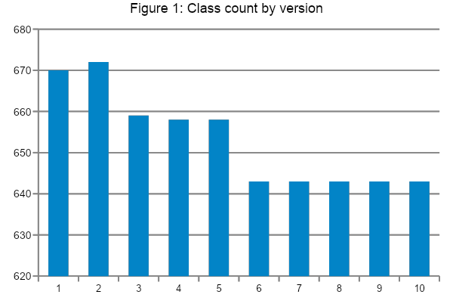
Key Metric Results
Class count
Total LOC
Avg WMC
Avg LCOM
670 → 643
26,958 → 26,292
10.123881 → 10.297045
21.523881 → 22.326594
• Measured code became smaller overall
• Average WMC increased slightly
• Average LCOM increased slightly
• Interpretation: slightly higher average complexity and lower cohesion
• Figure 2 can show CBO, WMC, and LCOM trends
QMOOD-inspired Logback analysis

Slide 9
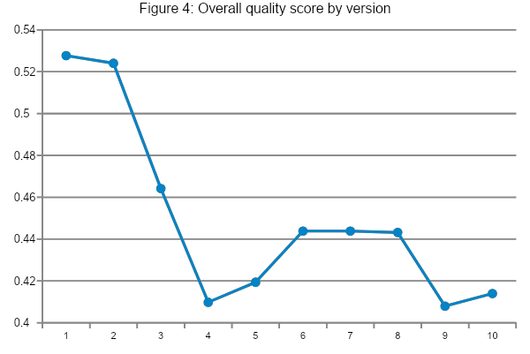
Quality Score Results
• Highest scores: v_1.5.25 and v_1.5.26
• Lowest scores: v_1.5.33 and v_1.5.34
• Partial recovery around v_1.5.30 to v_1.5.32
• Overall trend: downward, but not linear
• Figure 3 can show quality attributes by version
Later versions appear stronger in functionality-related scores, but weaker in understandability and reusability.
QMOOD-inspired Logback analysis

Slide 10
LLM Evaluation
• Same prompt and metrics given to ChatGPT, Gemini, DeepSeek
• ChatGPT: cautious and balanced
• Gemini: detailed and metric-specific
• DeepSeek: clear phase-based explanation
• LLMs used only for supporting interpretation
ChatGPT
Cautious
and balanced
Gemini
Detailed and
metric-specific
DeepSeek
Clear phase-based
explanation
QMOOD-inspired Logback analysis

Slide 11
Limitations
• QMOOD-inspired, not full QMOOD
• Metrics are aggregated
• Only two modules analyzed
• LLMs did not inspect source code
• Causes of changes require future changelog or commit analysis
How to read results
The results show possible trends in the provided metrics. They do not prove the exact reasons behind the changes.
QMOOD-inspired Logback analysis

Slide 12
Conclusion
• Logback became smaller in the analyzed modules
• Average complexity and LCOM slightly increased
• Overall quality score declined compared with early versions
• Later versions show a trade-off: better functionality, weaker understandability/reusability
• Metric-based analysis is useful, but cannot explain every cause
Main message
Useful for comparing versions, but not enough to explain every design decision.
QMOOD-inspired approximation
QMOOD-inspired Logback analysis

