Slide 1

SQL PROJECT -
PROPERTY LISTING ANALYSIS FOR PROPERTY RENTAL COMPANY
Presented By :
Hitesh Kumar Sharma

Slide 2
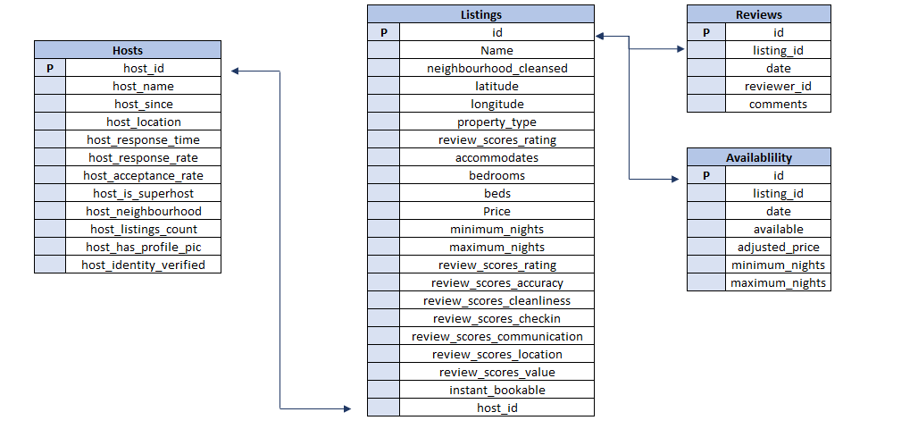
DATA OVERVIEW

Slide 3
POINT OF ANALYSIS
Analyse different metrics to draw the distinction between the different types of property along with their price listings
Study the trends of the different categories and provide insights on same
Using the above analysis, identify top 2 crucial metrics which makes different property types along their listing price stand ahead of other categories
Analyse how does the comments of reviewers vary for listings of distinct categories
Analyse if there is any correlation between property type and their availability across the months
Analyse what are the peak and off-peak time for the different categories of property type and their listings. Do we see some commonalities in the trend or is it dependent on the category
Using the above analysis, suggest what is the best performing category for the company

Slide 4
INTRODUCTION
The analysis of the Property rental company. This is the analysis of three categories of rooms which are hotel room , entire room/apt and private room .
The analysis is for the country Italy for the city Rome.
The Primary insights are as follows:
There is a host table which have 79 records.
The listing table have 582 records.
The availability table have 8987251 records.
The review table have 953439 records.

Slide 5
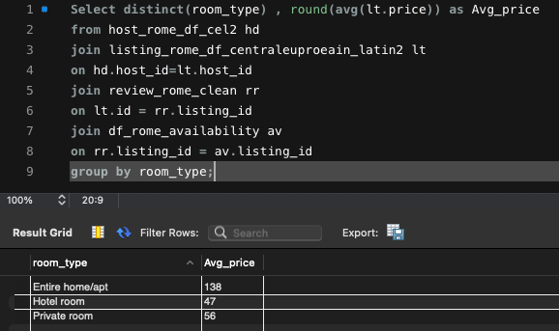
Analysis of the different metrics for the different room categories
Average price for all the three room categories :
Notes:
The price of the entire home/apt is is more then the double as compared with the rest of the room type

Slide 6
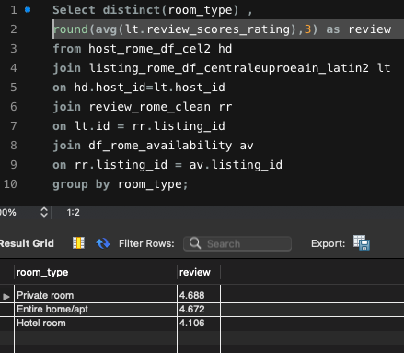
Review score
Average review score for the three different room type

Slide 7
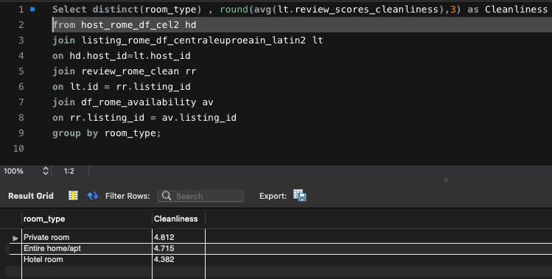
Cleanliness
Average cleanliness score different room type

Slide 8
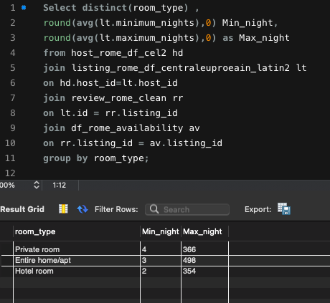
Nights
Average of Minimum and maximum nights

Slide 9
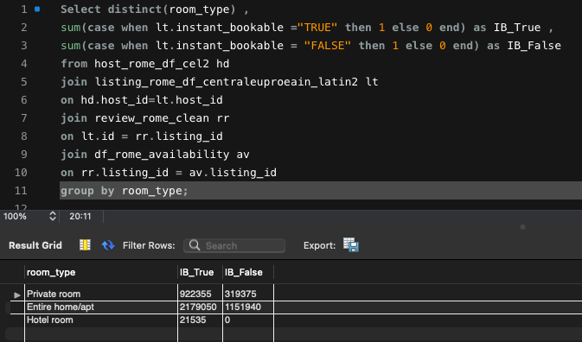
Instant bookable
Whether the room type is instant bookable or not

Slide 10
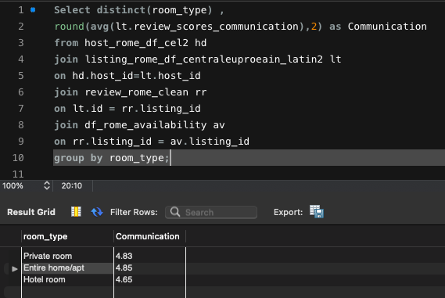
Communication :
Average of the communication review score

Slide 11
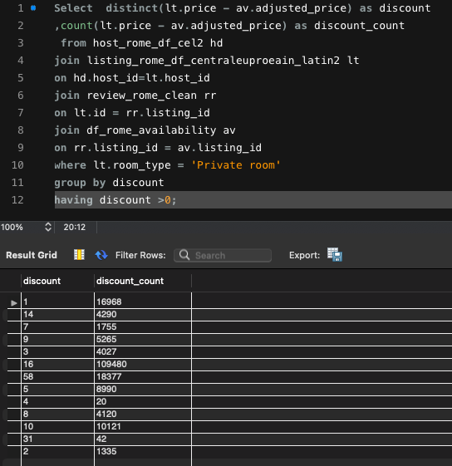
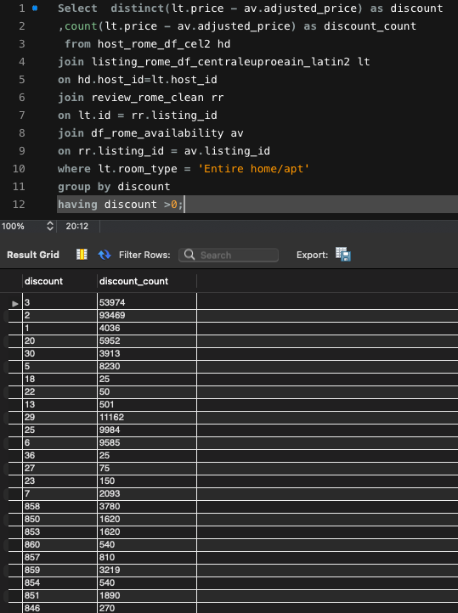
Discount :
Discount provided on the rooms

Slide 12
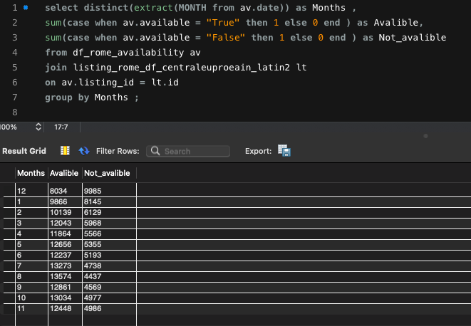
Availability :
Analysis of the correlation of availability
and months

Slide 13
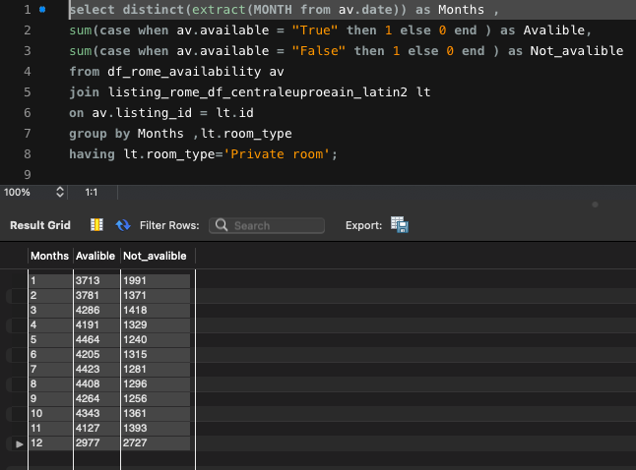
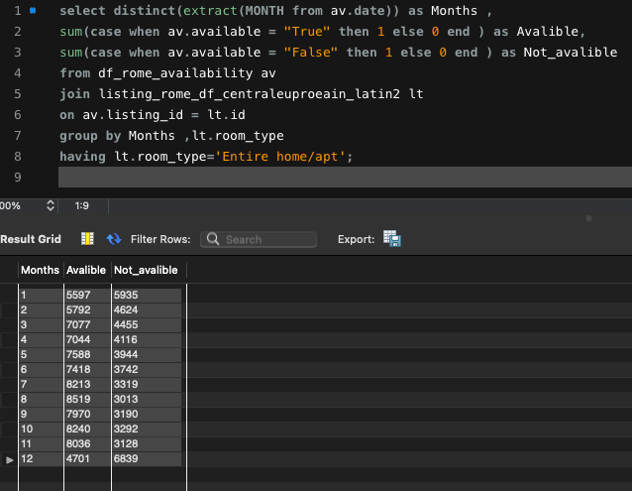
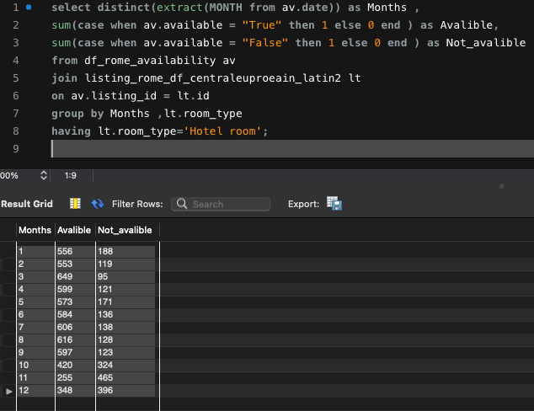
Availability :
Analyse what are the peak and off-peak time for the different categories of property type

Slide 14
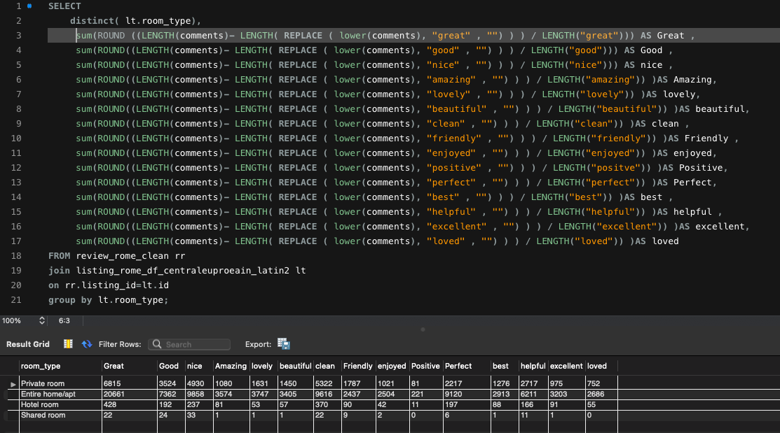
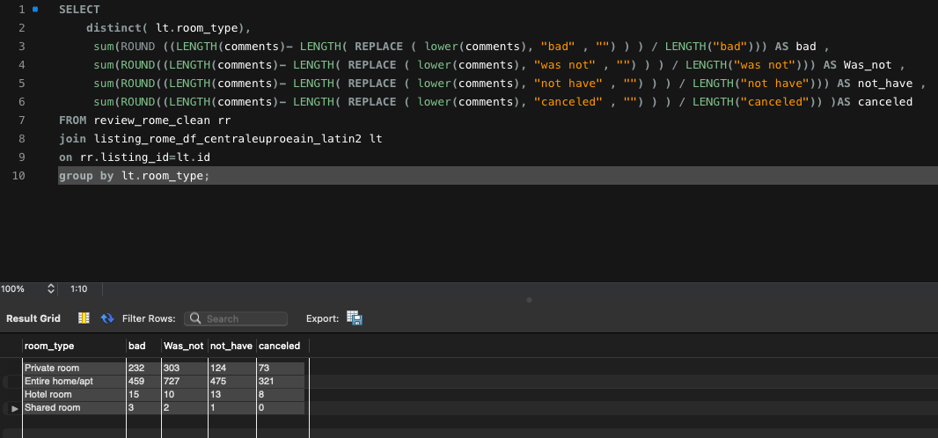
Comments review :
Analysis of the comments of reviewers vary for listings of distinct categories

Slide 15
Using the above analysis, suggest what is the best performing category for the company
After comparing all the metrics form the above chats we can say that private room would be the best category for the company as the price for the private room are almost half as compared to the entire room/apt and other metrics are quiet similar as compared from the above analysis . One of the major metrics which is cleanliness is higher for the private room as compared to the entire room/apt and also the review score for the private room is higher than that of the other categories so on the basis of above analysis we can suggest that private rooms is the best performing category for the company .

Slide 16


