Slide 1
Concurrency Performance and memory management Analysis in Java and GO
Team
Hitesh Kumar - 015237989
Aarsh Patel - 015721342

Slide 2


JAVA or GO ? Who wins when ?

Slide 3
AGENDA
Why we need concurrency in programming languages
Our tasks to check concurrency :
- Matrix multiplication with multithreading (16 threads)
- Key-value memory cache (16 threads)
Performance benchmark and analysis
”When” and “How” part of the analysis

Slide 4
Execution Steps
Input Preparation
Run map()
Shuffle
Run reduce()
Final Output
Assign master
Assign mappers with a specific key
Split input file into pieces
Make copies of the program on the cluster
Input splits are provided to all workers
Each worker will run map() on its piece
Write intermediate key-value pairs locally
Shuffle and forward map results to reduce nodes
Call reduce() for each unique key
Reduce workers append output to final output file
Sort combined output
Store final output to stable storage

Slide 5
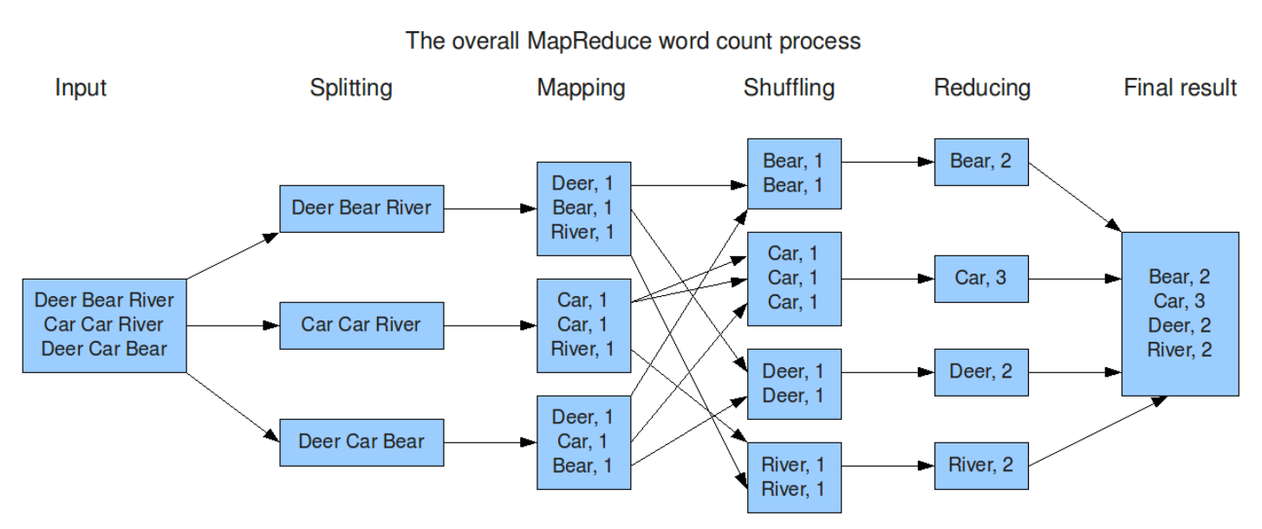
Use Case - Word Count
Fig. 1 MapReduce Process for generate word count [2]

Slide 6
Features: Fault Tolerance
What happens when a worker machine fails?
Master node marks the worker as failed and any ongoing map or reduce tasks are set to idle and can be picked up by other workers
MapReduce will always make forward progress until completion
MapReduce is resilient to large-scale work failures
What if Master node fails?
The master keeps checkpoints which can be used to restart the process from the last checkpoint state

Slide 7
Features: Refinements
Partitioning Function -
MapReduce allows users to write a custom partitioning function for example if keys were URLs and needed to be partitioned based on hostname
Combiner Function -
Sometimes intermediate keys have significant repetition. Might be useful to combine them early
Combiner is another custom function that can perform partial merging of data
Often times it is the same as the Reducer function!

Slide 8
Storage and Persistence
One common issue in distributed computing setups (clusters) - Machine failure
Solution?
Distributed File System
A DFS (such as Google’s GFS [3] or Hadoop’s HDFS) provides a global file namespace where data can be stored in chunks
Chunks can be spread across machines and replicated to provide redundancy
Chunk servers can also serve as Compute servers!

Slide 9
Team Criticisms
Difficult to design mappers and reducers for complex problems
Cannot be used with data streams. Processing is not real-time.

Slide 10



MapReduce on the Cloud
Hadoop [4] is an open-source implementation of MapReduce and has been an industry standard for many years.
Today, MapReduce is offered as a service by many of major Cloud providers
Amazon Elastic MapReduce [5]
MS Azure HDInsights [6]

Slide 11
Hadoop MapReduce Demo
We will show an example of MapReduce running on Apache Hadoop
Hadoop Word Count demo on a published text

Slide 12
References
[1] | Dean, J., & Ghemawat, S. (2004). MapReduce: Simplified data processing on large clusters.
[2] | Stanford HCI: https://hci.stanford.edu/courses/cs448g/a2/files/map_reduce_tutorial.pdf
[3] | Ghemawat, S., Gobioff, H., & Leung, S. T. (2003, October). The Google file system. In Proceedings of the nineteenth ACM symposium on Operating systems principles (pp. 29-43).
[4] | Apache Hadoop: https://hadoop.apache.org/
[5] | Amazon EMR: https://aws.amazon.com/emr/
[6] | Microsoft Azure HDInsights Hadoop: https://docs.microsoft.com/en-us/azure/hdinsight/hadoop/apache-hadoop-introduction

