Slide 1
SPEEDING UP MACHINE LEARNING USING Parallel processing
Presented By: Hitesh kumar

Slide 2
Agenda
Parallel Processing Introduction
Core performance
Supervised and Unsupervised Learning
History of Machine Learning(ML)
Parallelization of ML models
Python Implementation

Slide 3
Parallel Processing
Parallel processing is a technique of segmenting a larger problem into subproblems.
Parallel processing can be done on various levels Bit-level, instruction level, program level or system level.
Objective of parallel processing : i. to increase the throughput
ii. faster execution of overall processes

Slide 4
Core
A core is an essential component of the CPU that performs primary calculations.
A CPU can have single, dual, quad or n-cores.
More the core, more the performance. The system scheduler performs hyperthreading and achieves parallel processing using the performance of the available cores.

Slide 5
Core Continued..
Having a multi-core architecture, at a particular time, multiple tasks can execute on multicores, and it increases the throughput.
Figure 1. Multiprocessing of instructions to each processor

Slide 6
Supervised Learning
Supervised learning involves learning from data whose label has been already assigned.
This type of learning includes comparing the calculated output with actual output and assigning the weights according to the data.
For example, labelled data included opcodes of malware files and labels if it's benign or malware. The algorithm learns accordingly and predicts for a valid input is malware or not.

Slide 7
Unsupervised Learning
It involves data whose label is not defined. The algorithm's task is to find the internal structure of the data and solve the required problem.
The raw data is input to the algorithm, the algorithms look for any patterns and hidden structures and output the pattern which is interpreted by another machine or a human.
This type of learning is very beneficial in recommendation systems and pattern recognition intensive tasks.

Slide 8
History of Machine Learning
The term ML or machine learning was introduced back in 1959, primarily by Arthur Samuel.
A similar word for machine learning was used as self-learning by machines.
Also, this field was associated with pattern recognition and pattern classification. There was significant work going on pattern recognition back in the 1970s and 1980s.
A breakthrough was the introduction of neural nets which learnt the A-Z alphabets, numbers and some special characters from a computer system.

Slide 9
Parallelization of ML models
There are multiple machine learning (ML) algorithms that can be parallelized using sklearn python package using n_jobs parameter.
Also, we can manually set the n_jobs and cores to check the performance.
For performance purposes in this paper, a randomforest classifier is being used with variable features to check the overall performance.

Slide 10
1. Parallelization of Random Forrest
Random Forest Model
Random forest is used for classification and regression purposes. It falls under the supervised machine learning category which is easy to implement. A forest consists of collection trees data structures that perform the calculations and build a decision based on the inputs. The best branch of the best tree is selected as the best solution [6]. It has multiple applications ranging from image classification to feature selection.

Slide 11
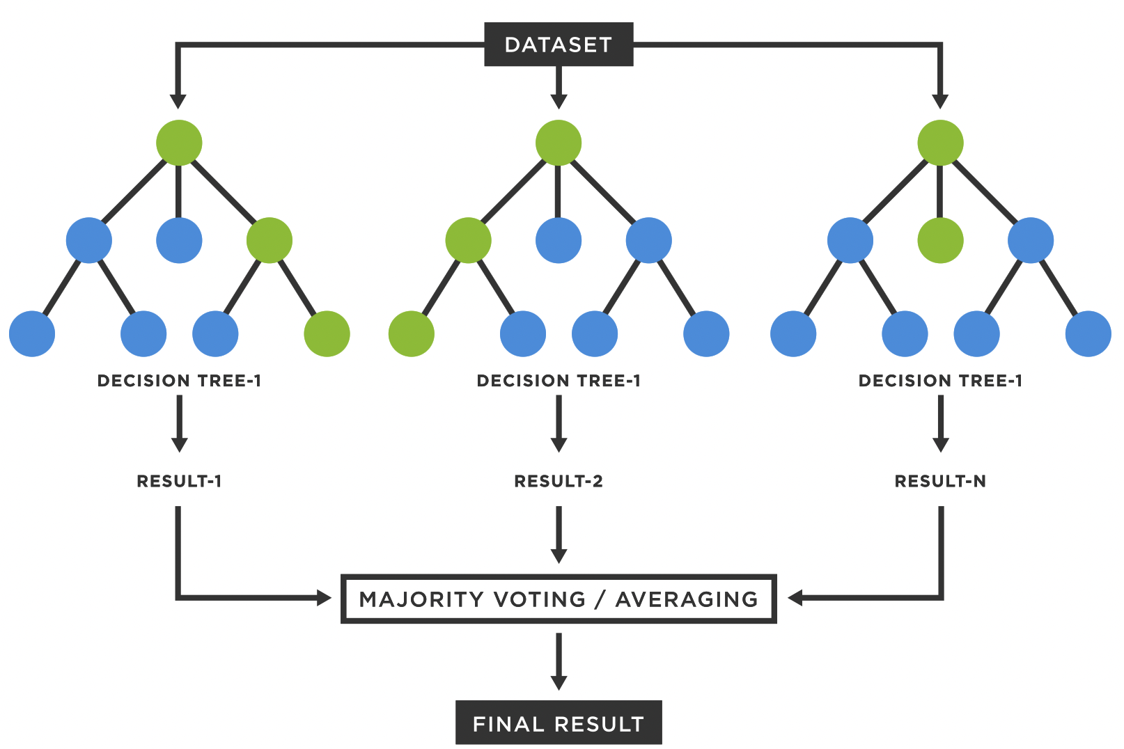
1. Parallelization of Random Forrest
The algorithm follows below steps:
Selection of random samples is done
Build a decision tree for the sample selected
Predict the result for each tree
Count the predicted results and
get the results with maximum voting

Slide 12
Implementation
Here we will implement multicore model training by using a random forest classifier.
The number of cores will be changed, and execution time will be recorded for each model training per core.

Slide 13
2. Parallelization of K-Fold Cross Validation
K-Fold Cross Validation
K-Fold is a gold standard resampling procedure for model evaluation when the data is less or there are limited rows.
The procedure is easy to implement which splits into K groups and select one for training and K-1 groups for training and keeps iterating for other groups for train and test.
Each time, a score is calculated, and the model performance is evaluated. The advantage of using this method is that it removes any bias from the data and created a perfect methodology for test and train split.

Slide 14
2. Parallelization of K-Fold Cross Validation
The below is the procedure:
Step 1: Randomly shuffle the dataset with a seed value
Step 2: Split the dataset into k subgroups
Step 3: Select the first group for testing and the rest for training
Step 4: Keep iterating all the groups by selecting one for testing and the rest for training
Step 5: Calculate the score each time
The value of 'k' is usually set depending on the dataset size. Usually, the value of k is set 10 which is experimentally found stable for bias removal. As the value of k increases, there are more splits and the group's size get smaller and hence the bias reduces [10] [11].

Slide 15
Implementation
For the implementation of K-fold CV, n_jobs parameter is used for python sklearn package. The initial value is set 1 and different values are set from 1-8 to check the overall throughput of the program. The sklearn package gives the flexibility to work on different cores. The function cross_val_scores() is initiated from sklearn.model_selection package. For each core, CV is done across different cores i.e., the model is trained across different cores which increases the throughput. The time is calculated for each increase of core execution.

Slide 16
Thank you

