Slide 1
Introduction to Digital Libraries
Assignment #3
Old Dominion University
Department of Computer Science
CS 751/851 Spring 2011
Michael L. Nelson <mln@cs.odu.edu>
03/22/11

Slide 2
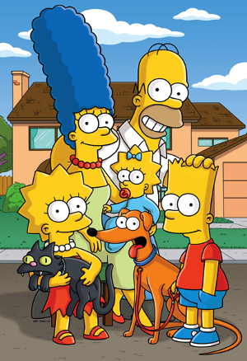

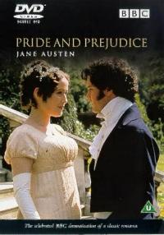

Build a Collection of
"Document-Like Objects"
Continue using your favorite universe (fictional or nearly so) from Assignment #2:

Slide 3
Collection of 1000 "Things"
Using 1 or more of:
  OAI-PMH
  Atom/RSS
  Web crawling
  SE APIs
Collect and store locally at least 1000 "things" (or DLOs, or …)
  1 "thing" can have many web resources
  1 web page with 999 images does not satisfy criteria of 1000 "things"
  intuition: each "thing" must be able to stand alone
    i.e., indexable by a SE
    stylesheets, embedded resources -- everything needs to be local!!!
Hint: get started early, this will be more detailed than you think

Slide 4
Validation & Visualization
Email to the class email list by 11:59PM April 12 URLs for:
  a browsable directory of personal, local copies of your 1000 objects
    not URLs to objects out on the web!
  an .html file explaining in detail how your 1000 objects were obtained, your experiences, lessons learned, etc.
  URLs can be anywhere:
    www.cs.odu.edu
    your magic laptop
    some remote site (e.g., sites.google.com)
    but the URL must be accessible when I check it
      not accessible == late
      no points if it doesn't display like the original version (e.g., wikipedia.org pages are tricky!)

