Slide 1
Object Algebras in Java with Annotations
Zhang Haoyuan
Oct 9, 2014

Slide 2
Abstract
In OO languages we usually deal with a data structure composed of some data variables and a few operations.
Company (depts, employees, personalInfo, incSalary)
Expression (lits, add, eval, print)
For a user, traversing requires a lot of boilerplate code, and may cause errors, type-unsafety and less extensibility.
Our approach can avoid such situation with Java annotations while still holding safety, extensibility and modularity.

Slide 3
Key words
Object algebras
Extensibility & Safety
Code generation

Slide 4
Overview
Background & Previous work
Motivation & Our focuses
Code generation
Instances & Testing

Slide 5
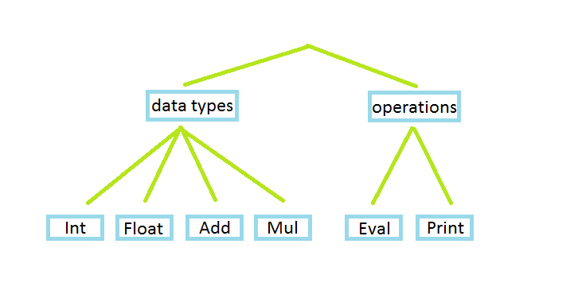
The expression problem
Working on a data structure:

Slide 6
The expression problem
Polymorphism?
Visitor pattern?
Requirements*:
Extensibility in both dimensions
Strong static type safety
No modification or duplication
Separate compilation and type-checking
Independent extensibility
*Ref: Extensibility for the Masses: Practical Extensibility with Object Algebras. (Ecoop2012)

Slide 7
Object algebras
Proposed in Bruno’s paper.
Implementation in various OO languages:
Adding new data types & operations:
data, type class, instance vs interface, inheritance
Static type safety
Combination of algebras:
intersection types vs pairs

Slide 8
Previous work
Done by Jason Chu @ HKU.
“Parser” and code generation with Java annotations
Query algebras based on monoids
Transformations based on visitor pattern

Slide 9
Focuses? (Properties?)
Type safety
Extensibility -> New operations? New data variables?
Query -> Traversals? Integrated information?
Transform -> Interfaces? Visitor pattern?

Slide 10
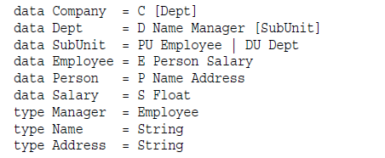
Framework
Here is an example.
*Ref: Scrap Your Boilerplate: A Practical Design Pattern for Generic Programming.

Slide 11
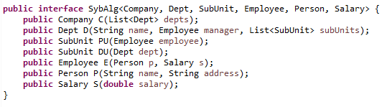
Framework
In Java we would use interfaces with generic types.

Slide 12
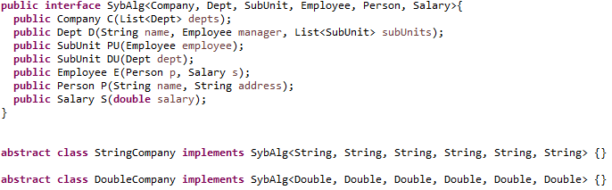
Framework
Implement the methods in StringCompany to collect all the names of employees as traversals.
The same for DoubleCompany to get the sum of salary.

Slide 13
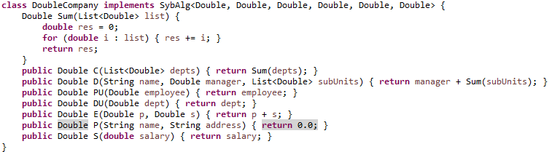
DoubleCompany
Each variable contains all information in its sub-trees.
A lot of code for users!

Slide 14
Problems in Query
A user may write a lot of “ugly” traversing code for EACH query algebra.
What if we use a representative operation interface?
That is, ++ for strings, and (+) for numbers.
They help to “append” the information.

Slide 15
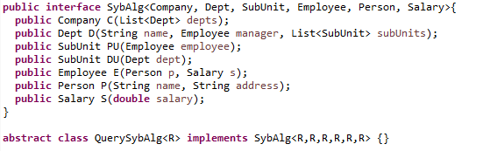
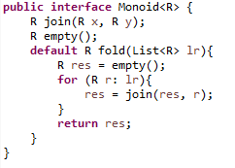
Generic monoids
QuerySybAlg takes a Monoid as an argument.
A user only needs to implement the monoid for a particular type.
Generic QuerySybAlg can be generated.
Loss of generality.

Slide 16
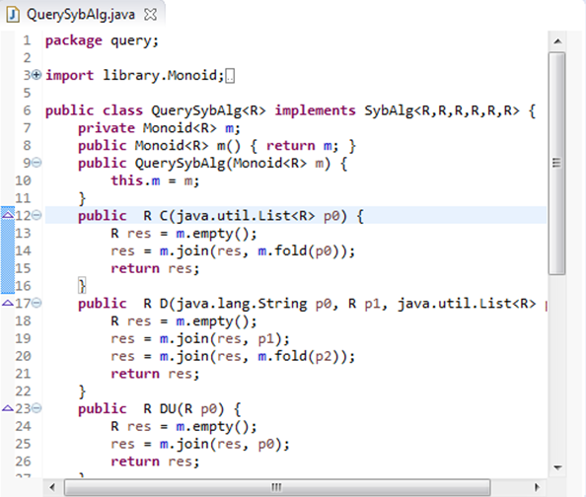
QuerySybAlg (generated auto)

Slide 17
Transformation
Based on the Visitor Pattern
We use the accept(visitor v) methods to implement the traversal, where a visitor (transformation) can go through the entire structure.
Therefore each data variable requires an accept() and its implementation.

Slide 18
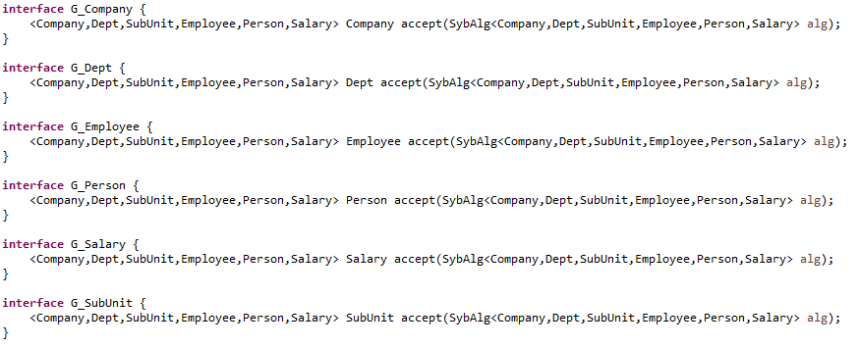
Transformation
new interfaces – for all data variables
- all with accept()
- generated

Slide 19
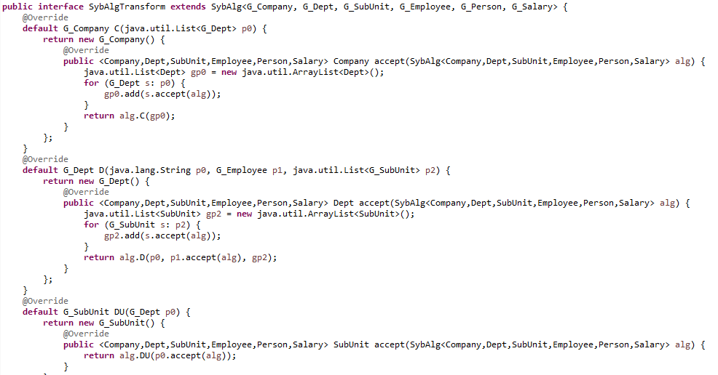
Transformation

Slide 20
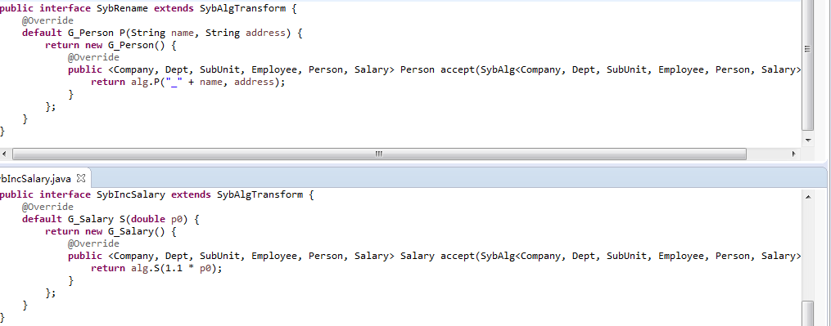
Instances of transformation

Slide 21
Combination
Combination of two algebras helps to achieve independent extensibility with modularity.
So far we have dealt with the combination of two query algebras. For transformations we use accept().

Slide 22
Combination
QuerySybAlg<String> q1; // Names of the employees.
QuerySybAlg<Double> q2; // Sum of salary.
Combination: CombineSybAlg<A, B> q:
- Two generic types
- Two query algebras as arguments in constructor, q1 and q2
- Nested

Slide 23
Combination
CombineSybAlg<A, B> q: (q1, q2)
q.company = q1.company ‘+’ q2.company
q.dept = q1.dept ‘+’ q2.dept
…
q1.company: String;
q2.company: Double;
What is the type of q.company?

Slide 24
Moreover…
Nested?
CombineSybAlg<A, B> extends QuerySybAlg<?>
Intersection types?
class Pair<A, B>.
q.company: Pair<String, Double>.
CombineSybAlg<A, B> extends QuerySybAlg<Pair<A, B>>.

Slide 25
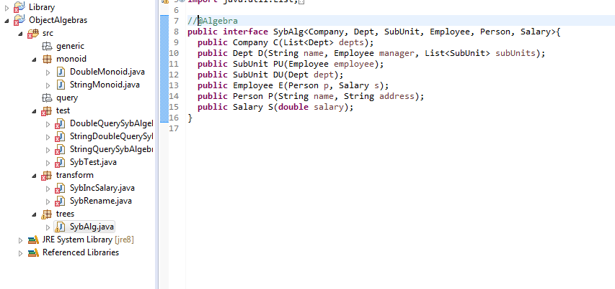
Code generation

Slide 26
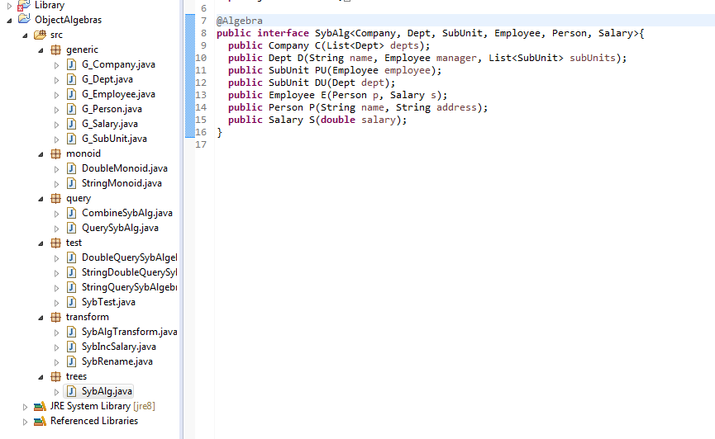
Code generation

Slide 27
Code generation
Done by Java annotations.
Subclass of AbstractProcessor in javax.annotation.processing
@Algebra: invoke the annotation
Java reflection API for code generation

Slide 28
What are generated?
Data variable interfaces with accept() methods.
Implementation of QuerySybAlg<R> taking a monoid as argument.
Implementation of CombineSybAlg<A, B> taking two queries.
SybAlgTransform interface, traversing visitors. To be overridden for transformations.

Slide 29
What are left for users?
Data structure. (with @Algebra)
Queries, transformations.
Like “return name;”
Or “return 1.1 * salary;”
Monoids.
Test code.

Slide 30
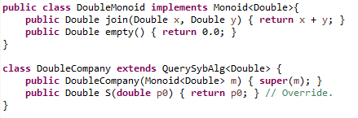
Comparison - Query

Slide 31
Transformation (previous)

Slide 32
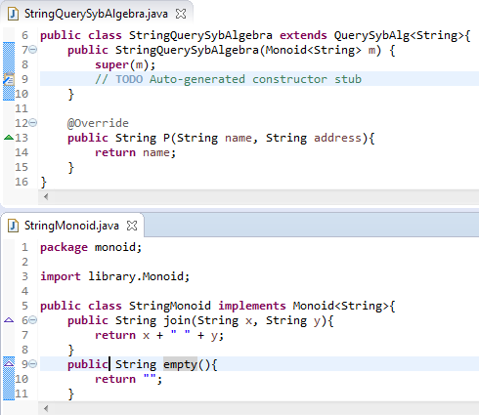
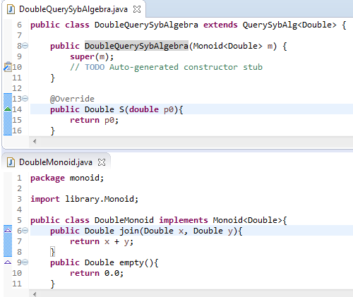
Screenshots. (Testing)

Slide 33
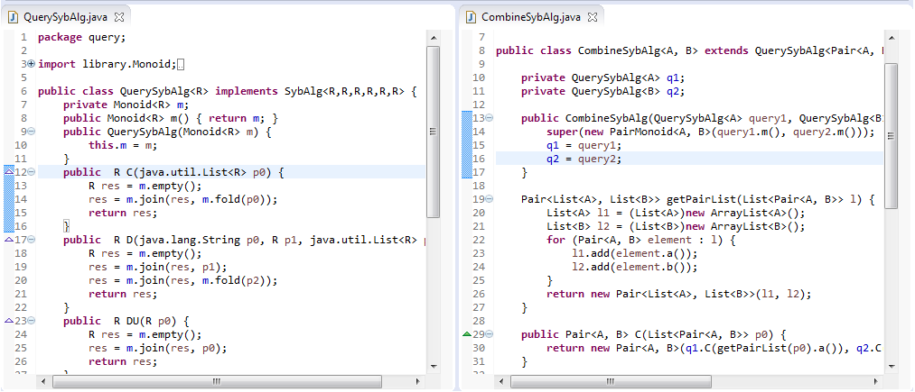
Screenshots. (Testing)

Slide 34
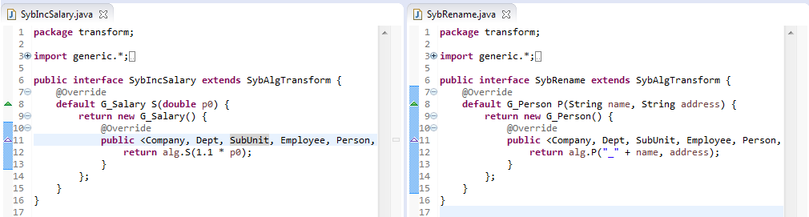
Screenshots. (Testing)

Slide 35
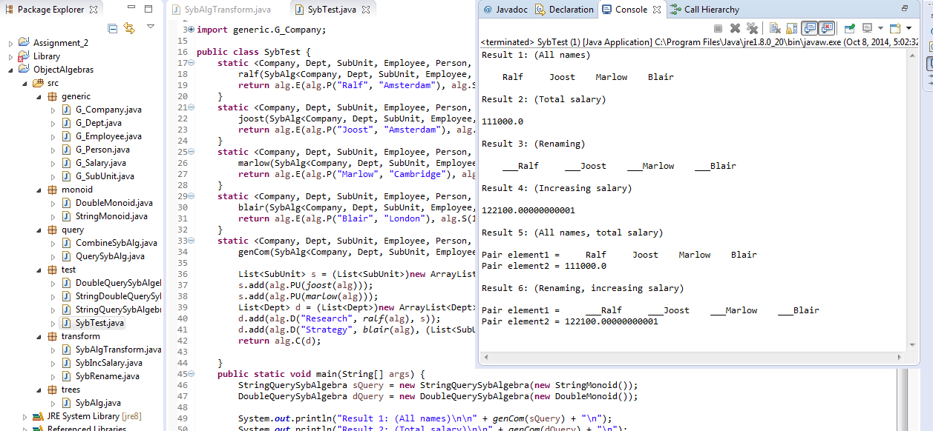
Screenshots. (Testing)

Slide 36
Future work
Currently the queries and combinations are more likely to be specific.
More general one?

Slide 37
Thank you!
Q & A ?

