Slide 1
Exploring lambdas in Java 8 & transformations
Haoyuan Dec 4, 2014

Slide 2
Part I: Lambda expressions
Like what we have in Haskell:
\x -> 2 * x
Function<Integer, Integer> doubleMe = x -> 2 * x;
apply() method in Function
final int double5 =
doubleMe.apply(5);
final int double5 =
((Function<Integer, Integer>) x -> 2 * x).apply(5);

Slide 3
Map():: Function -> List -> List
The method map() takes a Function as an argument and returns a new list.
The same for filter().
map (\x -> 2 * x) [1, 2, 3]
List<Integer> list1 =
Arrays.asList(new Integer[]{-1, 2, -3, 4, 5});
List<Integer> list2 =
list1.stream().map(x -> 2 * x).collect(Collectors.toList());

Slide 4
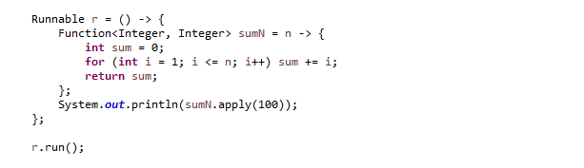
Lambdas with statements
(…) -> { …; …; return …; }
Runnable r: () -> { … }
Function sumN: Int -> Int

Slide 5

Supplier
Functional interface.
Supperlier<T>: something like () -> T.

Slide 6
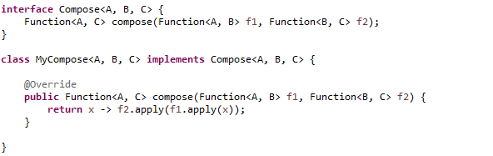
Customized interfaces
Function composition as the example.

Slide 7
Part II: Transformations in OA
Review:
Object algebra interface
Query and transformation algebras
Code generation by Java annotations
Non-contextual transformations
Contextual transformations

Slide 8
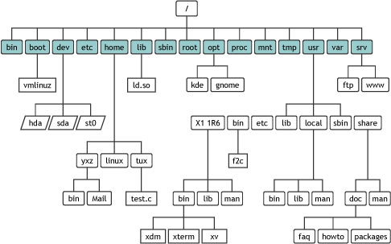
Example: File System

Slide 9
Example: File System
We are working on a data structure, with a set of operations.
Object algebra interface
User-defined data structure
Algebras
Intuitively…
Queries: collecting & processing information
Transformations: modifying the information

Slide 10

File system interface
Very simple: with two methods
Queries & Transformations
extends / implements FileSysAlg<?>

Slide 11
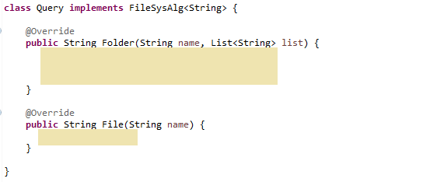
Query
Collecting all file names

Slide 12
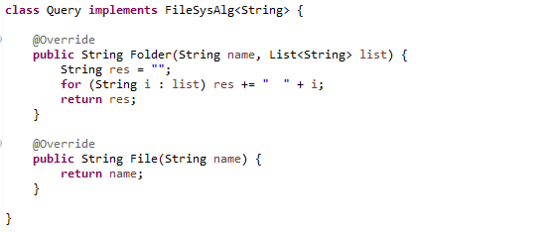
Query
Collecting all file names

Slide 13
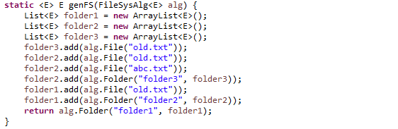
Testing

Slide 14
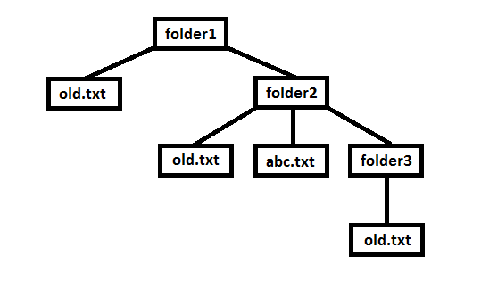
Testing
System.out.println(genFS(new Query()));
old.txt old.txt abc.txt old.txt

Slide 15
Transformation
Renaming all the files named
(oldName::String).
Also we specify a new name
(newName::String).
Idea: using “global” variables
Conquer those cases respectively
Additional information propagation is not necessary

Slide 16
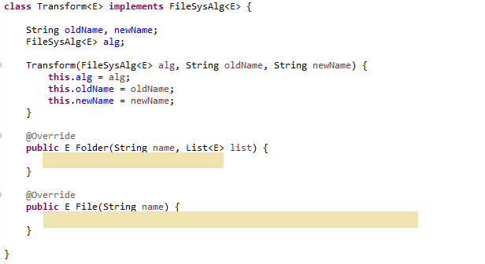
Transformation

Slide 17
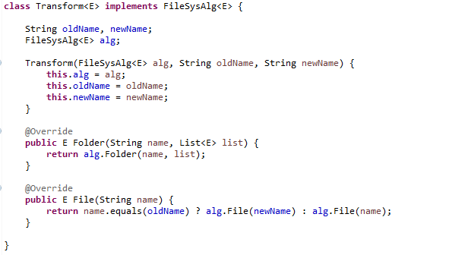
Transformation

Slide 18
Testing
System.out.println(genFS(new Transform<String> (new Query(), "old.txt", "new.txt")));
new.txt new.txt abc.txt new.txt

Slide 19
Transformation2
Renaming a specified file.
(oldName::String).
(path::List<String>).
Also we specify a new name
(newName::String).
Idea: “path” should be passed and modified through the structure
Contextual transformation

Slide 20
Example
oldName = “old.txt”, newName = “new.txt”
path = [“folder1”, “folder2”, “old.txt”]

Slide 21

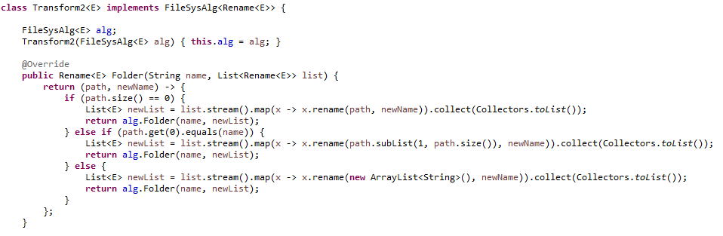
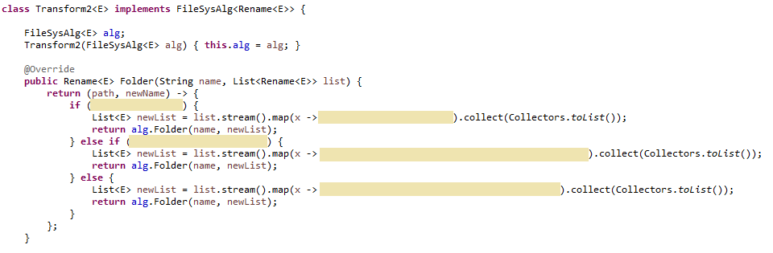
Transformation2

Slide 22
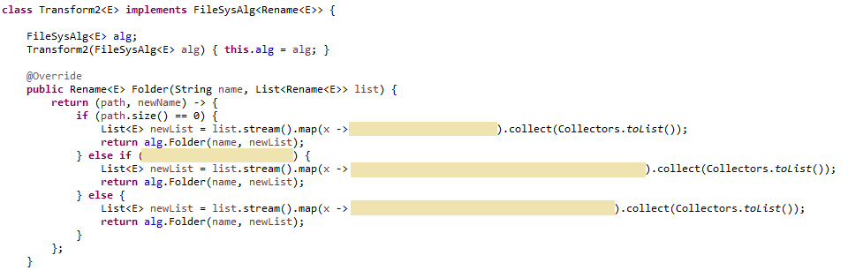
Transformation2

Slide 23

Transformation2

Slide 24

Transformation2

Slide 25
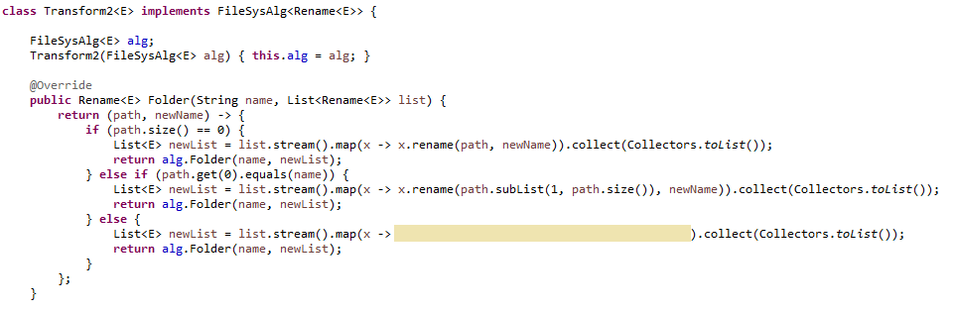
Transformation2

Slide 26
Transformation2

Slide 27
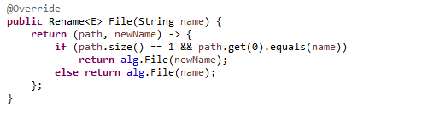
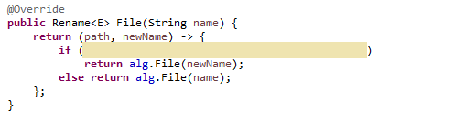
Transformation2

Slide 28
Transformation2

Slide 29
Testing
List<String> path = Arrays.asList(new String[] {"folder1", "folder2", "old.txt"});
System.out.println(genFS(new Transform2<String> (new Query())).rename(path, "new.txt"));
old.txt new.txt abc.txt old.txt

Slide 30
Q & A ?

