Slide 1
Object Algebras in Our Language
Zhang Haoyuan
Feb 12, 2015

Slide 2
Problems to solve
Implementing object algebras in our source language
Why? How?
Extensibility
Applying object algebras in specific data structures
Features & Advantages
Limitations

Slide 3
Introduction (motivation & contribution)
The contributions are:
Implementation of object algebras in our language
Encoding of algebras for more data structures
Polymorphic lists…
Guidance for designing syntax to support OA

Slide 4


Introduction (motivation & contribution)
Challenge 1: no datatypes
Object algebra interfaces as:
Type classes in Haskell
Interfaces in Java
Haskell
Java
But we are designing data types!

Slide 5

Introduction (motivation & contribution)
Challenge 2: no type inference
lit = \(x : Int). x
add = \(x : Int). \(y : Int). x + y
Kind of tedious but unavoidable!

Slide 6
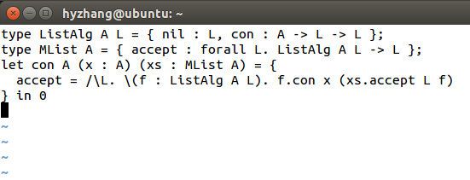

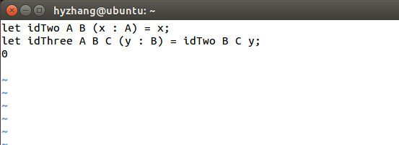
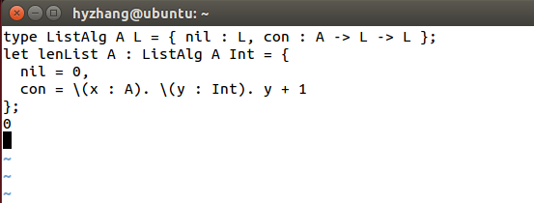
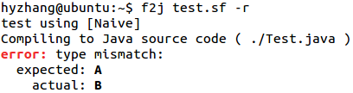
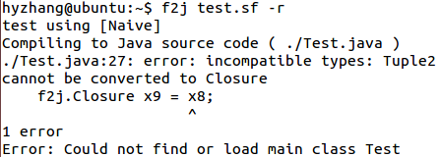
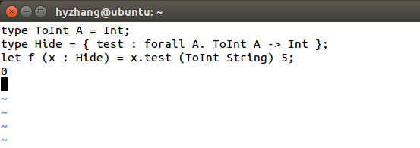

Introduction (motivation & contribution)
Challenge 3: bugs in frontend

Slide 7

Introduction (motivation & contribution)
Challenge 3: bugs in frontend
Parser, type-checker, simplifier…

Slide 8
Key words
Object algebras(..)
Example-based
Visitor pattern
Client code

Slide 9
Before we start
Previous work: Simplify.hs fixed (br: systemfi)
Weird substitution -> Safe substitution
Better solution in progress: PHOAS programming

Slide 10
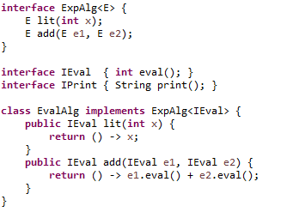
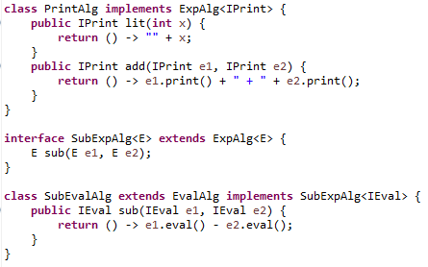
Review

Slide 11
First example: ExpAlg
(1) Define ExpAlg, IEval, IPrint as types
Using type synonyms & record
type ExpAlg E = { lit : Int -> E, add : E -> E -> E }
type IEval = { eval : Int }
type IPrint = { print : String }

Slide 12
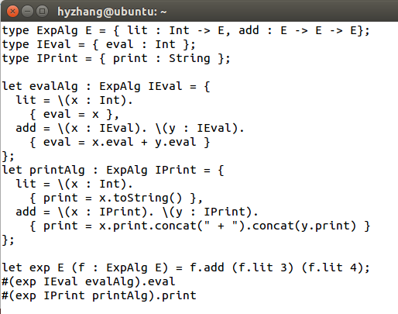
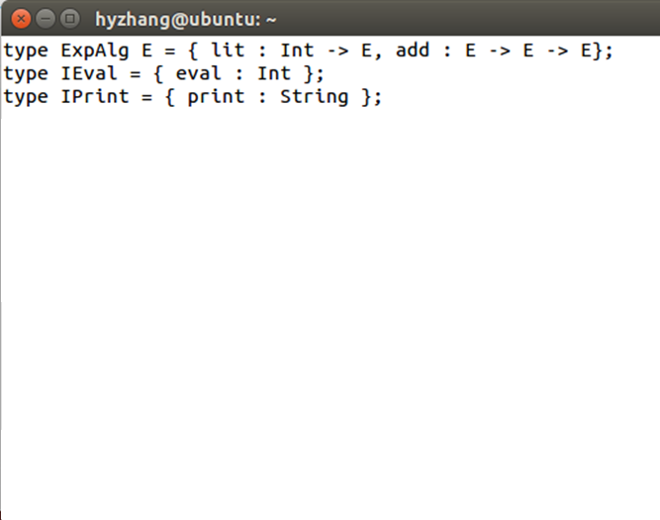
Coding!

Slide 13
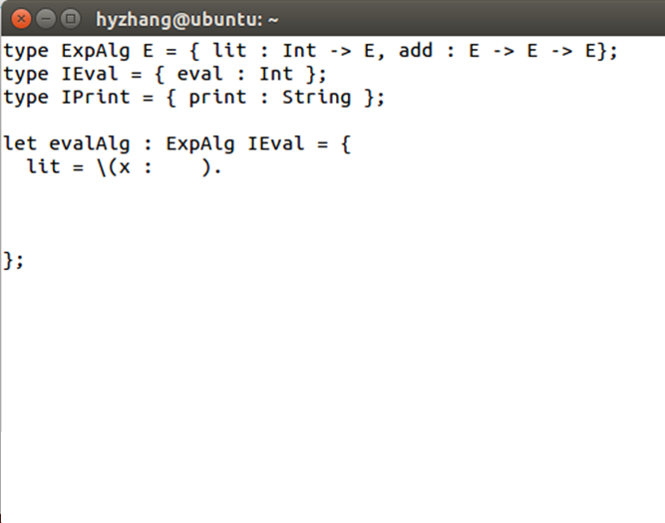
Query algebra: eval

Slide 14
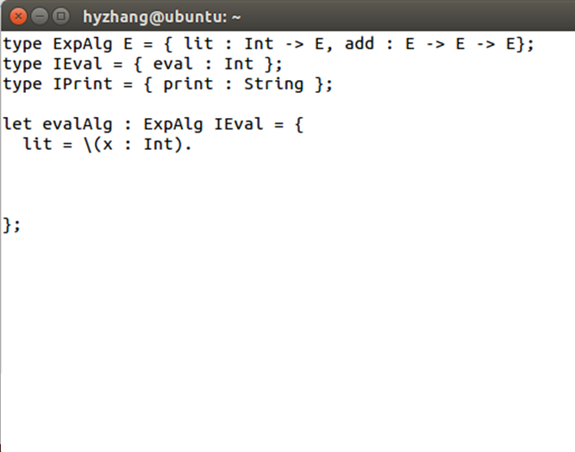
Query algebra: eval

Slide 15
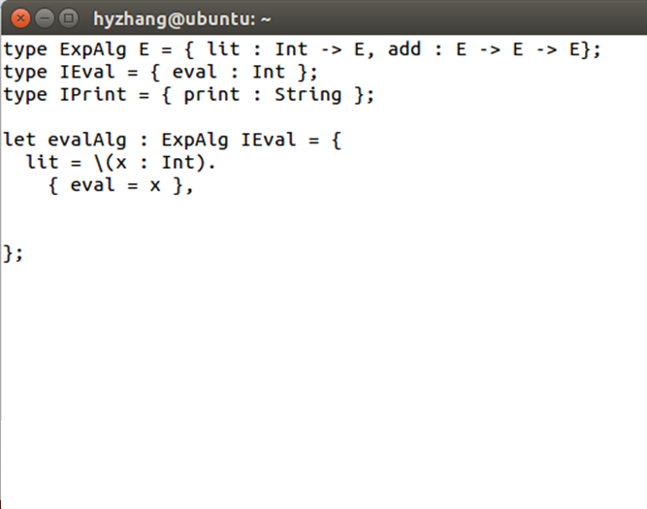
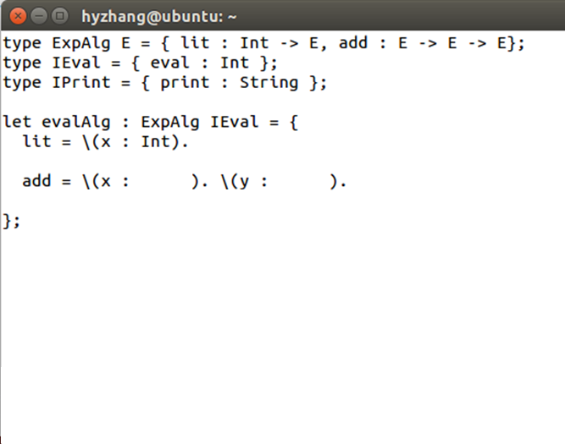
Query algebra: eval

Slide 16
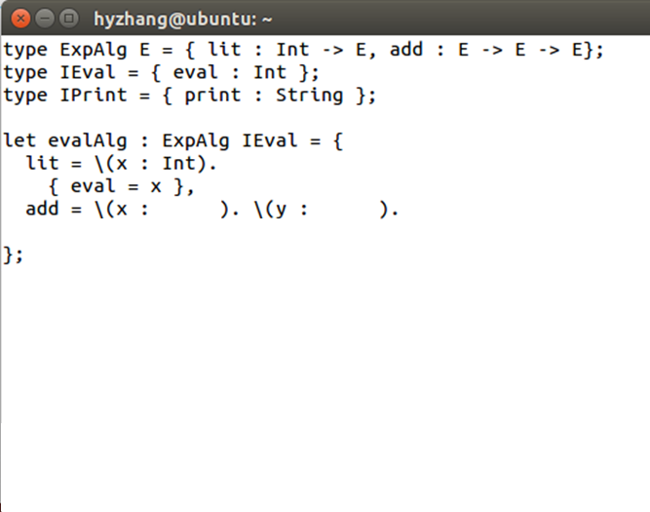
Query algebra: eval

Slide 17
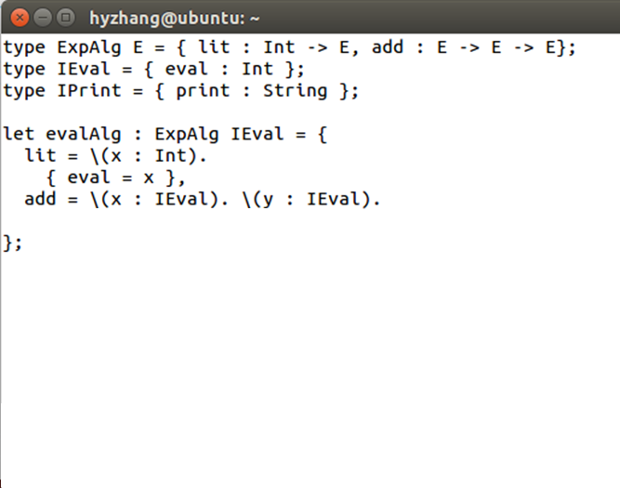
Query algebra: eval

Slide 18
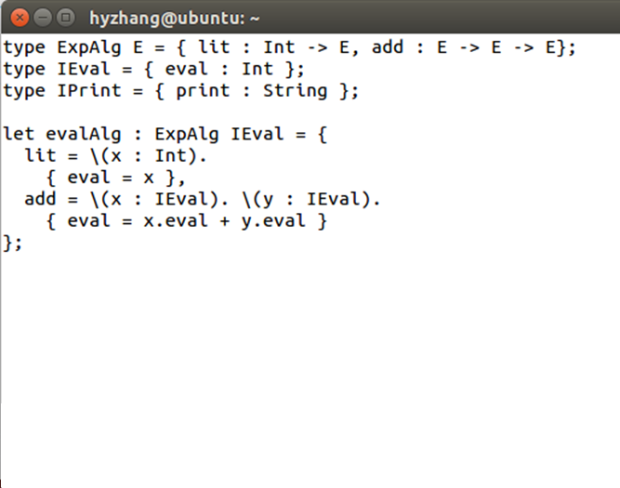
Query algebra: eval

Slide 19
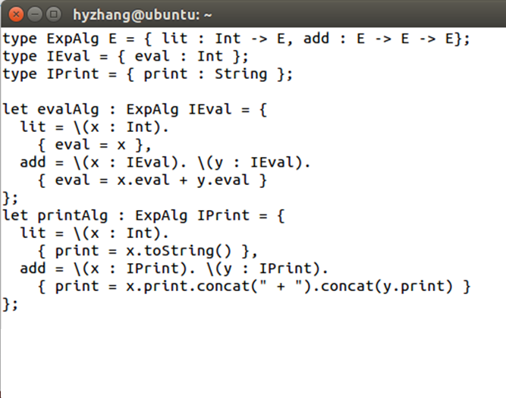
Query algebra: print

Slide 20
Testing

Slide 21
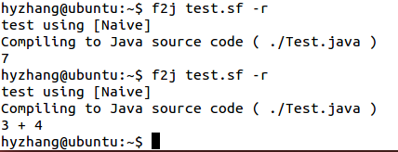
Testing

Slide 22
Well… not enough…
So far we are able to deal with:
Object algebra interfaces
Queries
What we need:
Transformations
Extensibility

Slide 23
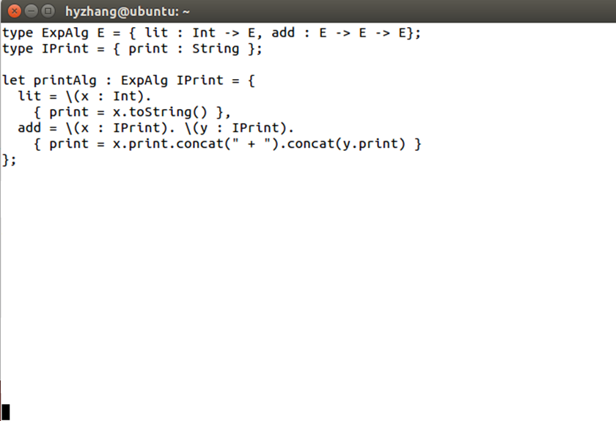
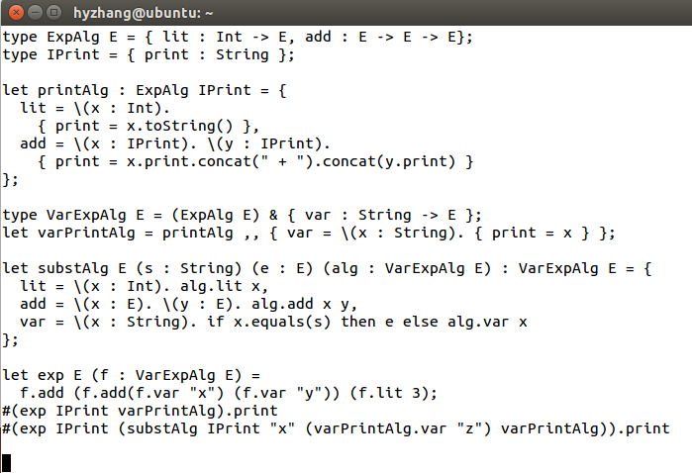
A simplified version

Slide 24
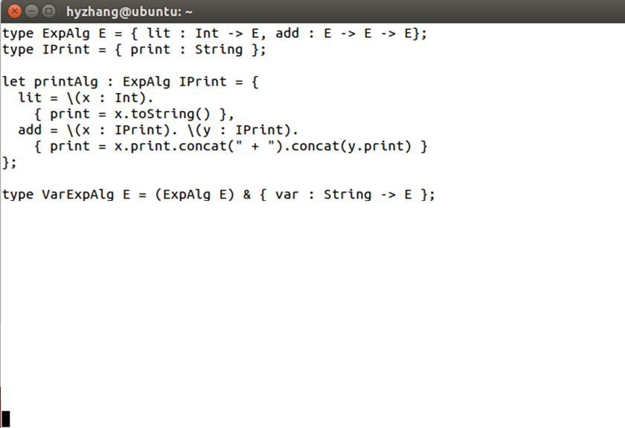
Extended data structure

Slide 25
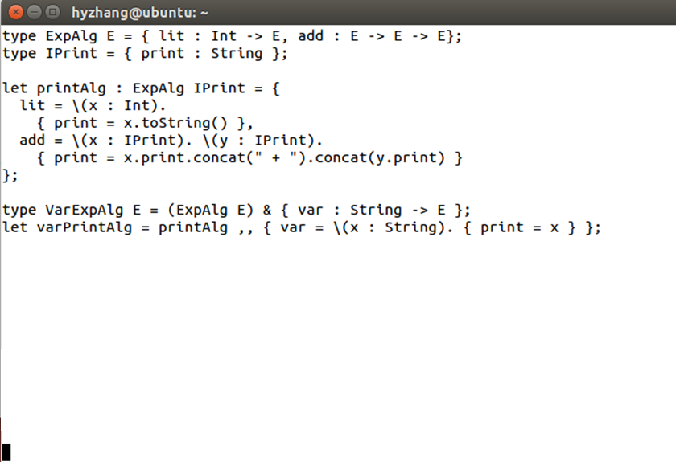
Query algebra for constructor “var”

Slide 26
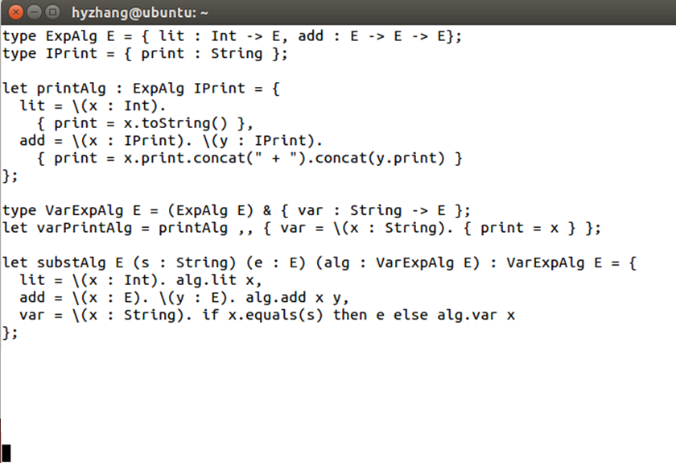
Transformation algebra: subst
lit – add - var

Slide 27
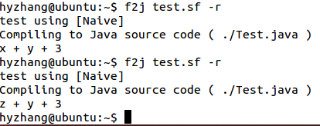
Testing

Slide 28

Combination
Two query algebras. Intersection type.

Slide 29

Let’s move on! Visitors
Constructing an instance seems clumsy.
let exp E (f : VarExpAlg E) =
f.add (f.add (f.var “x”) (f.var “y”)) (f.lit 3)
let exp = add (add (var “x”) (var “y”)) (lit 3)
What are the types?
“forall E.” needed.

Slide 30
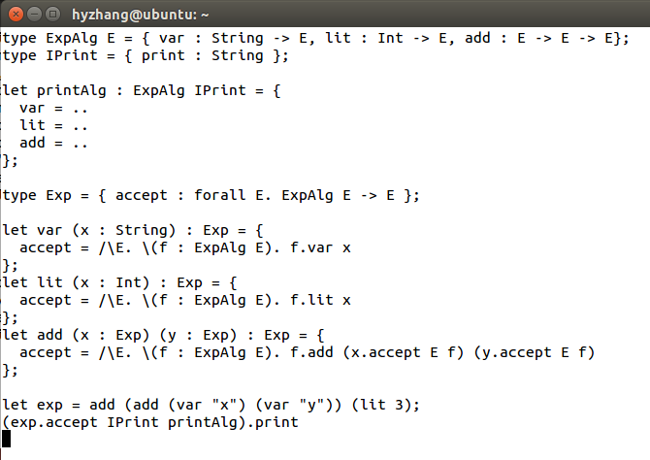
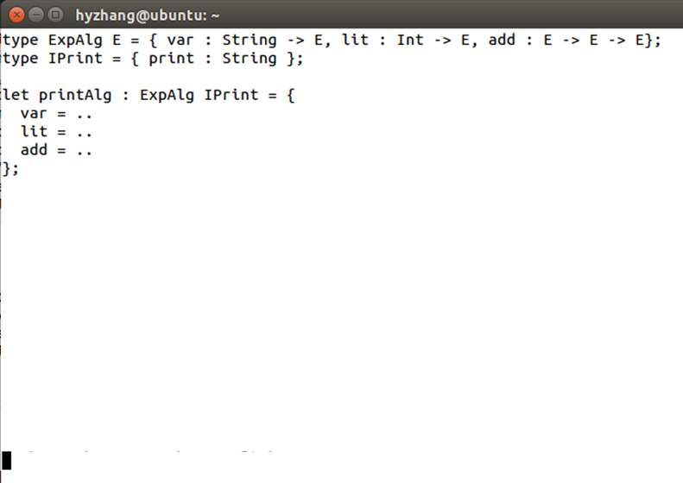
ExpAlg(var, lit, add)

Slide 31
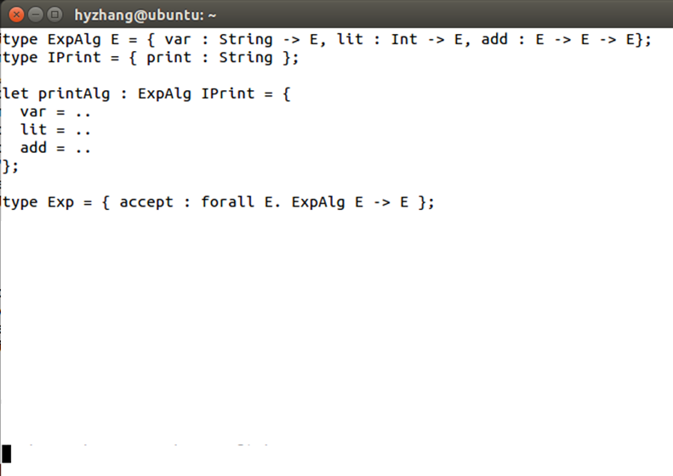
Exp “accept” Visitor

Slide 32
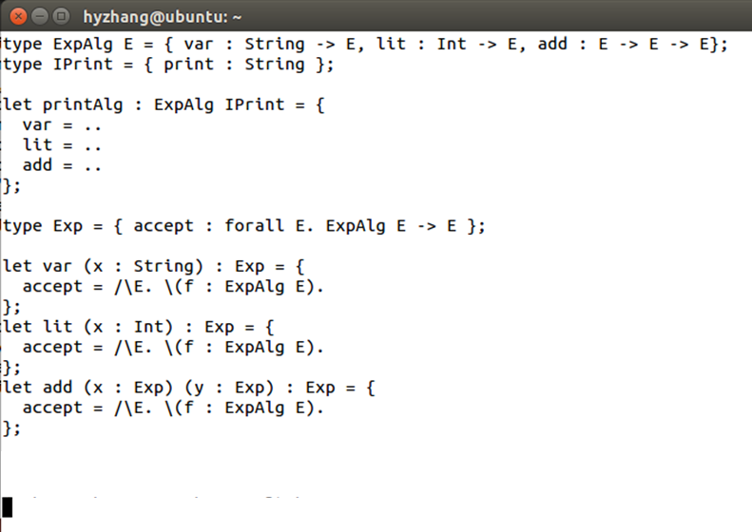
Auxiliary constructors

Slide 33
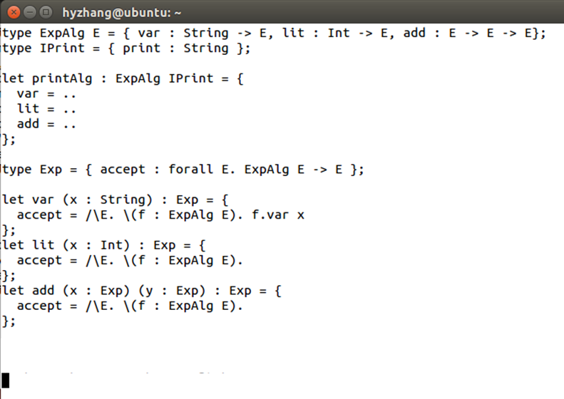
Auxiliary constructors

Slide 34
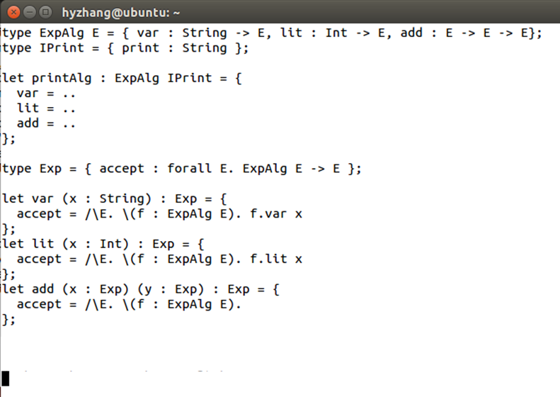
Auxiliary constructors

Slide 35
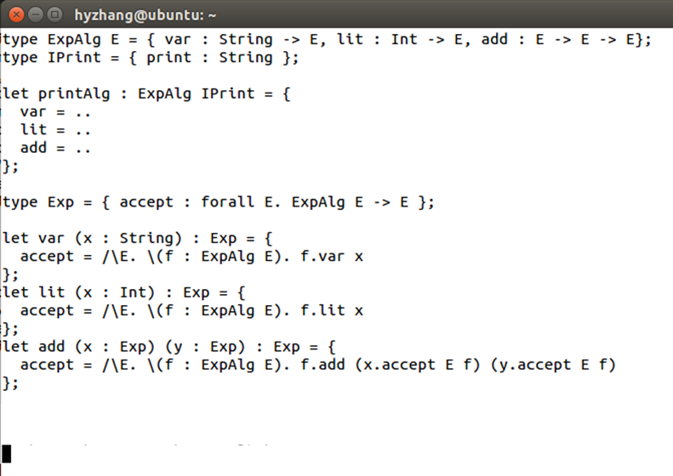
Auxiliary constructors

Slide 36

Testing

Slide 37
Second example: ListAlg
Let’s see how to define a polymorphic list.
type ListAlg A L = { nil : L, con : A -> L -> L }
Four useful algebras:
sumAlg : ListAlg Int Int
lenAlg : ListAlg A Int
headAlg : ListAlg A A
mapAlg : (A -> B) -> ListAlg B L -> ListAlg A L

Slide 38
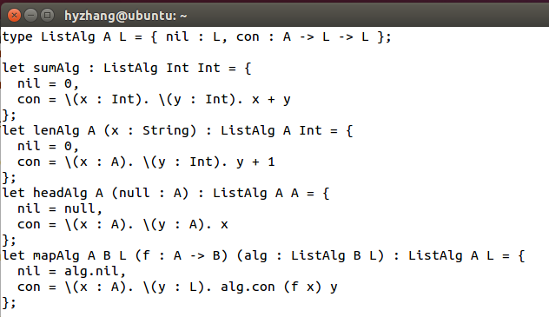
ListAlg

Slide 39
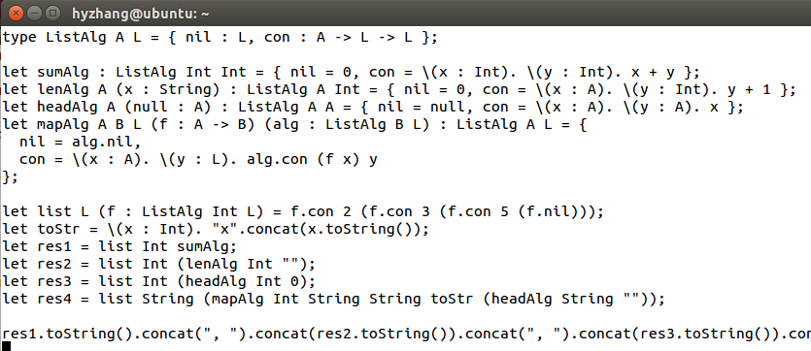

ListAlg

Slide 40
ListAlg using Visitor
A lot of algebra-related code!
But now we have visitors to encode object algebras!
See how to construct the data structure “List<E>”.
In that case, client code could be much shorter.

Slide 41
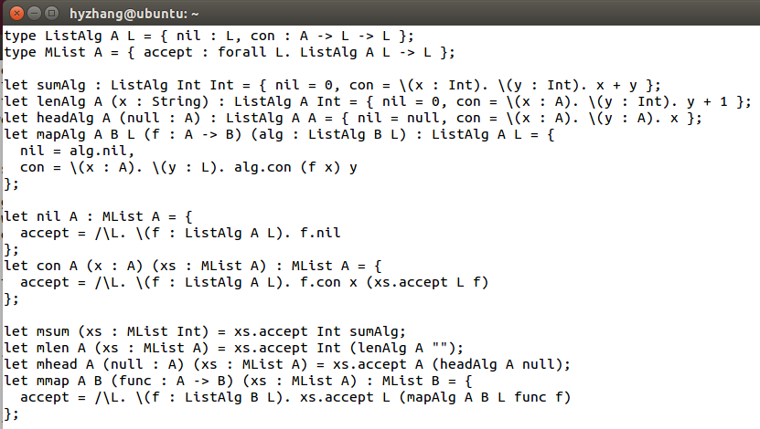
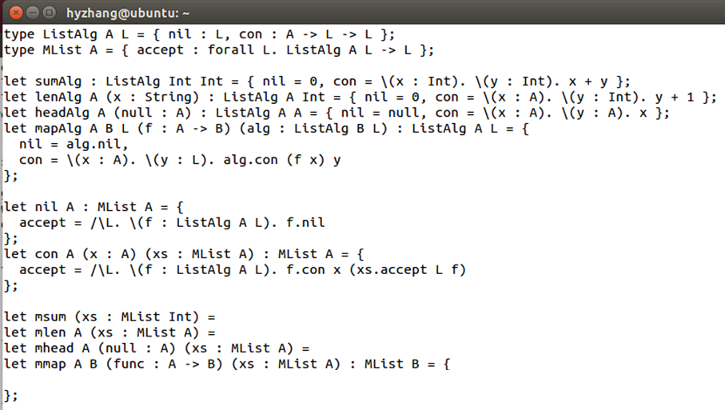
Mlist<A>

Slide 42
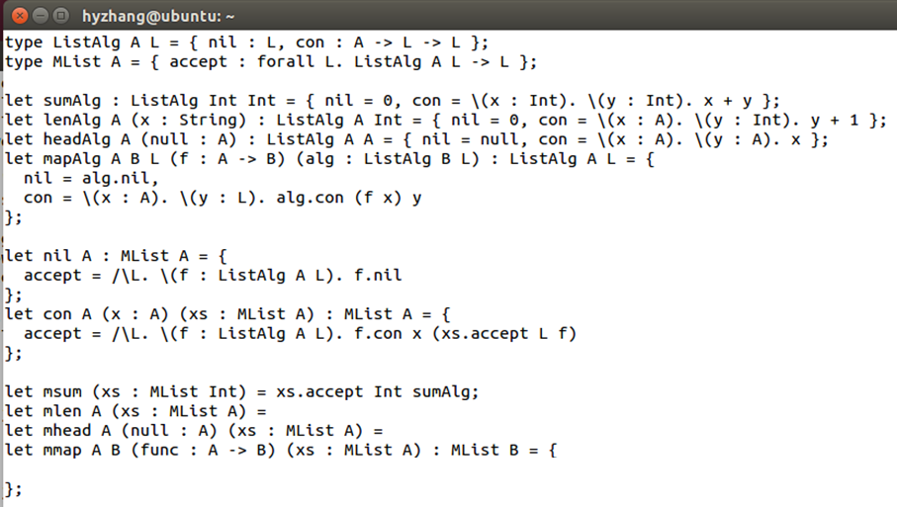
Mlist<A>

Slide 43
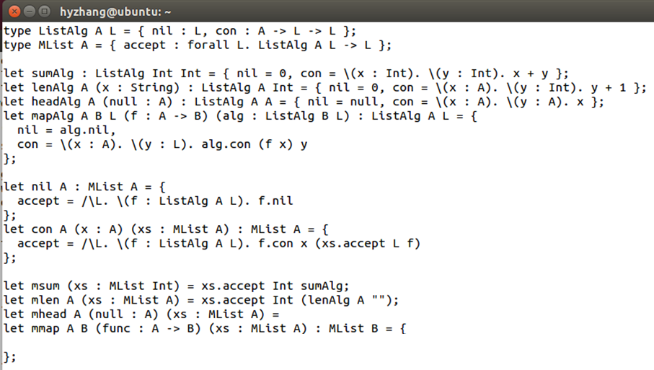
Mlist<A>

Slide 44
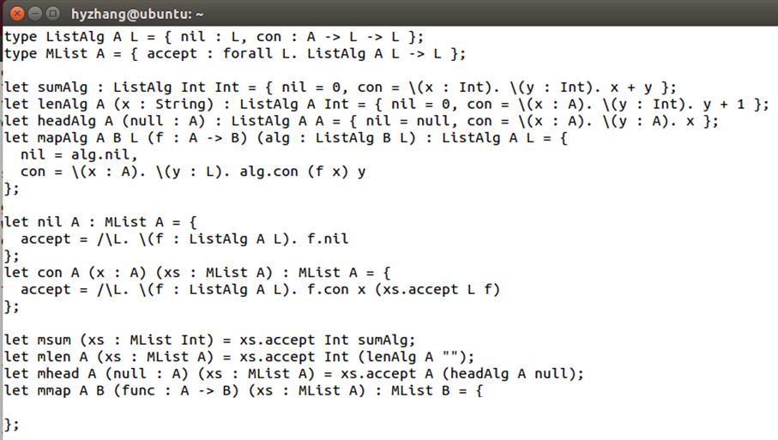
Mlist<A>

Slide 45
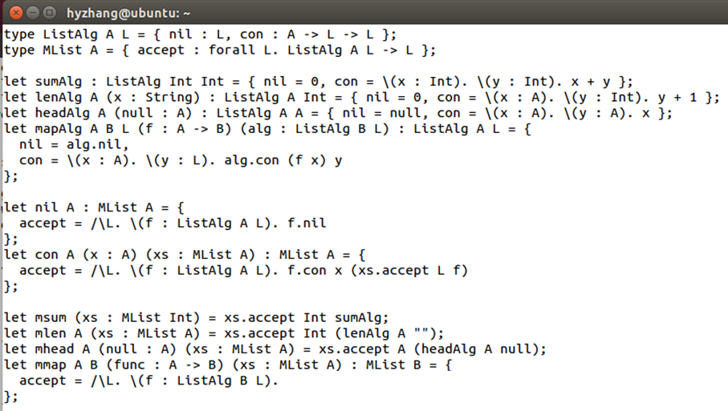
Mlist<A>

Slide 46
Mlist<A>

Slide 47
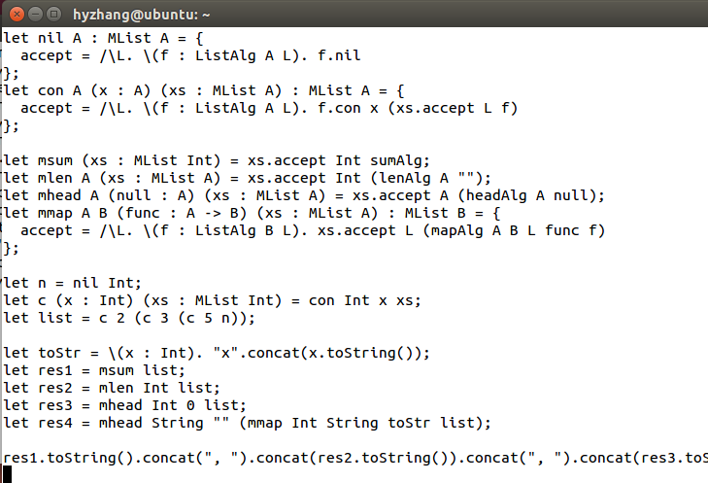
Client code & Testing

Slide 48
Second example: ListAlg
head, len, sum, map…
Easy!
!!(at), ++(concat), tail, filter…
Nontrivial.

Slide 49
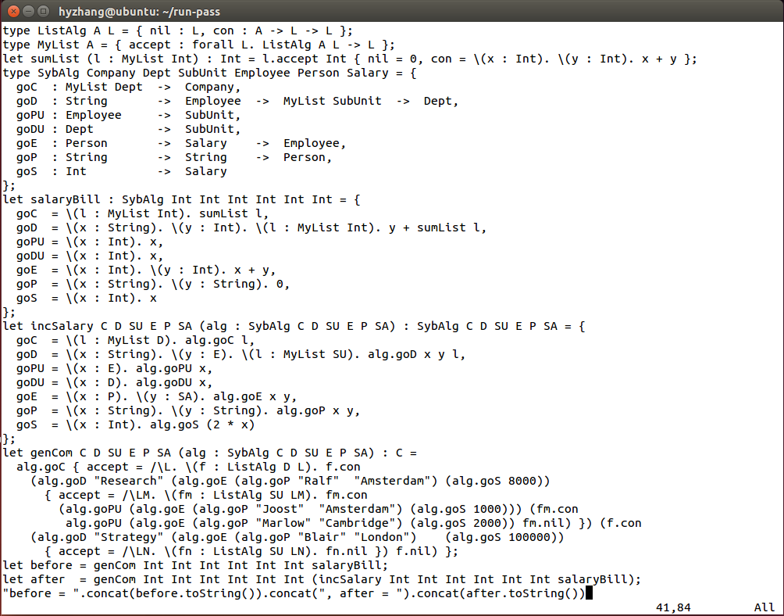

Third example: SybAlg

Slide 50
Can we further improve ListAlg?
(!!), tail, insert?
A good / bad idea?
Rewrite constructors in ListAlg
ListAlg A L = { nil : Int -> L, con : Int -> A -> L -> L }
Just like an array

Slide 51
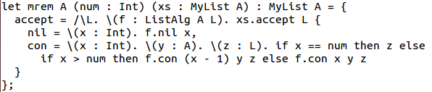
Can we further improve ListAlg?
Representative: “remove” index list.

Slide 52
Discussion
Q & A ?
Future work
Syntax support
Type inference for code generation (pattern matching)

