Slide 1

BSc (Hons) Cyber Security
COMP3000 Computing Project 2023/2024
Tse Chi Kin
10835044

Slide 2
ACS Mini System
Automation of Construction Data Monitoring
with Secure and Safety System

Slide 3
ACS Mini System - develop an affordable and suitable solution for SMEs - focuses on evaluating and implementing data encryption algorithm - for resource-constrained devices or embedded systems

Slide 4
A – Architecture, Automation, Artificial intelligence C – Construction, Cyber Security S – Secure, Safety & Education

Slide 5
Background The construction industry is undergoing a digital transformation, with automation and robotics playing an increasingly significant role in enhancing safety standards and operational efficiency.

Slide 6
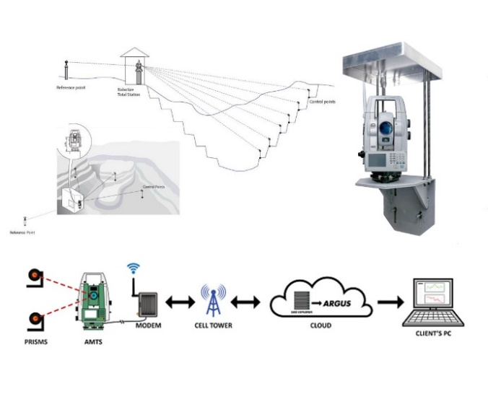
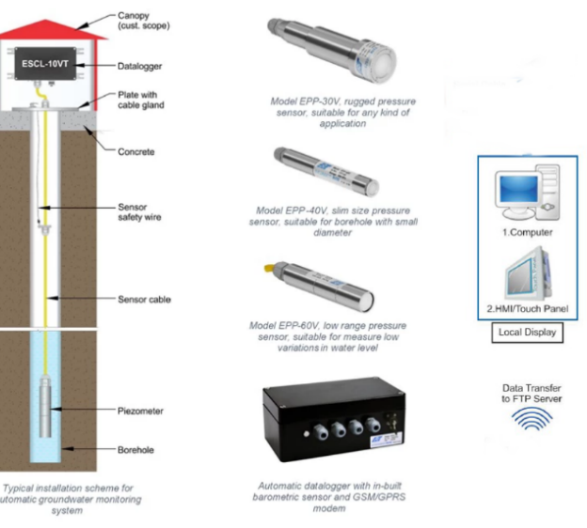
Automated Motorized Total Station (AMTS) System
Automatic Water Level Monitoring system

Slide 7
In HK, most SMEs still relied on manual monitoring methods. The workers use field book to mark down construction data from working site, go back to office, input data to computer and calculate the result with excel, print out report and submit to client. This increase the risk of errors and safety accidents!!!

Slide 8
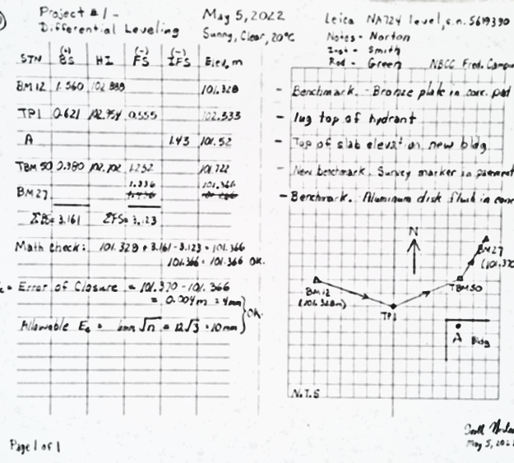
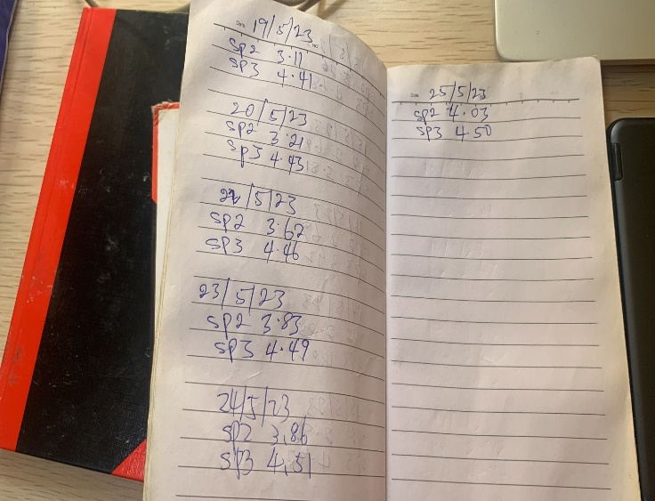
Manual Survey
Water Level Records

Slide 9
Reasons??? - aging workforce - outsourcing and short-term patterns - limited resources for SMEs Challenges??? - lack of stable electricity in construction sites - Internet of Things (IoT) devices strain the efficiency and reliability - monitoring, maintenance, repairs require significant manpower

Slide 10

How Is IoT Data Transmission? Fast? Secure? Power consumption?

Slide 11
Project Aims - To evaluate and compare the performance of different data encryption algorithms - test and analyze encryption algorithms suitable for IOT devices - identify the most efficient and suitable encryption technique for automated instrumentation in the construction sector

Slide 12
Project Implementation - Arduino-based simulations for data transfer with encryption. Encryption Algorithms - AES, AES Small, BLAKE2b, BLAKE2s, ChaCha, ChaCha20+Poly1305, SHA256, SHA3-256,SHAKE256

Slide 13
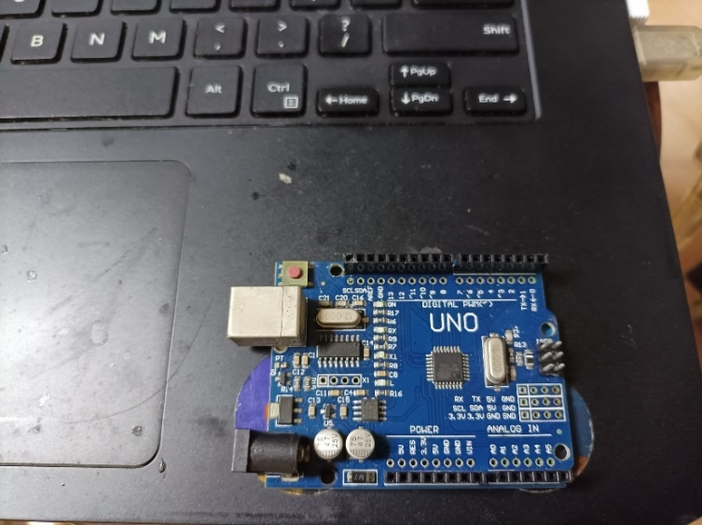
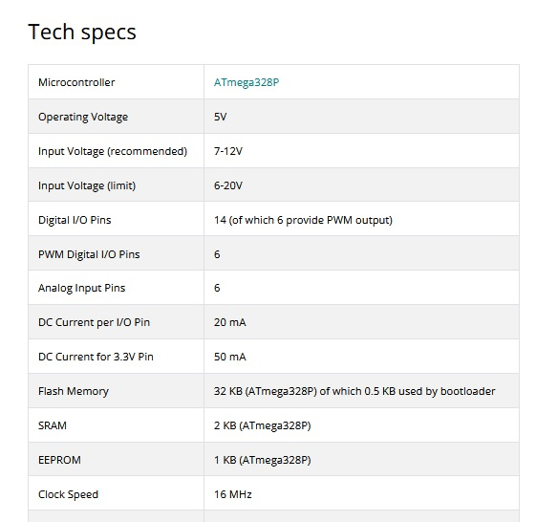
Testing in 3 different Equipment Arduino Uno

Slide 14
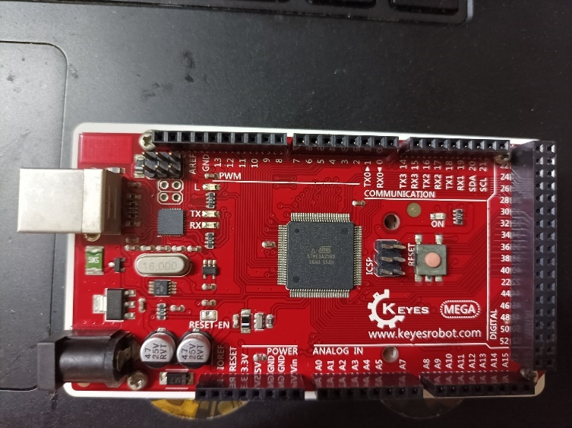
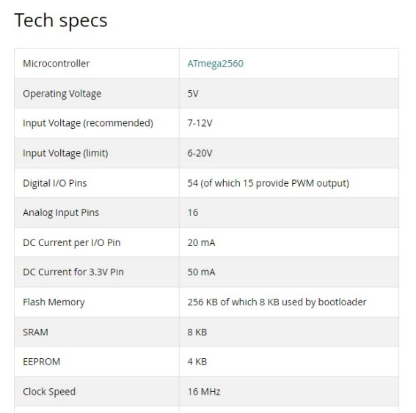
Testing in 3 different Equipment Arduino MEGA2560

Slide 15
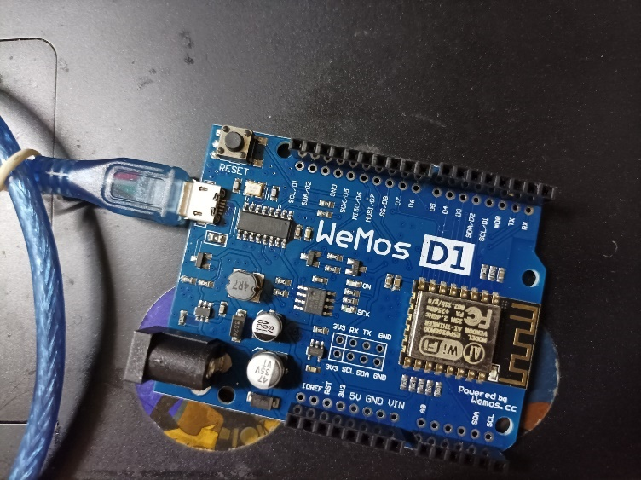
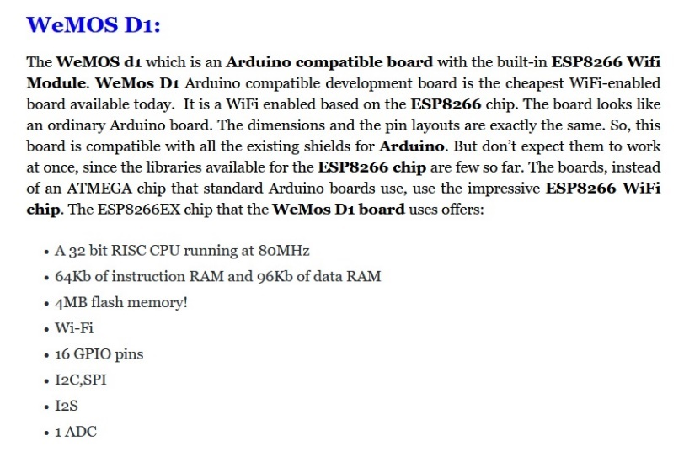
Testing in 3 different Equipment ESP8266 WeMos D1 R2

Slide 16
Testing Result (Arduino UNO)
 |  |  | Performance Tests (bytes per sec)
Encryption Algorithm |  | State Sizes (bytes) | Encrypt | Decrypt
 | AES128 | 181 | 28258.33 | 14826.03
 | AES192 | 213 | 23516.19 | 12240.27
 | AES256 | 245 | 20136.95 | 10422.52
 | AESSmall128 | 34 | 23585.91 | 13576.31
 | AESSmall256 | 66 | 17035.24 | 9541.69
 | BLAKE2b | 211 | 13659.58
 | BLAKE2s | 107 | 18310.39
 | ChaCha20 128 | 132 | 19538.38 | 19536.16
 | ChaCha20 256 | 132 | 19538.41 | 19536.14
 | ChaCha12 128 | 132 | 31005.23 | 30999.58
 | ChaCha12 256 | 132 | 31005.23 | 30999.52
 | ChaCha8 128 | 132 | 43882.14 | 43870.71
 | ChaCha8 256 | 132 | 43882.14 | 43870.83
 | ChaCha+Poly1305 | 221 | 13213.84 | 13213.83
 | SHA-256 | 107 | 5987.68
 | SHA3-256 | 205 | 16369.81
 | SHAKE-256 | 206 | 16409.23

Slide 17
Testing Result (Arduino MEGA2560)
 |  |  | Performance Tests (bytes per sec)
Encryption Algorithm |  | State Sizes (bytes) | Encrypt | Decrypt
 | AES128 | 181 | 27962.53 | 14743.35
 | AES192 | 213 | 23267.88 | 12171.95
 | AES256 | 245 | 19923.04 | 10364.32
 | AESSmall128 | 34 | 23336.24 | 13492.51
 | AESSmall256 | 66 | 16852.51 | 9483.58
 | BLAKE2b | 211 | 13482.85
 | BLAKE2s | 107 | 18305.26
 | ChaCha20 128 | 132 | 19535.42 | 19533.18
 | ChaCha20 256 | 132 | 19535.42 | 19533.18
 | ChaCha12 128 | 132 | 30999.88 | 30994.18
 | ChaCha12 256 | 132 | 30999.88 | 30994.24
 | ChaCha8 128 | 132 | 43873.72 | 43862.29
 | ChaCha8 256 | 132 | 43873.60 | 43862.29
 | ChaCha+Poly1305 | 221 | 13110.32 | 13110.33
 | SHA-256 | 107 | 5985.56
 | SHA3-256 | 205 | 16361.26
 | SHAKE-256 | 206 | 16400.75

Slide 18
Testing Result (ESP8266 WeMos D1 R2 )

Slide 19
Conclusion and Recommendations - ChaCha12 (128-bit or 256-bit) as the primary encryption algorithm for the ACS Mini System, leveraging its high throughput rates and security strength. - ChaCha20+Poly1305 use for secure communication channels, ensuring both data confidentiality and integrity. - Other algorithms like BLAKE2b, BLAKE2s, SHA-256, SHA3-256, and SHAKE-256 can use for specific cases with data integrity and authentication.

Slide 20
Additional Approach - Explore hardware acceleration techniques and code optimizations. - Continuously monitor the security landscape and periodically re-evaluate the selected algorithms. - Collaborate with industry partners, regulatory bodies, and construction SMEs to establish best practices and standards.

Slide 21
Special Thanks: Professor: Beta Yip, Ivy Wong

Slide 22
Thank you

