Slide 1
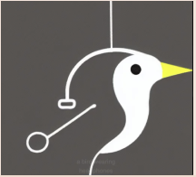
COMP2003HK Computing Group Project (22/AY/AUNS/M) Group-7
KWOK KA KIT (Scrum Master)
YIP KIN WANG (Technical Manager)
NG KA WAI Davina (Product Owner)

Slide 2
Content
Project aims
Prototype
Webpage design
App design
Project Plan overview

Slide 3
Project aims
Client introduces on project scope which the project covers the following services:
Build a public website and build a mobile app(or muti-platform website)
Provide options for researcher to upload photos either by web or app or both.
Design and develop content management system for admin user to update website content.
Perform system testing and security check to ensure the project is in the right track.

Slide 4
Project aims
Client provides information on current environment of existing website.
Provide a platform for the public to record the rare species in Hong Kong and share their findings by uploading photos of the extralimital species.
Server stores the photos uploaded by the public via web.
List of Hong Kong Birds will be published on the official website and app.
Keep the public abreast of the latest news and activities related to the organization.
A Survey form in excel format is used to gather surveyor information, such as location, date, time, name of surveyor, photo.
A Species information form in excel format is used to record rare species exist location, name of surveyor, photo.

Slide 5
Project aims
Client present user requirements and scope of work.
Front-end applications (Web and app):
Bilingual website (English and Chinese)
Public submission:
Collect Species seen before by uploading information such as Date / Time / Location / Date / Time / Location / amount of birds / range of birds in the same species / types of species can be chosen.
Share how they interact with birds.
Submit photos or videos for publishing approval (must include in each submission)
Content Management System (CMS):
Set roles: Admin and Moderator. Admin is the highest-level role permission. Admin can modify system content and delete posts.
Allows public posts and likes. Approval process given to CMS Admin to avoid public inappropriate comments.
Enable moderator approval. Survey record need to be approved by the moderator.
Notifications on/off
Web / App content editing

Slide 6
Project aims
Client concerns on the security level of major deliverables and the potential vulnerabilities. Technical measures include encryption, store and use of data.
Data protection is important.
Limiting the types and amount of personal data collected could minimize the risk of data jeopardize on unused personal private data.
It is encouraged to address data encryption at rest and/or in movement to prevent data breach.
Add an ownership of copyright notice to remind not to steal the photos and improper use of photos.
Photography usage rights agreement provided to public before he/she uploads photos.
Copy and paste images is not preferred. Project Team need to provide solution to cater this issue.

Slide 7
Prototype
In this part, our team ready webpage and app side design, the design for both a the same design.
This is a first round design, having update design on second round.
The next page shows the webpage design and app side design.

Slide 8
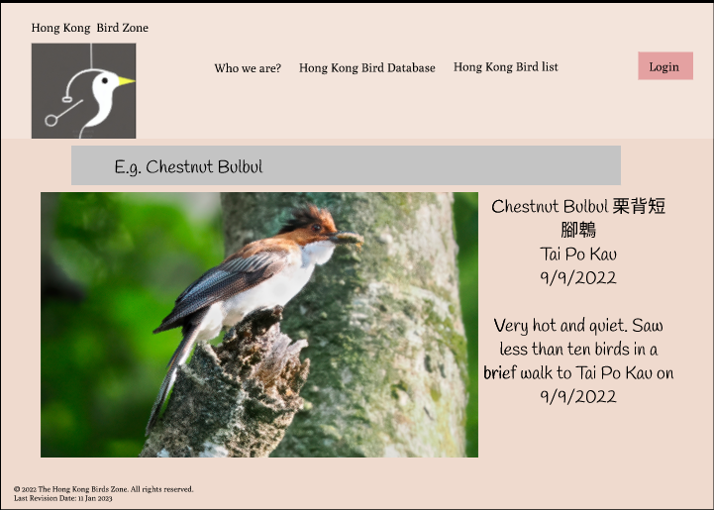
Prototype-Webpage design-First page

Slide 9
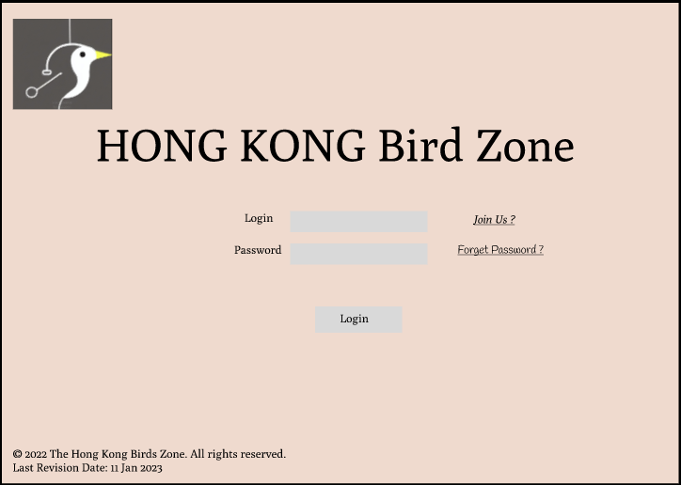
Prototype-Webpage design-Login page

Slide 10
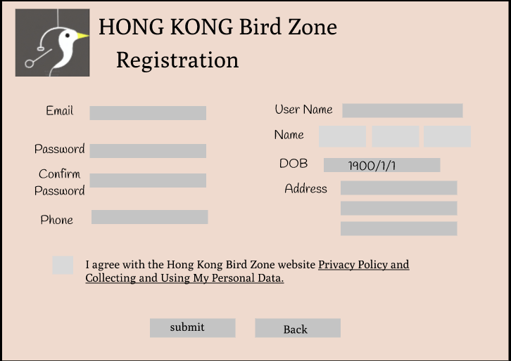
Prototype-Webpage design- user regisration

Slide 11
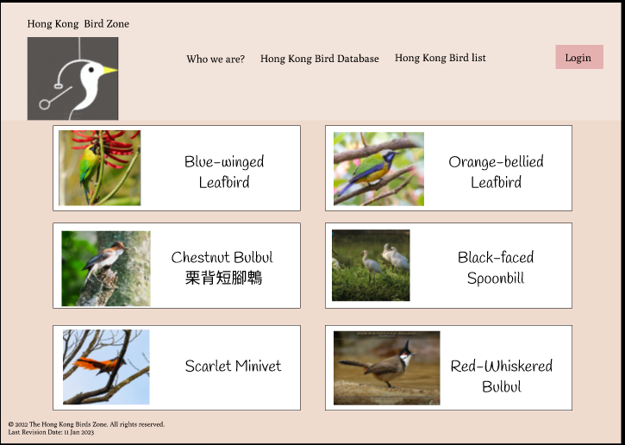
Prototype-Webpage design- bird list

Slide 12
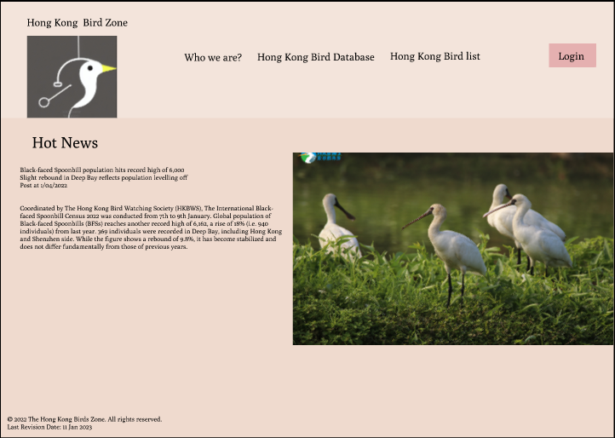
Prototype-Webpage design- update news

Slide 13
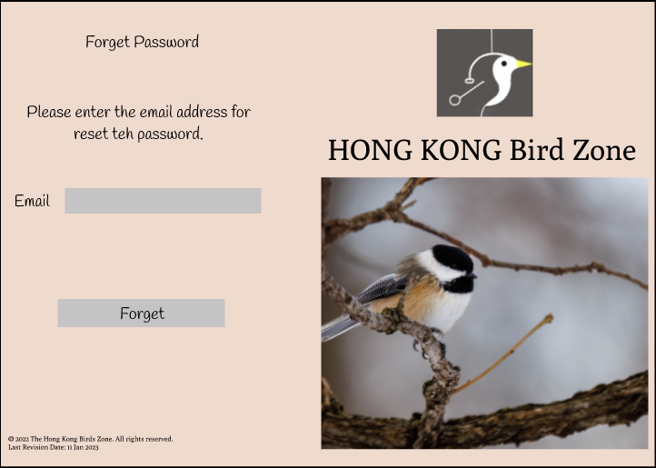
Prototype-Webpage design- forgot password

Slide 14
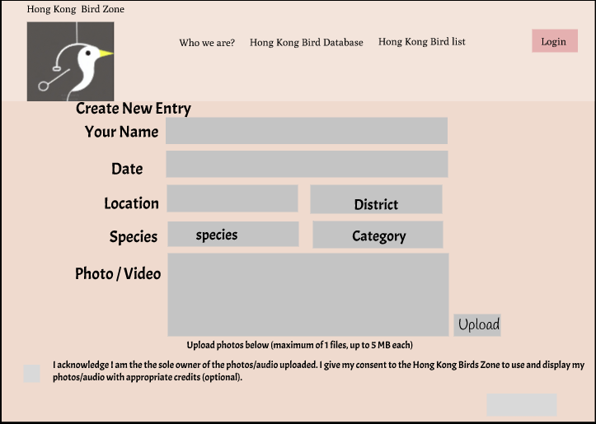
Prototype-Webpage design- create new bird

Slide 15
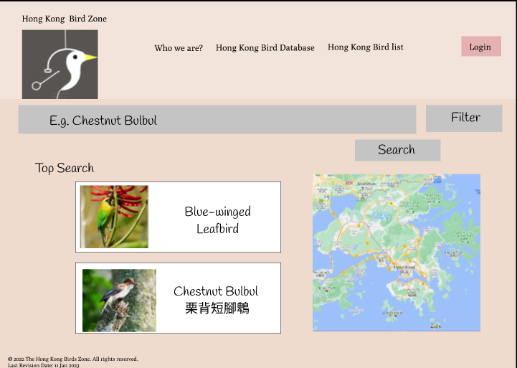
Prototype-Webpage design-search page

Slide 16
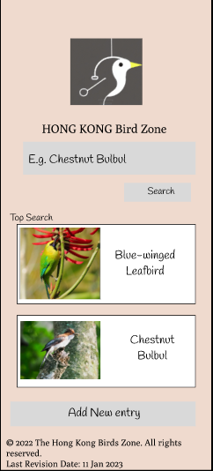
Prototype-App design-first page

Slide 17
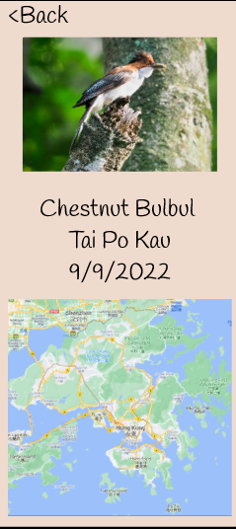
Prototype-App design- record

Slide 18
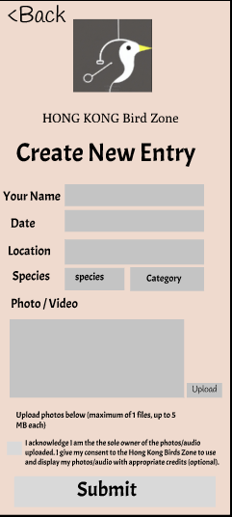
Prototype-App design-Create New Bird

Slide 19
Project Plan overview
We are ready for all part, after the meeting we get change for some part. Our team start to doing hold webpage and app now.

