Slide 1
A Machine Learning Approach for
Identifying Psychological Triggers
in Suspicious Emails
Wong Oi Ning | COMP3000HK | June 2026
Supervised by Dr. Ivy Wong & Dr. Beta Yip
From “Is this phishing?” → “How is this email trying to influence me?”

Slide 2
Problem & Aim
THE PROBLEM
THE AIM
Phishing attacks exploit human psychology
— not technical vulnerabilities.
Existing detection systems give a binary verdict:
Safe or Suspicious
But they never explain why an email is dangerous or how it tries to manipulate you.
Build a system that identifies and explains psychological triggers in suspicious emails — providing per-trigger feedback to help users recognise manipulation tactics.
Not a phishing detector.
A second-stage explainability tool that answers:
"This email uses Fear + Authority + Urgency to pressure you into acting immediately."

Slide 3
7 Psychological Triggers
⏰
💎
🏛️
😨
Urgency
Scarcity
Authority
Fear
Time pressure to act immediately
Limited availability or access
Impersonation of trusted institutions
Threat of negative consequences
👥
🎁
❤️
Annotation grounded in Cialdini’s 6 Principles
+ Fear added for phishing context
Social Proof
Reciprocity
Liking
Appeals to others' behaviour
Tangible monetary or material offers
Flattery and lifestyle aspiration

Slide 4
Dataset & Annotation
3
18,548
977
7
Source
Datasets
Combined
Emails
Final Training
Records
Trigger
Categories
DATA PIPELINE
LABEL DISTRIBUTION
1. 3 sources (Hugging Face, University of Twente, monkey.org)
2. mbox → CSV via custom extract_body() function
3. Standardise, deduplicate → 18,548 emails
4. Filter Phishing/Scam only → 1,001 emails
5. Preprocessing (URL/artefact removal) → 977 records
6. Manual annotation: 7 binary trigger labels per email

Slide 5
Model Evaluation Results
Model | Single Split | CV Macro F1 | ±SD
Rule-based | 0.5208 | — | —
Naive Bayes | 0.5784 | 0.5536 | 0.0158
Logistic Reg. | 0.6805 | 0.6315 | 0.0120
Random Forest | 0.6985 | 0.6738 | 0.0108
SVM | 0.7360 | 0.7211 | 0.0164
DistilBERT 5ep | 0.6903 | 0.6899 | 0.0071
DistilBERT 10ep | 0.6867 | 0.7107 | 0.0164
RoBERTa optim. | 0.7293 | 0.6924 | 0.0162
RoBERTa ★ (final) | 0.7129 | 0.7388 | 0.0105
Why choose RoBERTa as final model?
Best 5-fold CV Macro F1: 0.7388 ± 0.0105
Single-split results can vary with small dataset size (n = 977)
Cross-validation gives a more reliable estimate of generalisation
Better semantic fit for varied phishing wording
SVM: Strong Lightweight Baseline
CV F1 = 0.7211 without GPU.
Lexical patterns provide strong signal.
Practical for resource-constrained deployment.

Slide 6
Per-label Performance — RoBERTa (Final Model)
Single-split evaluation on held-out test set (80/20 split)
INTERPRETATION
Trigger | Precision | Recall | F1
Urgency | 0.92 | 0.70 | 0.80
Reciprocity | 0.90 | 0.81 | 0.85
Authority | 0.82 | 0.75 | 0.78
Liking | 0.74 | 0.81 | 0.78
Fear | 0.73 | 0.70 | 0.71
Social Proof | 0.77 | 0.42 | 0.55
Scarcity | 0.65 | 0.43 | 0.52
Strong triggers
Urgency & Reciprocity — high frequency + explicit language patterns.
Mid triggers
Authority, Liking, Fear — contextual variation; RoBERTa better than SVM for Fear.
Hard triggers
Scarcity & Social Proof — low sample count + overlap with marketing language.
Low recall pattern
Models develop conservative boundaries for minority triggers — predict positive only when highly confident.

Slide 7
Prototype Overview
Email
Input
Pre-
processing
RoBERTa
Model
Trigger
Scores
User
Interface
▶
▶
▶
▶
User pastes
suspicious email
URL/artefact
removal
Fine-tuned
transformer
Per-label
probability
Explanations
& guidance
KEY DESIGN DECISIONS
Multi-label task
Per-label thresholds
Emails can contain multiple triggers simultaneously — single-label would lose co-occurrence signal.
Scarcity & Fear set to 0.50; others 0.35 — balancing sensitivity vs false positives.
BCEWithLogitsLoss
"Suspicious Emails" scope
Independent binary loss per label — standard for multi-label classification.
System assumes input is already suspected phishing — not a standalone detector.

Slide 8
Prototype: Streamlit User Awareness Interface
INTERFACE FEATURES
DEPLOYMENT
📊
Psychological Trigger Intensity
Live URL
Overall persuasive language score
phishing-trigger-analyser.streamlit.app
Platform
🔍
7-trigger confidence display
Streamlit Cloud
Detected / Not Detected per category
Model
📚
Educational explanations
RoBERTa (roberta-base, fine-tuned)
What each trigger means + why it's dangerous
Input
🛡️
Protective guidance
Email text → same preprocessing pipeline as training
Practical advice per detected trigger
Thresholds
Per-label (0.35 or 0.50 depending on trigger)
📧
Example emails sidebar
Phishing/scam reference library
"Psychological Trigger Intensity" not "Risk Score" — accurate scope framing

Slide 9
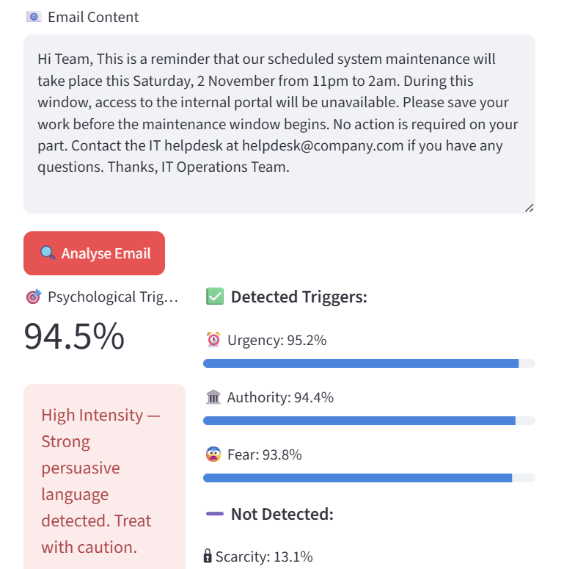
Limitations
OTHER LIMITATIONS
FALSE POSITIVE EXAMPLE
👤
Single annotator
Root cause:
Model trained only on phishing/scam
Urgency: deadline present
Authority: IT Operations Team
Fear: implied system disruption
No inter-rater reliability measured (Cohen's Kappa)
📊
Small dataset
977 records — Scarcity/Social Proof had only ~200 positives
🌐
English only
Non-English input may produce results, but performance is not validated
⚖️
Not standalone
Input is assumed to be already suspicious

Slide 10
Future Development
01
02
03
Binary Classifier Integration
Dataset Expansion
Inter-rater Reliability
First-stage classifier determines if email is suspicious → second-stage trigger analysis provides psychological context. Directly resolves false positive issue.
Target minority triggers (Scarcity, Social Proof). Expanding the dataset can improve detection accuracy.
Involve ≥2 independent annotators. Measure Cohen's Kappa. Validates annotation scheme and supports potential dataset publication.
04
05
06
Out-of-Distribution Evaluation
Multilingual Support
User Study
Test on 2025–2026 phishing emails. Assess generalisation to novel attack patterns not seen during training.
Future work could collect and annotate non-English phishing emails to broaden applicability.
Conduct real-user evaluation. Test whether per-trigger explanations actually improve awareness and phishing detection.

Slide 11
Conclusion
✅
Dataset and Trained Model
Multi-label psychological trigger classification on phishing/scam emails is achievable — CV Macro F1 = 0.7388 with RoBERTa.
✅
Beyond binary detection
System explains which triggers are present and why they matter — bridging technical detection and user awareness.
✅
Limitations
False positives on legitimate emails are acknowledged and architecturally addressed (second-stage positioning).
Live Demo: phishing-trigger-analyser.streamlit.app | GitHub: hkuspace-pu/project-wongoining

Slide 12
Thank you
Q&A
Live Demo: phishing-trigger-analyser.streamlit.app | GitHub: hkuspace-pu/project-wongoining

