Slide 2
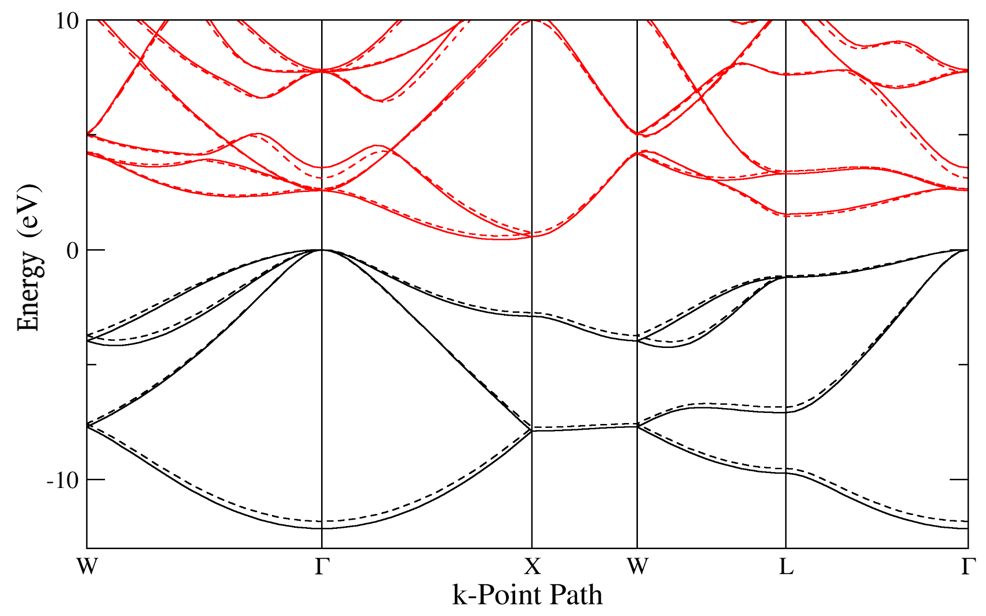
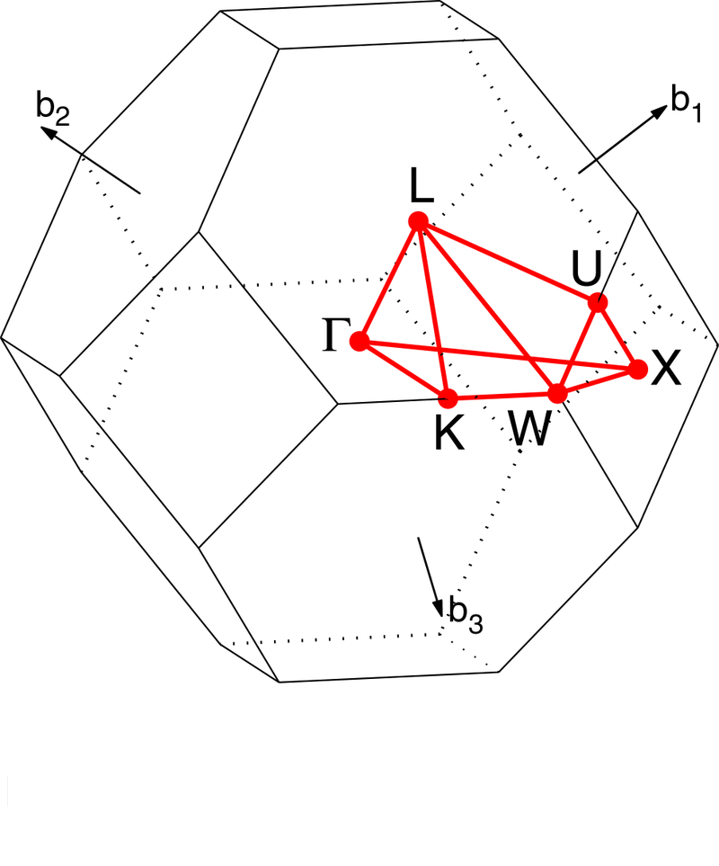

Slide 3
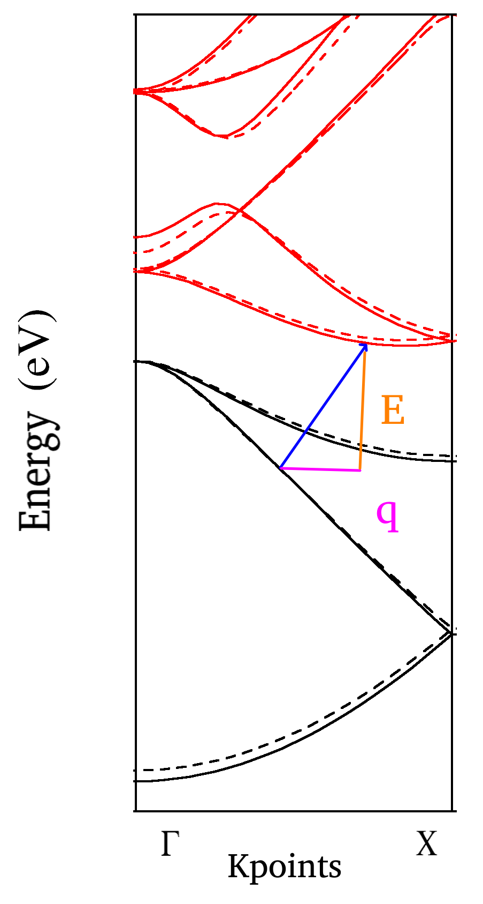

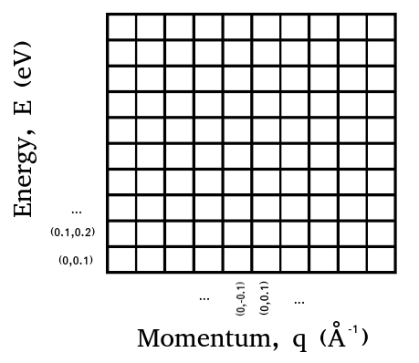

Slide 4
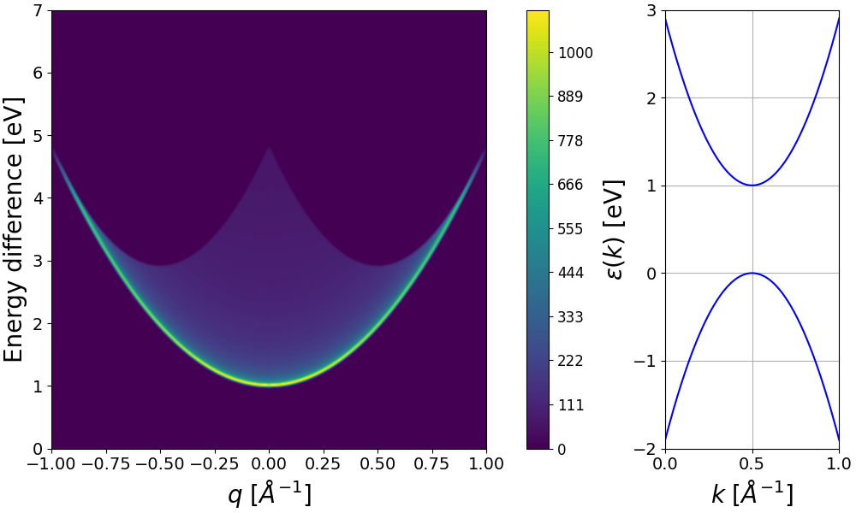
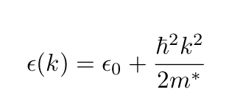

Slide 5
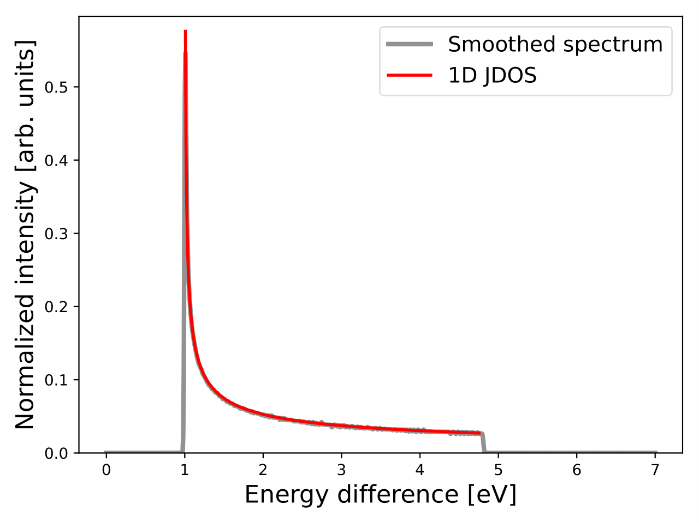




Slide 6
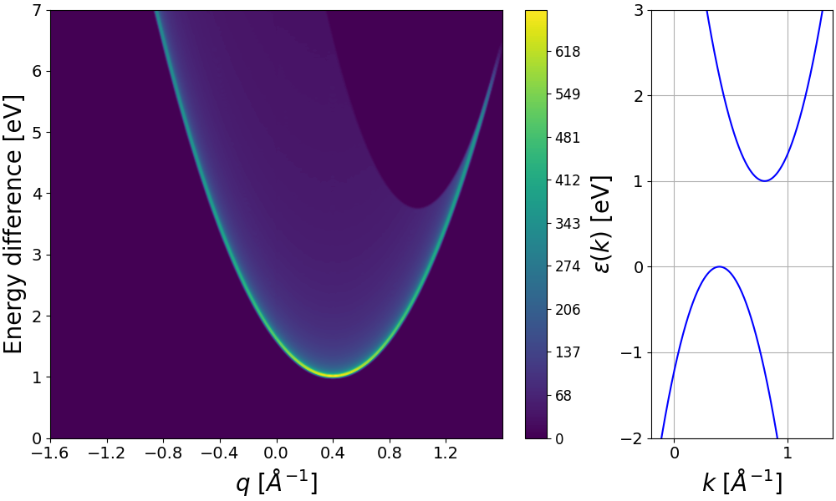

Slide 7
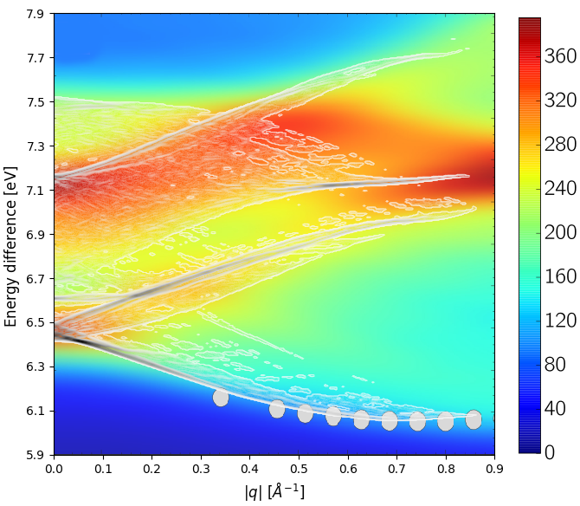
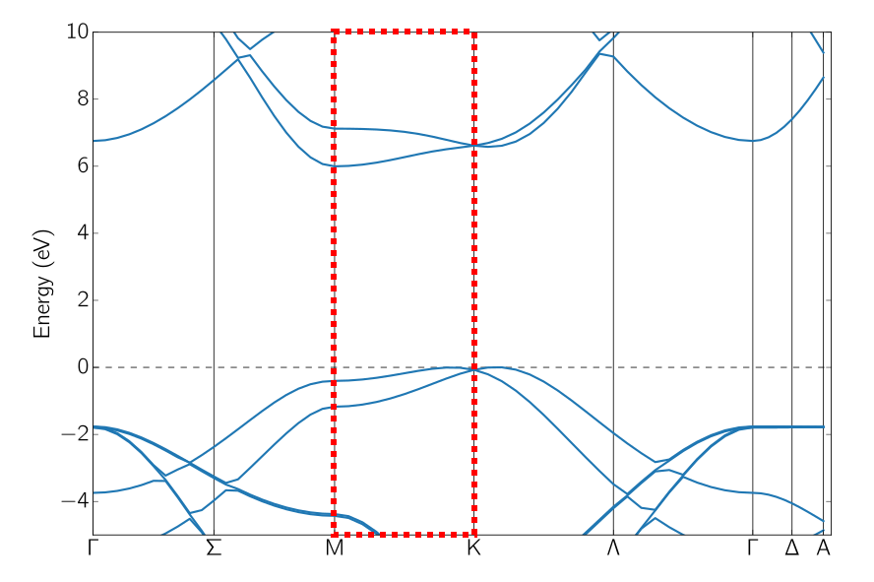

q-JDOS hexagonal boron nitride (h-BN)

Slide 8
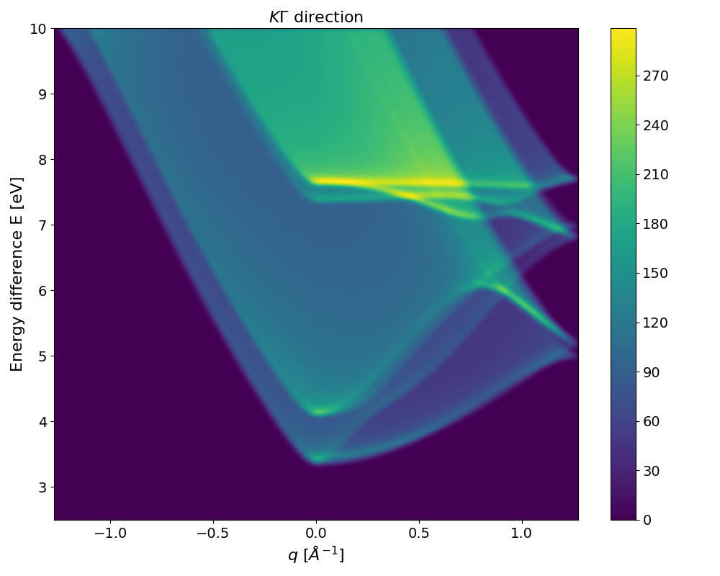
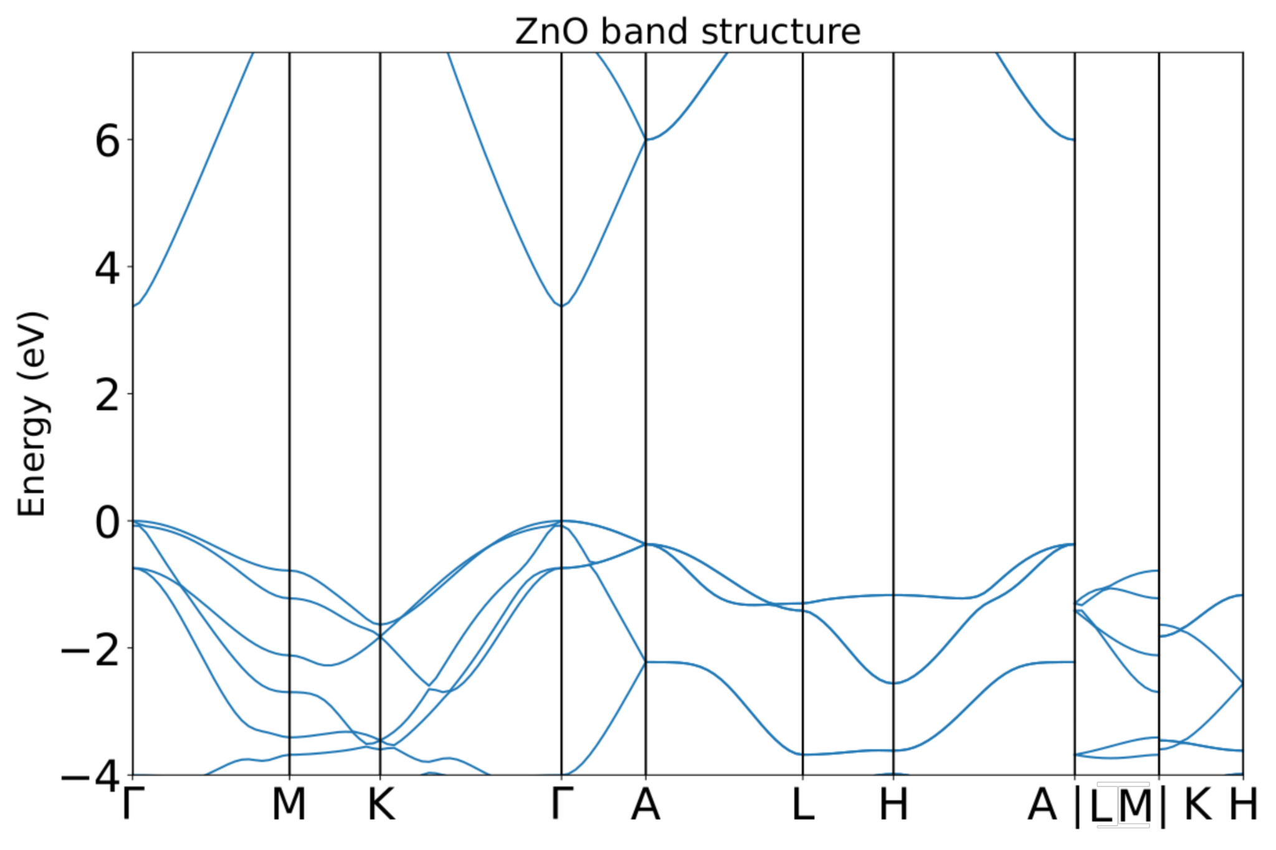
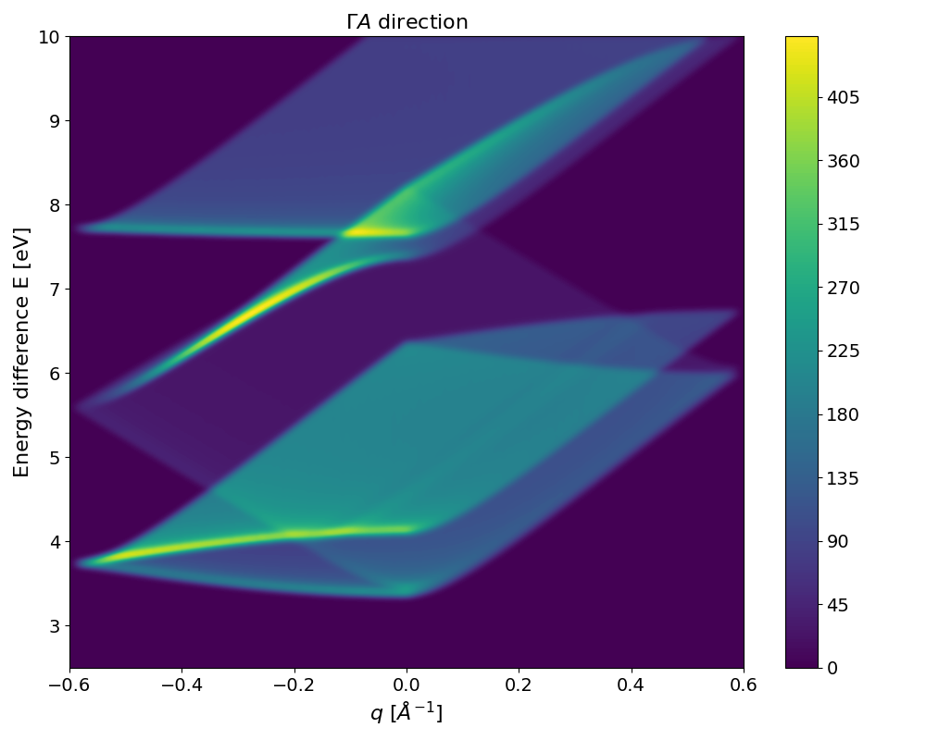
Zinc oxide (P6₃ mc)
Direct band gap
KΓ (top), ΓA (bottom)

Slide 9
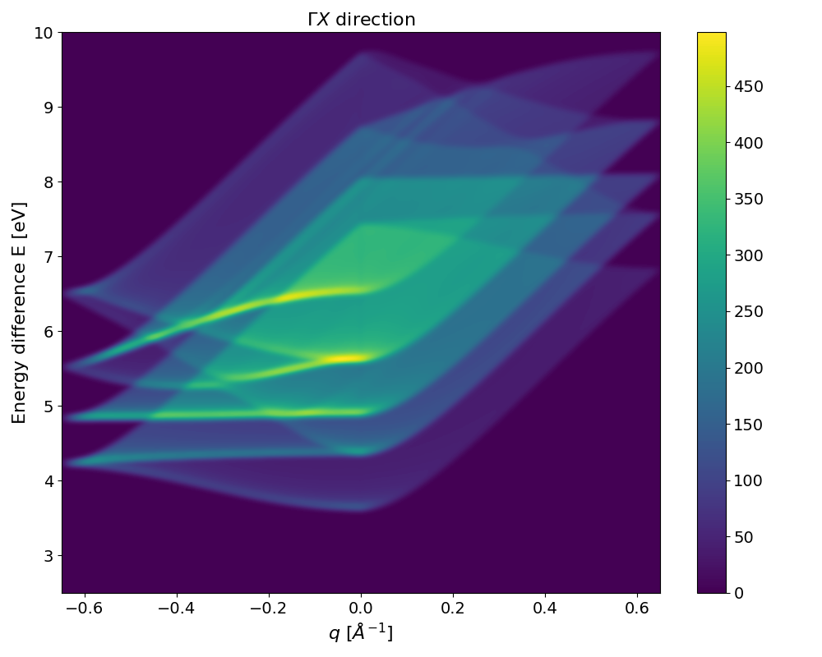
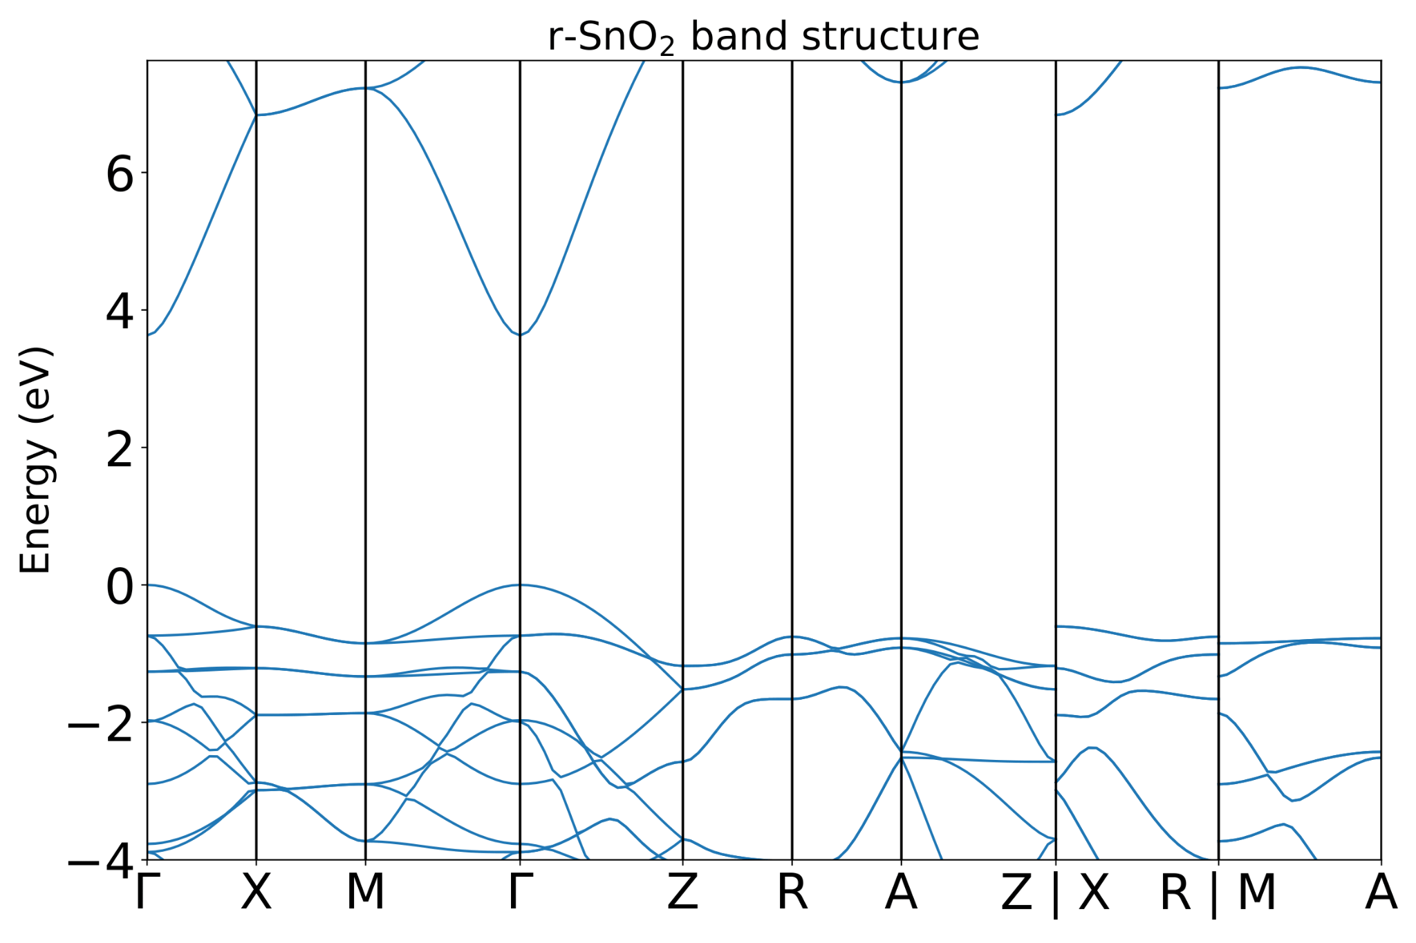
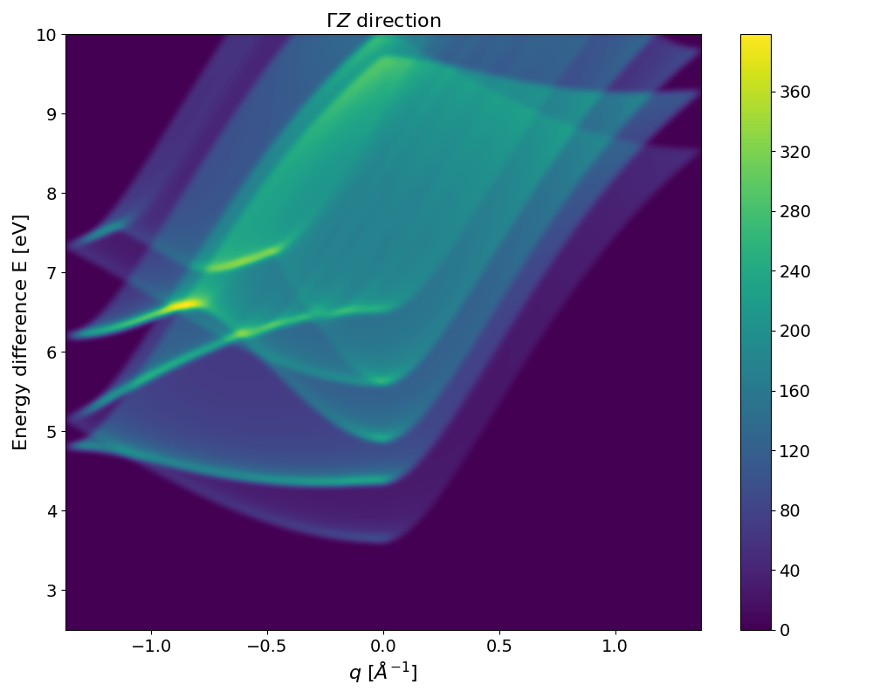
Rutile Tin(IV) oxide (P4₂/mmm)
Direct band gap
ΓX (top), ΓZ (bottom)

Slide 10

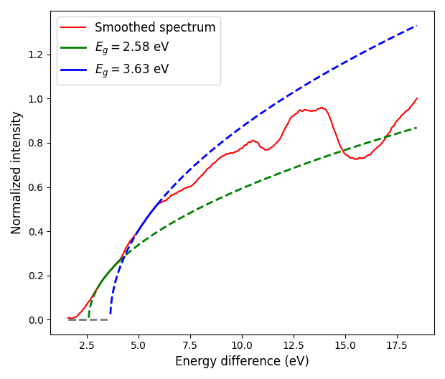
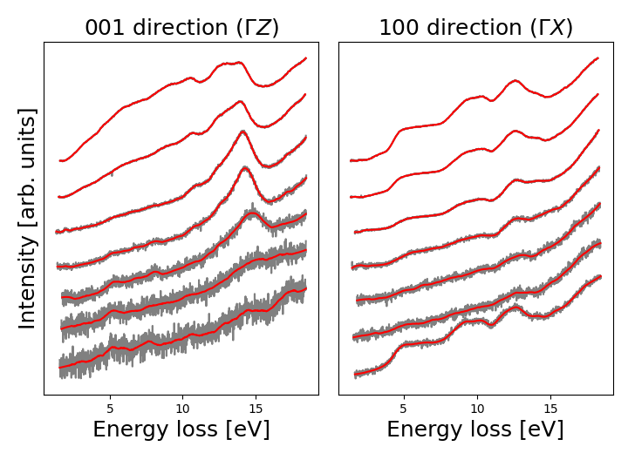
q [Å⁻¹] From top to bottom:
(0-0.1)
(0.1-0.2)
(0.3-0.4)
(0.5-0.6)
(0.7-0.8) (0.9-1.0)
(0-0.1)
(0.1-0.2)
(0.2-0.3)
(0.4-0.5)
(0.7-0.8) (0.9-1.0)
(1.2-1.3)

Slide 11
