Slide 1
A 180 GFLOP/s, 15 GFLOP/W, 500 million transistor FPGA in 90nm CMOS

Slide 2
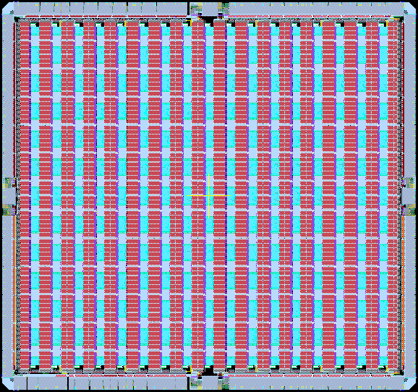
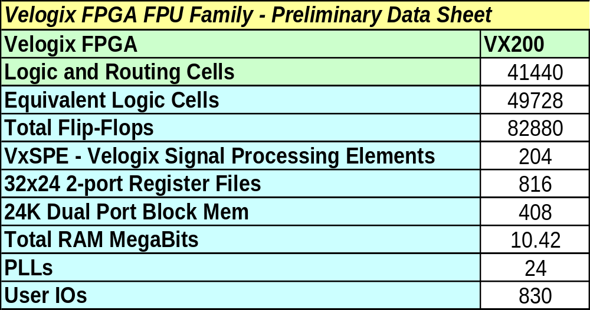
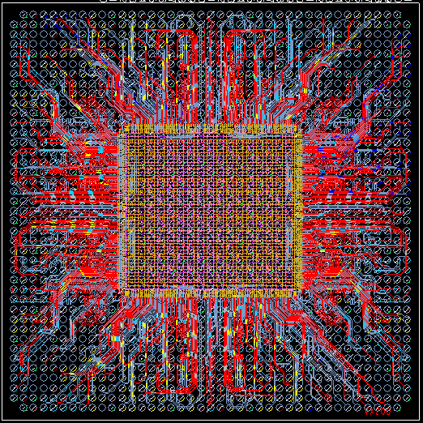
Functional Vx200 FPGA silicon
TSMC 90nm process; Large die with 500M transistors
Highest monolithic compute power: 180 Single Precision GFLOPs
Memory Bandwidth: 40GB/s external, >1TB/s internal
Silicon proven with ATE and in lab

Slide 3
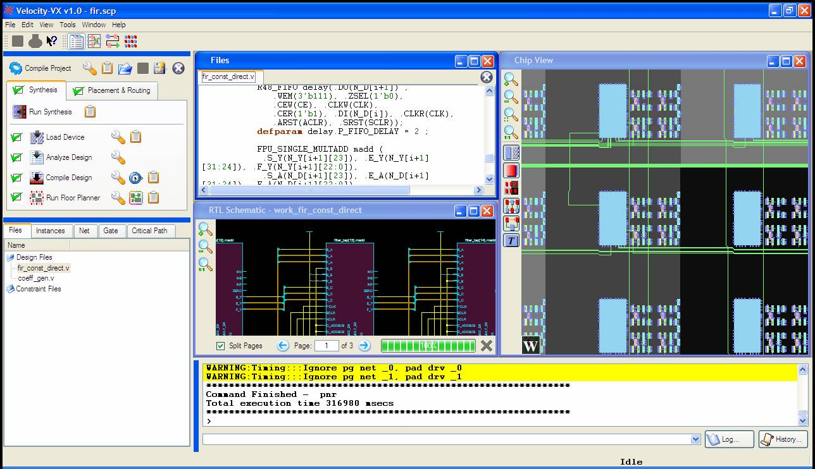
Velocity VX RTL Design Software Solution
Verilog/VHDL Design
Complete RTL-to-bitstream software solution
  Integrated Physical Synthesis and routing provides 5x faster timing convergence
  Multi-million gate designs routed
  User-friendly push-button design flow with industry standard constraints
  Tested on >100 design regression suite
  Inference and instantiation of hard macro units including floating point units
  Zero “failed to route” designs
Minimal switching cost
  Accepts existing FPGA designs
Synthesis
Physical Synthesis
(placement)
Routing
Bitstream

Slide 4
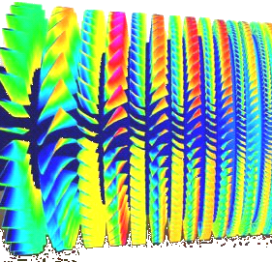



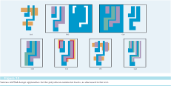

Real Problems, Real Solutions, Real Value
Market Segment | Key Problems | Current situation | Break-through goal | Breakthrough requirement
HPC | CFD simulation too slow- $1B/yr turbine blade maintenance | Simulate one fan blade in 46 hours | Simulate full turbine in minutes- save $100M/yr | >100 Single Precision GFLOPS
 | Black-Scholes evaluation | 5K trades/sec | 50K+ trades/sec | >100 Single Precision GFLOPS
Imaging | View internal organs during surgery | Snapshots every few seconds | Real time video of internal organs | 200 Single Precision GFLOPS
 | SAR to see through fog, clouds & foliage | Snapshots every few seconds | Real time video rate imagery | 100 Single Precision GFLOPS
Industrial | RET simulation | Low accuracy simulation in hours | Full simulation in minutes | 100 Single Precision GFLOPS
 | Wafer Inspection | Inspection interrupts processing | Real time Inspection | 160 Fixed-point GOPS
100-200 GFLOPs is the disruptive performance barrier

Slide 5
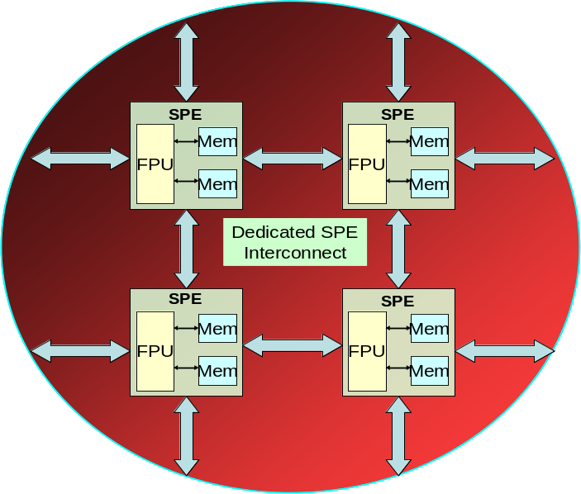
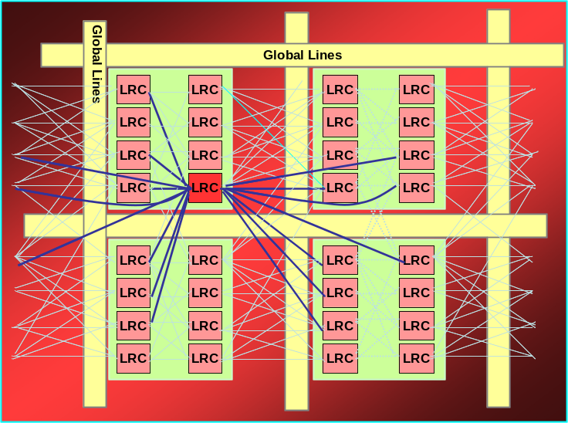
Velogix Programmable Logic Architecture – Powerful Fabric + Market Optimized engines
Next generation programmable logic fabric
Embedded Signal Processing Engine (SPE)
Push-button timing driven routability for full chip multi-million gate designs
Interconnect architecture tuned for higher clock frequencies
Offers 2x performance for select data path intensive designs
Processing Units integrate compute (FPU/MAC) and storage (memory, register file) blocks
Two-dimensional bus-based interconnect between integrated processing engines offer predictable performance of 450 MHz
17x12 (204) engines in Vx200 offer 180 Single Precision GFLOPs

Slide 6
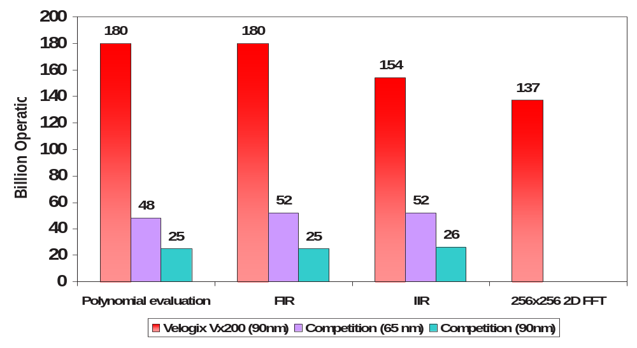
GFLOP Performance Comparison
Imaging, HPC
Test & Measurement
HPC
Test & Measurement

Slide 7
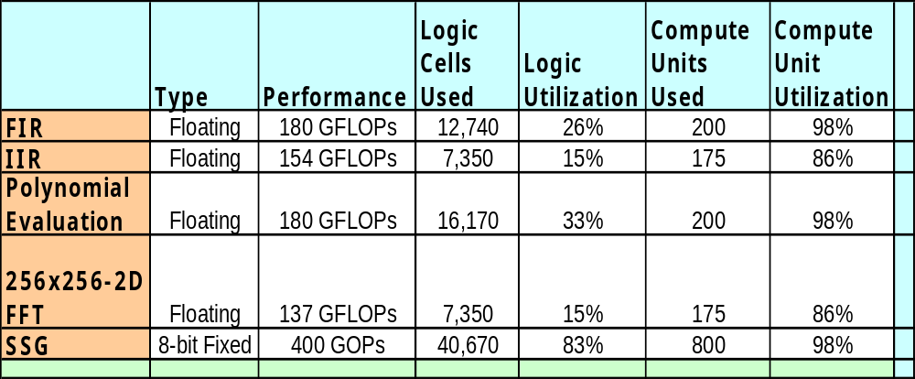
Full Chip Design Performance
High Performance maintained even with high utilization

Slide 8
Power Efficiency Comparison (1-D FFT)
 | Performance (SP GFLOPS) | Power dissipation (W) | Power efficiency (SP GFLOP/W)
Vx200 | 120 | 8 | 15
Quad core x86 | 22 | 105 | 0.21
GPUs | 52 | 100 | 0.52
Xilinx LX 220 | 40 | 15 | 2.7
Cell | 91 | 100 | 0.91

Slide 9
Standardized timing and verification flow
Design Constraints
(sdc)
RTL
(Verilog/VHDL)
Velogix
Integrated
Design
Environment
3rd Party
Timing Analysis
(Primetime)
3rd Party
Formal Verification/
Simulation
Netlist of
VxPrims
Reports
(Primetime Compatible)
Standard .lib timing and
Verilog models
for VxPrims
Standardized SDC based timing and model based verification flow

Slide 10
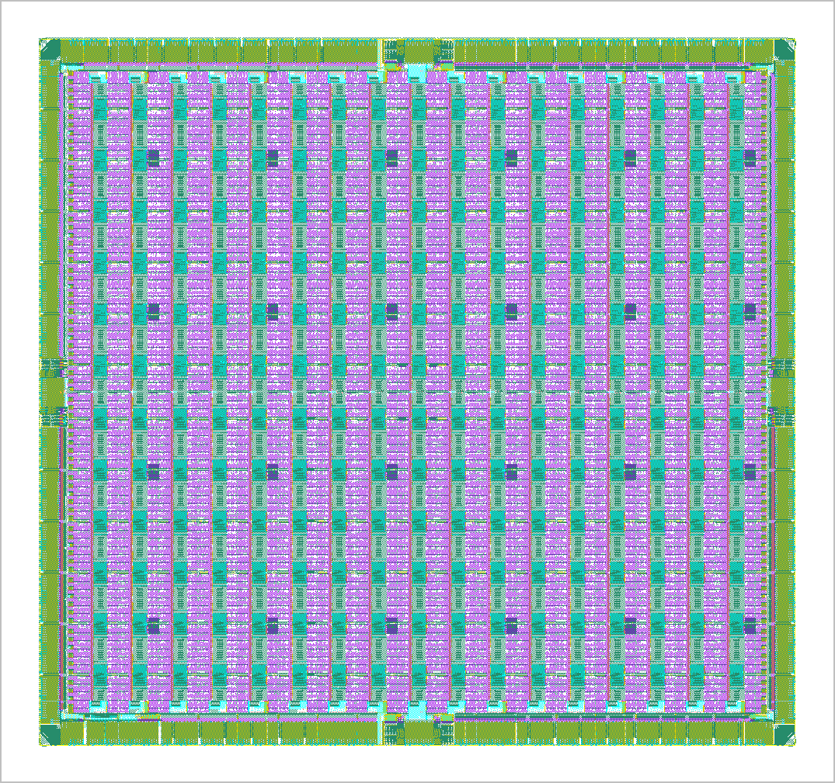
Vx200 Chip Architecture
DSP Hardware
Floating Point MADD
Fixed Point MAC
Programmable
FPGA fabric
Dual Port
Block RAM
PLL
2-port
Register File
Output Clock Synthesizer
High Speed
Configurable
Single Ended
IO Buffer
Single Ended
IO Subsystem
DLL
Dedicated
IO Bank
High Speed
Configurable
LVDS
IO Buffer
LVDS
IO Subsystem

Slide 11
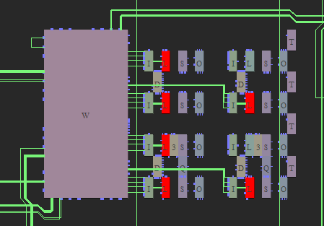
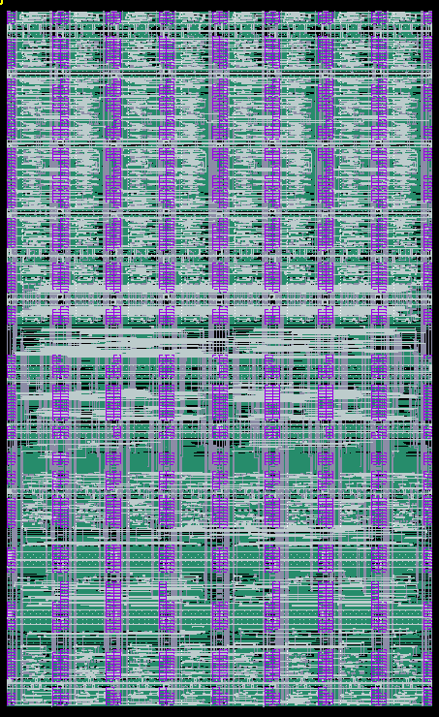
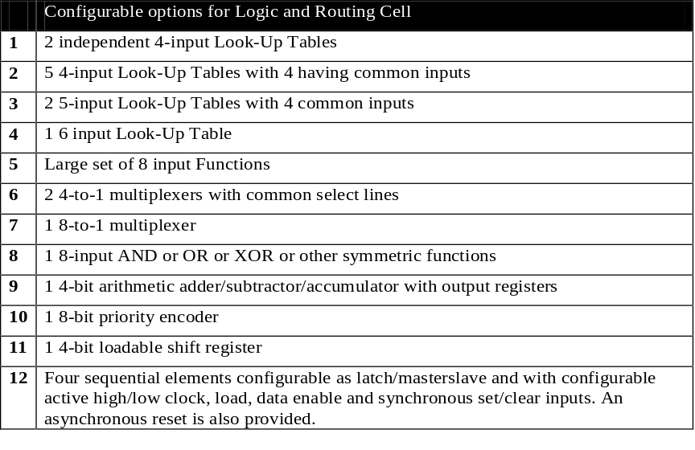
Next Generation Programmable Logic Fabric
Optimized for push-button routability and more performance for the same area
Optimized local connections for critical path delays
Seamless integration of hard macro blocks
  Symmetric fabric connection across hard macro blocks
Implemented on CMOS 90GT with 9 layers of metal
Complex logic and routing cells with global and local routes

Slide 12
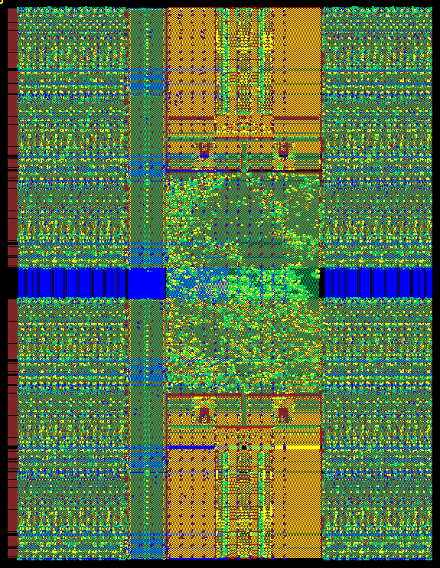
Signal Processing Engine
32x24 RF
Signal Processing Unit Integrates
  Computational Element
    IEEE Single or Extended Single Floating Point Multiply ADD or,
    Fixed Point Multiply Accumulate
    (1 36bit, 2 18bit and 4 9bit modes of operation)
  Memory Elements –
    Two 24Kb Block RAM configurable as memory or FIFO
    Four 32x24 Register file configurable as memory, FIFO or Delay Chain
Two-dimensional bus based Interconnect between Processing Units enables predictable 450MHz performance
Silicon Proven
24Kb RAM
Bus Based
Interconnect
FPU/MAC

Slide 13
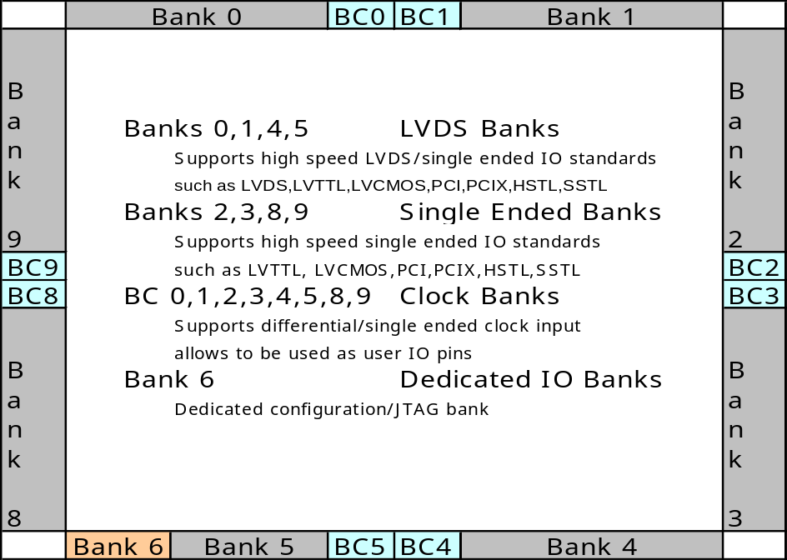
Highly Configurable High Speed IO Banks
Single Ended Banks
  SSTL, HSTL, PCI, PCI-X, LVCMOS, LVTTL Buffers
LVDS Banks
  LVDS up to 1.2 Gbps
  SSTL, HSTL, PCI, PCI-X, LVCMOS, LVTTL at slower speeds
Four 400 MHz DDR2 Interfaces on single chip
  112 DLLs and dedicated IO clock tree provide configurable strobe clocking for x8,x16,x32,x64
  DDR flops, per bit delay element for each pads
QDR2 SRAM interface using PLLs and IO banks
Support for high speed source synchronous LVDS Bus

Slide 14
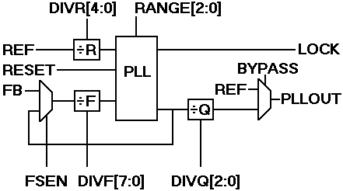
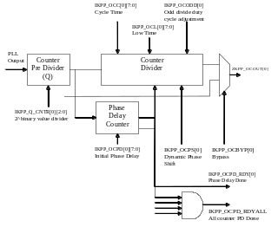
Highly configurable clock subsystem
VX200
  Less than 250 ps of full-chip skew
  24 high speed, low jitter, wide range, area efficient phase locked loops (PLL) on chip
  16 output synthesizers provide variable frequency, phase and duty cycle with dynamic phase adjustment
  16 H-tree global clock network with support for multiple independent clock domains
  Low skew, low jitter hierarchical clock network with flexible local/regional clock network provide up to 24 clock domains
  IO clock and regional clock network allows support for high speed system and memory interfaces
PLL and clock
synthesizers
KPM
KPM
KPO
Global clock
buffers
KPM
K
P
O
KPG
K
P
O
KPM
KPM
KPM
KPO
Clock Pad IO Buffers
KPM
KPM
PLL
Output Synthesizer

Slide 15
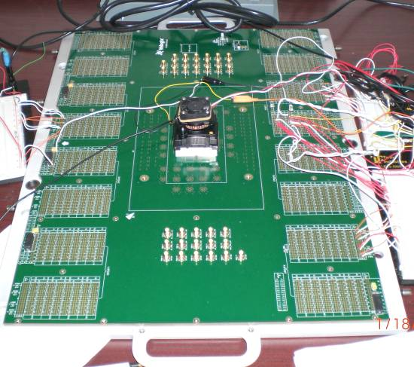
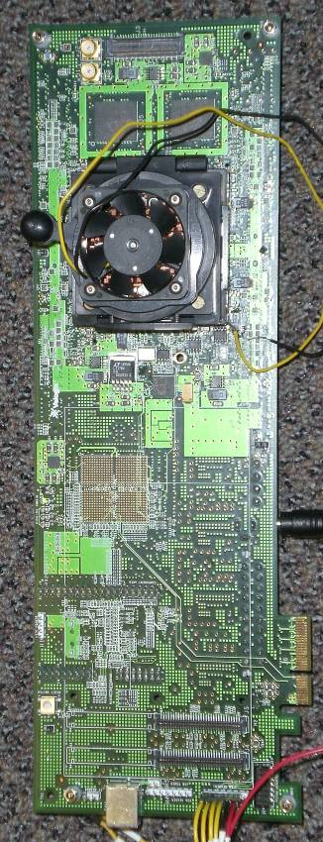
PCBs – Load board and Customer Boards
Load board for use with Agilent 93K Tester
Designed with SMA connectors for clock/IO characterizations
Used in lab to bring up FPGA using JTAG interface (via USB or Ethernet)
Fabric functional at 750MHz
14-layer Customer board designed for Application Accelerator Applications
  Accelerate compute part using Vx200 through PCI-Express Interface
Vx200 provides 180 GFLOP compute density
High memory bandwidth
  Four DDR2 x64 and two QDR2 x36 Interfaces

