Slide 1

Fast Fourier Transforms in FPGAs

Slide 2
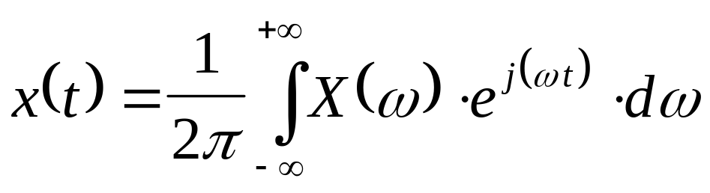
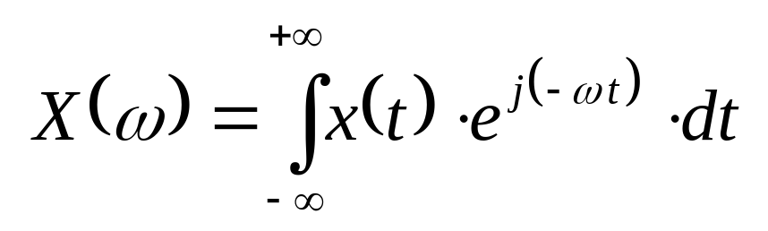
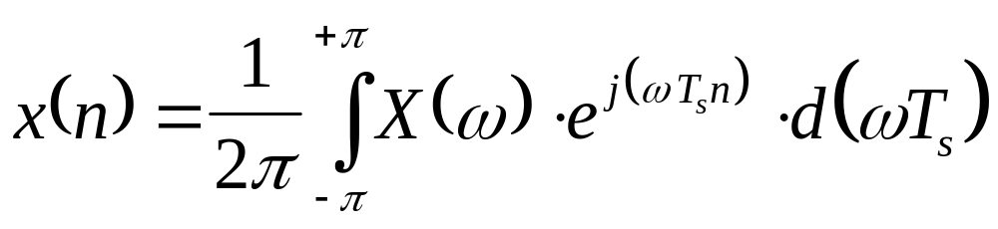
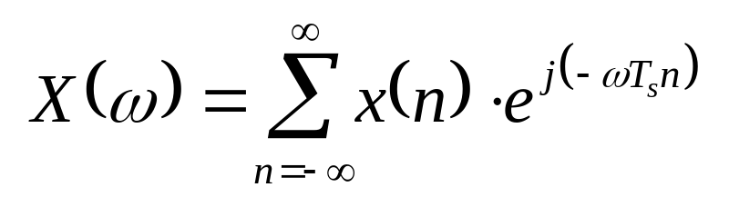
Fourier Transformation
Continuous
Discrete

Slide 3
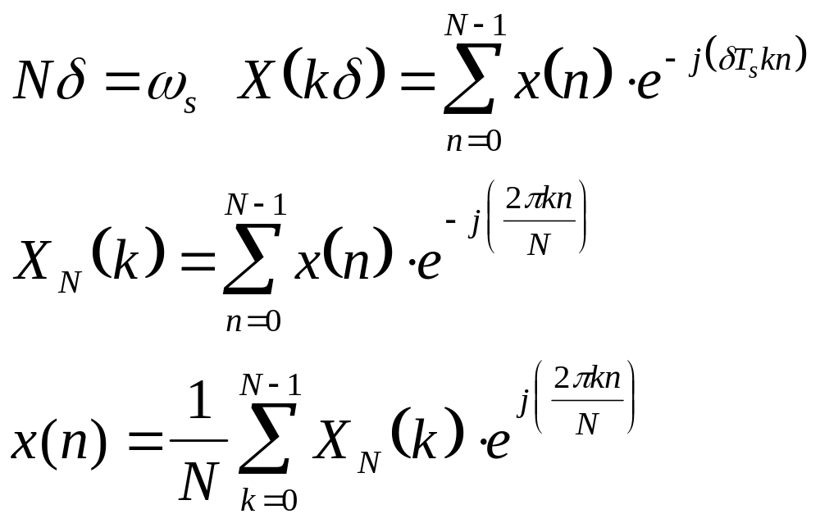
Discrete Fourier Transform (DFT)
Windowed
  (N time-points in: N freq-points out at fs/N)

Slide 4
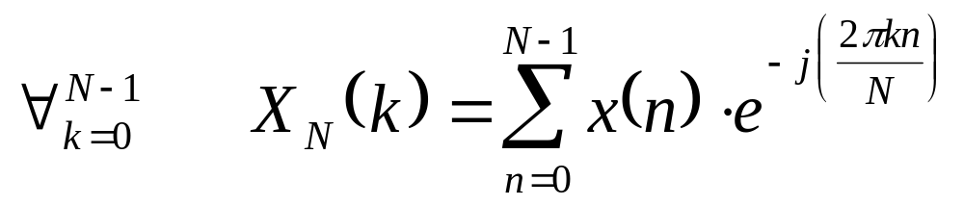
Fast Fourier Transform (FFT)
DFT
  Requires N multiplications
(Fast Fourier Transform) FFT
  uses repetitive nature of twiddle-factor
  (N/2)log(N) multiplications
2

Slide 5
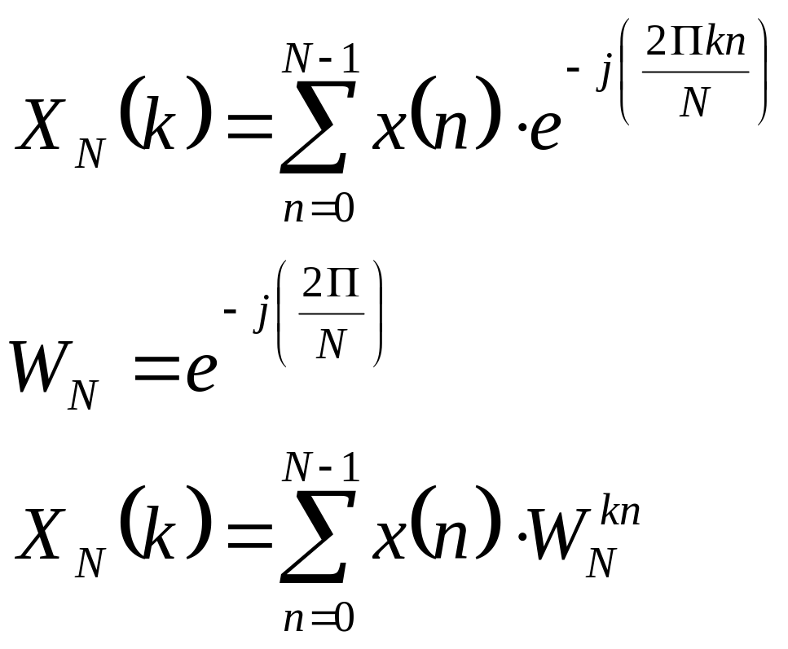
Fast Fourier Transform (FFT)
k
W is called the twiddle factor
N

Slide 6
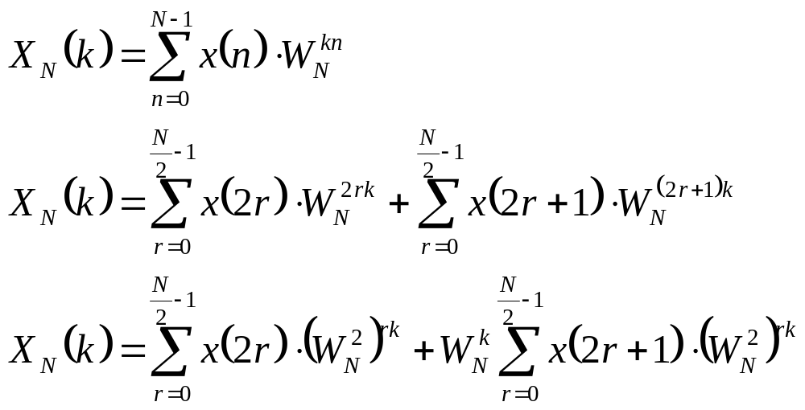
(FFT) Decimation in time
Decimate time samples in odd and even groups
Partition frequency samples into bottom and top halves

Slide 7
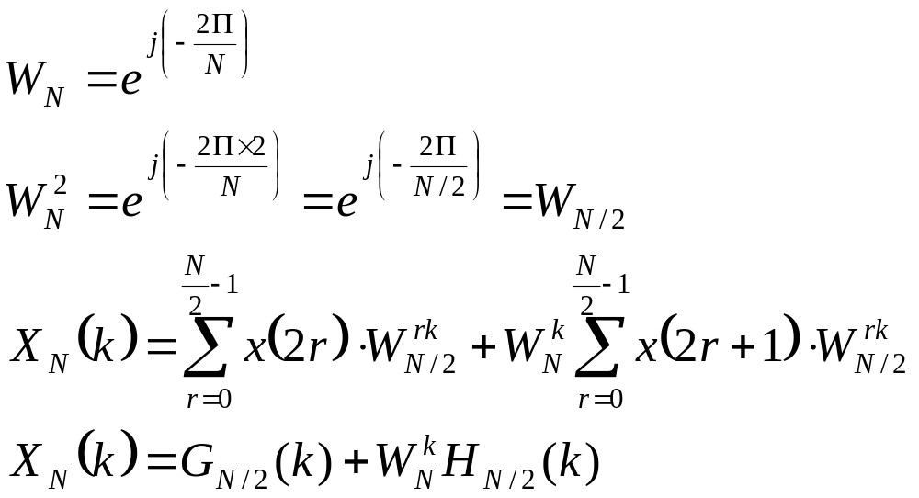
Decimation in time (contd.)

Slide 8
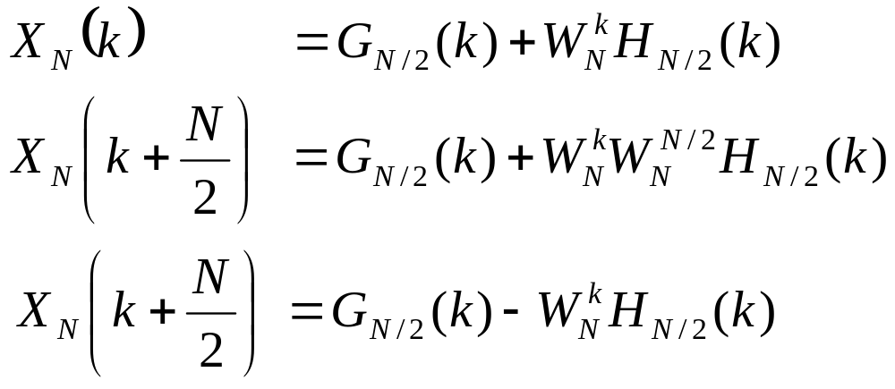
Decimation in time (contd.)
Decimate time samples in odd and even groups
Partition frequency samples into bottom and top halves

Slide 9
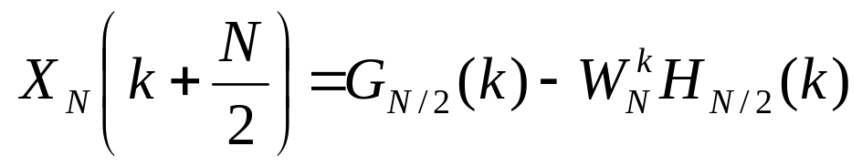
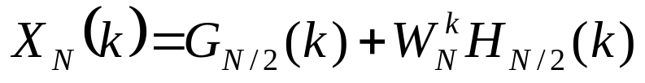
Example: 8-point FFT
f(0)
X(0)
4-pt
FFT
f(1)
X(1)
x(0/2/4/6)
f(2)
X(2)
f(3)
X(3)
3
W
8
f(0)
X(4)
4-pt
FFT
f(1)
X(5)
x(1/3/5/7)
f(2)
X(6)
f(3)
X(7)
3
-W
8

Slide 10
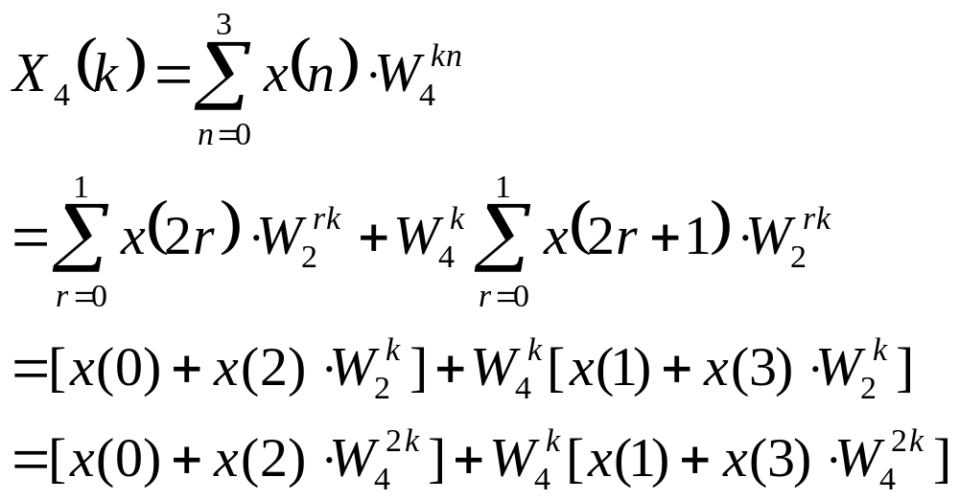
4-point FFT (Decimation in time)
{0, 1, 2, 3} => {0, 2} {1, 3}

Slide 11
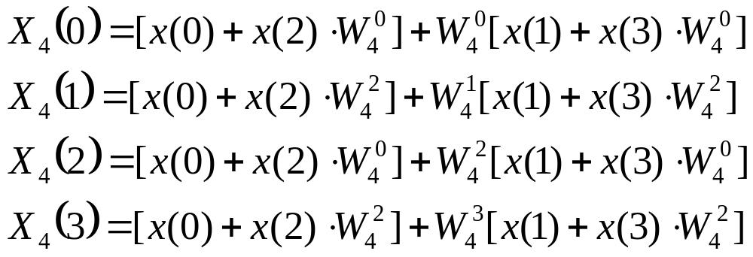
4-point FFT (contd.)
Expanded form

Slide 12
4-point FFT (contd.)
Pictorial form for complete 4-point FFT
Radix-2 structures form the core
x(0)
X(0)
0
0
2
x(2)
2
X(1)
2 => W
4
1
x(1)
2
X(2)
0
x(3)
2
3
X(3)

Slide 13
FFT structure
x(0)
X(0)
0
0
8-point FFT
input bit-reversed
6 => W = e
0
x(4)
4
X(1)
2
1
x(2)
4
X(2)
0
2
x(6)
4
6
X(3)
3
x(1)
4
X(4)
6
0
8
0
x(5)
4
5
X(5)
-j2 *6/8
2
x(3)
4
6
X(6)
0
x(7)
4
6
7
X(7)

Slide 14
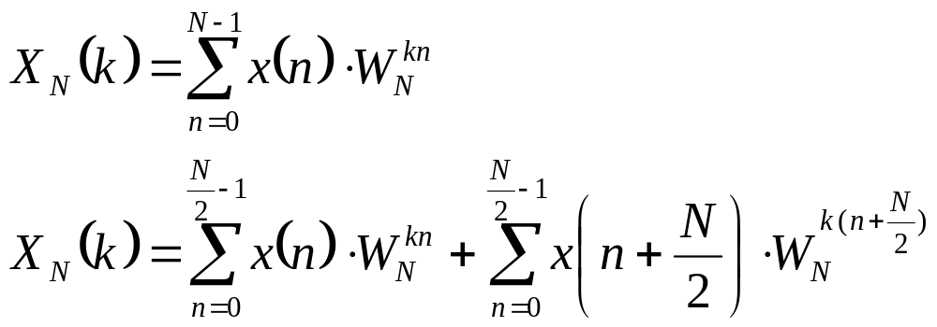
(FFT) Decimation in frequency
Decimate frequency samples in odd and even groups
Partition time samples into bottom and top halves

Slide 15
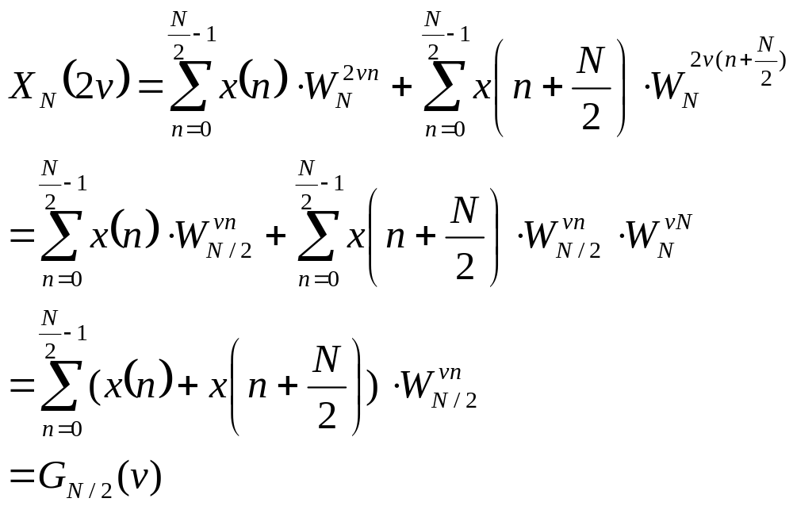
Even Freq components

Slide 16
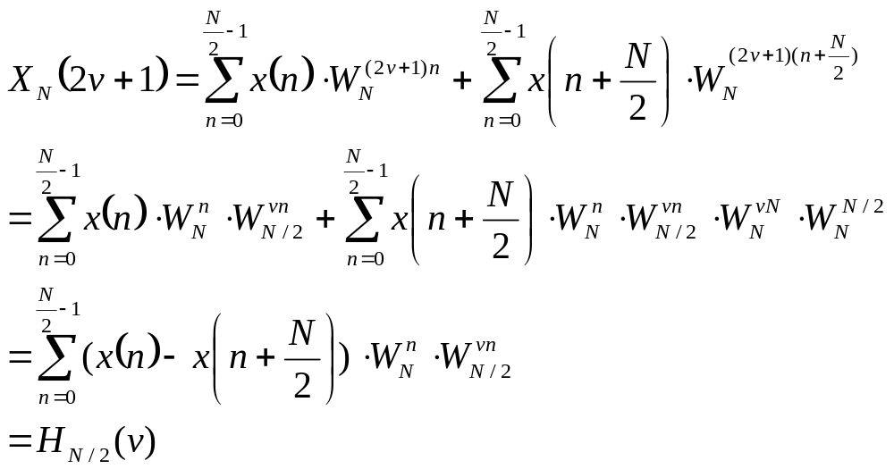
Odd Freq Components

Slide 17
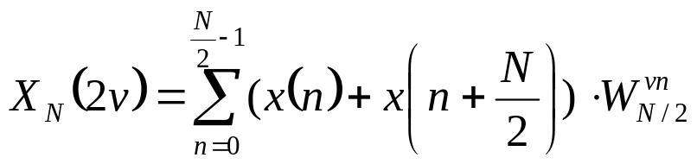
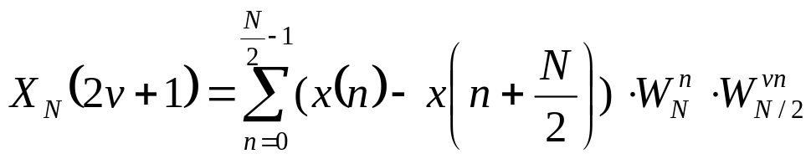
Ex: 8-point FFT
x(0)
X(0)
x(1)
4-pt
FFT
X(4)
x(2)
X(2)
x(3)
X(6)
x(4)
-
X(1)
x(5)
-
4-pt
FFT
X(5)
x(6)
-
X(3)
x(7)
-
X(7)
3
-W
8

Slide 18
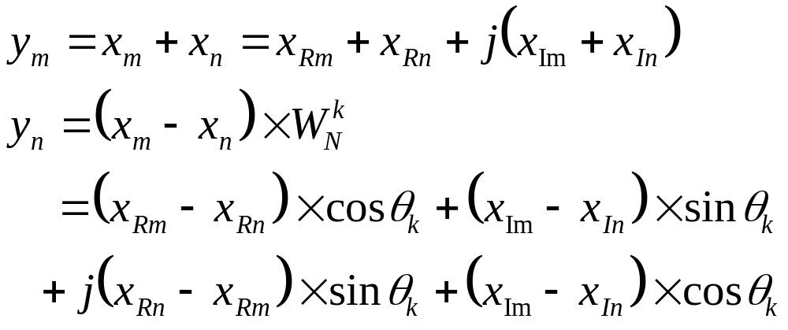
Radix-2 (decimation in freq)
Xm
Ym
W
k
Xn
-
N
Yn

Slide 19
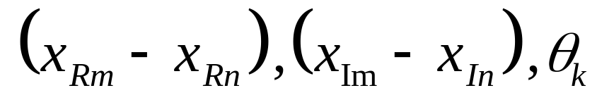
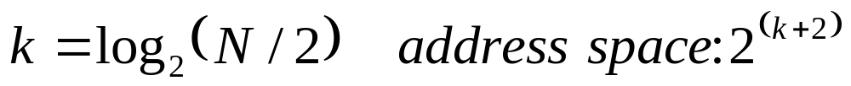
Radix-2 - using DA
y implemented using distributed arithmetic
DALUTs contain pre-computed sums of partial products
  3 variables:
DALUT size increases exponentially
  8192-point FFT, 16 bit sine-cosine accuracy
  will need 16384 deep, 16 bit wide DALUT
n

Slide 20
Radix-2 using DA
k
16
PSR
DALUT
Real
16384x16
Xrm
+
16
16
PSR
-
Xrn
16
PSR
Xim
+
DALUT
Imag
16384x16
16
16
PSR
-
Xin
N=8192, b=c=16, k=12
Huge DALUT size

Slide 21
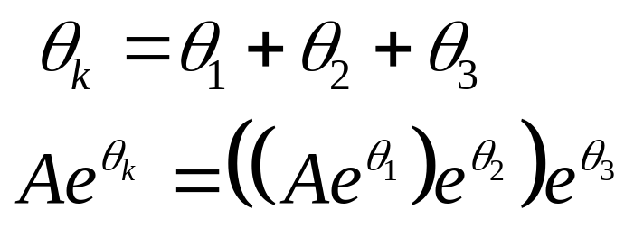
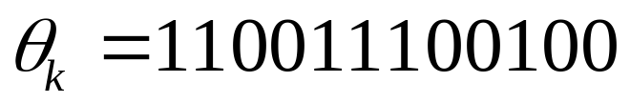
Efficient DA implementation
DALUT partitioning [Les Mintzer, ICSPAT’96]
  uses the following:
  breaks as:
reduces DALUT size from 16384 to 192
  requires some additional logic

Slide 22
Radix2 using DALUT partitioning
k
16
PSR
DALUT
Real
32x16
DALUT
Real
32x16
Xrm
+
Sc Accm
PSR
Sc Accm
16
PSR
-
Xrn
Same as Stage 2
Same as Stage 2
16
PSR
DALUT
Imag
32x16
DALUT
Imag
32x16
Xim
+
Sc Accm
PSR
Sc Accm
16
PSR
-
Xin
Stage 1
Stage 2
Stage 3
Stage 4
N=8192, b=c=16, k=12 (3+3+3+3)
DALUT partitioning => Large area savings

Slide 23
Parallel implementation
16
k
+
Xrm
16
16
rDALUT0
16
-
Xrn
rDALUT1
16
b bit input
b rDALUTs / stage
bX speedup
~bX area
rDALUT2
16
16
16
+
Adder Tree
Xim
16
Same as Stage 1
Same as Stage 1
16
-
Xin
rDALUT15
16
Similar to above
for iDALUTs
16
Stage 1
Stage 2
Stage 3

Slide 24
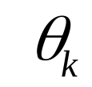
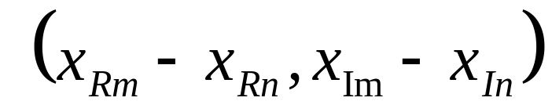
Redundancy in Parallel Implementation
Observation
  b DALUTs share same
  b DALUTs can have 4 inputs:
    (0,0) (0,1) (1,0) (1,1)
Improvement
  can replace b DALUTs with 4 DALUTs and b Muxes
  tremendous area saving with same speedup

Slide 25
Efficient Parallel Implementation
4 rDALUTS for
(00) (01) (10) (11)
k
16
+
Xrm
16
16
b bit input
4 rDALUTs / stage
b Muxes/stage
bX speedup
area incr << bX
MUX0
16
-
Xrn
MUX1
16
16
16
16
MUX2
Adder Tree
+
Xim
Same as Stage 1
16
Same as Stage 1
16
-
Xin
MUX15
16
Similar to above
for iDALUTs
16
Stage 1
Stage 2
Stage 3

Slide 26
Area Savings/Speedup
Benefit of parallel implementation and using muxes
Case A
  N=8192 k=12 b=16 c=16
Impl type
CLBs reqd (Case A)
Speed (Case A)
Serial
2ck/3 + c + 2b + 4
(180)
X
(X)
Simple
Parallel
2bck/3 + (b-1)c + 2b
(2320)
bX
(16X)
Efficient
Parallel
ck + bc + (b-1)c + 2b
(717)
bX
(16X)

Slide 27
FFT design with efficient radix-2s
N=1024 k=8 b=c=16 => 5120 radix-2 operations
Assuming 2 cycles/radix-2 operation => 10240 cycles
How can we reduce # of cycles required?
  Using more radix-2s alone will not help
  Bottleneck is interaction with memory
  Need to use memory-partitioning along with multiple radix-2s

Slide 28
Typical FFT structure
x(0)
X(0)
x(1)
X(4)
x(2)
X(2)
x(3)
X(6)
x(4)
X(1)
x(5)
X(5)
x(6)
X(3)
x(7)
X(7)

Slide 29
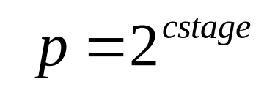
Memory partitioning
Observation
  radix-2 interacts with smaller memory part in advanced stages
  Assume p memory-partitions
  From after a critical stage, p radix-2s can interact independently with them in parallel
  Up to cstage, p/2 radix-2’s can operate in parallel

Slide 30
Memory partitioning
Partitioning Scheme
  optimal # of partitions = # of radix-2s
  Represent partitions as R and radix-2s as X
  stage k (< cstage)
    use radix-2s X such that kth bit of V is 0
    R_{V} interacts with X_{V1} and X_{V2}
      V1=V V2=V with kth bit reversed
  stage k ( >= cstage)
    X interacts with R
V
V
V
V
V

Slide 31
Radix-2 Memory interaction
X000
X000
X000
X000
R000
R001
X001
X001
X001
P = 8
R => ram-part
X => radix-part
X010
X010
X010
R010
X011
X011
R011
X100
X100
X100
R100
R101
X101
X101
X110
X110
R110
X111
R111
RAM stage 0 stage 1 stage 2 stage 3 onwards

Slide 32
A design for maximal radix-2 utilization
P=4
Memory-partitions: R00 R01 R10 R11
Radix-2 units: X00 X01 X10 X11
Stage 00 X00 <-> (R00, R10) X01 <-> (R01, R11)
Stage 01 X00 <-> (R00, R01) X10 <-> (R10, R11)
Stages 10/11 X00 <-> R00 X00 <-> R00 X00 <-> R00 X00 <-> R00

Slide 33
Area/speed effect with partitioning
K=12 b=16 c=16
Radix-2 Units
CLBs
Cycles
1
723
(X)
106496
(F)
1446
N=8192
2
(2X)
57344
(1.9F)
4
2892
(4X)
30720
(3.5F)
8
5784
(8X)
16384
(6.5F)
Radix-2 Units
CLBs
Cycles
1
640
(X)
10240
(F)
1280
N=1024
2
(2X)
5632
(1.9F)
4
2560
(4X)
3072
(3.5F)
8
5120
(8X)
1664
(6.5F)

Slide 34
Conclusion
New approach to efficiently design radix-2s for FPGAs
Present a novel memory partitioning scheme for optimal usage of multiple radix-2s
Provides a scheme to exploit area/speed tradeoff
Method can be easily adapted for automatic FFT core generation based on user’s requirement

