Slide 1

Filters in FPGA

Slide 2
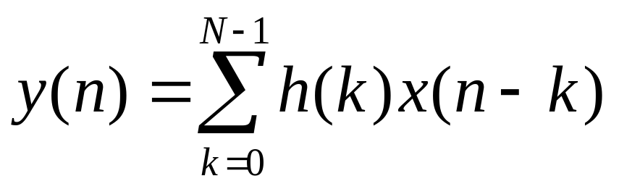
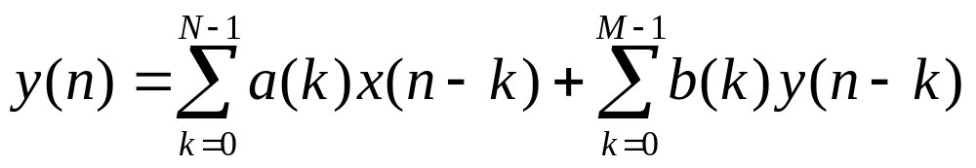
Filter Equations
A general Finite Impulse Response (FIR) Filter
A general Infinite Impulse Response (IIR) Filter

Slide 3
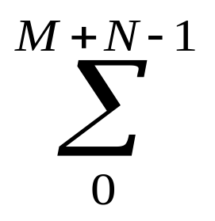
General Filter Structure
x(n)
a(0)
Χ
x(n-1)
a(1)
...
Χ
y(n)
x(n-N+1)
a(N-1)
Χ
y(n)
b(0)
Χ
...
y(n-M+1)
b(M-1)
Χ
Shift Registers
Coefficient Multipliers
Summation

Slide 4
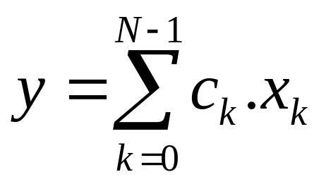
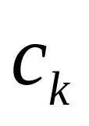
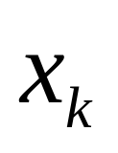
Filter Structure Analysis
Shift Registers differentiate FIR and IIR
Coefficient Multiplication and Summation is a sum of products equation
where are coefficients and are inputs to the sum of product equation.
  is a constant for a given filter response

Slide 5
Basic Idea in Distributed Arithmetic
Any Function can be realized by a huge memory.
In DA, we break this huge memory in smaller memories, and stitch them using extra logic.
In Virtex Series of FPGAs, the smallest memory sizes are 16 and 32 deep.
The stitching logic consist mostly of Arithmetic Units like adders and subtractors. Use fast carry logic to implement them.

Slide 6
Basic Idea in DA
12
1024x5
ROM
5
5K Bits of Storage
Addr
Data Out
4
5
16x5 ROM
Glue
Logic
Addr
240 Bits of
Storage
and some extra
logic
4
5
5
16x5 ROM
Addr
Data Out
4
5
16x5 ROM
Addr

Slide 7
Basic Idea in Distributed Arithmetic
The trick lies in getting a smart smaller partitioned memory and an appropriate stitching logic.
For Filters to be implemented in FPGAs, there is a structured way to use Distributed Arithmetic.

Slide 8
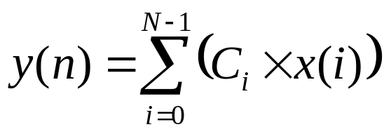
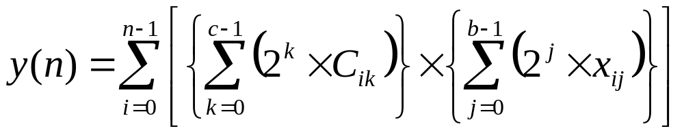
A FIR Filter with Constant Coefficients
An N tap FIR Filter Equation given below
is further expanded to
where c-bits wide coefficients and b-bits wide inputs are represented in terms of its bits along with its weights.

Slide 9
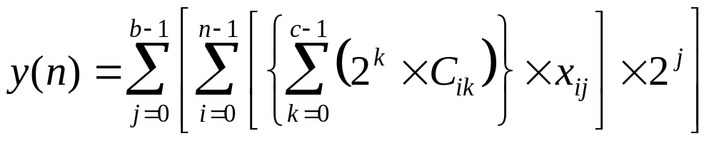
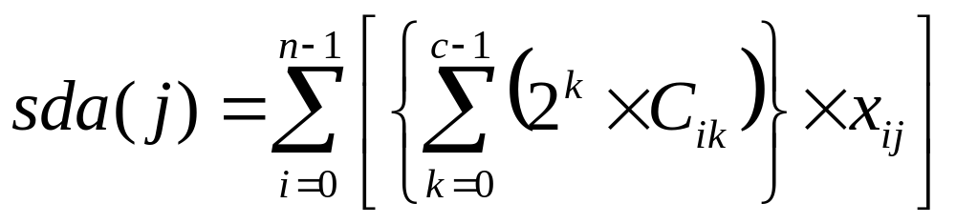
Distributed Arithmetic in FIR

Slide 10
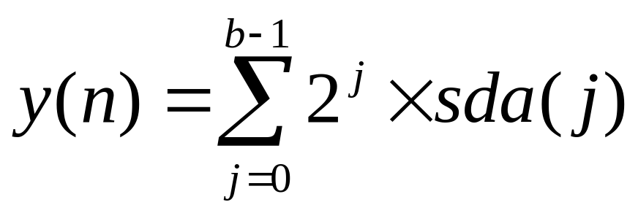
Distributed Arithmetic in FIR
Filter can now be written as a sum of the common term sda(j)
  The term sda can now be implemented using Distributed Arithmetic LUT, whose inputs are the bits x_{ij}
  This sum is equivalent to a scaling accumulator

Slide 11
Distributed Arithmetic in FIR
x(n)
Single
or
more
DALUTs
Logic
to
stitch
the
LUT
outputs
PSC
+
y(n)
TSB
TSB
...
+
>>1
...
TSB
Scaling Accumulator
PSC : Parallel to Serial Converter
TSB : Timing Skew Buffer

Slide 12
TSB in Xilinx FPGA
TSB (Timing Skew Buffer) is a Serial In Serial Out Shift Register
For XC4000 series use counter and synchronous RAM primitive RAM16x1 to implement this. Can be used to build delays of up to 17
4
Modulo N
Counter
RAM16x1
Flip
Flop
Addr
Data In
TSB with a delay of (N+1)

Slide 13
TSB in Xilinx FPGA
For Virtex Series of FPGAs, a RAM Unit can be programmed as a Shift Register
D Q
C
CE
A[3:0]
Signal A specifies the delay number
4
SRL16E

Slide 14
TSB in Xilinx FPGA
For delays greater than 17 use multiple Synchronous RAM or Shift Register LUT primitives.
Use single bit in single bit out TSB to build multiple bits in multiple bits out TSB. A mXn-bit TSB is a shift register shifting n bits each cycle with a delay of m.

Slide 15
Distributed Arithmetic in FIR
Filter Realizations are ways of implementing a sum of product equation
In FPGAs, hardware configuration is very flexible. A host of implementations are possible
  Fully Serial Arithmetic to Fully Parallel Arithmetic
  Distributed Arithmetic, Multiply-Accumulate or Other Possible Implementations
We present DA approach with optional multi-bit operations. Very popular for FPGAs.

Slide 16
Distributed Arithmetic in FIR
The number of system clock cycles, one has to wait for the result to appear, determine the throughput.
  Achieve high throughput with more parallel units.
Latency is the number of cycles taken for first output to appear after reset.
  High latency for Xilinx due to register rich implementation is not an issue in pipelined DSP applications

Slide 17
Common Terms in Distributed Arithmetic for 4 Tap FIR Filter
C₃₃C₃₂C₃₁C₃₀
x₃₃x₃₂x₃₁x₃₀
C₂₃C₂₂C₂₁C₂₀
x₂₃x₂₂x₂₁x₂₀
C₁₃C₁₂C₁₁C₁₀
x₁₃x₁₂x₁₁x₁₀
C₀₃C₀₂C₀₁C₀₀
x₀₃x₀₂x₀₁x₀₀
y₃₃₀y₃₂₀y₃₁₀y₃₀₀
y₃₃₁y₃₂₁y₃₁₁y₃₀₁
y₃₃₂y₃₂₂y₃₁₂y₃₀₂
y₃₃₃y₃₂₃y₃₁₃y₃₀₃
y₂₃₀y₂₂₀y₂₁₀y₂₀₀
y₂₃₁y₂₂₁y₂₁₁y₂₀₁
y₂₃₂y₂₂₂y₂₁₂y₂₀₂
y₂₃₃y₂₂₃y₂₁₃y₂₀₃
y₁₃₀y₁₂₀y₁₁₀y₁₀₀
y₁₃₁y₁₂₁y₁₁₁y₁₀₁
y₁₃₂y₁₂₂y₁₁₂y₁₀₂
y₁₃₃y₁₂₃y₁₁₃y₁₀₃
y₀₃₀y₀₂₀y₀₁₀y₀₀₀
y₀₃₁y₀₂₁y₀₁₁y₀₀₁
y₀₃₂y₀₂₂y₀₁₂y₀₀₂
y₀₃₃y₀₂₃y₀₁₃y₀₀₃
Single Input
Bit
Two Input
Bits
Four Input
Bits
y_{ijk} = C_{ij} * x_{ik}
Address Bits:
x₀₀ x₁₀ x₂₀ x₃₀
Address Bits:
x₀₀ x₀₁ x₁₀ x₁₁
Address Bits:
x₀₀ x₀₁ x₀₂ x₀₃

Slide 18
Distributed Arithmetic in FIR
Multi bit Covering: The three implementations with single, double or four input bits covered fit nicely in 4 input DALUTs. Comparative speed can be achieved by registering as many stages as possible.
Multi bit Arithmetic: A particular performance can be achieved by processing a particular number of bits in each cycle.
For a required multi bit arithmetic, choose an appropriate covering.

Slide 19

Single Input-Bit Implementation of 4 Tap FIR Filter
sda(j) is the common term in the implementation
sda(j) are accumulated in the following fashion

Slide 20
Single Input Bit Implementation
C₃₃C₃₂C₃₁C₃₀
x₃₃x₃₂x₃₁x₃₀
C₂₃C₂₂C₂₁C₂₀
x₂₃x₂₂x₂₁x₂₀
C₁₃C₁₂C₁₁C₁₀
x₁₃x₁₂x₁₁x₁₀
C₀₃C₀₂C₀₁C₀₀
x₀₃x₀₂x₀₁x₀₀
y₃₃₀y₃₂₀y₃₁₀y₃₀₀
y₃₃₁y₃₂₁y₃₁₁y₃₀₁
y₃₃₂y₃₂₂y₃₁₂y₃₀₂
y₃₃₃y₃₂₃y₃₁₃y₃₀₃
y₂₃₀y₂₂₀y₂₁₀y₂₀₀
y₂₃₁y₂₂₁y₂₁₁y₂₀₁
y₂₃₂y₂₂₂y₂₁₂y₂₀₂
y₂₃₃y₂₂₃y₂₁₃y₂₀₃
y₁₃₀y₁₂₀y₁₁₀y₁₀₀
y₁₃₁y₁₂₁y₁₁₁y₁₀₁
y₁₃₂y₁₂₂y₁₁₂y₁₀₂
y₁₃₃y₁₂₃y₁₁₃y₁₀₃
y₀₃₀y₀₂₀y₀₁₀y₀₀₀
y₀₃₁y₀₂₁y₀₁₁y₀₀₁
y₀₃₂y₀₂₂y₀₁₂y₀₀₂
y₀₃₃y₀₂₃y₀₁₃y₀₀₃
Common DALUT addressed
by (x_{0j} x_{1j} x_{2j} x_{3j}) for j^{th} partial
product.
y_{ijk} = C_{ij} * x_{ik}

Slide 21
Single Input-Bit Implementation of 4 Tap FIR Filter
The common term sda is implemented using Distributed Arithmetic Look Up Table (DA LUT)
The scaling accumulation can be performed with appropriate parallelism to achieve the required throughput

Slide 22
Fully Serial Single Input-Bit Implementation of 4 Tap FIR
Assume coefficient width is 8 and input bit width is 4
4-input
DA
LUT
x(n)
PSC
10
+
14
y(n)
TSB
+
>> 1
TSB
TSB
Scaling Accumulator

Slide 23
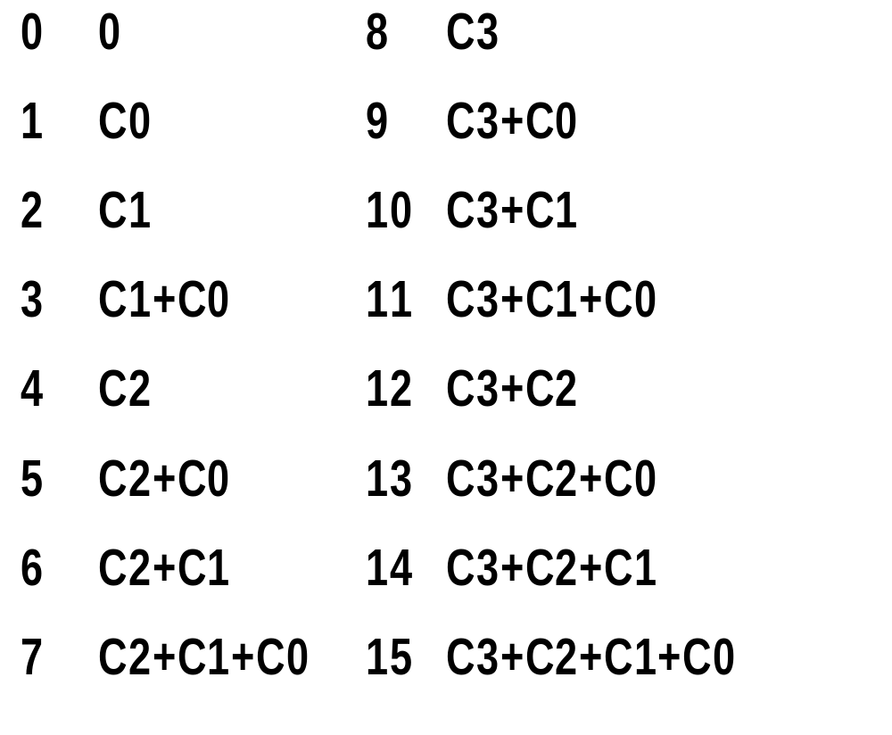
DALUT contents of a 4 Tap FIR
The Filter Equation is y = C₀x₀+C₁x₁+C₂x₂+C₃x₃
DALUT Contents are shown here for the addresses from 0 to 15. This DALUT will fit in a 4 input LUT.

Slide 24
Fully Parallel Single Input-Bit Implementation of 4 Tap FIR Filter
Remove Shift Registers and Scaling Accumulator from the Serial Implementation
Replicate DALUT as many times as there are input bits
Add the DALUT outputs using an adder tree with proper shifting
Achieves 4 times the throughput of the fully serial implementation.

Slide 25




Fully Parallel 4-Tap Filter
Assume coefficient width is 8 and input bit width is 4.
LUT0
10
Adder Tree
4
+
12
4
LUT1
10
+
+
Y(n)
>>1
14
4
LUT1
10
+
>>2
+
12
4
LUT2
10
+
>>1

Slide 26
Half Parallel Single Input-Bit Implementation of 4 Tap FIR Filter
1x1 TSB changes to 2x2 TSB
DALUTs are replicated twice
Add the DALUT outputs using an adder tree with proper shifting
Achieves 2 times the throughput of the fully serial implementation

Slide 27
Half Parallel 4-Tap Filter
Assume coefficient width is 8 and input bit width is 4.
x(n)
2
2x2 TSB
4
LUT0
10
2
+
2x2 TSB
12
+
y(n)
2
10
2x2 TSB
LUT1
+
14
4
>>1
2
+
2x2 TSB
>>2

Slide 28
Salient points in FIR Implementation
For achieving a higher throughput, replicate the DALUTs, modify the TSBs, Adder Tree and the Scaling Accumulator
No TSBs and Scaling Accumulator in the fully parallel case

Slide 29
Fully Serial Single Input-Bit Implementation of 8 Tap FIR
Assume coefficient width is 8 and input bit width is 4
x(n)
PSC
DA
LUT0
+
14
10
+
>>1
+
y(n)
18
>>2
10
+
DA
LUT1
+
14
+
>>1
TSB

Slide 30
Salient points in large FIR Filter Implementations
Use 4 input DALUT by grouping inputs in groups of 4. These are conveniently implemented in 4 input Logic Blocks.
Connect these DALUTs using Adder Tree with appropriate shifts to get the correct result.
For a serial implementation, use scaling accumulator to accumulate for output.

Slide 31
Two Input Bits Implementation
C₃₃C₃₂C₃₁C₃₀
x₃₃x₃₂x₃₁x₃₀
C₂₃C₂₂C₂₁C₂₀
x₂₃x₂₂x₂₁x₂₀
C₁₃C₁₂C₁₁C₁₀
x₁₃x₁₂x₁₁x₁₀
C₀₃C₀₂C₀₁C₀₀
x₀₃x₀₂x₀₁x₀₀
y₃₃₀y₃₂₀y₃₁₀y₃₀₀
y₃₃₁y₃₂₁y₃₁₁y₃₀₁
y₃₃₂y₃₂₂y₃₁₂y₃₀₂
y₃₃₃y₃₂₃y₃₁₃y₃₀₃
y₂₃₀y₂₂₀y₂₁₀y₂₀₀
y₂₃₁y₂₂₁y₂₁₁y₂₀₁
y₂₃₂y₂₂₂y₂₁₂y₂₀₂
y₂₃₃y₂₂₃y₂₁₃y₂₀₃
y₁₃₀y₁₂₀y₁₁₀y₁₀₀
y₁₃₁y₁₂₁y₁₁₁y₁₀₁
y₁₃₂y₁₂₂y₁₁₂y₁₀₂
y₁₃₃y₁₂₃y₁₁₃y₁₀₃
y₀₃₀y₀₂₀y₀₁₀y₀₀₀
y₀₃₁y₀₂₁y₀₁₁y₀₀₁
y₀₃₂y₀₂₂y₀₁₂y₀₀₂
y₀₃₃y₀₂₃y₀₁₃y₀₀₃
Another common DALUT addressed
by (x₂₂ x₂₃ x₃₂ x₃₂) for a common
partial product.
A common DALUT addressed
by (x₀₀ x₀₁ x₁₀ x₁₁) for a common
partial product.

Slide 32




Fully Parallel Two Input Bit Implementation for 4 Tap FIR
Assume coefficient width is 8 and input bit width is 4.
LUT0
10
Adder Tree
4
+
11
4
LUT1
10
+
+
y(n)
14
4
LUT0
10
>>2
+
+
11
4
LUT1
10
+

Slide 33
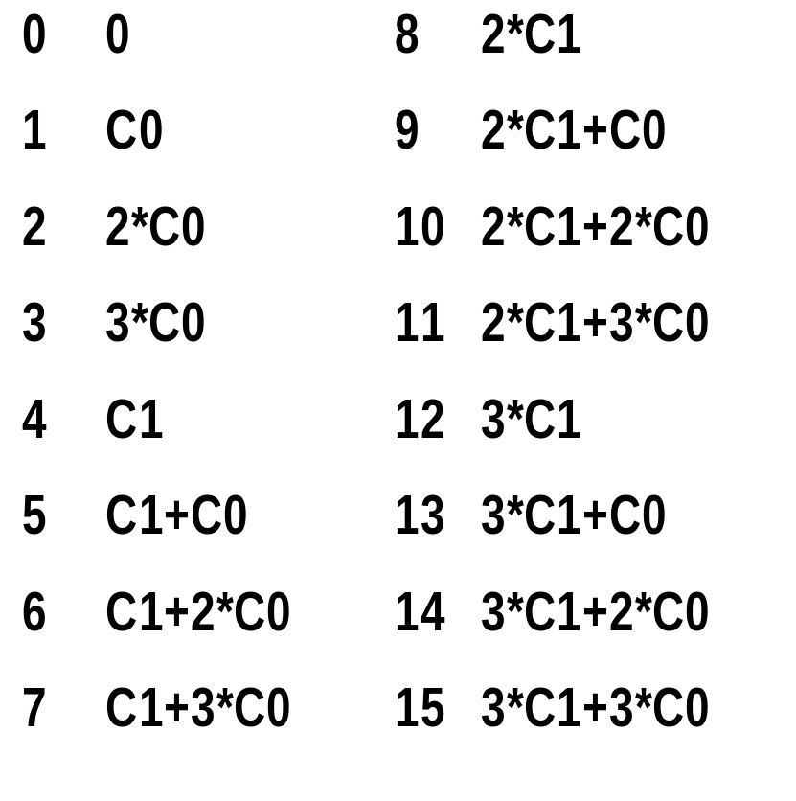

DALUT contents for Two Bit
The Filter Equation is y=C₀x₀+C₁x₁+C₂x₂+C₃x₃
LUT1
LUT0

Slide 34
Fully Serial Two Input Bit Implementation for 4 Tap FIR
X(n)
2x2PSC
4-input
DA
LUT0
Scaling Accumulator
10
+
2x2TSB
11
+
Y(n)
4-input
DA
LUT1
14
2x2TSB
10
+
2x2TSB
+
>> 2

Slide 35
Four Input Bits Implementation
C₃₃C₃₂C₃₁C₃₀
x₃₃x₃₂x₃₁x₃₀
C₂₃C₂₂C₂₁C₂₀
x₂₃x₂₂x₂₁x₂₀
C₁₃C₁₂C₁₁C₁₀
x₁₃x₁₂x₁₁x₁₀
C₀₃C₀₂C₀₁C₀₀
x₀₃x₀₂x₀₁x₀₀
y₃₃₀y₃₂₀y₃₁₀y₃₀₀
y₃₃₁y₃₂₁y₃₁₁y₃₀₁
y₃₃₂y₃₂₂y₃₁₂y₃₀₂
y₃₃₃y₃₂₃y₃₁₃y₃₀₃
y₂₃₀y₂₂₀y₂₁₀y₂₀₀
y₂₃₁y₂₂₁y₂₁₁y₂₀₁
y₂₃₂y₂₂₂y₂₁₂y₂₀₂
y₂₃₃y₂₂₃y₂₁₃y₂₀₃
y₁₃₀y₁₂₀y₁₁₀y₁₀₀
y₁₃₁y₁₂₁y₁₁₁y₁₀₁
y₁₃₂y₁₂₂y₁₁₂y₁₀₂
y₁₃₃y₁₂₃y₁₁₃y₁₀₃
y₀₃₀y₀₂₀y₀₁₀y₀₀₀
y₀₃₁y₀₂₁y₀₁₁y₀₀₁
y₀₃₂y₀₂₂y₀₁₂y₀₀₂
y₀₃₃y₀₂₃y₀₁₃y₀₀₃
Four Different DALUTs for each tap addressed
by 4 bits of input data x. DALUTs will be common
if number of bits in input data x is more than 4.

Slide 36




Fully Parallel Four Input Bit Implementation for 4 Tap FIR
Assume coefficient width is 8 and input bit width is 4.
LUT0
12
Adder Tree
4
+
13
4
LUT1
12
+
+
y(n)
14
4
LUT2
12
+
+
13
4
LUT3
12
+

Slide 37
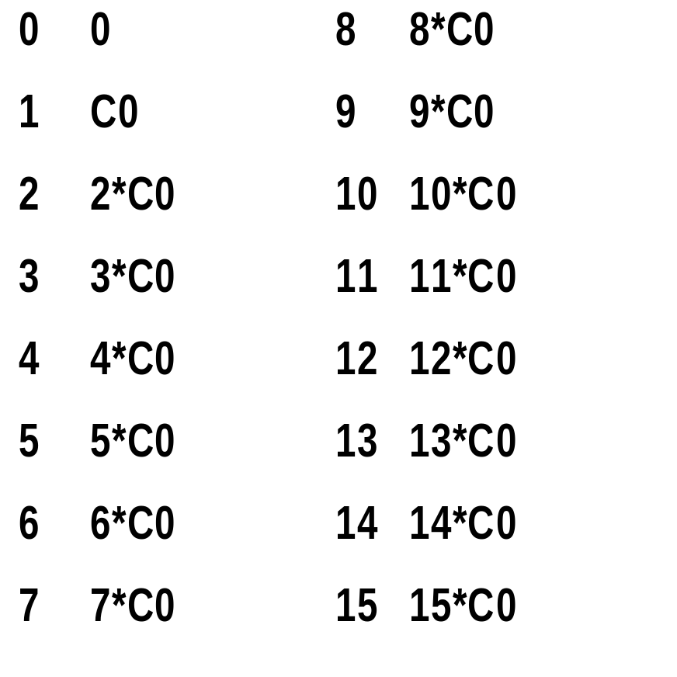
DALUT contents of a 4 Tap FIR
The Filter Equation is y = C₀x₀+C₁x₁+C₂x₂+C₃x₃
DALUT contents are shown here for the coefficient C₀. Similar DALUT contents can be derived for C₁, C₂ and C₃.

Slide 38
Different Distributed Arithmetic choices and their comparisons
Range of throughputs available for different coverings
For real designs, choose a throughput for the required bit rate
One of the coverings single, two or four input bits will give the most optimal result

Slide 39
FIR Implementations: Signed Numbers
Signed Coefficient Numbers are stored as twos complement in DA LUTs
Signed Data Inputs
  For serial implementation, subtract the partial product if sign bit is 1
  For parallel implementations, the DALUT contents are calculated properly for sign bits

Slide 40
Signed Numbers in Serial Distributed Arithmetic for FIR
x(n)
Single
or
more
DALUT
and
extra
stitching
logic
+/-
PSC
y(n)
TSB
+
TSB
>>1
...
Subtract when it is sign bit else add to the result
TSB
PSC : Parallel to Serial Converter
TSB : Timing Skew Buffer

Slide 41
Symmetrical FIR Filter
For an N tap symmetrical FIR Filter, h(k) is same as h(N-k) for k less than N/2.
Popular because phase response is constant
Can be implemented in hardware using N/2 tap Filter.

Slide 42
8 tap Symmetrical FIR Filter -I
Assume coefficient width is 8 and input bit width is 4
y = C₀*(x₀+x₇)+C₁*(x₁+x₆)+C₂*(x₂+x₅)+C₃*(x₃+x₄)
I0
X(n)
PSC
+
I1
TSB
+
TSB
+
TSB
I2
Serial Adder
TSB
+
TSB
I3
TSB
+
TSB
Shift Register Arrangements

Slide 43
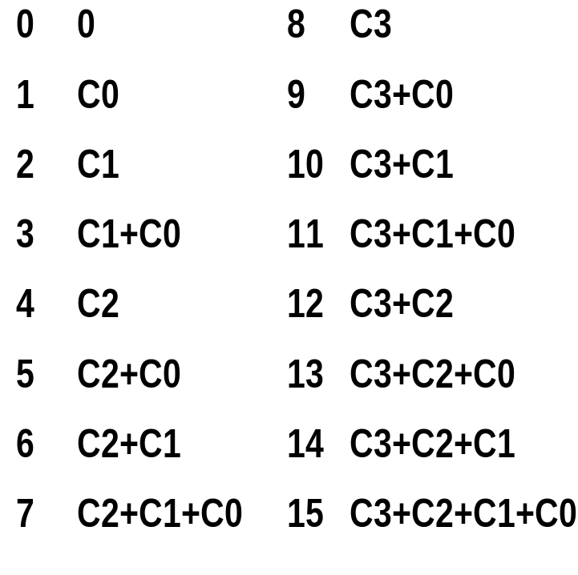
8 tap Symmetrical FIR Filter -II
I0
4-input
DA
LUT
10
I1
+
Y(n)
14
I2
+
>> 1
I3
Scaling Accumulator
DALUT Contents

Slide 44
Comment on Distributed Arithmetic Implementations
A wide array of implementation with varying throughput can be obtained in a standard way by using Distributed Arithmetic.
In certain cases, it might be possible that a better implementation exists. However DA results into good implementations in a consistent manner.

Slide 45
IIR Filter
A general Infinite Impulse Response (IIR) Filter
Difficult to design a stable high order IIR Filter. A Biquad Filter is more popular. High Order Filters are cascaded Biquad Filters.

Slide 46
Biquad IIR Filter
Biquad Filter Equation
  y(n)=B₀*x(n)+B₁*x(n-1)+B₂*x(n-2)-A₁*y(n-1)- A₂*y(n-2)
x(n)
x B₀
+
y(n)
x B₁
x -A₁
z⁻¹
z⁻¹
x B₂
x -A₂
z⁻¹
z⁻¹

Slide 47
Serial Biquad IIR Implementation
Assume coefficient width is 8 and input bit width is 4
x(n)
PSC
5-input
32-Deep
DA
LUT
10
+
TSB
14
y(n)
TSB
+
<< 1
y(n)
PSC
Scaling Accumulator
TSB
No Registers in DALUT

Slide 48
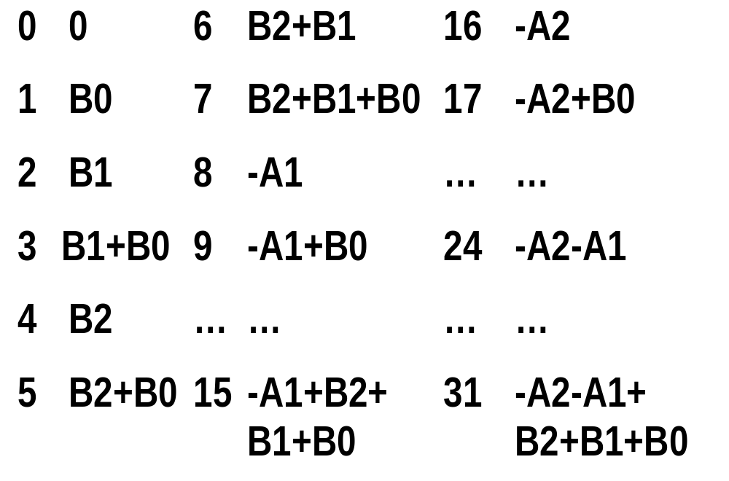
DALUT contents of Biquad IIR

Slide 49
IIR Filters
Since the output is fed back, the delays in the output path are an issue.
Fully pipelined operations are not viable.
Good Performance can be achieved for Biquad Filters even without pipelining.

Slide 50
Interpolation Filter
t
t
t
T
T
T/4
T
T/4
Low Rate Fs
High Rate 4Fs
FIR
Interpolation
Filter
High Rate 4Fs
Upsampler
1:4
0
Fs/2
0
Fs/2
0
Fs/2

Slide 51
1:2 Interpolation FIR Filter
For 1:2 interpolation, sample frequency changes from Fs to 2Fs.
-1.5Fs
-Fs
-0.5Fs
0.5Fs
Fs
1.5Fs
Low Pass Filter Response to remove the aliased frequency component beyond 0.5Fs

Slide 52
10 Tap 1:2 Interpolating FIR
Insert one zero every other data sample
Even Outputs:
  y(2n)=C₀*x(n)+C₁*0+C₂*x(n-1)+C₃*0+C₄*x(n-2) +C₅*0+C₆*x(n-3)+C₇*0+C₈*x(n-4) +C₉*0 =C₀*x(n)+C₂*x(n-1)+C₄*x(n-2)+C₆*x(n3)+C₈*x(n-4)
Odd Outputs:
  y(2n+1)= C₀*0+C₁*x(n)+C₂*0+C₃*x(n-1)+C₄*0+ C₅*x(n-2)+C₆*0+C₇*x(n-3)+C₈*0+C₉*x(n-4) =C₁*x(n)+C₃*x(n-1)+C₅*x(n-2)+C₇*x(n-3)+C₉*x(n-4)

Slide 53
10 Tap 1:2 Interpolating FIR
PSC
LUT0
for
C₀, C₂,
C₄, C₆
& C₈
x(n)
y(2n)
Mux
TSB
TSB
y(n)
LUT1
for
C₁, C₃,
C₅, C₇
& C₉
TSB
y(2n+1)
TSB
DI
DO
CE
>
Divide
By 2
Clock for the rest of design
System Clock

Slide 54
Interpolating Filter
In 1:n interpolation, we have n output sample for every 1 input samples. Pay attention to clocking scheme and the timing diagram.
A Interpolation Filter can exploit the symmetrical nature of the coefficients by rearranging the Timing Skew Buffer to the inputs of DALUTs. The number of DALUTs reduce by half.

Slide 55
Decimation Filter
t
t
t
T/4
T
T/4
T
High Rate 4Fs
FIR
Interpolation
Filter
High Rate 4Fs
Low Rate Fs
Downsampler
4:1
0
0
Fs/2
Fs/2
0
Fs/2

Slide 56
4:1 Decimation Filter
For 4:1 decimation, sample frequency changes from Fs to 0.25Fs.
-0.5Fs
-Fs/4
-Fs/8
Fs/8
Fs/4
0.5Fs
Low Pass Filter Response to remove the frequency component beyond 0.125Fs

Slide 57
8 Tap 4:1 Decimating FIR
Consider four consecutive outputs
y(4n)=C₀x(n)+C₁x(n-1)+C₂x(n-2) +C₃x(n-3)+C₄x(n-4) +C₅x(n-5)+C₆x(n-6)+C₇x(n-7)
y(4n-1)=C₀x(n-1)+C₁x(n-2)+C₂x(n-3) +C₃x(n-4)+C₄x(n-5) +C₅x(n-6)+C₆x(n-7)+C₇x(n-8)
y(4n-2)=C₀x(n-2)+C₁x(n-3)+C₂x(n-4) +C₃x(n-5)+C₄x(n-6) +C₅x(n-7)+C₆x(n-8)+C₇x(n-9)
y(4n-3)=C₀x(n-3)+C₁x(n-4)+C₂x(n-5) +C₃x(n-6)+C₄x(n-7) +C₅x(n-8)+C₆x(n-9)+C₇x(n-10)
y(4n-4)=C₀x(n-4)+C₁x(n-5)+C₂x(n-6) +C₃x(n-7)+C₄x(n-8) +C₅x(n-9)+C₆x(n-10)+C₇x(n-11)
Downsampler accepts one sample (y(4n)) and rejects three samples (y(4n-1), y(4n-2) and y(4n-3)). Do not do the extra multiplies.

Slide 58
8 Tap 4:1 Decimating FIR
DI
DO
DI
DO
CE
C₀
CE
C₄
>
>
Data In
DI
DO
DI
DO
Σ
Data Out
CE
C₁
CE
C₅
>
>
System Clock
DI
DO
1
CE
>
DI
DO
DI
DO
0
CE
C₂
CE
C₆
DI
DO
>
>
CE
>
DI
DO
0
CE
DI
DO
DI
DO
>
C₃
C₇
CE
CE
DI
DO
0
>
>
CE
>
Divide
By 4
System Clock

Slide 59
8 Tap 4:1 Decimating FIR
DI
DO
PSC
DA
LUT0
for C₀,
C₄, C₁
& C₅.
CE
>
TSB
Scaling Accumulator
x(n)
+
DI
DO
PSC
CE
+
>
TSB
System Clock
1
y(n)
DI
DO
CE
>
DI
DO
PSC
DA
LUT1
for C₂,
C₆, C₃
& C₇.
+
0
CE
DI
DO
>
TSB
<< 1
CE
>
0
+
DI
DO
CE
DI
DO
PSC
>
CE
DI
DO
0
>
TSB
CE
>
Divide
By 4
System Clock

Slide 60
Decimating Filter
In n:1 decimation, we have 1 output sample for every n input samples. Pay attention to clocking scheme and the timing diagram.
A Decimation Filter can exploit the symmetrical nature of filter coefficients by rearranging the Timing Skew Buffer and adding Multiplexers to the inputs of DALUTs. The number of DALUTs reduce by half.

Slide 61
Adaptive FIR Filters
Coefficients change according to an algorithm
Pay Attention to
  Delays in the Feedback Path
  Latency in the Coefficient Updating Logic
  How coefficients get updated
Design of Adaptive Filters closely related with the application where it gets used

Slide 62
Implementations of Adaptive Filter
Usage of Efficient Variable Multiplier is a viable option in Virtex
The Distributed Arithmetic Implementations can be made reloadable by using Distributed RAM or Shift Register LUT instead of LUTs
  Logic to update the coefficients depend on the DA Implementation
  Two copies of DA RAMs allow filter operation in one RAM while other gets updated. Switch between two DA RAMs appropriately

Slide 63
Fully Parallel Four Input Bit Implementation for 4 Tap FIR
Assume coefficient width is 8 and input bit width is 4
LUT0
12
Adder Tree
4
+
13
4
LUT1
12
+
+
y(n)
14
4
LUT2
12
+
+
13
Change LUT
to RAM for
reloadable
coefficients
4
LUT3
12
+

Slide 64
Reloadable Coefficients
Data In
LUT0
Data Out
Stored Data Values
4
12
Change it to a
reloadable RAM
based Multiplier

Slide 65
Reloadable Coefficients
4
Data Out
LUT3
12
Data In
Data In
4
Addr
Sync
reset
Binary UpCounter
0 to 15
RAM
16x12
Data Out
we
12
Din
Update_signal
Reg
12
New Coefficient
Load
Sync reset

Slide 66
DA Implementations of Adaptive Filter
Updating typically takes 16 cycles for a RAM16x1 implementation
Avoid Address Multiplexing by using Shift Register LUT instead of RAM16x1 in Virtex
Two copies of DA RAMs allow filter operation in one RAM while other gets updated. Switch between two DA RAMs appropriately
  Look at http://www.xilinx.com/xapp/xapp055.pdf for an example implementation

Slide 67
Conclusion
FPGA Architectures are nicely suited for Filter Applications
Design Tricks explained the area-speed tradeoffs
Distributed Arithmetic is key to a lot of Filter Implementations
Do Filters in FPGA and you will

