Slide 1

Introduction to Digital Signal Processing

Slide 2
Digital Signal Processing
Perform useful transformations on signals represented in discrete form
Challenges
  Process information fast
    Often deal with real world signals
  Process enough information
    Ensure no useful information is lost

Slide 3
Why is DSP so popular
Repeatability
  component tolerances very high
Versatility
  can be reprogrammed
Simplicity
  many transformations done easily in digital domain

Slide 4
Typical DSP flow
A2D
DSP
D2A

Slide 5
Digitization Issues
Sampling clock errors
  bad for timing
Sample measurement accuracy
  bad for small changes
Finite length of sampling
  bad for slow changes
Finite sample intervals
  bad for fast changes

Slide 6
Effect of low sampling-rate
Miss glitches
Miss high frequency components

Slide 7
Aliasing
Interpret a high frequency as a lower one wrongly

Slide 8
Aliasing
Nyquist: : sampling-rate >= 2*largest_sig_freq
Avoiding aliasing
  use antialiasing filter before sampling
  inhibits freq components > 0.5*sampling_rate

Slide 9
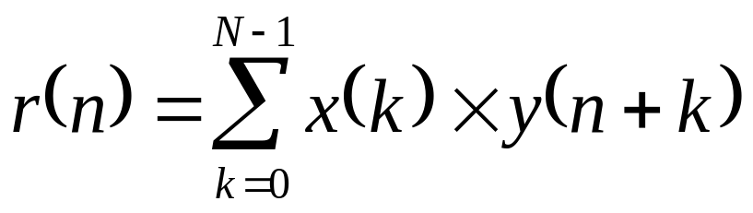
Time domain processing
Correlation
Signal x
Signal y
Shift y
Integrate
Correlated signal r

Slide 10
Correlation
Autocorrelation
  extract signal from noisy environment

Slide 11
Correlation
Cross correlation
  correlate input signal with library of signals

Slide 12
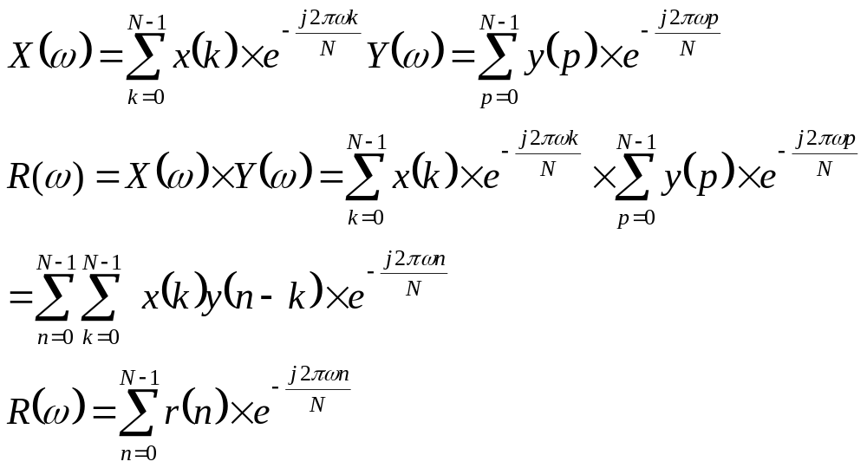
Convolution

Slide 13
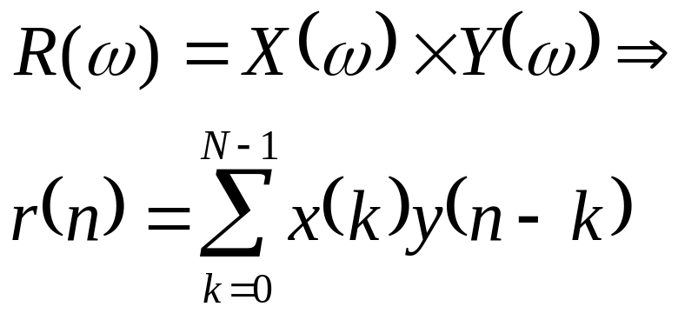
Convolution
Multiplication in frequency domain => convolution in time-domain

Slide 14
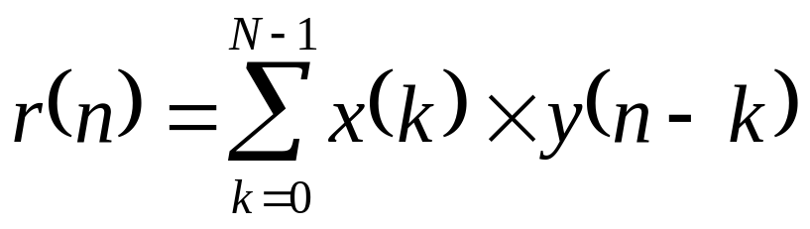
Convolution
Signal x
Signal y
Flip/Shift y
Integrate
Convoluted signal r

Slide 15
Time domain processing
Correlation
Convolution
Multiply/accumulate are the most widely used core functions for DSP

Slide 16
Conclusions
Why DSP is popular
Effect of sampling
Aliasing
Correlation
Convolution

Slide 17
VLSI Signal Processing in FPGAs
Sudip K Nag (Xilinx Inc.)
Hare K Verma (Xilinx Inc.)
Kaushik Roy (Purdue Univ.)

Slide 18
Sections
Introduction to DSP
VIRTEX Architecture
Filters in FPGAs
FFTs in FPGAs
MPEG decoding in FPGAs
Cordic Algorithms in FPGAs
Low-power solutions
Specific DSP architectures as FPGAs

