Slide 1

MPEG decoding in FPGAs

Slide 2
Why compress?
Typical HDTV standard: 1920 x 1080 at 30 frames/sec
8 bits for each of three primary colors
1.5 Gb/sec!
Bandwidth limitation => 18 Mb/sec per channel for video
Require 83:1 compression
With high quality video to end user

Slide 3
MPEG format
Transmission in form of series of frames
Use YCbCr color-space instead of RGB
Each frame comprises a set of macroblocks
  Macroblocks comprise set of blocks
  e.g. formats 4:4:4 4:2:2 4:2:0

Slide 4
MPEG format
High correlation between neighboring pixels
Use Discrete Cosine Transform
  Near optimal for energy concentration and decorrelation
  Transform 8x8 block to produce 8x8 DCT coeffs
  Most higher-order coeffs are 0
  Drastically reduces bandwidth requirement

Slide 5
Discrete Cosine Transform
22
19
13
13
15
18
13
7
6
9
14
11
5
5
7
12
8
1
2
3
12
14
9
3
5
10
12
2
2
5
8
4
2
0
0
4
2
0
0
0
2
0
0
0
0
0
0
0
0
0
0
1
0
0
0
0
0
0
0
0

Slide 6
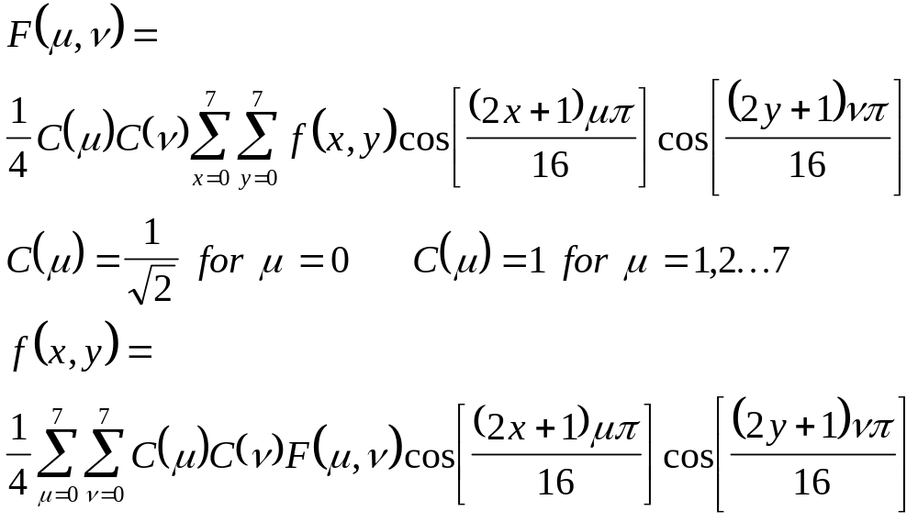
Discrete Cosine Transform

Slide 7
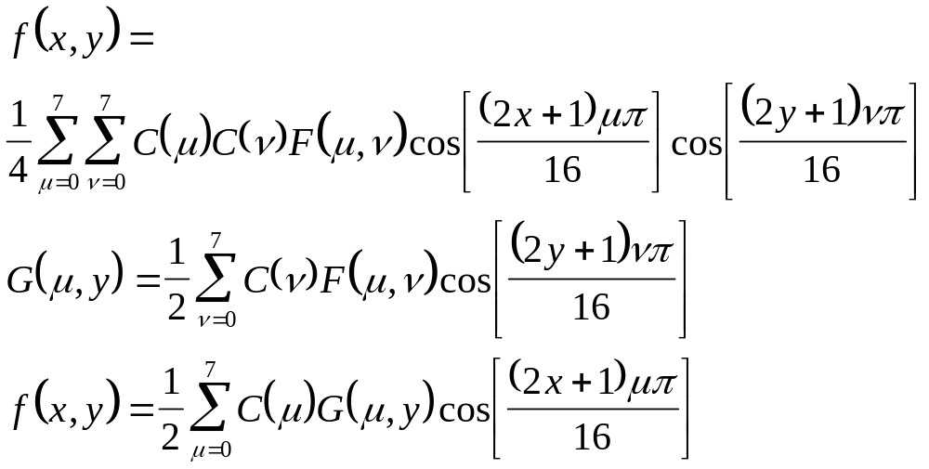
Discrete Cosine Transform
Implementing 2D DCT with two 1D DCTs

Slide 8
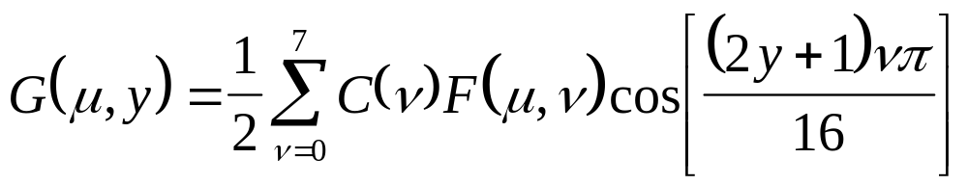
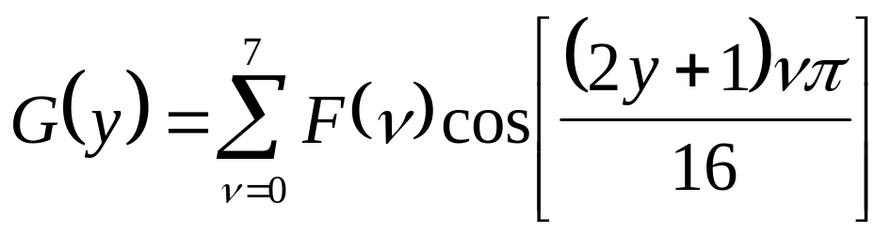
1D-DCT using DA
Simplified
form

Slide 9
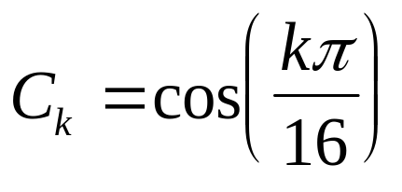
1D-DCT using DA
F(0)
F(1)
C₀
C₁
C₂
C₃
C₄
C₅
C₆
C₇
G(0)
C₀
C₃
C₆
C₉
C₁₂
C₁₅
C₁₈
C₂₁
C₀
C₅
C₁₀
C₁₅
C₂₀
C₂₅
C₃₀
C₃₅
C₀
C₇
C₁₄
C₂₁
C₂₈
C₃₅
C₄₂
C₄₉
C₀
C₉
C₁₈
C₂₇
C₃₆
C₄₅
C₅₄
C₆₃
C₀
C₁₁
C₂₂
C₃₃
C₄₄
C₅₅
C₆₆
C₇₇
C₀
C₁₃
C₂₆
C₃₉
C₅₂
C₆₅
C₇₈
C₉₁
G(7)
C₀
C₁₅
C₃₀
C₄₅
C₆₀
C₇₅
C₉₀
C₁₀₅

Slide 10
1D-DCT : simplified coeffs
C₀
C₁
C₂
C₃
C₄
C₅
C₆
C₇
C₀
C₃
C₆
-C₇
-C₄
-C₁
-C₂
-C₅
C₀
C₅
-C₆
-C₁
-C₄
C₇
C₂
C₃
C₀
C₇
-C₂
-C₅
C₄
C₃
-C₆
-C₁
C₀
-C₇
-C₂
C₅
C₄
-C₃
-C₆
C₁
C₀
-C₅
-C₆
C₁
-C₄
-C₇
C₂
-C₃
C₀
-C₃
C₆
C₇
-C₄
C₁
-C₂
C₅
C₀
-C₁
C₂
-C₃
C₄
-C₅
C₆
-C₇

Slide 11
1D-DCT : simplified coeffs
F(0)
F(7)
C₀
C₁
C₂
C₃
C₄
C₅
C₆
C₇
G(0)
C₀
C₃
C₆
-C₇
-C₄
-C₁
-C₂
-C₅
C₀
C₅
-C₆
-C₁
-C₄
C₇
C₂
C₃
C₀
C₇
-C₂
-C₅
C₄
C₃
-C₆
-C₁
C₀
-C₇
-C₂
C₅
C₄
-C₃
-C₆
C₁
C₀
-C₅
-C₆
C₁
-C₄
-C₇
C₂
-C₃
C₀
-C₃
C₆
C₇
-C₄
C₁
-C₂
C₅
G(7)
C₀
-C₁
C₂
-C₃
C₄
-C₅
C₆
-C₇

Slide 12
Block diagram for 1D-DCT
F(0 2 4 6)
8 DALUTs
C₀, C₂, C₄, C₆
+
G(0)
-
G(7)
C₁, C₃, C₅, C₇
C₀, C₆, -C₄, -C₂
+
G(1)
-
G(6)
C₃, -C₇, -C₁, -C₅
C₀, -C₆, -C₄, C₂
+
G(2)
-
C₅, -C₁, C₇, C₃
G(5)
C₀, -C₂, C₄, -C₆
+
G(3)
-
C₇, -C₅, C₃, -C₁
G(4)
F(1 3 5 7)

Slide 13
Original Picture block
22
19
13
13
15
18
13
7
6
9
14
11
5
5
7
12
8
1
2
3
12
14
9
3
5
10
12
2
2
5

Slide 14
DC-transformed block
8
4
2
0
0
4
2
0
0
0
2
0
0
0
0
0
0
0
0
0
0
1
0
0
0
0
0
0
0
0
8 4 2 0 0 4 2 0 0 0 2 0 0 0 0 0 0 0 0 0 0 1 0 0 0 0 0 0 0 0

Slide 15
Zigzag scan ordering
8
4
2
0
0
4
2
0
0
0
2
0
0
0
0
0
0
0
0
0
0
1
0
0
0
0
0
0
0
0
8 4 4 2 2 2 0 0 0 0 0 0 0 0 0 0 0 0 1 0 0 0 0 0 0 0 0 0 0 0

Slide 16
Variable-length code table
Zero run-length
Amplitude
MPEG code value
N/A
8
110 1000
0
4
0000 1100
0
4
0000 1100
0
2
0100 0
0
2
0100 0
0
2
0100 0
12
1
0010 0010 0
EOB
EOB
10

Slide 17
Huffman codes
Typically 20% - 90% compression
Coding based on frequency of occurrence
a b c d e f
Frequency (%) 60 11 12 15 1 1
Fixed-length code 000 001 010 011 100 101
Huffman code 0 101 100 111 1101 1100
100char: Fixed-length: 300 bits Huffman-code: 182 bits

Slide 18
Huffman codes
a b c d e f
Frequency (%) 60 11 12 15 1 1
Fixed-length code 000 001 010 011 100 101
Huffman code 0 101 100 111 1101 1100
100
100
1
0
1
0
a:45
55
86
14
1
0
1
0
0
25
30
58
28
14
0
1
0
1
1
1
1
0
0
0
c:12
b:13
14
d:16
a:45
b:13
c:12
d:16
e:9
f:5
0
1
f:5
e:9

Slide 19
Construction of Huffman codes
Sort objects
Merge 2 objects with least frequencies
f:5
e:9
c:12
b:13
d:16
a:45
Step 1
c:12
b:13
14
d:16
a:45
0
1
Step 2
f:5
e:9
14
d:16
25
a:45
0
1
0
1
Step 3
f:5
e:9
c:12
b:13

Slide 20
Huffman codes
25
30
a:45
Step 4
0
1
0
1
Step 6
c:12
b:13
14
d:16
100
1
1
0
0
55
f:5
e:9
a:45
1
0
a:45
55
25
30
1
0
1
0
1
0
25
30
14
1
c:12
b:13
d:16
0
1
0
0
1
c:12
b:13
14
d:16
f:5
e:9
0
1
f:5
e:9
Step 5

Slide 21
Huffman decoder in FPGA
Comparators
Wide-ORs
Code 1
Code 2
Coded
Word
Code 3
Decoded
Word
Code N
1-hot coding

Slide 22
MPEG decoding in FPGA
Variable-length decoding
  Comparators
  Wide-ORs
IDCT
  Distributed Arithmetic
All these functions can be implemented very efficiently in VIRTEX

Slide 23
Motion compensation
Consecutive video frames similar
Small movement => block matches very likely
  search space based on encoder
Use motion vectors
Four motion vectors for bidirectional prediction
Residual error frame encoded efficiently

Slide 24
Motion compensation
FRAME 1
FRAME 2

Slide 25
Motion compensation
FRAME 1
FRAME 2

Slide 26
Motion compensation
BAD MATCH
FAIR MATCH
GOOD MATCH

Slide 27
Frames
Transmission in form of series of frames
Each frame comprises a set of macroblocks
3 types of frames
  I frame
    Exploits spatial redundancy
  P/B frames
    Exploit temporal redundancy

Slide 28
P Frames
Predictor frames
Macroblocks comprise motion-vectors relative to previous frame’s macroblocks
I P P P P P I P P P P P
  P frame predicted from frame before
  I frames coded spatially - no reference to any other frames

Slide 29
B Frames
Bidirectional frames
Macroblocks comprise motion-vectors relative to previous AND next frame’s macroblocks
I B P B P B I B P B P B
  P frame predicted from frame before
  I frames coded spatially - no reference to any other frames
  B frame predicted from frame before and after

Slide 30
Conclusions
Image compression
  YCbCr color-space
  DCT
  Variable-length coding
  Motion compensation
Primary components for MPEG decoding (IDCT/Huffman decoding) can be implemented efficiently in FPGAs for speed

