Slide 1

Programmable Digital Signal Processors (pDSP) and
Field Programmable Gate Arrays (FPGA)

Slide 2
pDSP
Most commonly used DSP solution
Basic Characteristics
  High Speed Arithmetic
  Excellent Real Time Signal Handling
  Multiple Memory Access
High Speed Arithmetic
  Multiply and Accumulate (MAC) in one cycle
  Multiple MAC Units

Slide 3
pDSP
Multiple Memory Access
Harvard Architecture
16k x 16
PROGRAM
DSP
Processor
16k x 16
DATA
Modified von Neuman Architecture
  Memory clock runs faster than Instruction Cycle
16k x 16
MEMORY
DSP
Processor

Slide 4
pDSP
Excellent at real time signal handling
Various types of Port Support
  Serial Port: High Speed Synchronous or Asynchronous Serial Port
  Host Port: Communication with Hosts like PC
  Link (or Comm) Port: Interprocessor Communication
Data can be transferred without stopping the DSP

Slide 5
pDSP
EFFICIENT
I/Os
REGISTERS
  Integer
  Float
Signal In
Out
DMA
PORTS
Serial
Host
Link
System
Controller
ADDRESS
Generator
PARALLEL
MAC
Other
DSP
Processors
MULTIPLE MEMORIES
16k x 16
PROGRAM
16k x 16
DATA

Slide 6
Virtex FPGA
EFFICIENT
I/Os
Register Rich
Signal In
Out
Distributed
MAC & Logic
Drop In
Comm.
Protocols
Drop In
Cores
Constant or Variable
Multipliers
System
Controller
16 or 32
Deep
LUTs
and
Memories
Fast
Carry
Logic
Fast External
Memory Interface
Other
Processors
MEMORIES
Block
Memory
Distributed
Memory

Slide 7
Virtex FPGAs
High Speed Arithmetic
  Use Distributed Arithmetic Technique which utilizes the Look Up Tables, Distributed Synchronous RAM Units and Fast Carry Logic to do the multiplies
  Use Multiple Constant or Variable Multipliers
  Decide on the number of parallel units from the required sample rate

Slide 8
Virtex FPGAs
Input Output Signal Handling
  Implement or Drop In an existing Core for the proper Communication or Bus Interfaces like PCI
  Input Output Ports support wide variety of signaling standards
  Drop In an Asynchronous or Synchronous FIFO
  High Speed Communication is achieved using FPGAs

Slide 9
Virtex FPGAs
Lots of Memory
Use Memory Compilers to get various Memory Sizes
  Dual Port Block Memory in the blocks of 4096 memory bits which can be configured as 4096x1, 2048x2, 1024x4, 512x8 and 256x16 memory blocks
  Distributed Single Port Memories in the units of 16x1 and 32x1
  Distributed Dual Port Memories in the units of 16x1

Slide 10
Design Flow
Design Entry
Schematic
HDL
CORES
Translation, Mapping,
Place and Route
Simulation and
Verification
Tools
Program Bit Generation
To FPGA

Slide 11
FPGA
Hardware in an FPGA is configured by a bit stream generated from the design
  Reconfigurable Computing is an emerging area
Current FPGAs can be used if the design fits in the device otherwise choose a larger device

Slide 12
Data Format
Most Applications store data in Fixed Point Format
0 1 0 1 . 0 1 0 1 = 5.375
Track Decimal Point properly as we progress along the data path.
5
001.10
+
6
0110.11
5
101.01
+

Slide 13
Data Format
Maintain your own precision by discarding appropriate number of bits after each operation
  Tools like Elanix help do bit true simulation
No restrictions on the number of bits
  Use the number of bits required by the application’s dynamic range

Slide 14
An example FIR Filter
Simple Code in C
  y[n] = 0;
  for (k = 0; k < N; k++)
    y[n] = y[n] + c[k]*x[n-k];
Sequential
Commands
to the Processor
Efficient Code in C
  register temp = 0;
  for (k = 0; k < N; k++)
    temp = temp + *c_ptr++ * *x_ptr--;

Slide 15
An example FIR Filter
Concurrent
Statements mapped
to Digital Gates
in FPGAs
Generic VHDL Code
  …...
  mult : FOR k IN 0 TO N-1 GENERATE
    munits : y[n] <= c[k] * x[k];
  END GENERATE;
Instantiate Efficient Constant Multiplier
  …...
  mult : FOR k IN 0 TO N-1 GENERATE
    munits : Constant_Coefficient_Multiplier
      GENERIC MAP (const_value => c[k])
      PORT MAP (mult_in => x[k], mult_out => y[n] );
  END GENERATE;
  …...

Slide 16
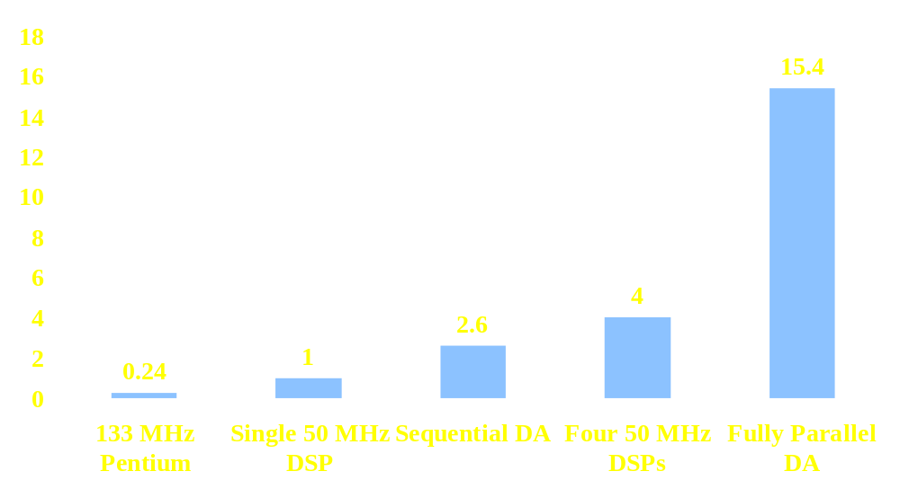
8-Bit, 16-Tap FIR Filter Performance Comparisons

Slide 17
pDSP vs FPGA
Use DSP Processor and FPGAs together to achieve high performance DSP solutions
FPGAs can do compute intensive parts of the DSP System very efficiently
Use pDSP for control intensive operations
Use FPGAs and DSP Processor instead of multiple DSP Processors to achieve high speed
http://www.xilinx.com/products/logicore/dsp/index.htm for more information

