Slide 1

VirtexTM Architecture

Slide 2
VIRTEXTM Architecture
DLL
IOBs
DLL
VersaRing
VersaRing
BlkRAMs
CLBs
BlkRAMs
DLL
DLL

Slide 3
VIRTEXTM CLB
COUT
COUT
YB
YB
Y
Y
G3
Carry &
Control
YQ
G3
Carry &
Control
YQ
G2
LUT
REG
G2
LUT
REG
G1
G1
G0
G0
BY
BY
XB
XB
X
X
F3
Carry &
Control
XQ
F3
Carry &
Control
XQ
F2
LUT
REG
F2
LUT
REG
F1
F1
F0
F0
BX
BX
Slice1
Slice2
CIN
CIN

Slide 4
VIRTEXTM SLICE
COUT
YB
CY
G3
Y
G2
LUT
G1
D
Q
YQ
G0
REG
BY
XB
F5IN
F6
CY
F5
F5
X
BX
D
Q
XQ
F3
REG
F2
LUT
F1
F0
SR
CK
CE
CIN

Slide 5
Two 4-input functions
G(0-3)
LUT
F(0-3)
LUT

Slide 6
5-input function
F(0-3)
LUT
Out
F4
F(0-3)
LUT

Slide 7
6-input function (half shown)
Out
F(0-3)
LUT
F5
F5IN
F4
F(0-3)
LUT

Slide 8
2 reg driven by direct inputs
YQ
REG
BY
BX
XQ
REG
SR
CK
CE

Slide 9
2 reg driven by LUTs
YQ
REG
RS
XQ
REG
SR
CK
CE

Slide 10
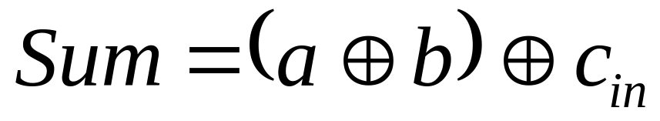
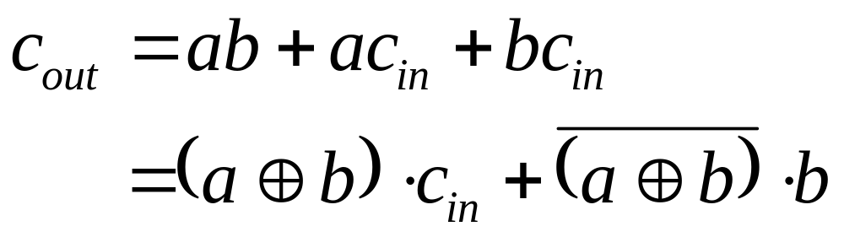
1-bit Full Adder
Adding a and b; carry in Cin

Slide 11
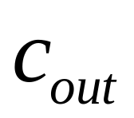


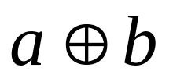

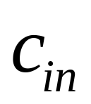
1-bit full adder

Slide 12



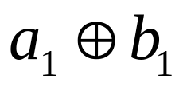
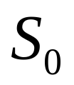


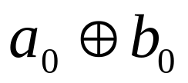
2-bit adder cascaded

Slide 13
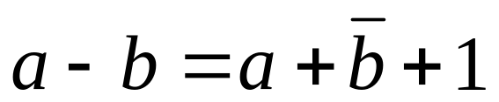
1-bit Subtractor
B_{out}
a
S
b
1

Slide 14
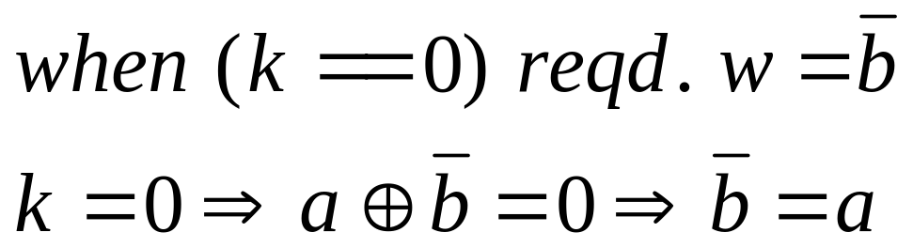
1-bit Subtractor
k
a
b
S
w
1
b
a
S
1

Slide 15
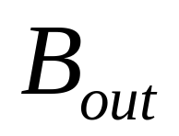
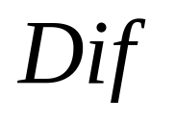

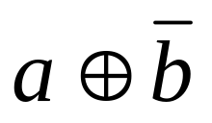


1-bit subtractor

Slide 16
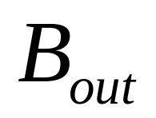
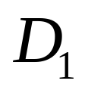
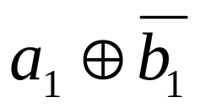
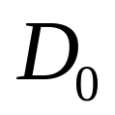
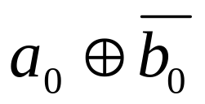

2-bit subtractor

Slide 17
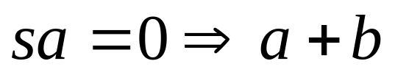
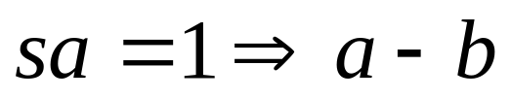
1-bit add-sub
b
a
S
0
b
a
S
1

Slide 18
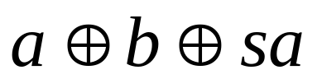
1-bit add-sub
sa
b
a
S

Slide 19
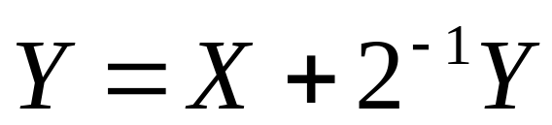
Scaling Accumulator
X : 16-bit input
Y : 17-bit output

Slide 20
Scaling Accumulator
X15
Y16
Y15
2-bit adder
X14
Register
N-bit scaling acc:
N/2 slices or
N/4 CLBs
Y1
X0
Y0

Slide 21
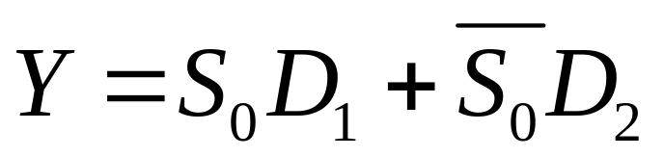
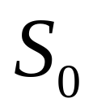
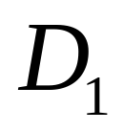
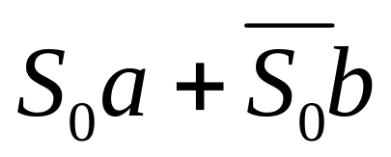

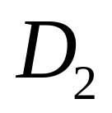
2:1 Multiplexer
Requires 1 LUT

Slide 22
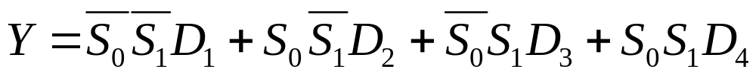
4:1 Multiplexer
6 input function
naïve implementation will require 4 LUTs
exploit partitioning of variables
  can implement using just 2 LUTs (1 slice)

Slide 23






4:1 Multiplexer
2:1
2:1

Slide 24











8:1 Multiplexer
11 input function
can be implemented with 4 LUTs (1 CLB)
4:1 MUX : 2 LUTs
F6 MUX
4:1 MUX : 2 LUTs

Slide 25



16:1 Multiplexer
Build larger muxes using [8:1] [4:1] [2:1] modules
8:1 MUX : 1 CLB
2:1 MUX : 1 LUT
F6 MUX
8:1 MUX : 1 CLB

Slide 26
Wide-AND
Y
I0
I0
I1
I1
I2
I2
I3
I3
0
Y
I4
I5
I6
I7
I4
I5
I6
I7
0
1

Slide 27











8-bit Wide-AND
0
0
1

Slide 28
Wide-OR
Y
I0
I0
I1
I1
I2
I2
I3
I3
1
Y
I4
I5
I6
I7
I4
I5
I6
I7
1
0

Slide 29


8-bit Wide-OR
1
1
0

Slide 30
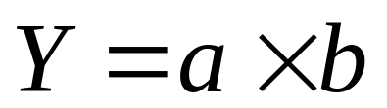
Multiplier
a : 16-bit multiplicand
b : 16-bit multiplier
Y : 32-bit output

Slide 31
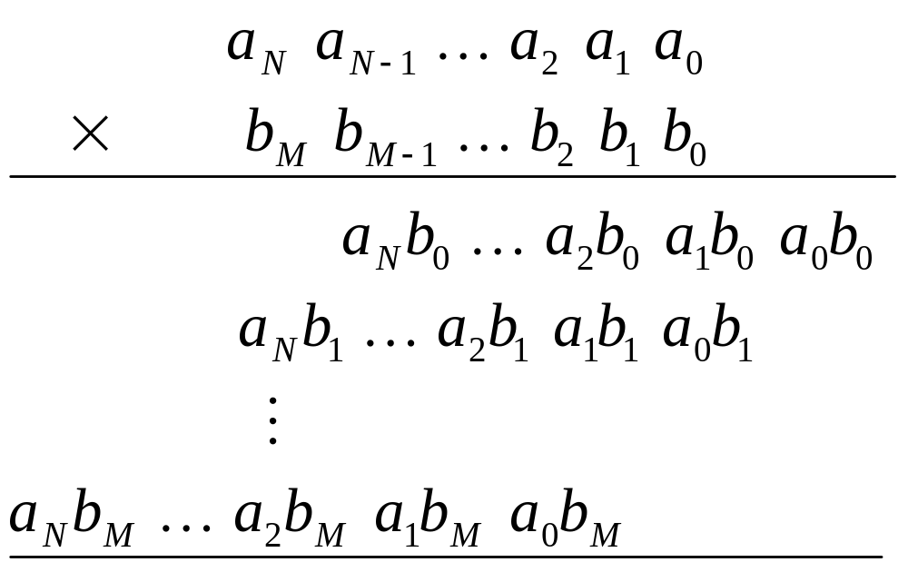
Multiplier

Slide 32
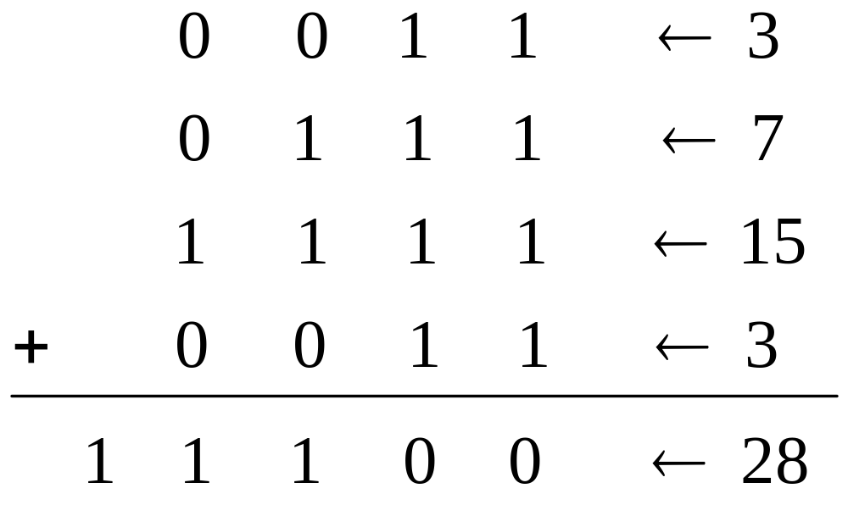
Multiplier
1
11
111
11

Slide 33
Multiplier
1
1
1
1

Slide 34
Multiplier
0
0
0
0
0
0
1
1
0
1
1
1
1
0
1
0
1
1
1
0
1
0
0
1
0
0
1
1
1
1
0
0

Slide 35
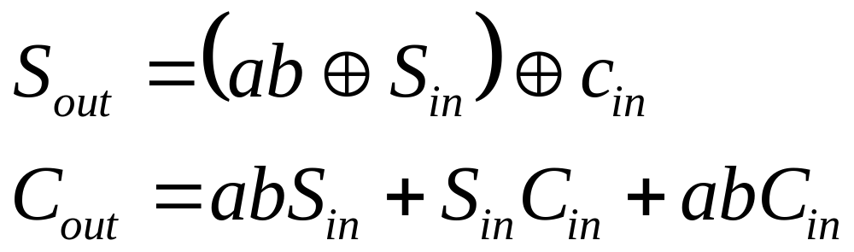
Multiplier
S_{in}
C_{out}
C_{in}
ab
S_{out}

Slide 36
Multiplier
S_{in}
C_{out}
C_{in}
ab
S_{out}
C_{out}
S_{in}
S_{out}
a
b
C_{in}

Slide 37
Multiplier
S_{in}
C_{out}
C_{in}
ab
S_{out}
C_{out}
S_{in}
S_{out}
a
b
C_{in}

Slide 38
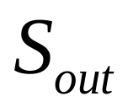


Multiplier core

Slide 39
N-bit Multiplier
0
0
0
0
Area: N² LUTs
= N²/2 slices
= N²/4 CLBs
Speed : 2Nc + Ns
c = carry delay = 0.1ns
s = slice delay = 3ns
0
0
1
1
0
1
1
1
1
0
1
0
1
1
1
0
1
0
0
1
0
0
1
1
1
1
0
0

Slide 40
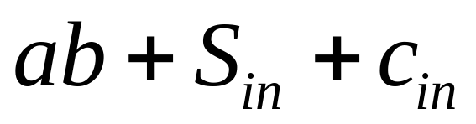
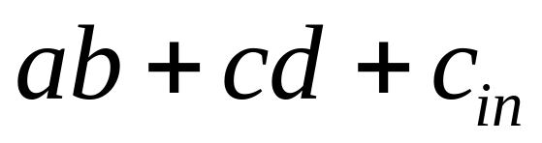
N-bit Multiplier (efficient)
0
0
0
0
0
0
1
1
0
1
1
1
1
0
1
0
1
1
1
0
1
0
0
1
0
0
1
1
1
1
0
0

Slide 41
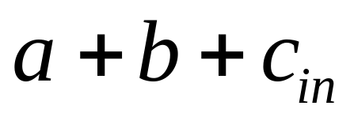
N-bit Multiplier (efficient)

Slide 42
Multiplier (efficient)
ab
C_{out}
C_{in}
cd
S_{out}
C_{out}
a
b
S_{out}
c
d
C_{in}

Slide 43
Multiplier(efficient)
ab
C_{out}
C_{in}
cd
S_{out}
C_{out}
a
b
S_{out}
c
d
C_{in}

Slide 44



Multiplier core

Slide 45
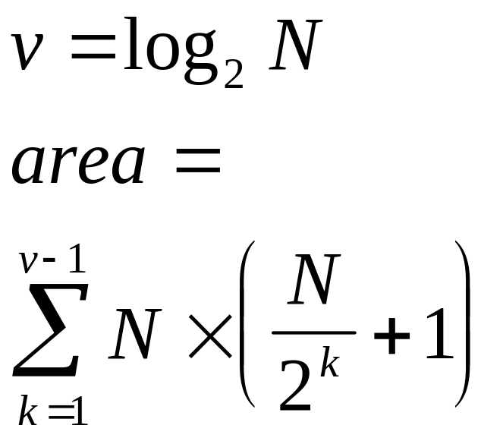
N-bit Multiplier (efficient)
Area (LUTs):
Speed : 2Nc + vs

Slide 46
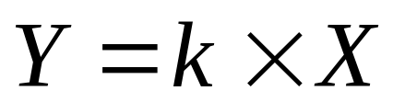
Constant-Coeff Multiplier
K : 8-bit constant coefficient
X : 8-bit variable input
Y : 16-bit output

Slide 47
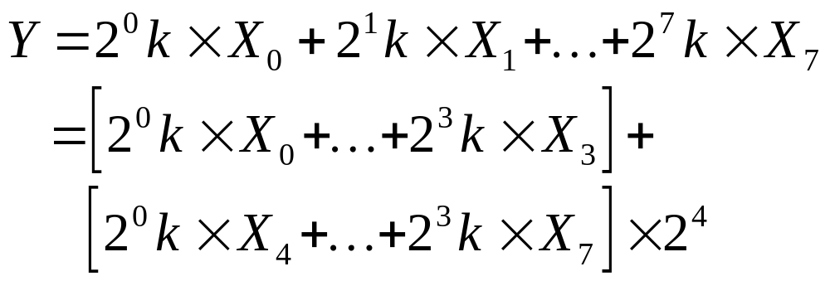
Constant-Coeff Multiplier
K : 8-bit constant coefficient
X : 8-bit variable input
Y : 16-bit output

Slide 48
Constant-Coeff Multiplier
12 LUTs
0
4
k
12
...
15k
12
8
12-bit ADDER
16
X
8
Y
0
k
12
...
4
4
15k
12 LUTs

Slide 49
Const-coeff mult: 8-bits
Area:
  2 LUTs 12 bit wide => 24 LUTs
  1 adder 12 bit wide => 12 LUTs
  Total area = 36 LUTs
Speed:
  2s (2 levels of LUT)

Slide 50
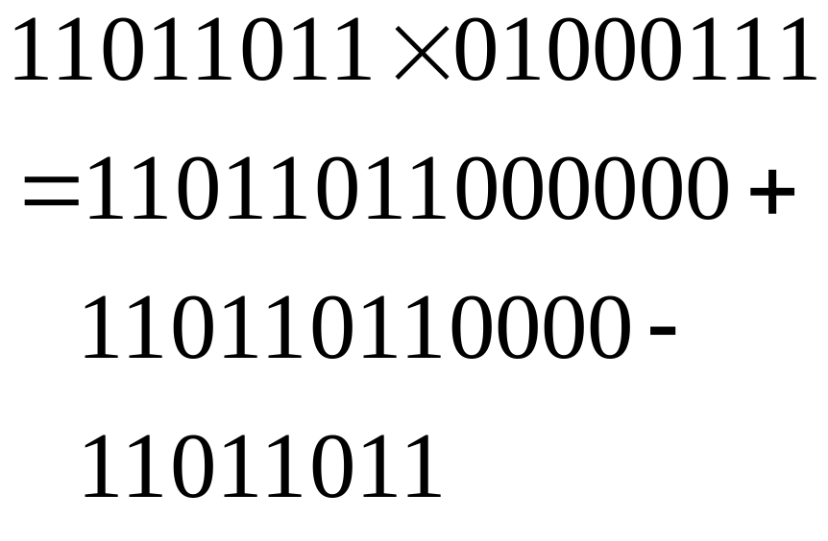
Constant-coeff: Booth-style
Each run of 1 represents one ADD and one SUB
Isolated 1 represents one ADD

Slide 51
Constant-coeff: Booth-style
Coeff = 10001011
Area
  A = add shift-1 and shift-2 => 11 LUTs
  B = add shift-4 and shift-7 => 13 LUTs
  C = A + B => 16 LUTs
  Total area = 11+13+16=40 LUTs ( > 36 LUTs)
Speed
  2s or s
Better to use KCM

Slide 52
Constant-coeff: Booth multipler
Coeff = 00011101
Area
  A = add shift-0 and shift-5 => 14 LUTs
  C = A - shift-1 => 15 LUTs
  Total area = 14+15=29 LUTs ( < 36 LUTs)
Speed
  2s or s
Better to use Booth-style

Slide 53
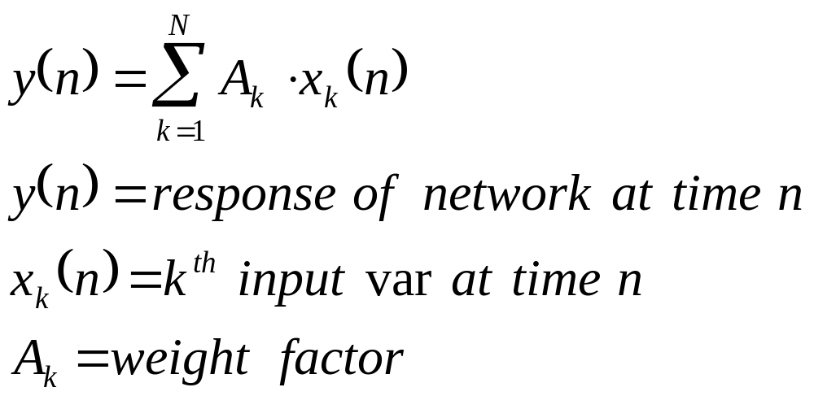
Distributed Arithmetic
Linear time-invariant networks

Slide 54
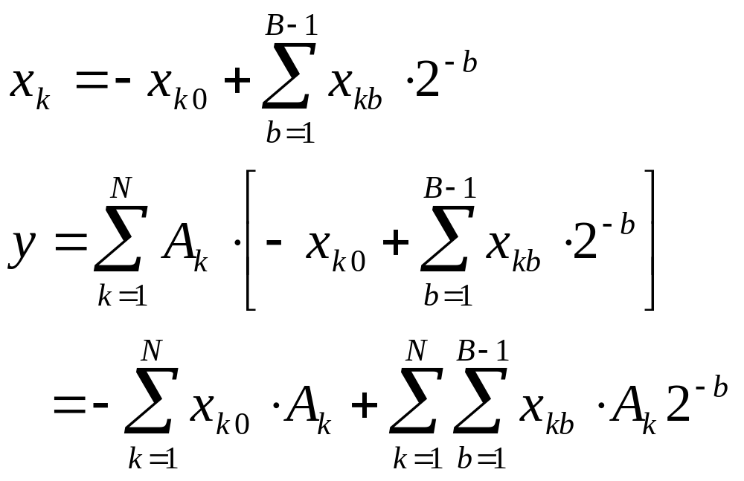
Distributed Arithmetic

Slide 55
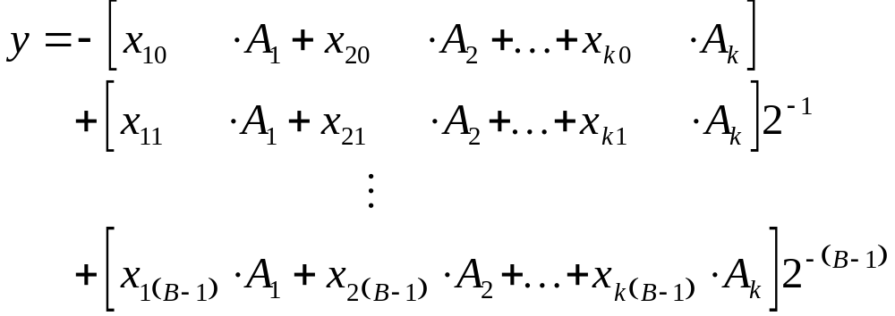
Distributed Arithmetic
Expanded form

Slide 56
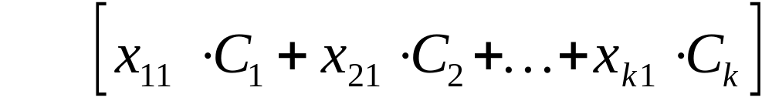
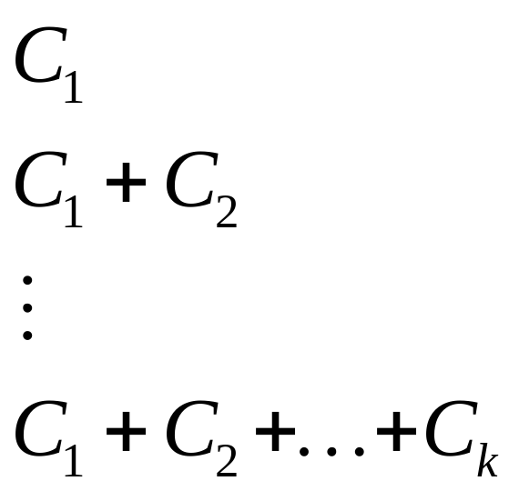
DALUT
x₁₁
x₂₁
y
x_{k1}

Slide 57
Distributed Arithmetic
K=16 => 2¹⁶ DALUT contents! => 512xW CLBs
Break DALUTs to 4/5 inputs and add
x₀
...
x₃
DALUT
x₄
...
x₇
+
Needs W CLBs
Delay = 3s
DALUT
x₈
...
x₁₁
+
DALUT
x₁₂
x₁₅
+
...
DALUT

Slide 58
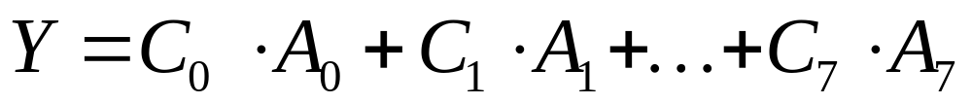
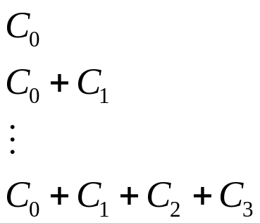
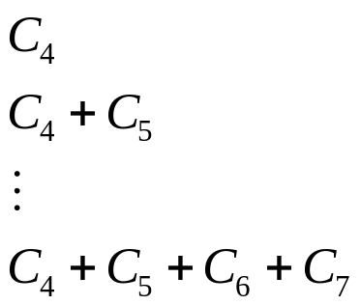
Area efficient
C_{k}: 16-bit
A_{k}: 16-bit
A_{0k}
A_{1k}
A_{2k}
18
A_{3k}
Area: [2*18]+19+32 = 87 LUTs
Speed: [3s*16] = 48s
19
Scaling
Accum
32
A_{4k}
+
A_{5k}
18
A_{6k}
A_{7k}

Slide 59
Speed efficient
S_{k}
A_{0k}
A_{1k}
A_{2k}
18
A_{3k}
19
Scaling
Accum
32
A_{4k}
+
A_{5k}
18
A_{6k}
A_{7k}

Slide 60
Speed efficient
Area: [2*18*16]+ [8*20]+ [4*23]+ [2*28]+ [32] = 916 LUTs (9X)
Speed: s+4s = 5s (9X)
Intermediate configurations possible
S₀
18
+
S₁
18
+
32
S₁₄
18
+
S₁₅
18

Slide 61
Conclusions
Described the latest generation of Xilinx FPGA: VIRTEXTM
Architecture is very well-suited for DSP core functions:
  Adders / Subtractors
  Wide AND / Ors
  Comparators / Decoders
  Multiplexers
  Multipliers
  Distributed Arithmetic

