Slide 1
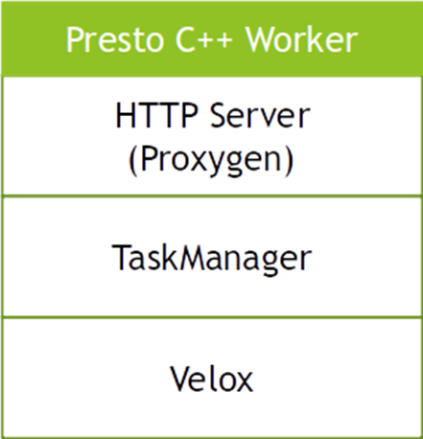
Velox has two separate repos
Velox library
Presto C++ worker
Pick Velox library for query execution
Spark, Presto, Splunk
Push down transcode, predicates, joins
Liten C++ Cluster
HTTP Server
Ray Based Coordination
Liten Workers - Data Tensors, Data Storage
Velox library – For all vector query execution

