Slide 1
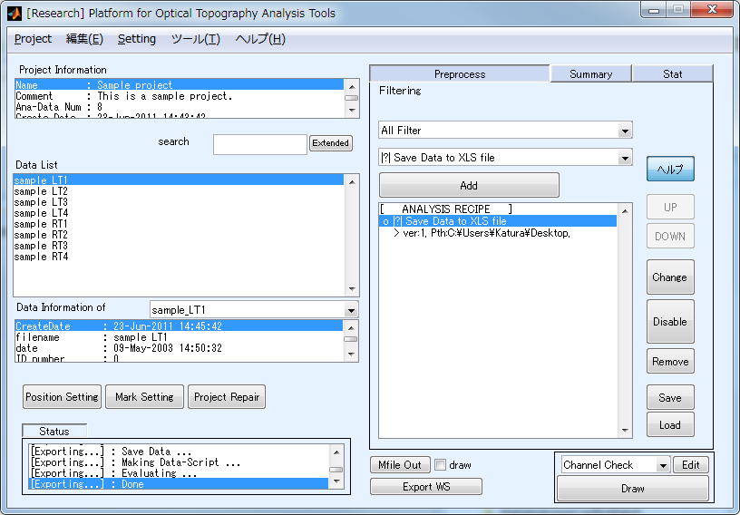
Add this function to your recipe.
And select a directory to save a file.
Then click “Export WS” or
“Draw” button.
Your file will be created on
the directory you selected.
Note: Every time you click “Draw” or “Export WS” button,
a file will be created or overwritten until you delete or disable this function.

Slide 2
Example of exported file: Continuous
Channel
 | A | B | C | …
1 | -0.04109 | 0.039619 | -0.05423
2 | -0.00382 | 0.080966 | -0.00916
3 | 0.015251 | 0.018875 | 0.019656
…
Time point
Sheet1 Sheet2 Sheet3 Oxy Deoxy Total

Slide 3
Example of exported file: Blocked (segmented)
Channel
 | A | B | C | …
1 | 1 | -0.03247 | -0.01538
2 | 1 | -0.01783 | 0.002921
3 | 1 | 0.010203 | -0.00465
…
Time point
Sheet1 Sheet2 Sheet3 Oxy Deoxy Total Oxy Deoxy Total Oxy Deoxy Total
_Ave _Ave _Ave _SD _SD _SD
The first row shows a number of
block for each time point.
These sheets show values
of averaged over blocks.
These sheets show values
of SD over blocks.

