Slide 1
CG Programming Tutorial
CIS 665
GPU Programming and Architecture
Joseph Kider

Slide 2
CG Tutorial
http://www.seas.upenn.edu/~cis665/
  Schedule and resource pages
Slides, links, more details of what I am talking about today.

Slide 3
CG Tutorial (thanks too…)
Slide information sources:
  Suresh Venkatasubramanian
    (RenderTexture Tutorial)
  Paul Kanyuk
    Cg ShadingTutorial (Open GL)
  Mark Harris (Nvidia)
    SIGGRAPH 2005 (Mapping Computational Concepts to the GPU
  Nvidia Corporation
    Teaching CG
  Dominik Goddeke’s tutorial

Slide 4
Overview
1 Introduction
a. What is CG
b. Hardware requirements
c. Software requirements
2 Setting up OpenGL
a. GLUT
b. OpenGL extensions
3 Creating a simple shader with the Cg shading language
a. Setting up the Cg runtime
b. Change color of a box with fragment shader (Demo)
c. Overview of data: float3, float4, COLOR, wpos
4 Arrays = textures
a. Creating arrays on the CPU
b. Creating floating point textures on the GPU
c. One-to-one mapping from array index to texture coordinates
d. Using textures as render targets (FBOs)
e. Demo Program
5 GPGPU Transferring Data:
a. Transferring data from CPU arrays to GPU textures
b. Transferring data from GPU textures to CPU arrays
c. Preparing the computational kernel
d. Setting input arrays / textures
e. Setting output arrays / textures
f. Performing the computation
6 GPGPU concept 4: Feedback
a. Multiple rendering passes
b. The ping pong technique

Slide 5
Introduction: What is CG?
Cg is an open-source high-level shading language to make graphics programming faster and easier
Cg replaces assembly code with a C-like language and a compiler
Cg was developed in close collaboration with Microsoft and is syntactically equivalent to HLSL, the shading language in DirectX 9
Cg is cross-API (OpenGL & DirectX) and cross-platform (Windows, Linux, and Mac OS)

Slide 6
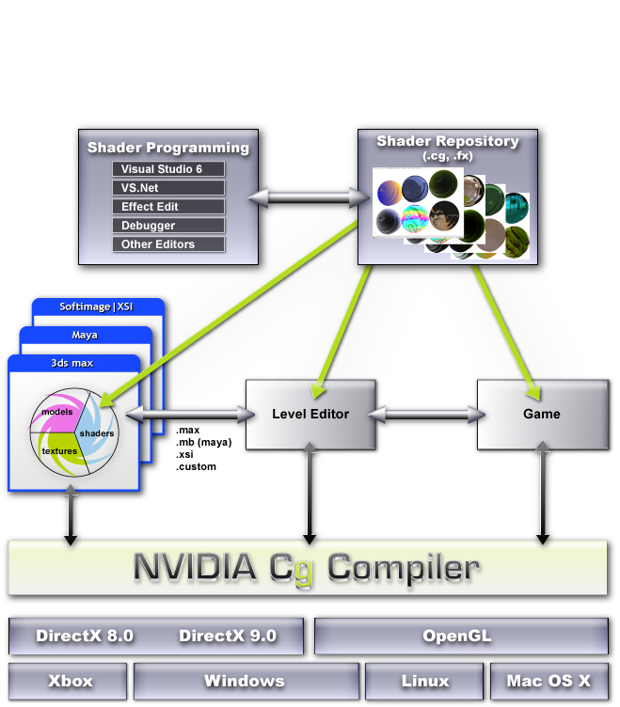
Introduction: How CG works?
Shaders are created
These shaders are used for modeling in Digital Content Creation (DCC) applications or rendering in other applications
The Cg compiler compiles the shaders to a variety of target platforms, including APIs, OSes, and GPUs
Spoiler Alert!
porting CG is a pain sometimes since many features are hardware dependant.

Slide 7
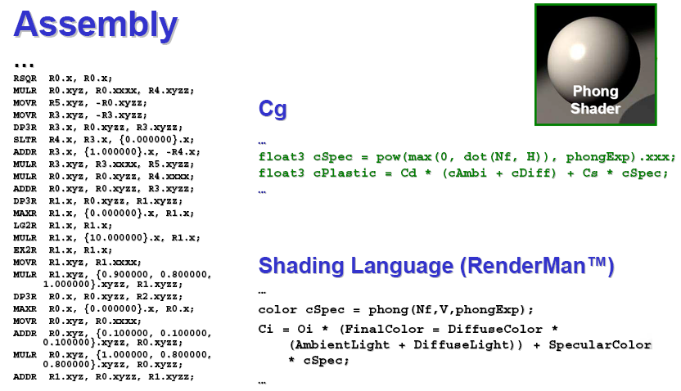
Introduction: What does CG look like?

Slide 8
Introduction: Hardware Requirements
You will need at least a NVIDIA GeForce 5800 or an ATI RADEON x9800 graphics card… preferably Nvidia…
Older GPUs do not provide the features (most importantly, single precision floating point data storage and computation) which we require.
The CUDA language can only be run on the 8800 cards and the corresponding Quadro cards. The emulator runs on the CPU and does not require a specific card. I am not expecting anyone to complete the homework on the 8800 cards. I am expecting the 8800 card we have will be used for following homeworks and the final project.

Slide 9
Introduction Software Requirements
Again links all on my site…
and basic directions what goes where…
Visual Studio 2005 (preferable)
  (you can use cygwin, eclipse, g++)
At least CG Toolkit 1.5 (2+ is preferable)
GLUT
GLEW
Up to date Graphics Drivers!!!
  Go to the Nvdia Driver page and ATI: Catalyst Software Suite

Slide 10
Introduction: Lab
No Graphics card? No Money?
Don’t fret Moore Lab 100B and (HMS lab 8800s) is set up with the proper software and Nvidia 6800s for the Homework assignments …. I hope!

Slide 11
Overview
1 Introduction
a. What is CG
b. Hardware requirements
c. Software requirements
2 Setting up OpenGL
a. GLUT
b. OpenGL extensions
3 Creating a simple shader with the Cg shading language
a. Setting up the Cg runtime
b. Change color of a box with fragment shader (Demo)
c. Overview of data: float3, float4, COLOR, wpos
4 Arrays = textures
a. Creating arrays on the CPU
b. Creating floating point textures on the GPU
c. One-to-one mapping from array index to texture coordinates
d. Using textures as render targets (FBOs)
e. Demo Program
5 GPGPU Transferring Data:
a. Transferring data from CPU arrays to GPU textures
b. Transferring data from GPU textures to CPU arrays
c. Preparing the computational kernel
d. Setting input arrays / textures
e. Setting output arrays / textures
f. Performing the computation
6 GPGPU concept 4: Feedback
a. Multiple rendering passes
b. The ping pong technique

Slide 12
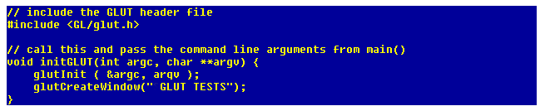
Setting up OpenGL: GLUT
GLUT, the OpenGL Utility Toolkit, provides functions to handle window events, create simple menus etc
Here, we just use it to set up a valid OpenGL context (allowing us access to the graphics hardware through the GL API later on) with as few code lines as possible. Additionally, this approach is completely independent of the window system that is actually running on the computer

Slide 13
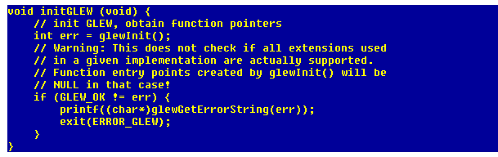
Setting up OpenGL: GLEW
The small tool glewinfo that ships with GLEW, or any other OpenGL extension viewer, or even OpenGL itself can be used to check if the hardware and driver support a given extension.
Obtaining pointers to the functions the extensions define is an advanced issue, so in this example, we use GLEW as an extension loading library that wraps everything we need up nicely with a minimalistic interface:

Slide 14
Overview
1 Introduction
a. What is CG
b. Hardware requirements
c. Software requirements
2 Setting up OpenGL
a. GLUT
b. OpenGL extensions
3 Creating a simple shader with the Cg shading language
a. Setting up the Cg runtime
b. Change color of a box with fragment shader (Demo)
c. Overview of data: float3, float4, COLOR, wpos
4 Arrays = textures
a. Creating arrays on the CPU
b. Creating floating point textures on the GPU
c. One-to-one mapping from array index to texture coordinates
d. Using textures as render targets (FBOs)
e. Demo Program
5 GPGPU Transferring Data:
a. Transferring data from CPU arrays to GPU textures
b. Transferring data from GPU textures to CPU arrays
c. Preparing the computational kernel
d. Setting input arrays / textures
e. Setting output arrays / textures
f. Performing the computation
6 GPGPU concept 4: Feedback
a. Multiple rendering passes
b. The ping pong technique

Slide 15
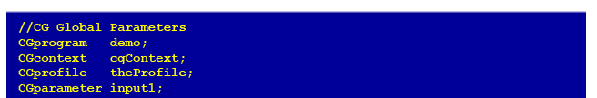
Simple Shader: Setting up CG
This subsection describes how to set up the Cg runtime in an OpenGL application. First, we need to include the Cg headers (it is sufficient to include <Cg/cgGL.h>) and add the Cg libraries to our compiler and linker options. Then, we declare some variables:
The CGcontext is the entry point for the Cg runtime, since we want to program the fragment pipeline, we need a fragment profile (Cg is profile-based) and a program container for the program we just wrote. For the sake of simplicity, we also declare three handles to the parameters we use in the shader that are not bound to any semantics, and we use a global variable that contains the shader source we just wrote.

Slide 16
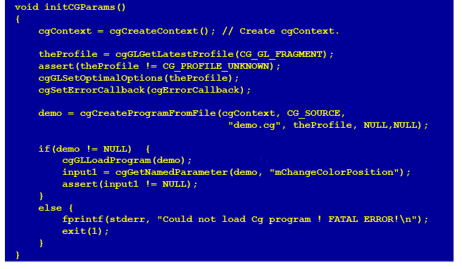
Setting up CG: Parameters

Slide 17
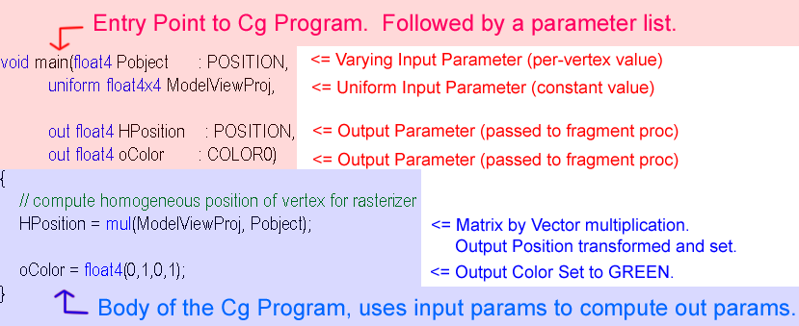
Setting up Cg: Vertex Processor
Fully programmable (SIMD / MIMD)
Processes 4-vectors (RGBA / XYZW)
Capable of scatter but not gather
  Can change the location of current vertex
  Cannot read info from other vertices
  Can only read a small constant memory
Latest GPUs: Vertex Texture Fetch
  Random access memory for vertices
  ≈Gather (But not from the vertex stream itself)

Slide 18
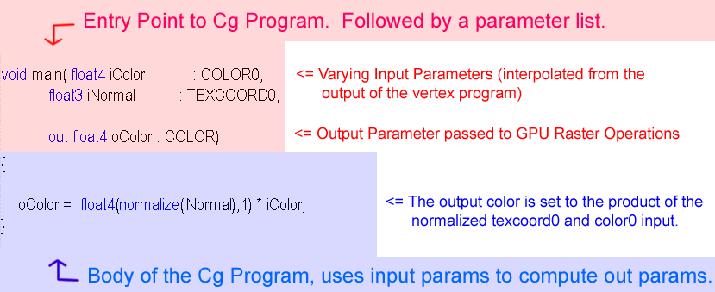
Setting up Cg: Fragment Processor
Fully programmable (SIMD)
Processes 4-component vectors (RGBA / XYZW)
Random access memory read (textures)
Capable of gather but not scatter
  RAM read (texture fetch), but no RAM write
  Output address fixed to a specific pixel
Typically more useful than vertex processor
  More fragment pipelines than vertex pipelines
  Direct output (fragment processor is at end of pipeline)

Slide 19
Setting up CG: Demos
Green Sphere
2 color Box Demo
Normal Vertex Sphere
Plastic” Per-Vertex Shading

Slide 20
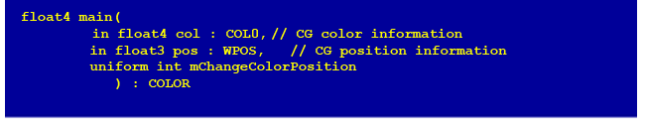
Setting up CG: Data Structures
float4, float3 (packed arrays /not vectors)
in : variables coming in from pipeline
out: variables going out to pipeline
WPOS, position: positional vectors
Uniform int,floats : input values
in float2 coords : TEXCOORD0 :texture coords
tex2d, sampler2d, samplerRECT :input textures
WARNING:
Make sure you are consistent with recs and 2ds when setting up textures!!!

Slide 21
Overview
1 Introduction
a. What is CG
b. Hardware requirements
c. Software requirements
2 Setting up OpenGL
a. GLUT
b. OpenGL extensions
3 Creating a simple shader with the Cg shading language
a. Setting up the Cg runtime
b. Change color of a box with fragment shader (Demo)
c. Overview of data: float3, float4, COLOR, wpos
4 Arrays = textures
a. Creating arrays on the CPU
b. Creating floating point textures on the GPU
c. One-to-one mapping from array index to texture coordinates
d. Using textures as render targets (FBOs)
e. Demo Program
5 GPGPU Transferring Data:
a. Transferring data from CPU arrays to GPU textures
b. Transferring data from GPU textures to CPU arrays
c. Preparing the computational kernel
d. Setting input arrays / textures
e. Setting output arrays / textures
f. Performing the computation
6 GPGPU concept 4: Feedback
a. Multiple rendering passes
b. The ping pong technique

Slide 22

Textures: C++ Arrays (CPU)
Creating arrays on the CPU
One option to hold data for GPGPU calculations
Another option for rendering is to draw geometry
and use that as the input data to the textures used more
for advanced rendering effects

Slide 23
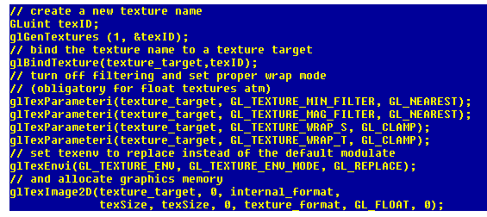
Textures: OpenGL
This gets complicated fast…
Look at glTexImage2D
  Texture_target (next slide)
  0: not to use any mipmap levels for this texture
  Internal format (next slide)
  texSize, texSize (width and height of the texture)
  0: turns off borders for our texture
  Texture_format: chooses the number of channels
  GL_Float : Float texture (nothing to do with the precision of the values )
  0 or NULL : We do not want to specify texture data right now…

Slide 24
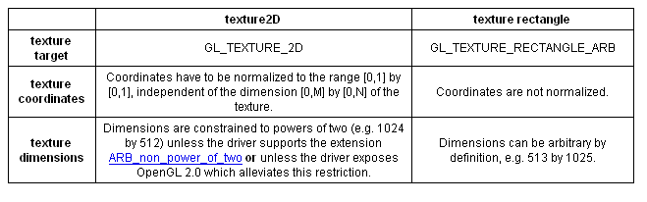
Textures: Formats
On the GPU, we use floating point textures to store the data
a variety of different so-called texture targets available
Internal texture format. GPUs allow for the simultaneous processing of scalars, tupels, tripels or four-tupels of data
Precision of data: GL_FLOAT_R32_NV, GL_R, GL_R16, GL_RGB, GL_RGB16, GL_RGBA …
  More explanation on website tutorial
  ATI warning … here is where you need to specify ATI extensions

Slide 25
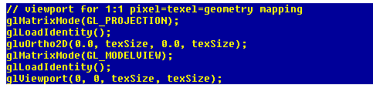
Mapping textures
Later we update our data stored in textures by a rendering operation.
To be able to control exactly which data elements we compute or access from texture memory, we will need to choose a special projection that maps from the 3D world (world or model coordinate space) to the 2D screen (screen or display coordinate space), and additionally a 1:1 mapping between pixels (which we want to render to) and texels (which we access data from).
The key to success here is to choose an orthogonal projection and a proper viewport that will enable a one to one mapping between geometry coordinates
(add this to your reshape, init, and initFBO methods)

Slide 26
Using Textures as Render Targets
the traditional end point of every rendering operation is the frame buffer, a special chunk of graphics memory from which the image that appears on the display is read
Problem! : the data will always be clamped to the range of [0/255; 255/255] once it reaches the framebuffer.
What to do?
cumbersome arithmetic that maps the sign-mantissa-exponent data format of an IEEE 32-bit floating point value into the four 8-bit channels ???
OpenGL extension called EXT_framebuffer_object allows us to use an offscreen buffer as the target for rendering operations such as our vector calculations, providing full precision and removing all the unwanted clamping issues. The commonly used abbreviation is FBO, short for framebuffer object.

Slide 27
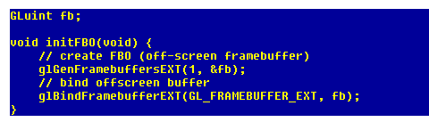

Frame Buffer Objects: (FBO)
To use this extension and to turn off the traditional framebuffer and
use an offscreen buffer (surface) for our calculations, a few lines of
code suffice. Note that binding FBO number 0 will restore the
window-system specific framebuffer at any time.
The framebuffer object extension provides a very narrow interface to render to a texture. To use a texture as render target, we have to attach the texture to the FBO
drawback is: Textures are either read-only or write-only (important later)

Slide 28
Using FBOs: DEMO
HelloGPGPU Demo

Slide 29
Overview
1 Introduction
a. What is CG
b. Hardware requirements
c. Software requirements
2 Setting up OpenGL
a. GLUT
b. OpenGL extensions
3 Creating a simple shader with the Cg shading language
a. Setting up the Cg runtime
b. Change color of a box with fragment shader (Demo)
c. Overview of data: float3, float4, COLOR, wpos
4 Arrays = textures
a. Creating arrays on the CPU
b. Creating floating point textures on the GPU
c. One-to-one mapping from array index to texture coordinates
d. Using textures as render targets (FBOs)
e. Demo Program
5 GPGPU Transferring Data:
a. Transferring data from CPU arrays to GPU textures
b. Transferring data from GPU textures to CPU arrays
c. Preparing the computational kernel
d. Setting input arrays / textures
e. Setting output arrays / textures
f. Performing the computation
6 GPGPU concept 4: Feedback
a. Multiple rendering passes
b. The ping pong technique

Slide 30
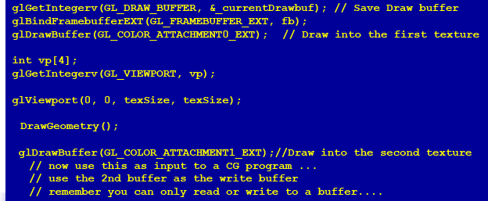
Transferring data from CPU arrays to GPU textures
To transfer data (like the two vectors dataX and dataY we created previously) to a texture, we have to bind the texture to a texture target and schedule the data for transfer with an OpenGL
(note: NVIDIA Code)
Again not only method, if you rather do rendering rather then GPGPU computations draw geometry to the buffer directly as follows:

Slide 31
Transferring data from GPU textures to CPU arrays
Many times you want the actual values that you calculated back, there are 2 ways to do this

Slide 32
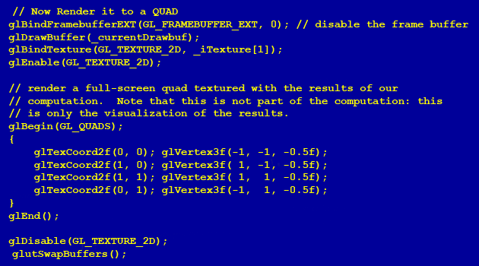
Transferring data from GPU textures to QUADS
Other time you really just want to see the mess you created on the screen
To do this you have to render a QUAD

Slide 33
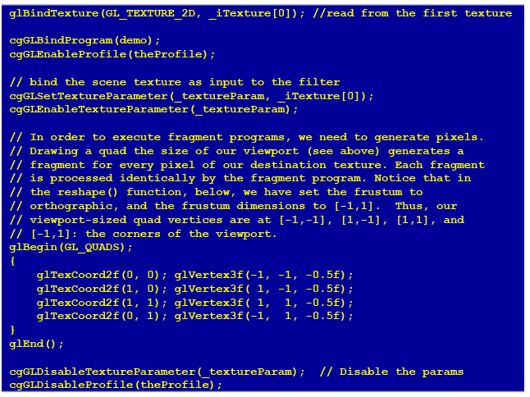
Preparing the computational kernel setting up input textures/arrays

Slide 34

Setting output arrays / textures
Defining the output array (the left side of the equation) is essentially the same operation like the one we discussed to transfer data to a texture already attached to our FBO. Simple pointer manipulation by means of GL calls is all we need. In other words, we simply redirect the output: If we did not do so yet, we attach the target texture to our FBO and use standard GL calls to use it as the render target:

Slide 35
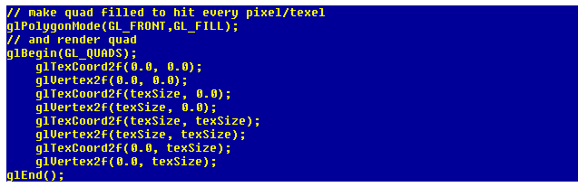
Performing a computation
Let us briefly recall what we did so far.
We enabled a 1:1 mapping between the target pixels, the texture coordinates and the geometry we are about to draw.
We also prepared a fragment shader we want to execute for each fragment.
All that remains to be done is: Render a "suitable geometry" that ensures that our fragment shader is executed for each data element we stored in the target texture.
In other words, we make sure that each data item is transformed uniquely into a fragment.
Given our projection and viewport settings, this is embarrassingly easy: All we need is a filled quad

Slide 36
Overview
1 Introduction
a. What is CG
b. Hardware requirements
c. Software requirements
2 Setting up OpenGL
a. GLUT
b. OpenGL extensions
3 Creating a simple shader with the Cg shading language
a. Setting up the Cg runtime
b. Change color of a box with fragment shader (Demo)
c. Overview of data: float3, float4, COLOR, wpos
4 Arrays = textures
a. Creating arrays on the CPU
b. Creating floating point textures on the GPU
c. One-to-one mapping from array index to texture coordinates
d. Using textures as render targets (FBOs)
e. Demo Program
5 GPGPU Transferring Data:
a. Transferring data from CPU arrays to GPU textures
b. Transferring data from GPU textures to CPU arrays
c. Preparing the computational kernel
d. Setting input arrays / textures
e. Setting output arrays / textures
f. Performing the computation
6 GPGPU concept 4: Feedback
a. Multiple rendering passes
b. The ping pong technique

Slide 37
Multiple rendering passes
In a proper application, the result is typically used as input for a subsequent computation.
On the GPU, this means we perform another rendering pass and bind different input and output textures, eventually a different kernel etc.
The most important ingredient for this kind of multipass rendering is the ping pong technique.

Slide 38
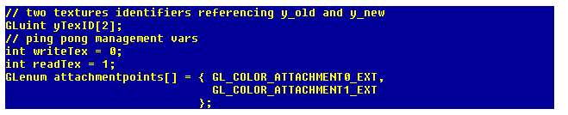
The ping pong technique
Ping pong is a technique to alternately use the output of a given rendering pass as input in the next one.
Lets look at this operation: (y_new = y_old + alpha * x)
this means that we swap the role of the two textures y_new and y_old, since we do not need the values in y_old any more once the new values have been computed.
There are three possible ways to implement this kind of data reuse (take a look at Simon Green's FBO slides for additional material on this, link posted on the url):

Slide 39
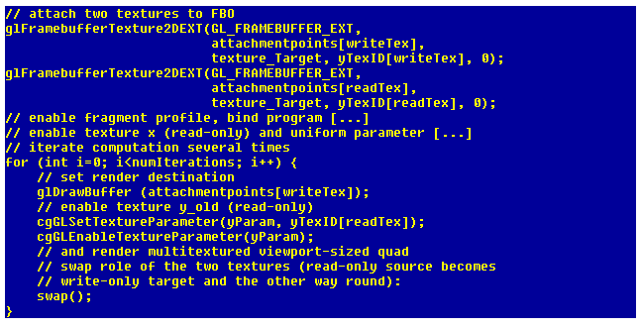
The ping pong technique
During the computation, all we need to do now is to pass the correct value from these two tupels to the corresponding OpenGL calls, and to swap the two index variables after each pass:

Slide 40
The ping pong Demo
Saxpy Demo

Slide 41
Closing thoughts…
Best to just hack away
I have some simple debugging code imbedded in the demos … best to take a look at it and use it … debugging on the GPU is not explicit

