Slide 1
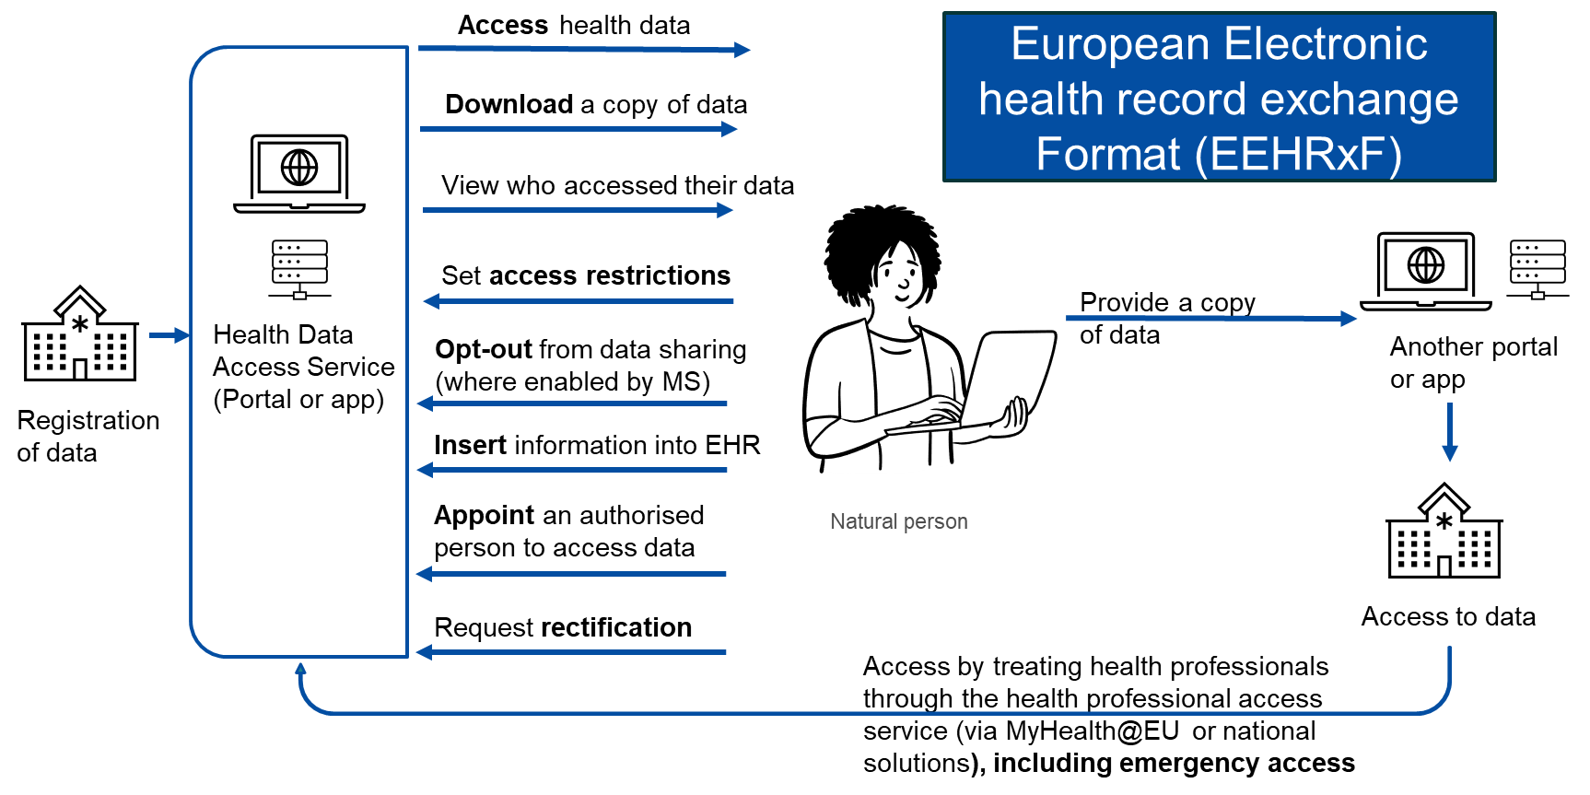

The context: EHDS Primary use
Image from EC
Notes:
Rights of natural persons in primary use

Slide 2
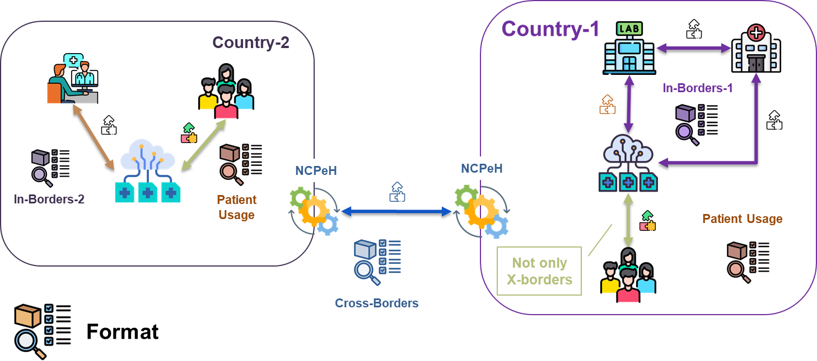
The context: not only cross-border !
Notes:
The strategy for supporting this goal is – as I said – not to but to have the format as ….

Slide 3
The context: priority categories for primary use
ePrescription/ eDispensation
Patient summary
Medical test results, including laboratory and other diagnostic results and related reports
Medical imaging studies and related imaging reports;
Discharge report
Member States may provide by virtue of national law that additional categories of personal
The Commission is empowered to adopt delegated acts <…> by adding, modifying or removing the main characteristics of the priority categories
Notes:
The context: EHDS Primary use

Slide 4







The context: several actors engaged
March 2027
Innovation & Experimentation
X-eHealth
XpanDH
xShare
Formalization (proposal)
Xt-EHR
Implementing Acts
EC
…

Slide 5
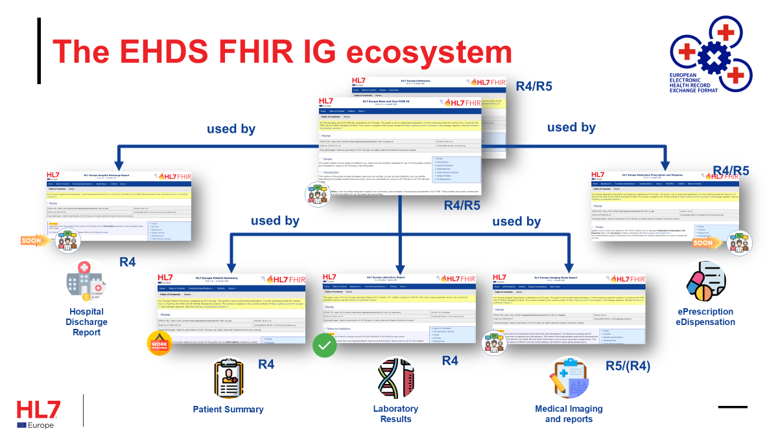
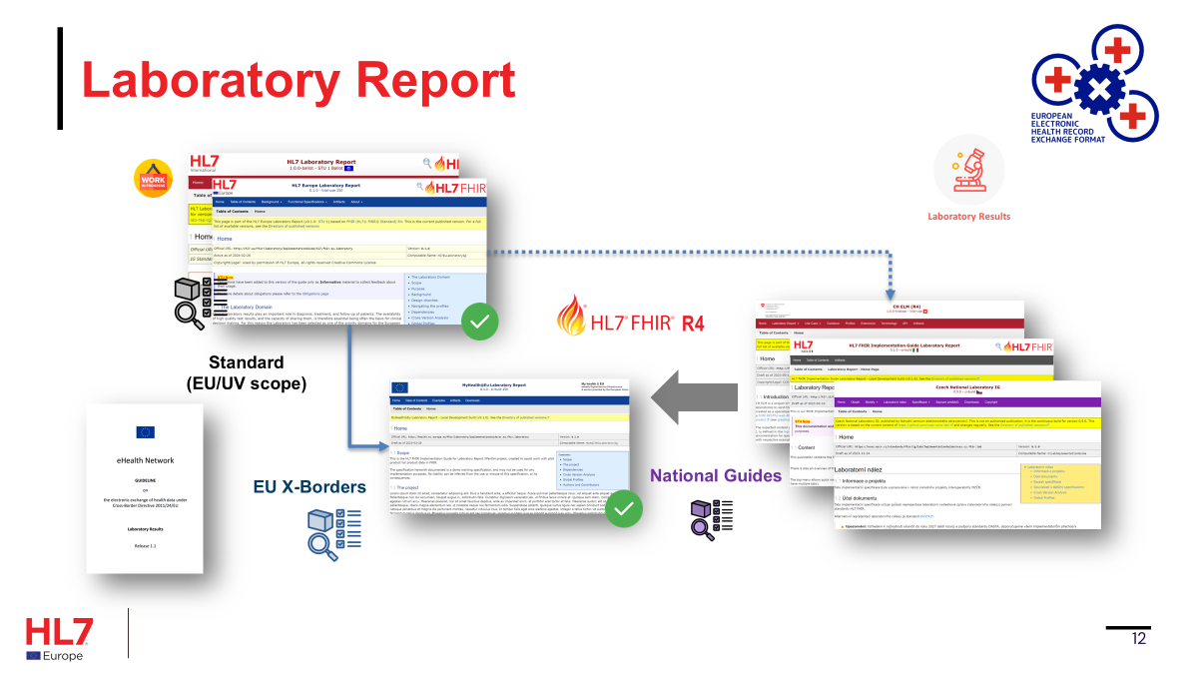
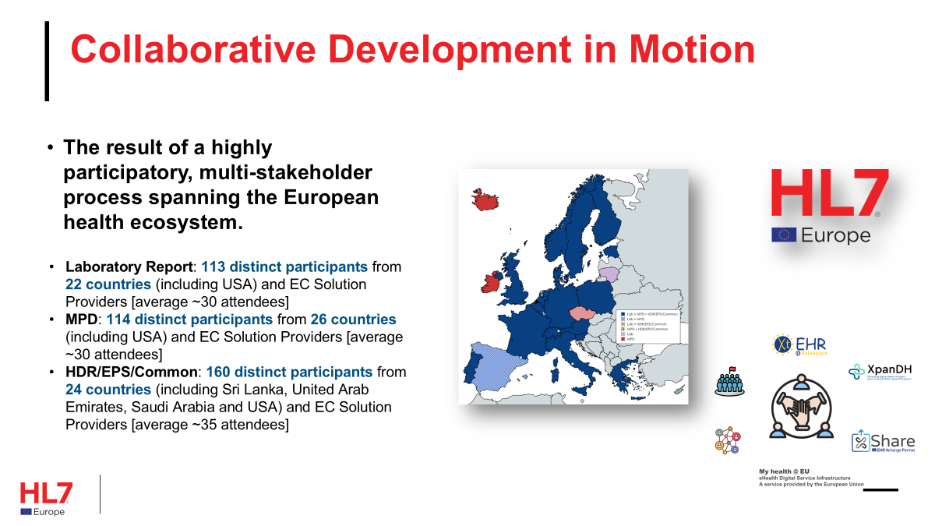
The proposed solution
Standard
Flexibility
Participation

Slide 6
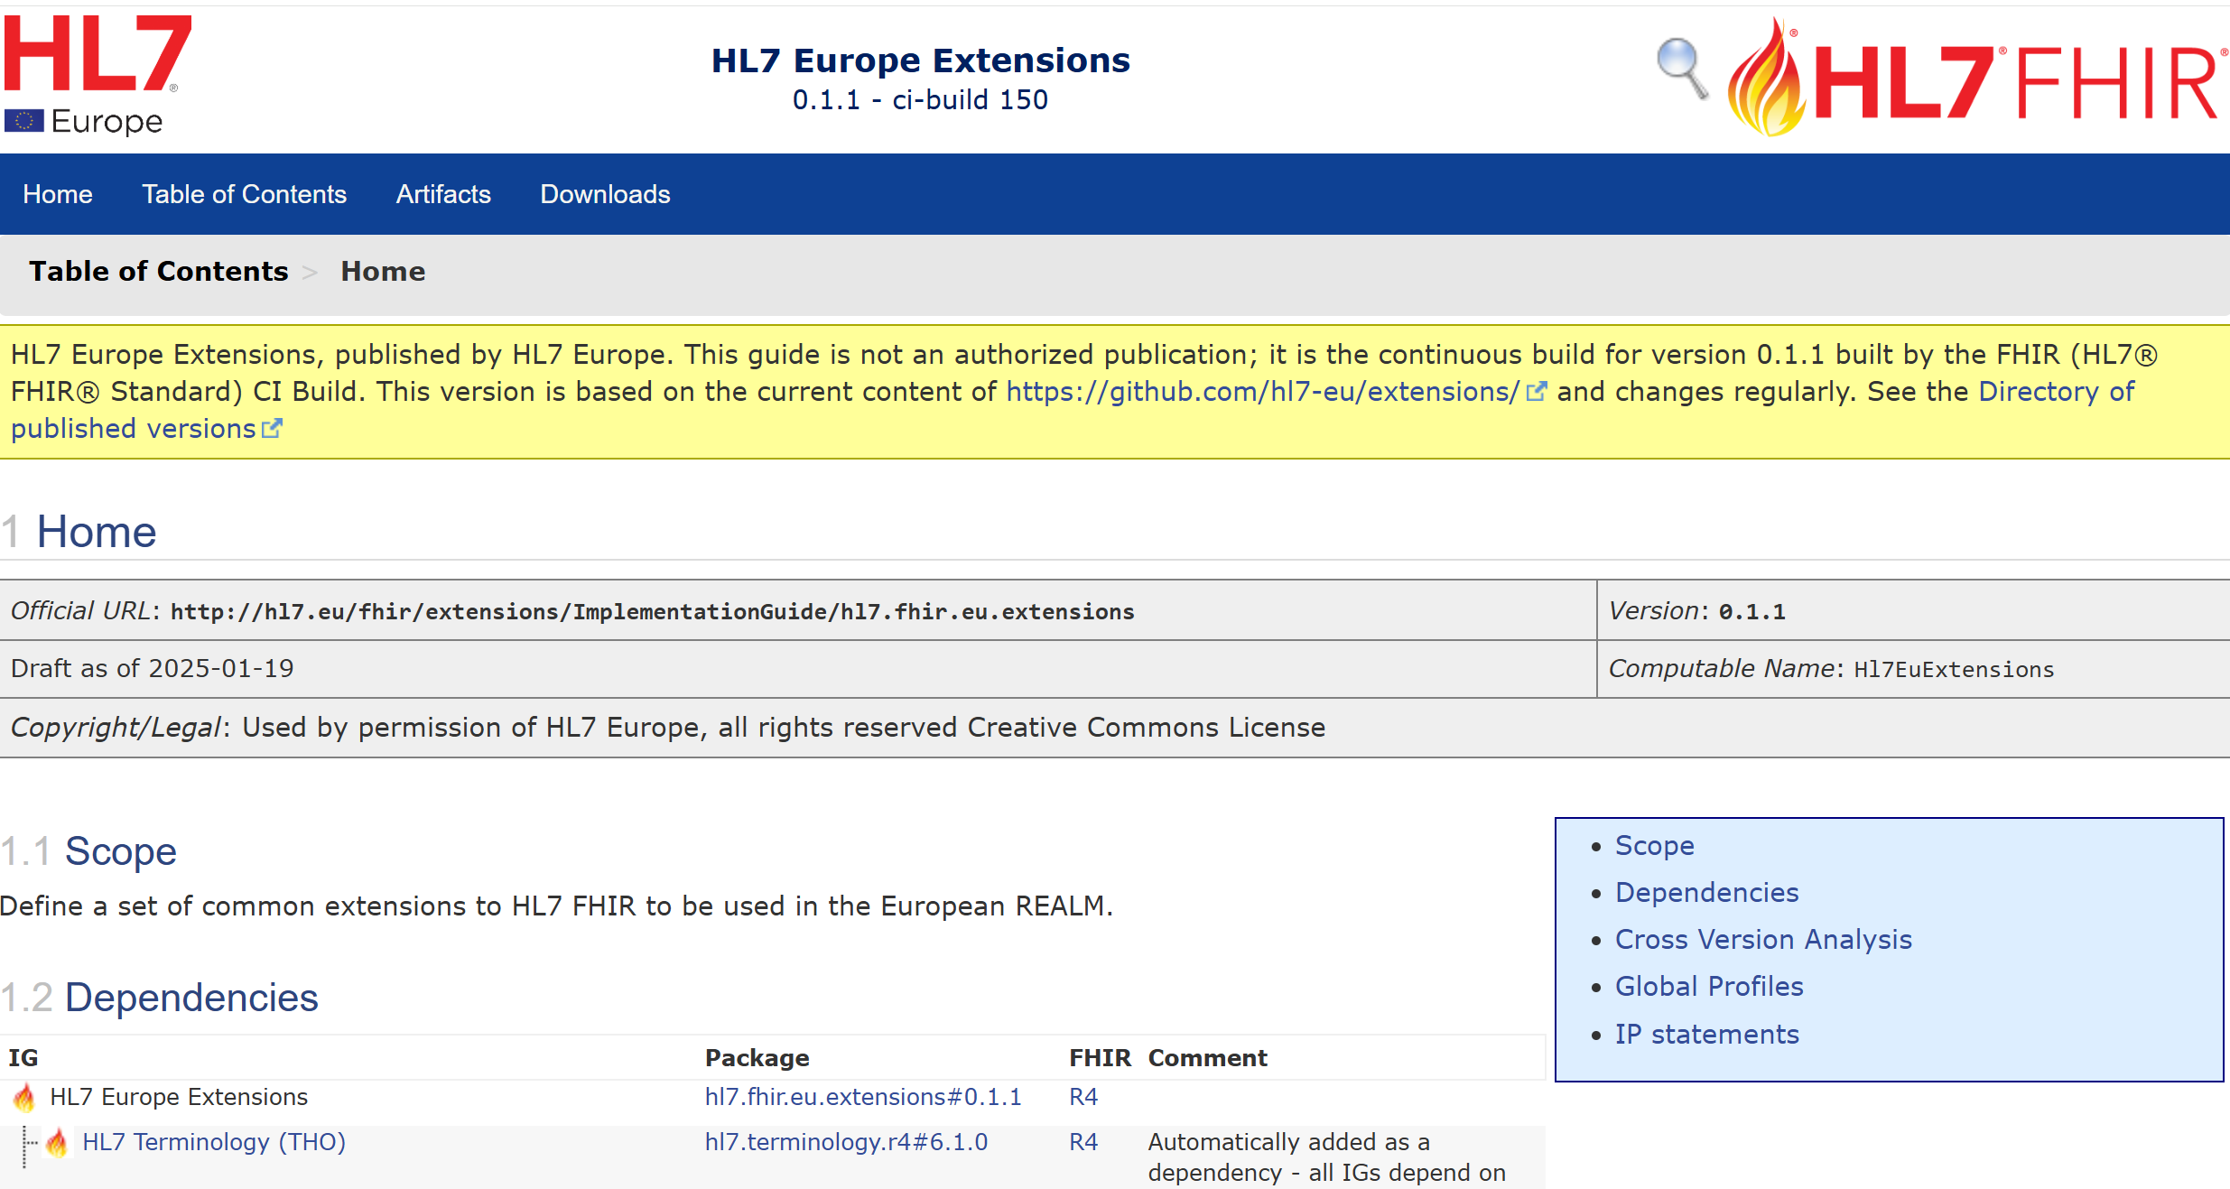
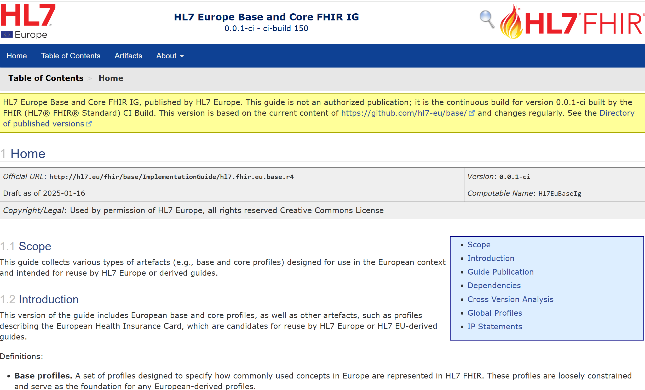
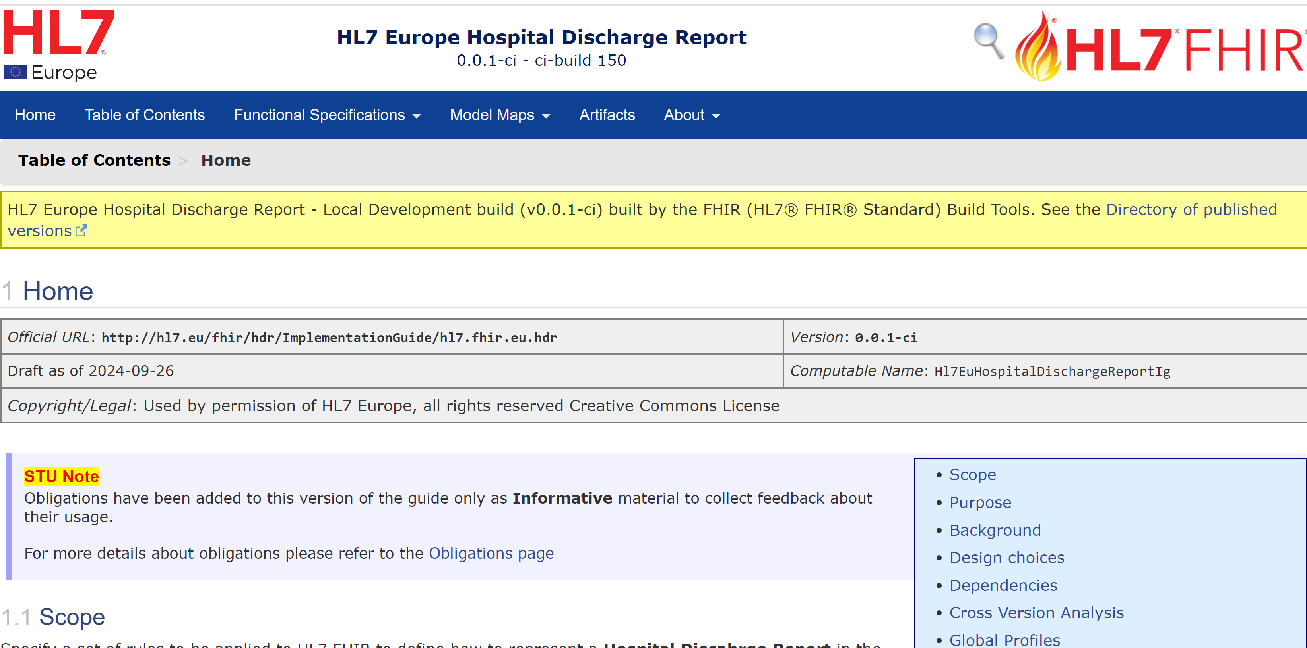

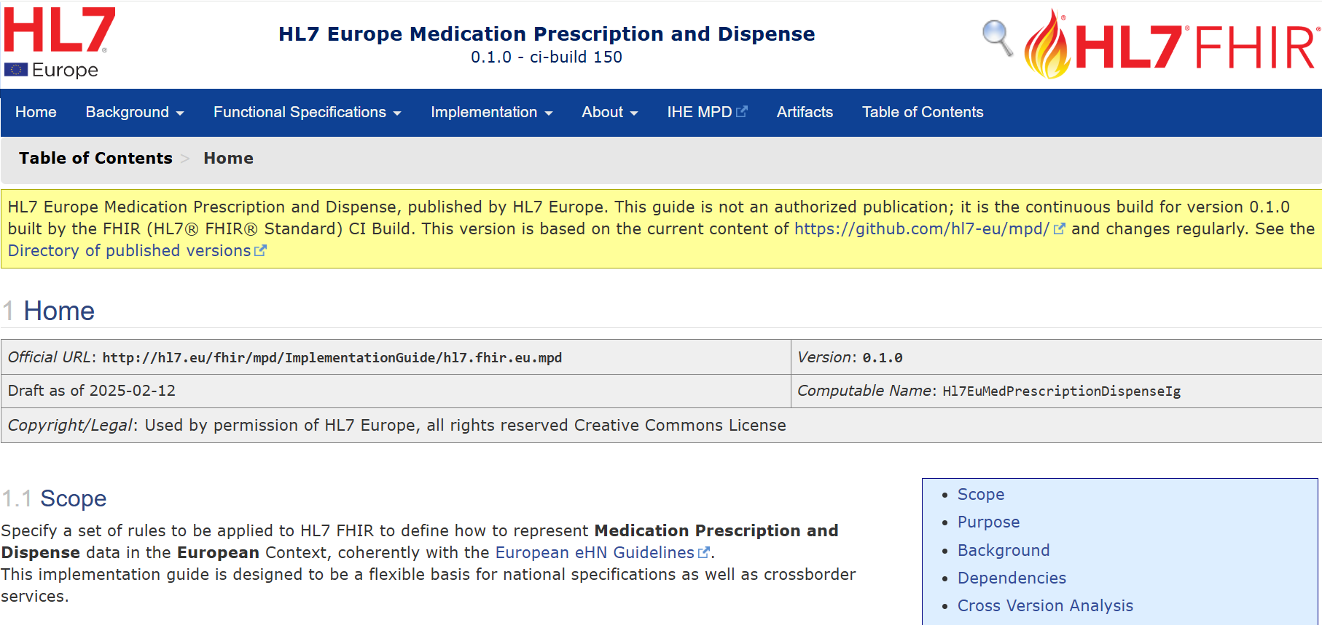



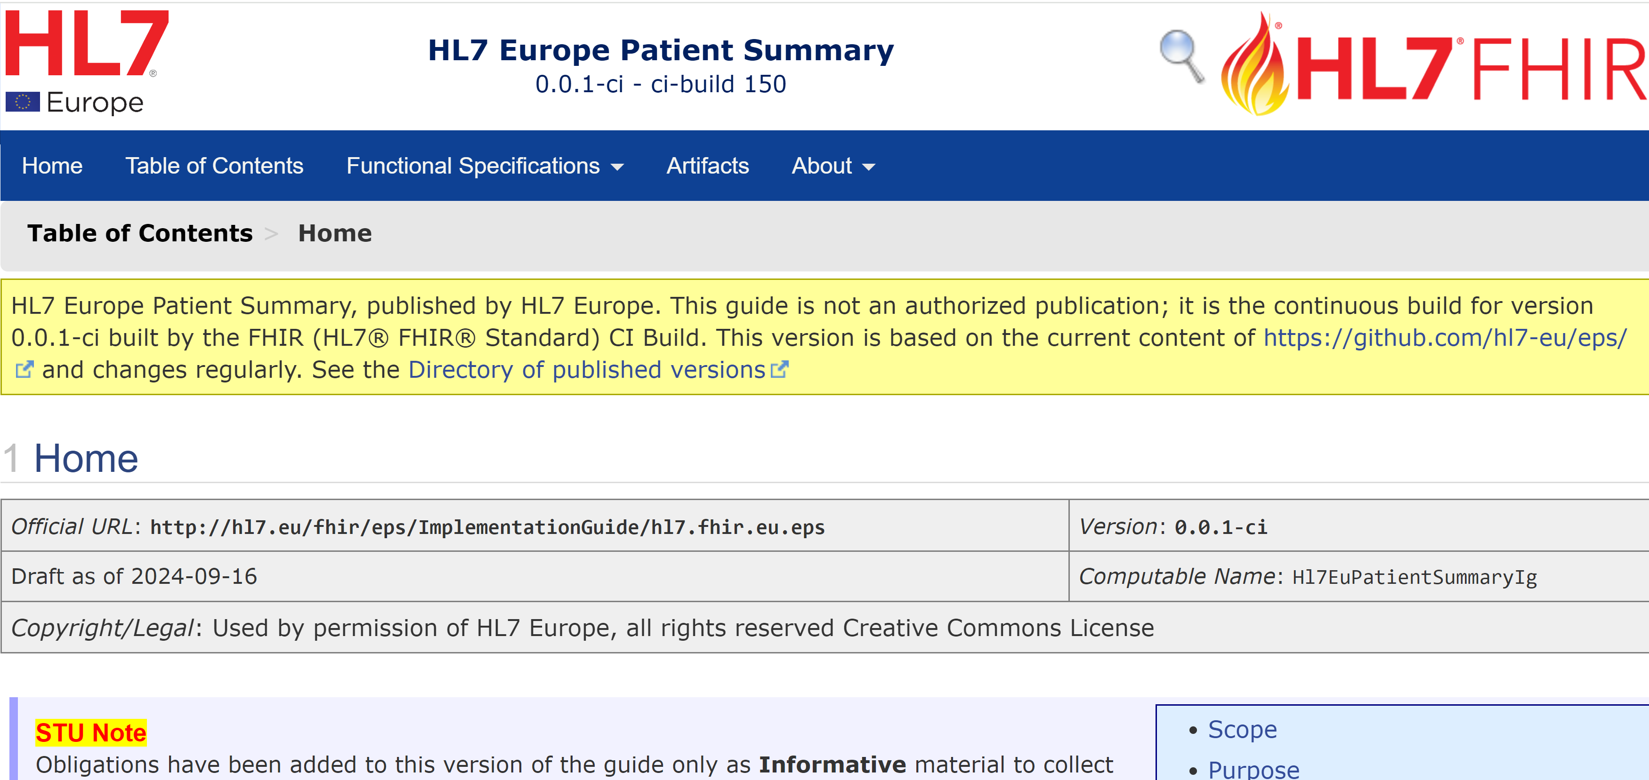
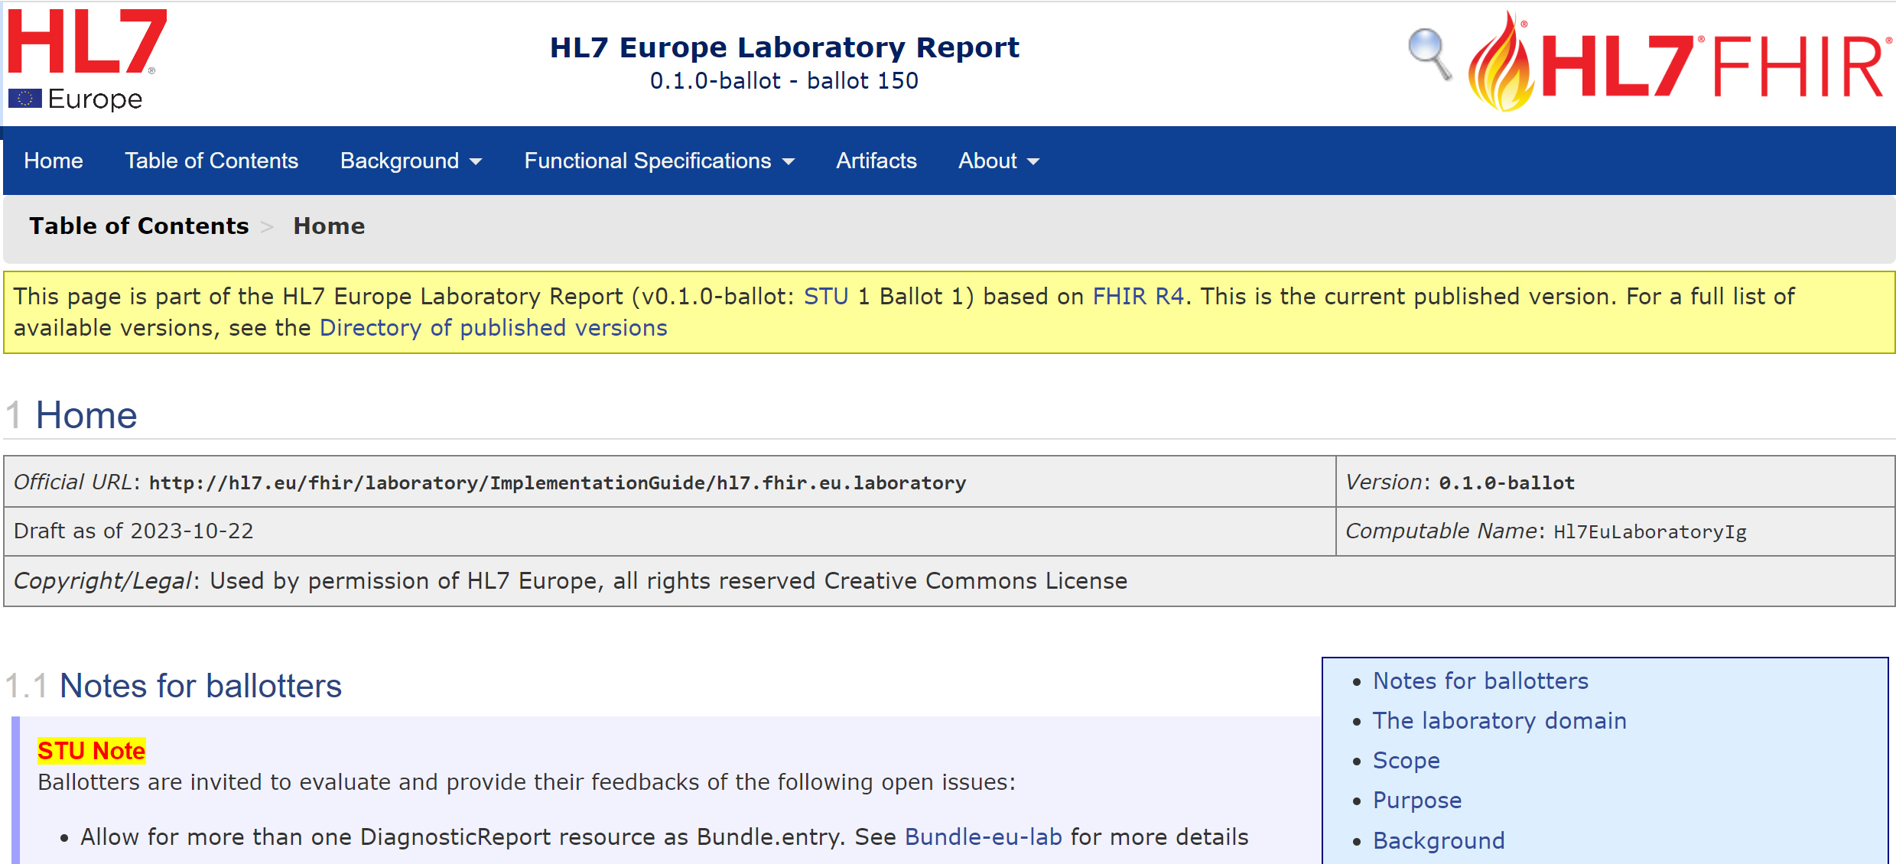
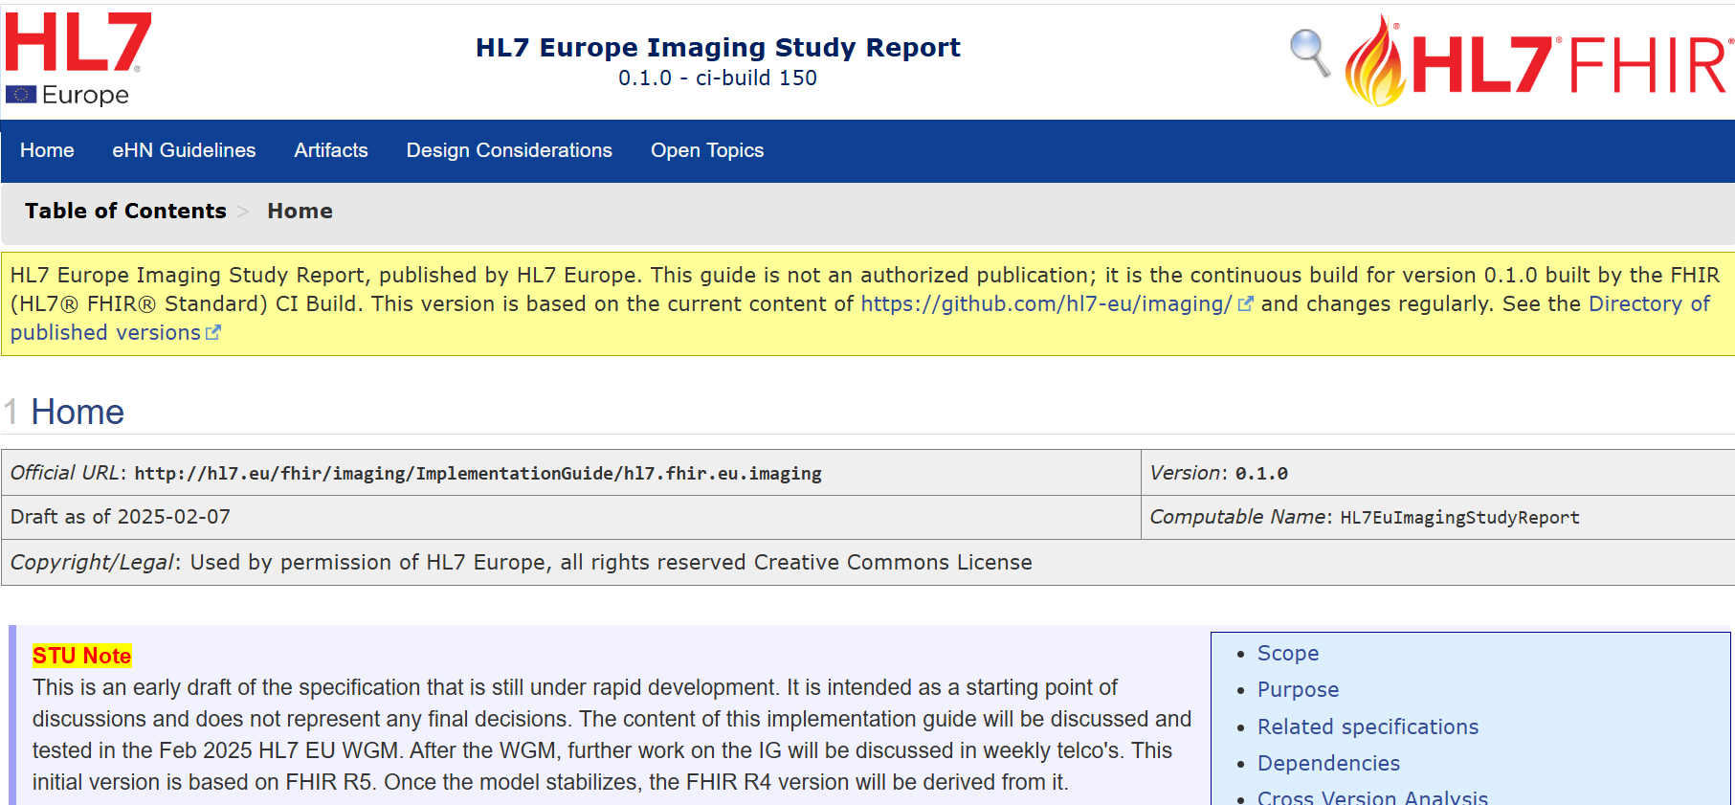





The HL7 FHIR IG ecosystem for EHDS
R4/R5
used by
used by
R4/R5
R4/R5
used by
used by
R4
Hospital Discharge Report
ePrescription
eDispensation
R4
R4
R5/(R4)
Patient Summary
Laboratory Results
Medical Imaging and reports
Notes:
This includes the HL7 FHIR Implementation Guides (IGs) which will hopefully serve as the foundation for the future European EHR eXchange Format (EEHRxF)
EU Base/Core profiles,
EU Laboratory Report,
EU Hospital Discharge Report,
EU Medication Prescription and Dispense,
EU Patient Summary,
and EU Imaging Report

Slide 7
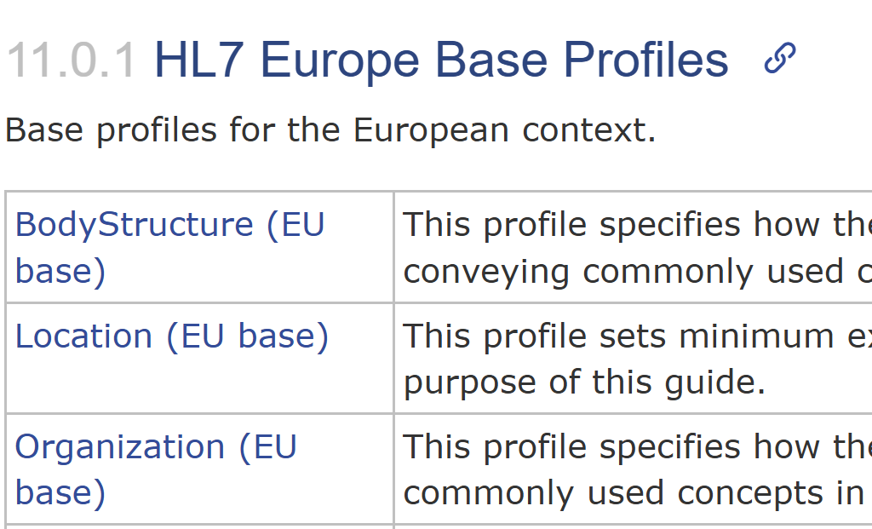
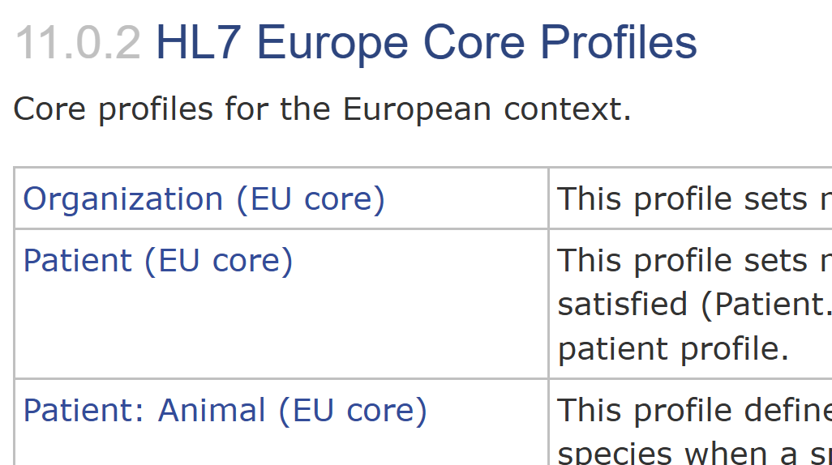
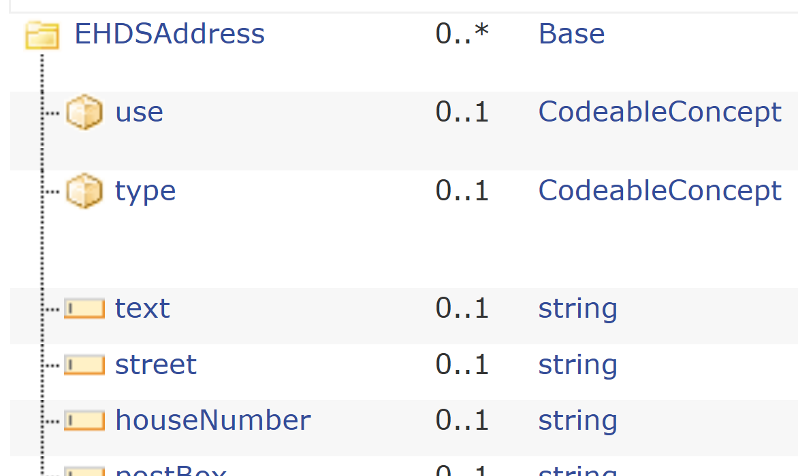
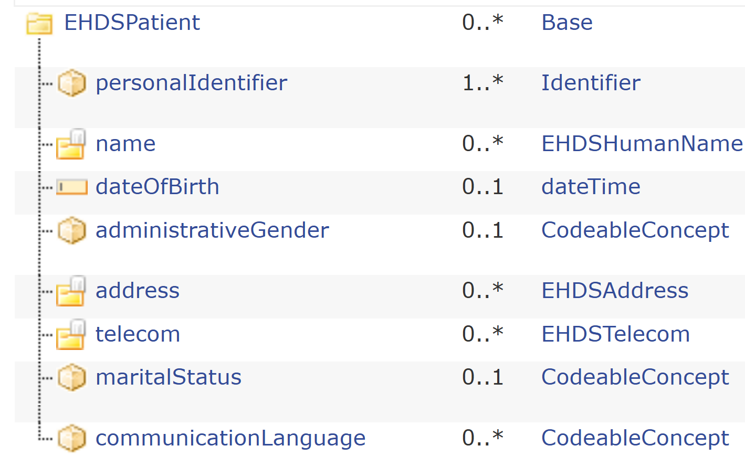
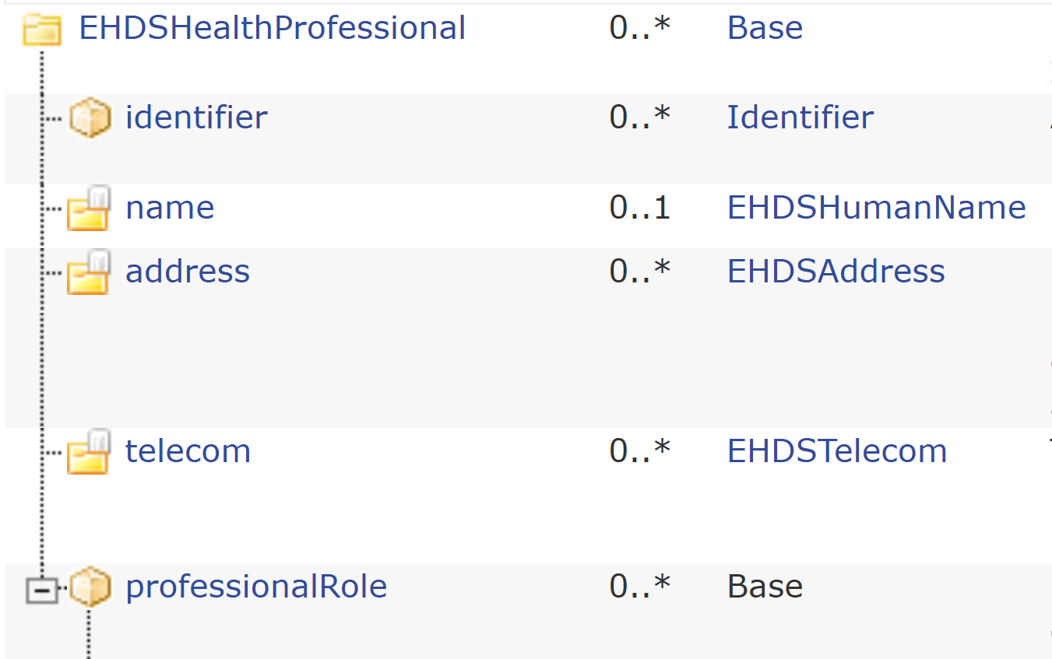
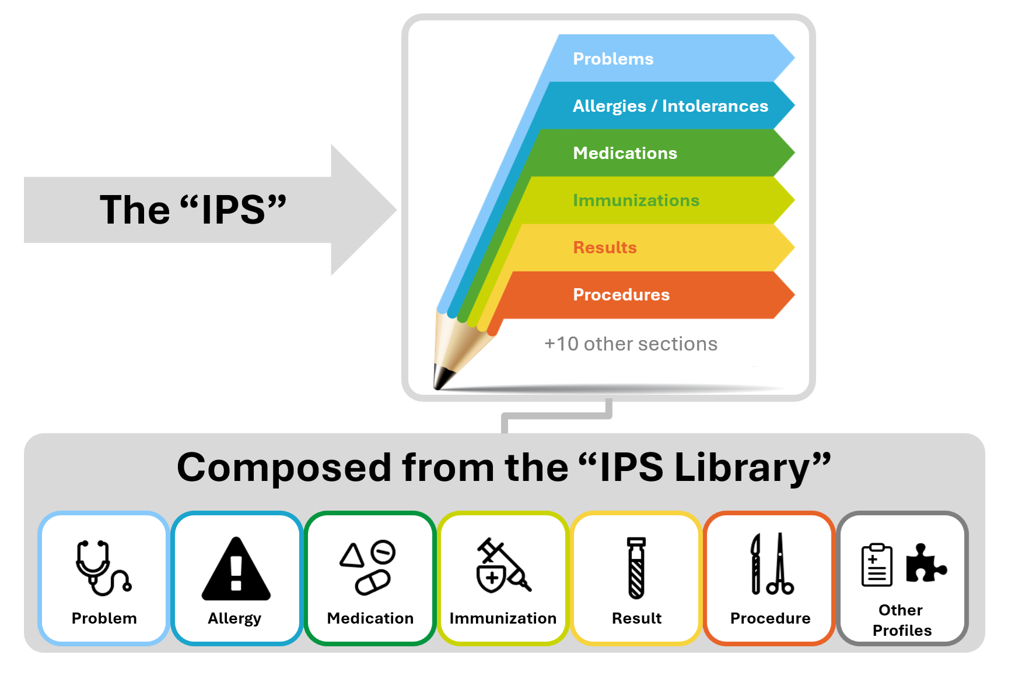
Base
Baseline for all HL7 Europe profiles.
Loosely constrained, providing a flexible foundation.
Rarely used “as is”, but always extended or specialized.
Core
Defines essential constraints that cut across many use cases.
Serves as the first reference point for the large majority of HL7 Europe FHIR IGs.
Can often be used “as is”, without further refinement.
Realizes the common EHDS logical models in practice.
Extensions
(R4/R5)
used by
Base and Core
(R4/R5)
derived from
Scoped HL7 EU IGs
(R4/R5)
used by
EHDS Models
Realise
HL7 FHIR IPS
Pursue
Alignment
with
Notes:
This includes the HL7 FHIR Implementation Guides (IGs) which will hopefully serve as the foundation for the future European EHR eXchange Format (EEHRxF)
EU Base/Core profiles,
EU Laboratory Report,
EU Hospital Discharge Report,
EU Medication Prescription and Dispense,
EU Patient Summary,
and EU Imaging Report

Slide 8
Extensions
(R4/R5)
Base
Baseline for all HL7 Europe profiles.
Loosely constrained, providing a flexible foundation.
Rarely used “as is”, but always extended or specialized.
Base and Core
(R4/R5)
Core
Defines essential constraints that cut across many use cases.
Serves as the first reference point for the large majority of HL7 Europe FHIR IGs.
Can often be used “as is”, without further refinement.
Realizes the common EHDS logical models in practice.
Scoped HL7 EU IGs
(R4/R5)
Notes:
This includes the HL7 FHIR Implementation Guides (IGs) which will hopefully serve as the foundation for the future European EHR eXchange Format (EEHRxF)
EU Base/Core profiles,
EU Laboratory Report,
EU Hospital Discharge Report,
EU Medication Prescription and Dispense,
EU Patient Summary,
and EU Imaging Report

Slide 9
EHDS Models
Realise
HL7 FHIR IPS
Base Profiles
Pursue
Alignment
with
Derived from
Used by
HL7 Europe IGs
Notes:
This includes the HL7 FHIR Implementation Guides (IGs) which will hopefully serve as the foundation for the future European EHR eXchange Format (EEHRxF)
EU Base/Core profiles,
EU Laboratory Report,
EU Hospital Discharge Report,
EU Medication Prescription and Dispense,
EU Patient Summary,
and EU Imaging Report

Slide 10
Base
Baseline for all HL7 Europe profiles.
Loosely constrained, providing a flexible foundation.
Rarely used “as is”, but always extended or specialized.
Core
Defines essential constraints that cut across many use cases.
Serves as the first reference point for the large majority of HL7 Europe FHIR IGs.
Can often be used “as is”, without further refinement.
Realizes the common EHDS logical models in practice.
Base and Core
(R4/R5)
derived from
EHDS Models
Realise
HL7 FHIR IPS
Pursue
Alignment
with
Notes:
This includes the HL7 FHIR Implementation Guides (IGs) which will hopefully serve as the foundation for the future European EHR eXchange Format (EEHRxF)
EU Base/Core profiles,
EU Laboratory Report,
EU Hospital Discharge Report,
EU Medication Prescription and Dispense,
EU Patient Summary,
and EU Imaging Report

