Slide 1

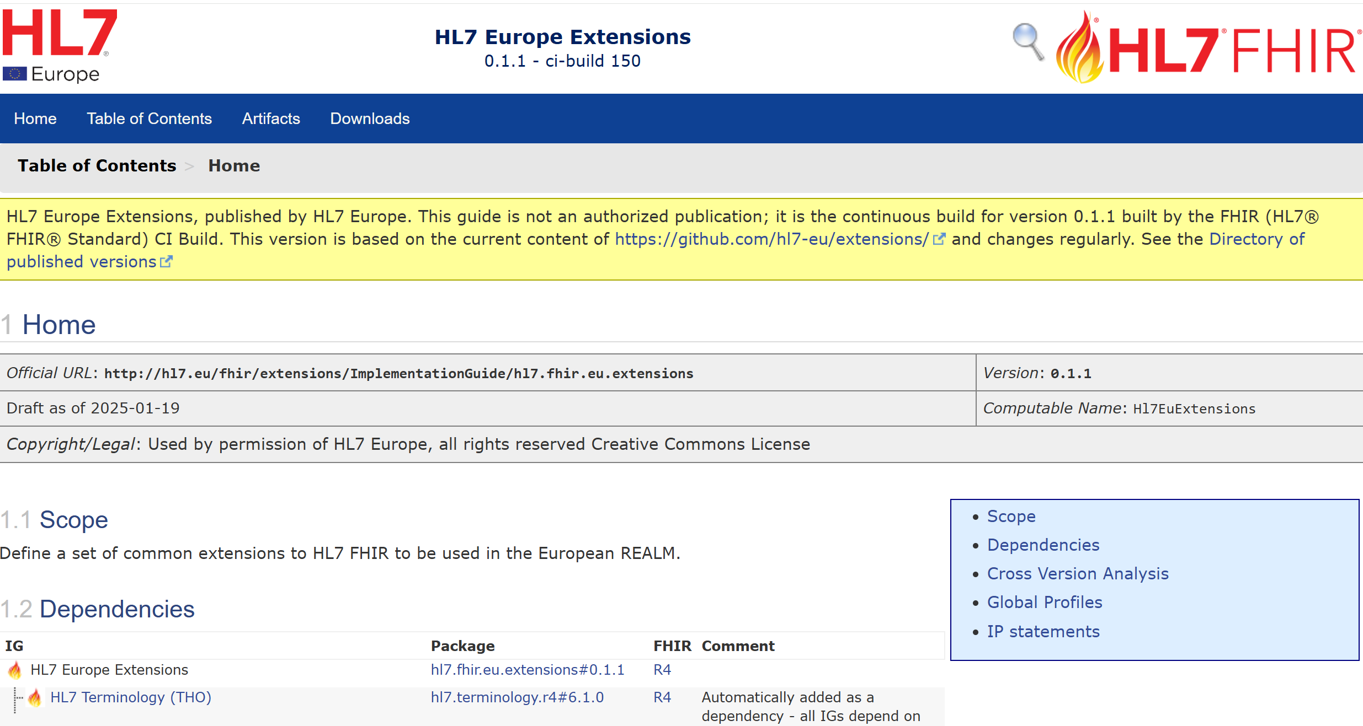
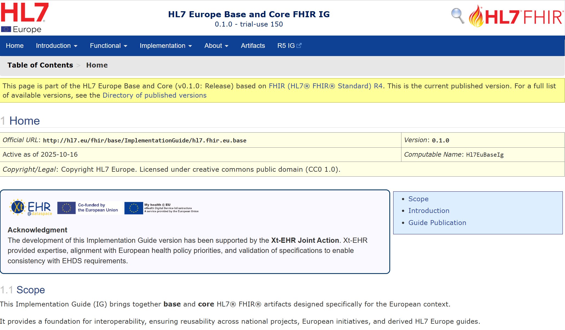
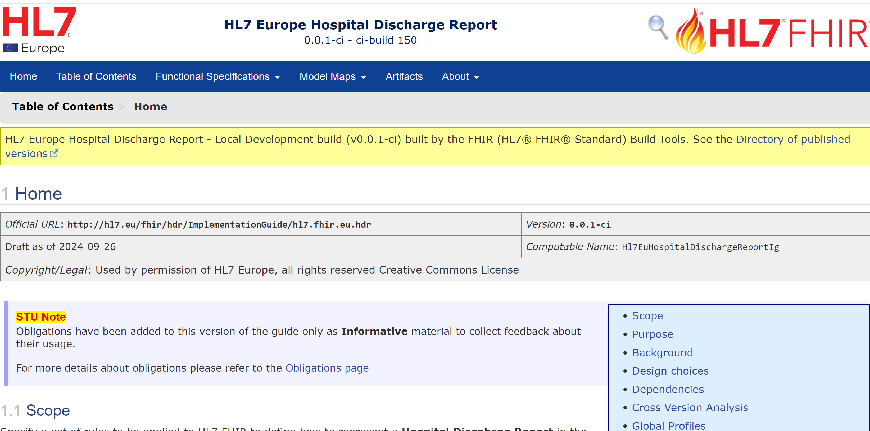
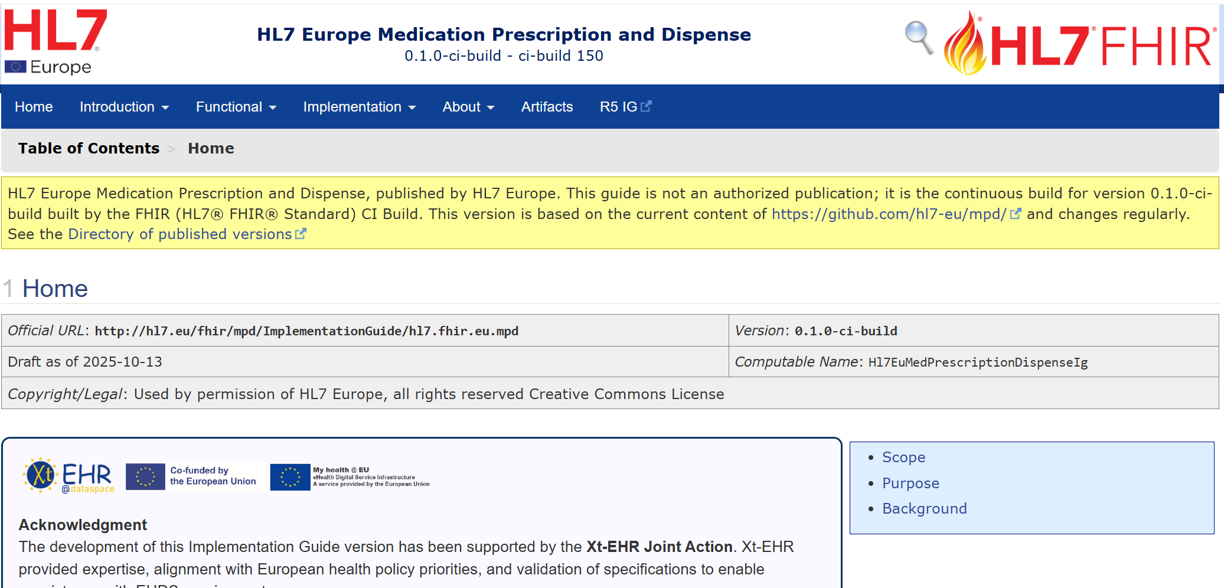


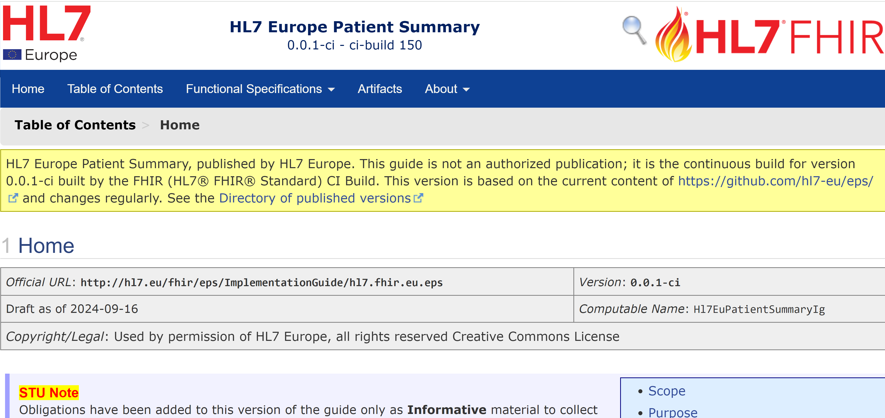
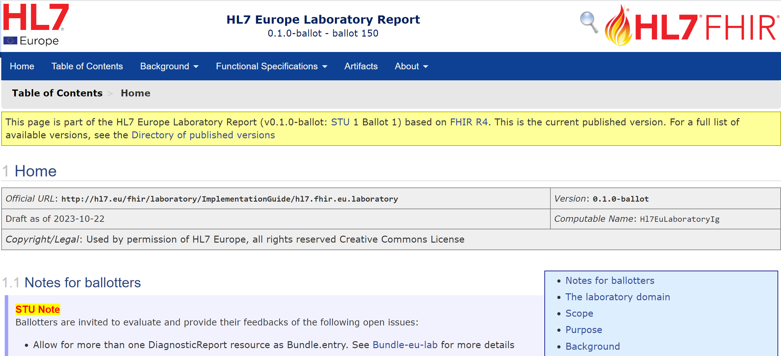
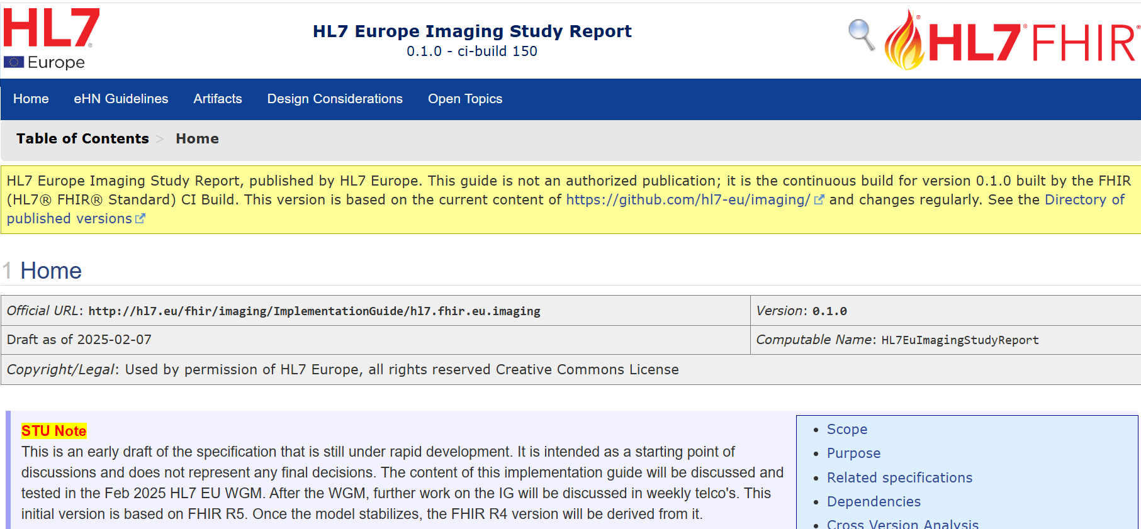
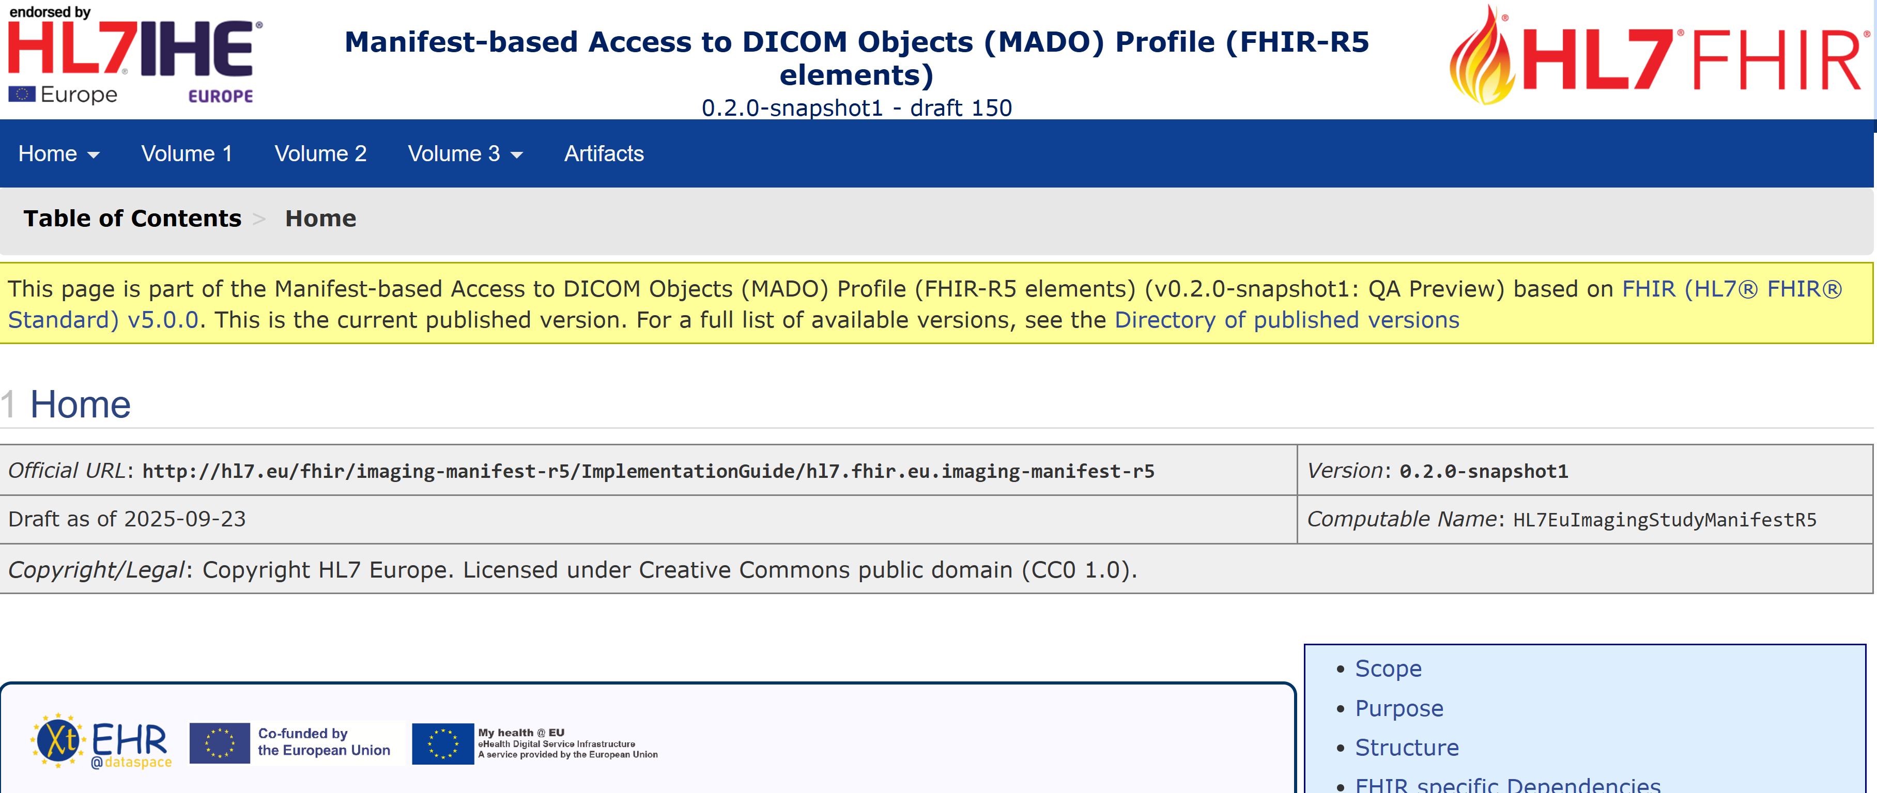



R4/R5
Core
used by
used by
R4/R5
R4/R5
used by
used by
R4
Hospital Discharge Report
ePrescription
eDispensation
R4
R4
R5/(R4)
Patient Summary
Laboratory Results
Medical Imaging and reports
Notes:
This includes the HL7 FHIR Implementation Guides (IGs) which will hopefully serve as the foundation for the future European EHR eXchange Format (EEHRxF)
EU Base/Core profiles,
EU Laboratory Report,
EU Hospital Discharge Report,
EU Medication Prescription and Dispense,
EU Patient Summary,
and EU Imaging Report

Slide 2

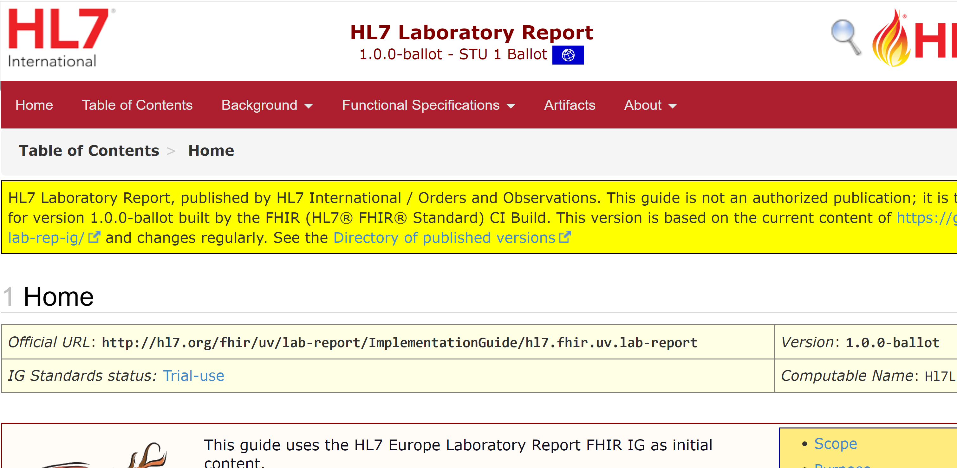
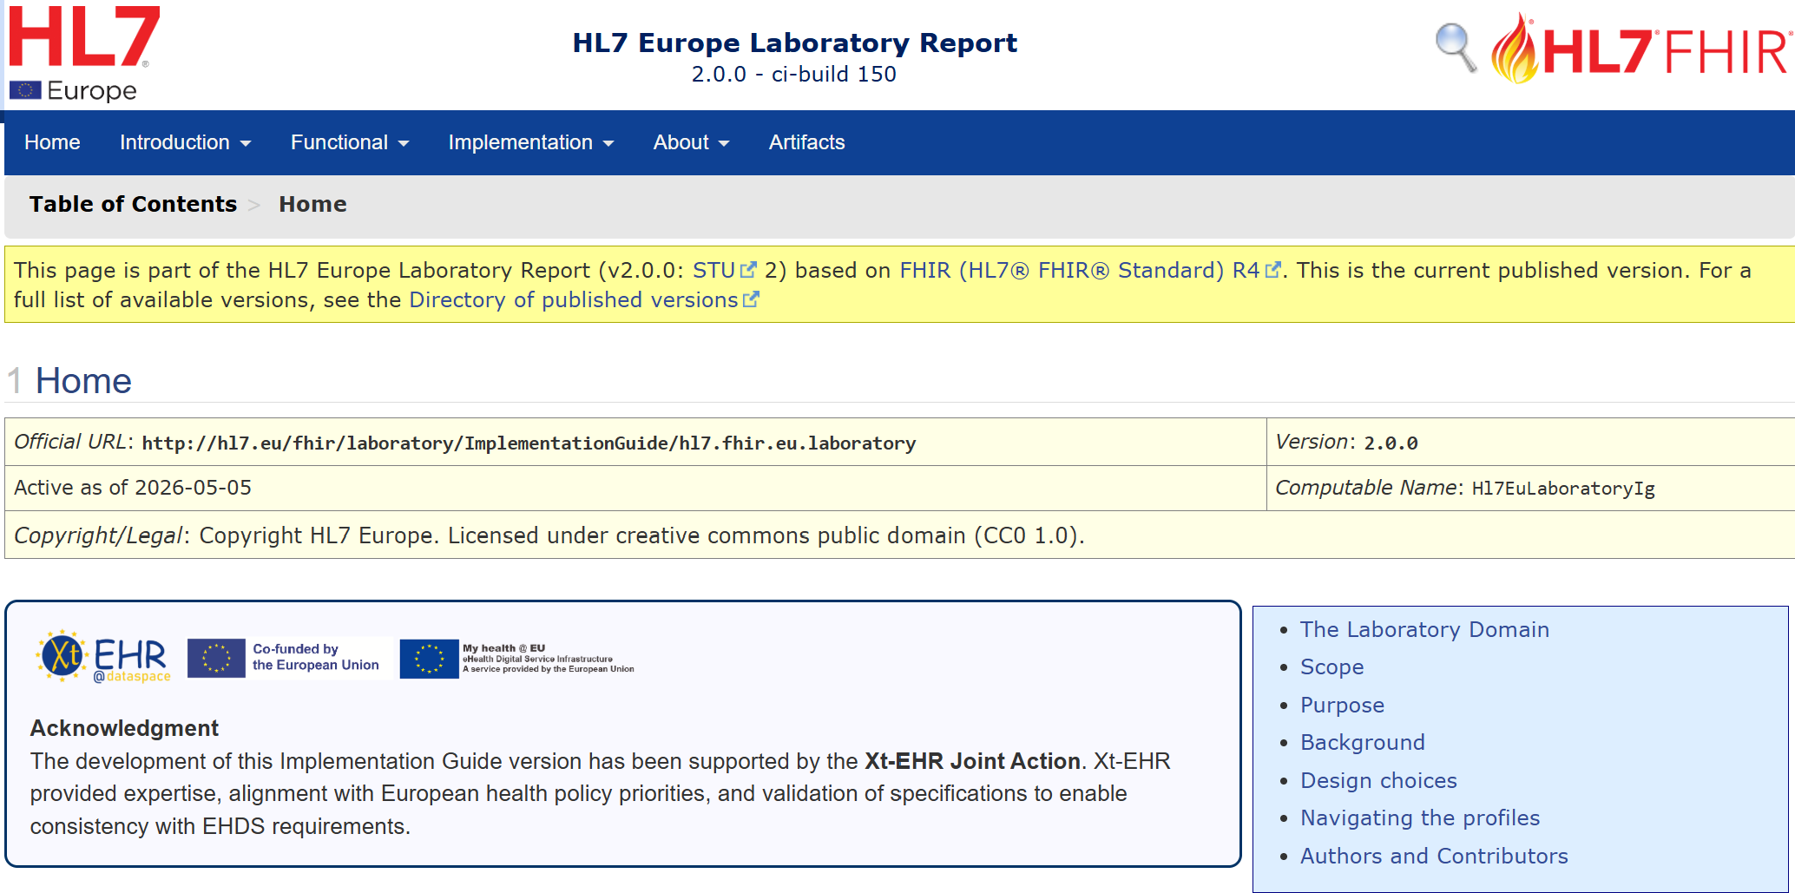
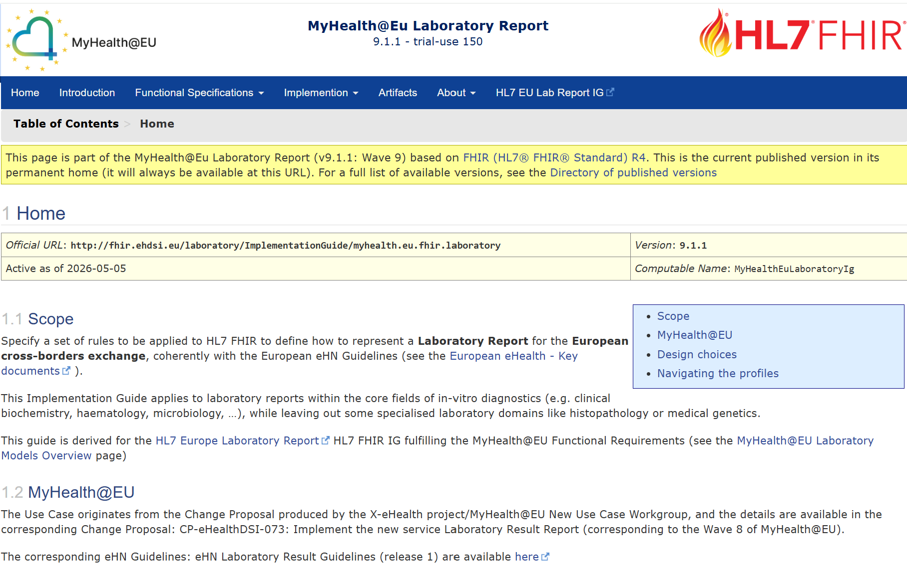
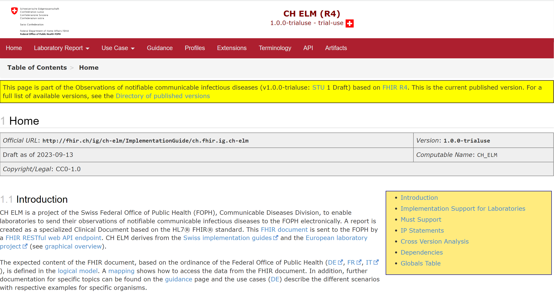
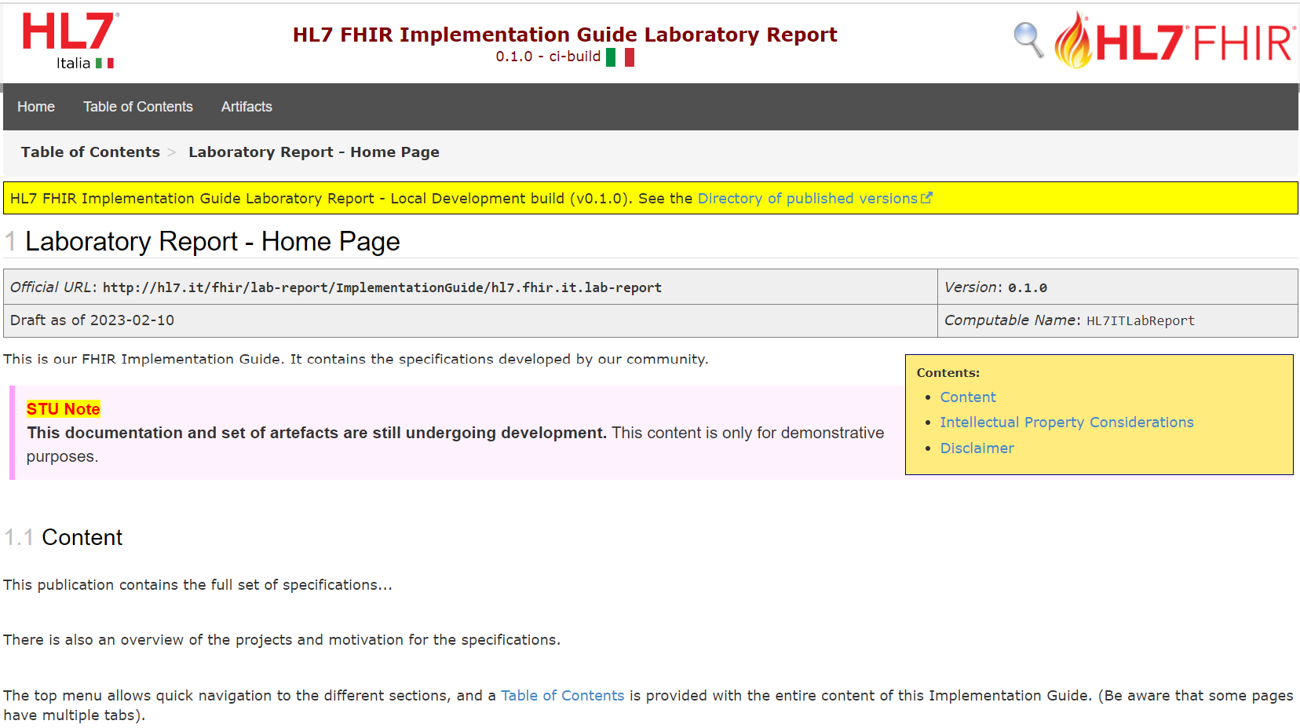
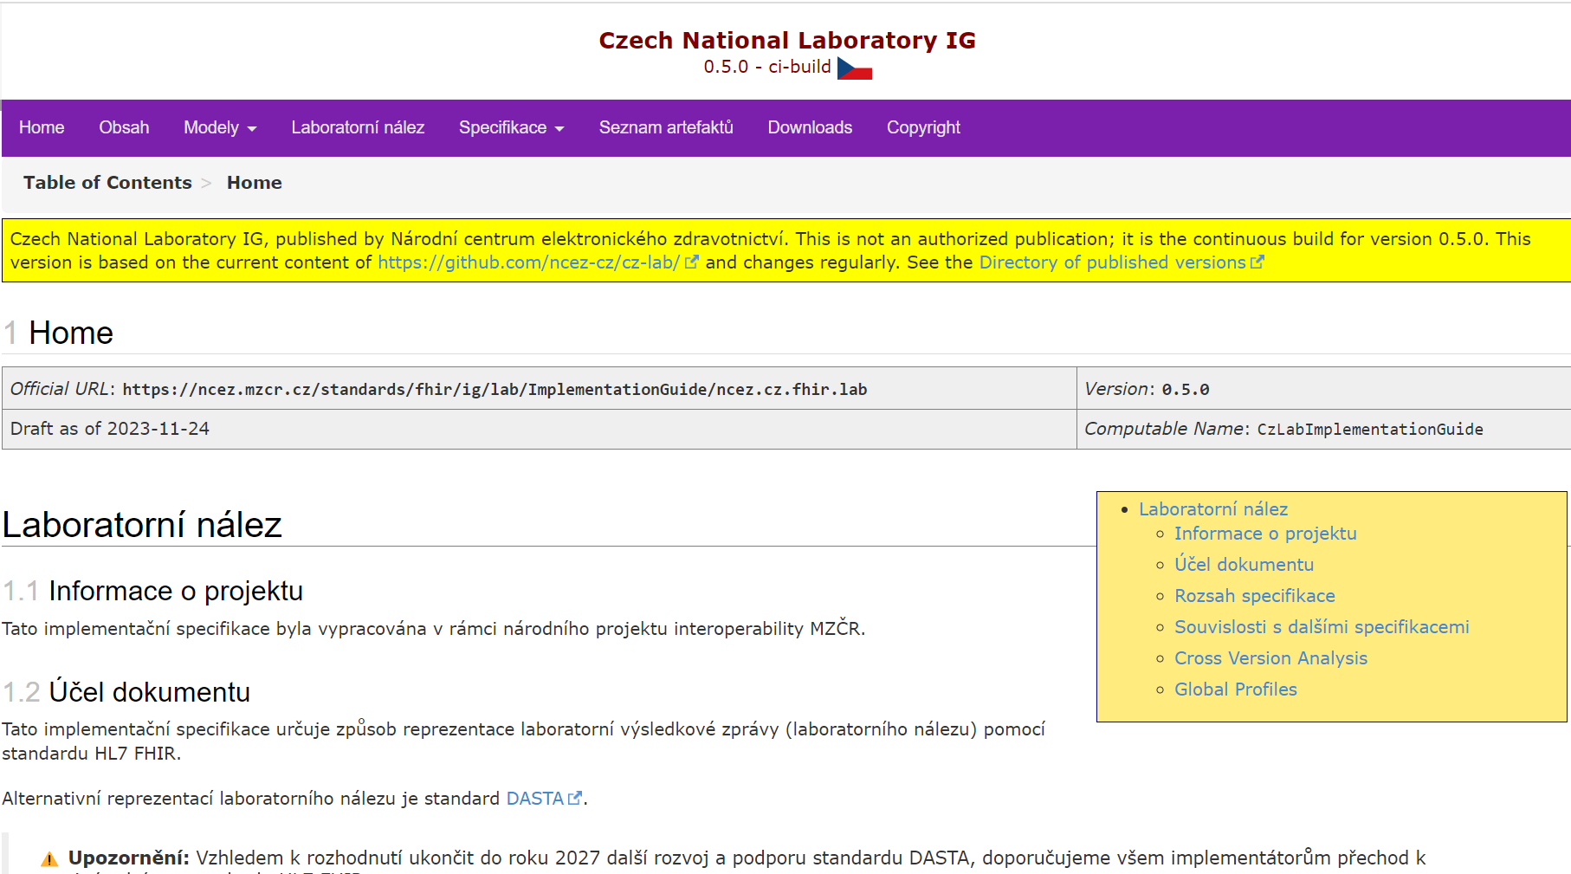
European Flexible Common Rules
Standard
(EU/UV scope)
Laboratory Results
EU X-Borders
National Guides
Notes:
Following the timeline priority the first in line has been the Laboratory report for which we can assert today that the strategy described has been applied.

Slide 3

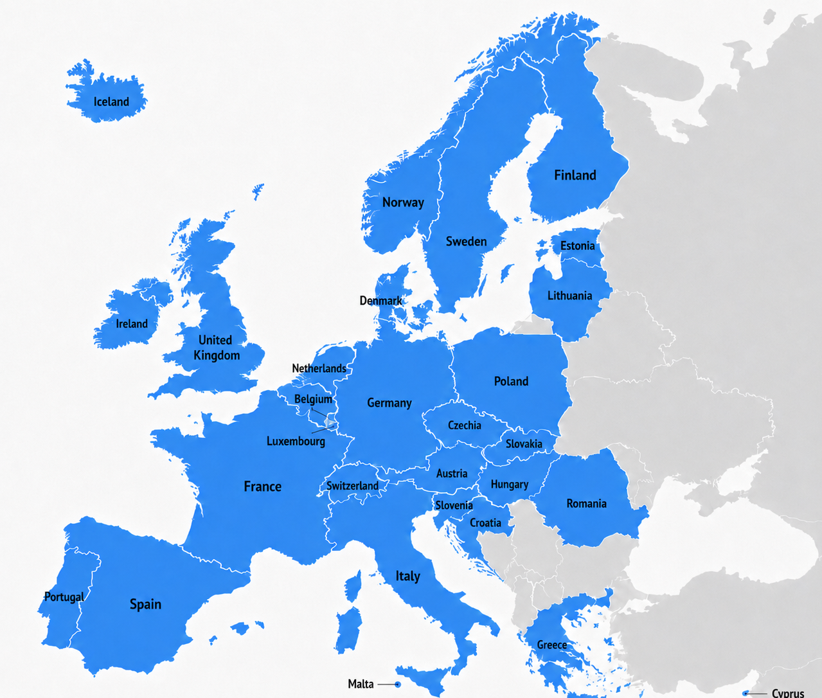







Collaborative Development in Motion
The result of a highly participatory, multi-stakeholder process spanning the European health ecosystem, e.g.:
Laboratory Report: 113 distinct participants from 22 countries (including USA) and EC Solution Providers [average ~30 attendees]
MPD: 114 distinct participants from 26 countries (including USA) and EC Solution Providers [average ~30 attendees]
HDR/EPS/Common: 225 distinct participants from 29 countries (including Sri Lanka, United Arab Emirates, Saudi Arabia and USA) and EC Solution Providers [average ~35 attendees]
Notes:
Total 29 EU countries

Slide 4
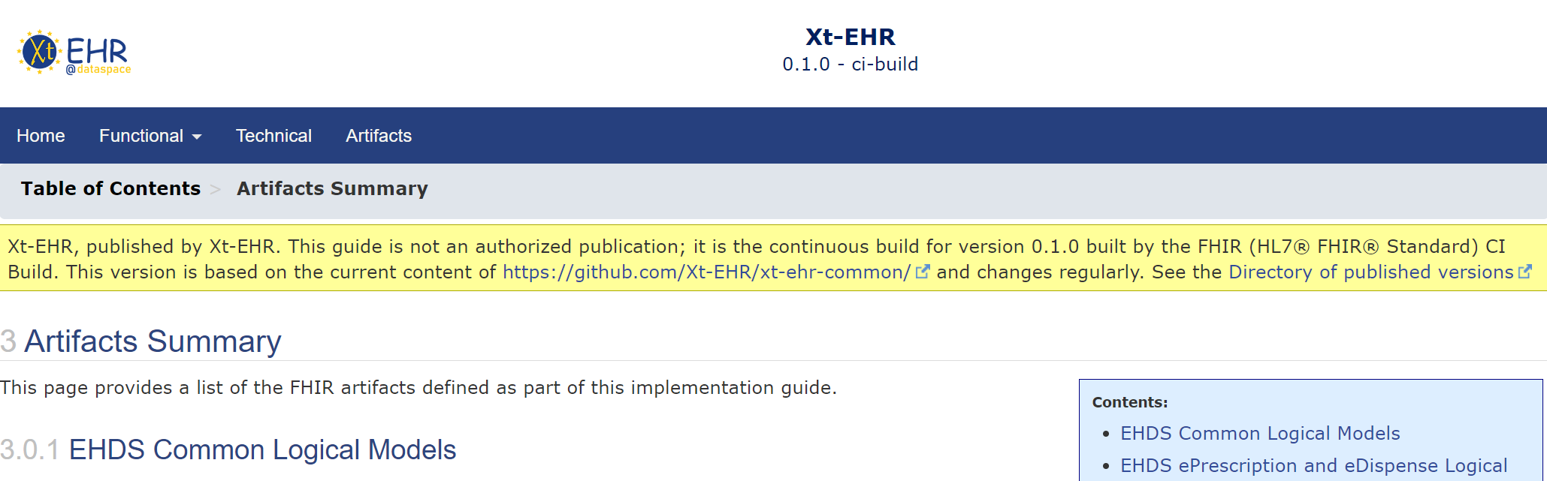



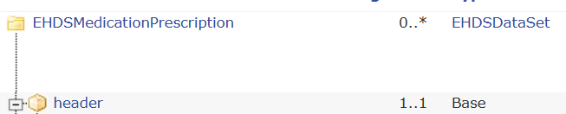
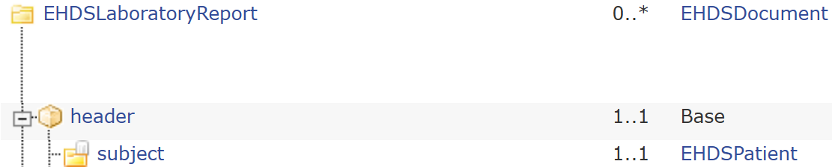
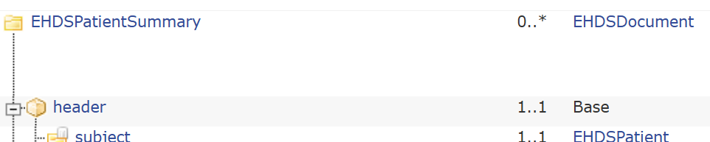
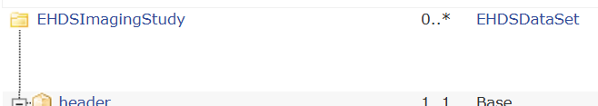
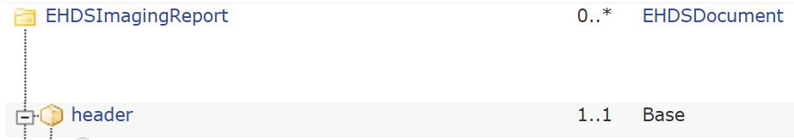
The HL7 FHIR IG ecosystem for EHDS
Content
Common Models
ePrescription
eDispensation
Laboratory Results
Patient Summary
Medical Imaging and reports
Hospital Discharge Report
Notes:
This includes the HL7 FHIR Implementation Guides (IGs) which will hopefully serve as the foundation for the future European EHR eXchange Format (EEHRxF)
EU Base/Core profiles,
EU Laboratory Report,
EU Hospital Discharge Report,
EU Medication Prescription and Dispense,
EU Patient Summary,
and EU Imaging Report

Slide 5

Current Status
Published FHIR IGs:
HL7 Europe Extensions v1.3.0 (R4/R5) – March 2026
HL7 Europe Base and Core v2.0.0 (R4 and R5) – April 2026
HL7 Europe Laboratory Report FHIR IG v2.0.0 (R4) – May 2026
HL7 Europe Medication Prescription and Dispense FHIR IG v1.0.0 (R4 and R5) – May 2026
Ballot
HL7 Europe Imaging Report R4 (R5) 2nd ballot March 2026
Xt-EHR Projectathon - March 2026
HL7 Europe European Patient Summary (R4)
HL7 Europe Hospital Discharge Report (R4)

Slide 6
Links for HL7 FHIR IGs (R4)
Medication Prescription & Dispense (1.0): https://hl7.eu/fhir/mpd;
European Patient Summary (xtehr): https://hl7.eu/fhir/eps/xtehr
Laboratory Report (2.0): https://hl7.eu/fhir/laboratory
Medical imaging Report (2.0 ballot): https://hl7.eu/fhir/imaging
Hospital Discharge Report (xtehr): https://hl7.eu/fhir/hdr/xtehr
All CI-build: https://build.fhir.org/hl7-eu
Base and Core (2.0): https://hl7.eu/fhir/base;

Slide 7
Plan
May ‘26
HL7 EU MPD Publication
HL7 EU EPS Ballot
July ’26
Sept. ’26
HL7 Europe HDR Published
Oct. ’26
Impl. Act art 15 aligned FHIR IG ballot (as needed, depending on EC delivery)
HL7 EU EPS Published
Dec ’26
All FHIR IG published as and if needed)
March ’27
Implementing Act
June ‘26
Imaging Report Publication


