Slide 1
MedTechLabel
Drawings for WP2 T2.2
Export Slides

Slide 2



MedTechLabel: Draft Idea
Company 1: Product 1
Warning: lore ipsum lore ipsum ….
Preparation: lore ipsum, lore ipsu, ….
????: …..
Whatever is needed here…
e
1
Notes:
Filename=label_idea_1
Links=40
Rechts=40
Oben=150
Unten=50

Slide 3
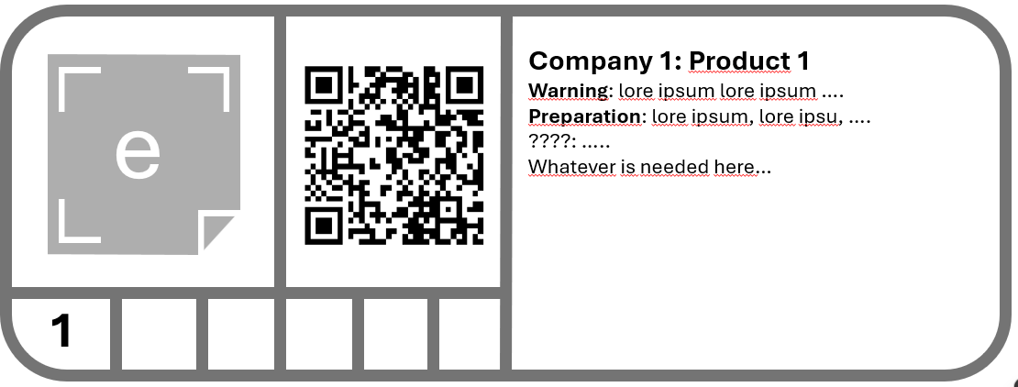
Explanation
Identification as
MedTechLabel
QR-Code
Manufacturer Identification
Product Identification
Human
Readable
text
Class of Medical Device
Place for Icons/Symbols
Notes:
Filename=label_idea_2
Links=60
Rechts=40
Oben=140
Unten=50

Slide 4
Layout may vary ….
Company 1: Product 1
Warning: lore ipsum lore ipsum ….
Preparation: lore ipsum, lore ipsu, ….
????: …..
Whatever is needed here…
Or which format fits better
…..
e
1
Notes:
Filename=label_idea_3
Links=350
Rechts=10
Oben=20
Unten=10

Slide 5
Other

