Slide 1
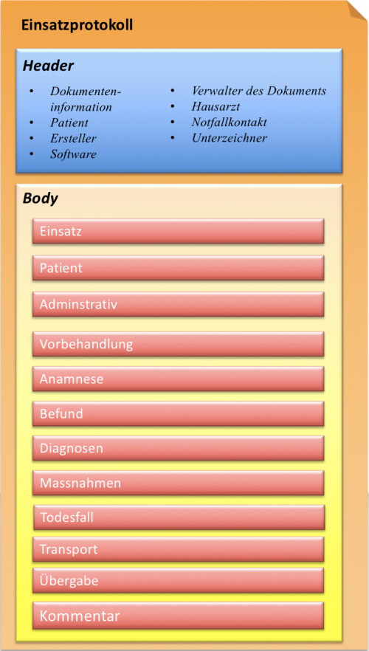
Bundle: Emergency Medical Service protocol
entry: Composition
Parameters like date, identifier
Patient (Reference)
Practitioner (Reference)
...
Mission (Section)
Administrative (Section)
Pretreatment (Section)
Anamnesis (Section)
Findings (Section)
Airway (Section)
Breathing (Section)
Circulation (Section)
Disability (Section)
Exposure (Section)
Diagnosis (Section)
Procedures (Section)
Airway (Section)
Breathing (Section)
Circulation (Section)
Disability (Section)
Exposure (Section)
Event of Death (Section)
Transport (Section)
Handover (Section)
Annotation (Section)
entry: Patient
entry: Practitioner
entry: Encounter
entry: …

